Slide 1
Multivariable thinking across the curriculum
Jamie Bunting, Department of Biology, Cal Poly San Luis Obispo
Beth Chance, Department of Statistics, Cal Poly San Luis Obispo
Elena Keeling, Department of Biology, Cal Poly San Luis Obispo
Karen McGaughey, Department of Statistics, Cal Poly San Luis Obispo
Nathan Tintle, Department of Mathematics and Statistics, Dordt University
eCOTS, May 2020

Slide 2
Motivation
For far too long, statistics education in early courses has focused on one or two variables at a time
Newest GAISE guidelines for intro stats talk about a multivariable thinking experience in the first course
But, how do we do this? What should the goal be – not only in a first course, but into a second course and beyond?

Slide 3
What is multivariable thinking?
Recognize that variation in a response comes from many, many sources and be able to identify these sources
Recognize that relationships ‘discovered’ in a statistical analysis and/or data visualization between two variables (e.g., a response and explanatory variable) depend in large part on how the study has dealt with many other variables that may influence that response.
Design studies that effectively control for the many variables that may influence the response (e.g., blocking, inclusion criteria, direct control, etc.)
Analyze data in the presence of confounding and bias
Draw appropriate conclusions from a data analysis and convey the limitations of these conclusions

Slide 4
Goals and approach
Goals:
  Appreciate why multivariable thinking is so important for all statistics (and non-statistics!) students at all levels
  Get you thinking about how you can approach multivariable thinking in your courses
  Get you thinking about vertically integrated approaches to multivariable thinking within and beyond your department
Approach in this session:
  Motivation for a focus on multivariable thinking vs. other topics
  Curriculum and pedagogy projects we’re working on that are being impacted by a focus on multivariable thinking – concrete examples
  Time for Q+A with all of you to hear what you’re doing and for us to brainstorm, think and dream with you about the future of multivariable thinking in statistics education

Slide 5
Session overview
Introduction. Motivation, Goals, Overview, Introduction of presenters. (10 minutes).
More motivation. Problems we’re seeing in practice; why multivariable thinking vs. other topics. (10 minutes).
Digging deeper part 1. Addressing multivariable thinking in discipline specific courses: biology case study (25 minutes: including Q+A).
Digging deeper part 2. Addressing multivariable thinking in a second course in statistics. (25 minutes: including Q+A).
Digging deeper part 3. Anticipating and laying a foundation of multivariable thinking in a first course in statistics (20 minutes: including Q+A).
Wrap-up and final Q+A. Resources and acknowledgments.(15 minutes: final Q+A).

Slide 6

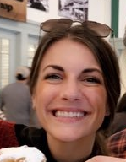

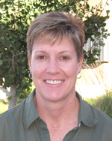
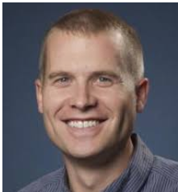
Introduction of presenters
Beth Chance, Cal Poly- SLO
Jamie Bunting, Cal Poly - SLO
Elena Keeling, Cal Poly - SLO
Karen McGaughey, Cal Poly - SLO
Nathan Tintle, Dordt

Slide 7
Logistics
Use Q+A feature to enter questions throughout the session (Beth and all presenters will help to moderate).
  Four set aside times for Q+A spread throughout the session
  But ask questions anytime!
  Feel free to also share your approaches and ideas!
Use chat feature to ask technical questions or deal with technical issues (Nick Horton will assist)

Slide 8
Problems we’re seeing in practice
M&Ms and statistics: A disconnection from reality
  Hypothetical data →Real data → Real data that matters
M&Ms are ‘real’ and fun but do they matter?
The world is complex → Multivariable
We do our students a disservice if we gloss over this complexity too often…
…but we also do our students a disservice if we throw them into the deep end too quickly and expect them to ‘sink or swim’

Slide 9
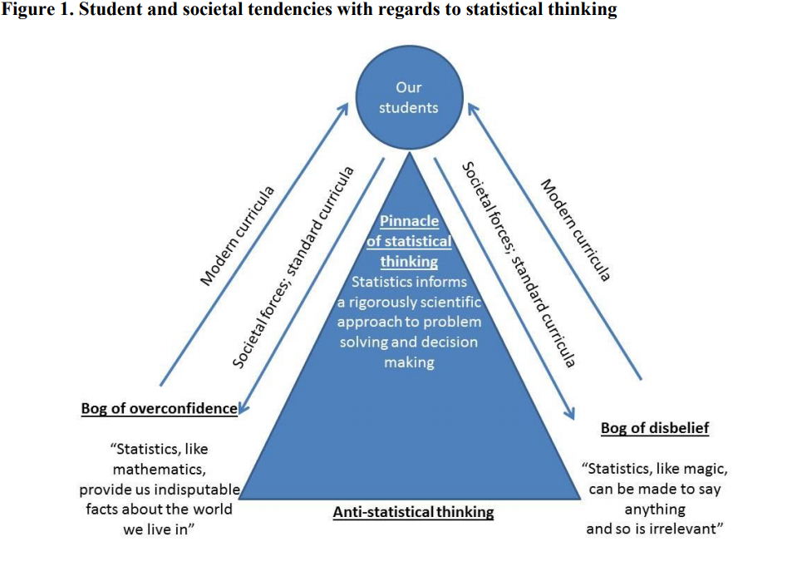
Over simplified examples
Separated from reality
Hypothetical examples
Overly complicated examples
Black box algorithms
Click and hope for a miracle
Tintle, Chance, Cobb, Roy, Swanson and VanderStoep (2015) “Combating anti-statistical thinking using
simulation-based methods throughout the Undergraduate curriculum” The American Statistician. 69:362-370

Slide 10
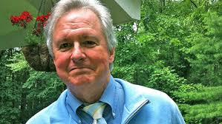
George Cobb
Professor Emeritus of Mathematics and Statistics at Mount Holyoke College
Fellow of the American Statistical Association
ASA’s Founders Award
USCOTS Lifetime Achievement Award
Among many other accolades

Slide 11

The consequence
Few students ever leave our course seeing statistics as this

Slide 12

The consequence
The better students may get a fuzzy impression

Slide 13

The consequence
All too many noses stay too close to the canvas, and see disconnected details

Slide 14
Why multivariable thinking?
Keep students focused on statistical thinking – by emphasizing multivariable thinking!
  Practical problems, but simple enough time isn’t all spent on data cleaning/import/etc.
  Focus on what statistics can and can’t tell you
  Focus on explained variation
  Focus on the logic of inference and overarching process of statistical investigations

Slide 15
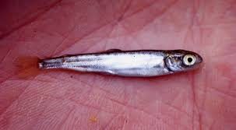
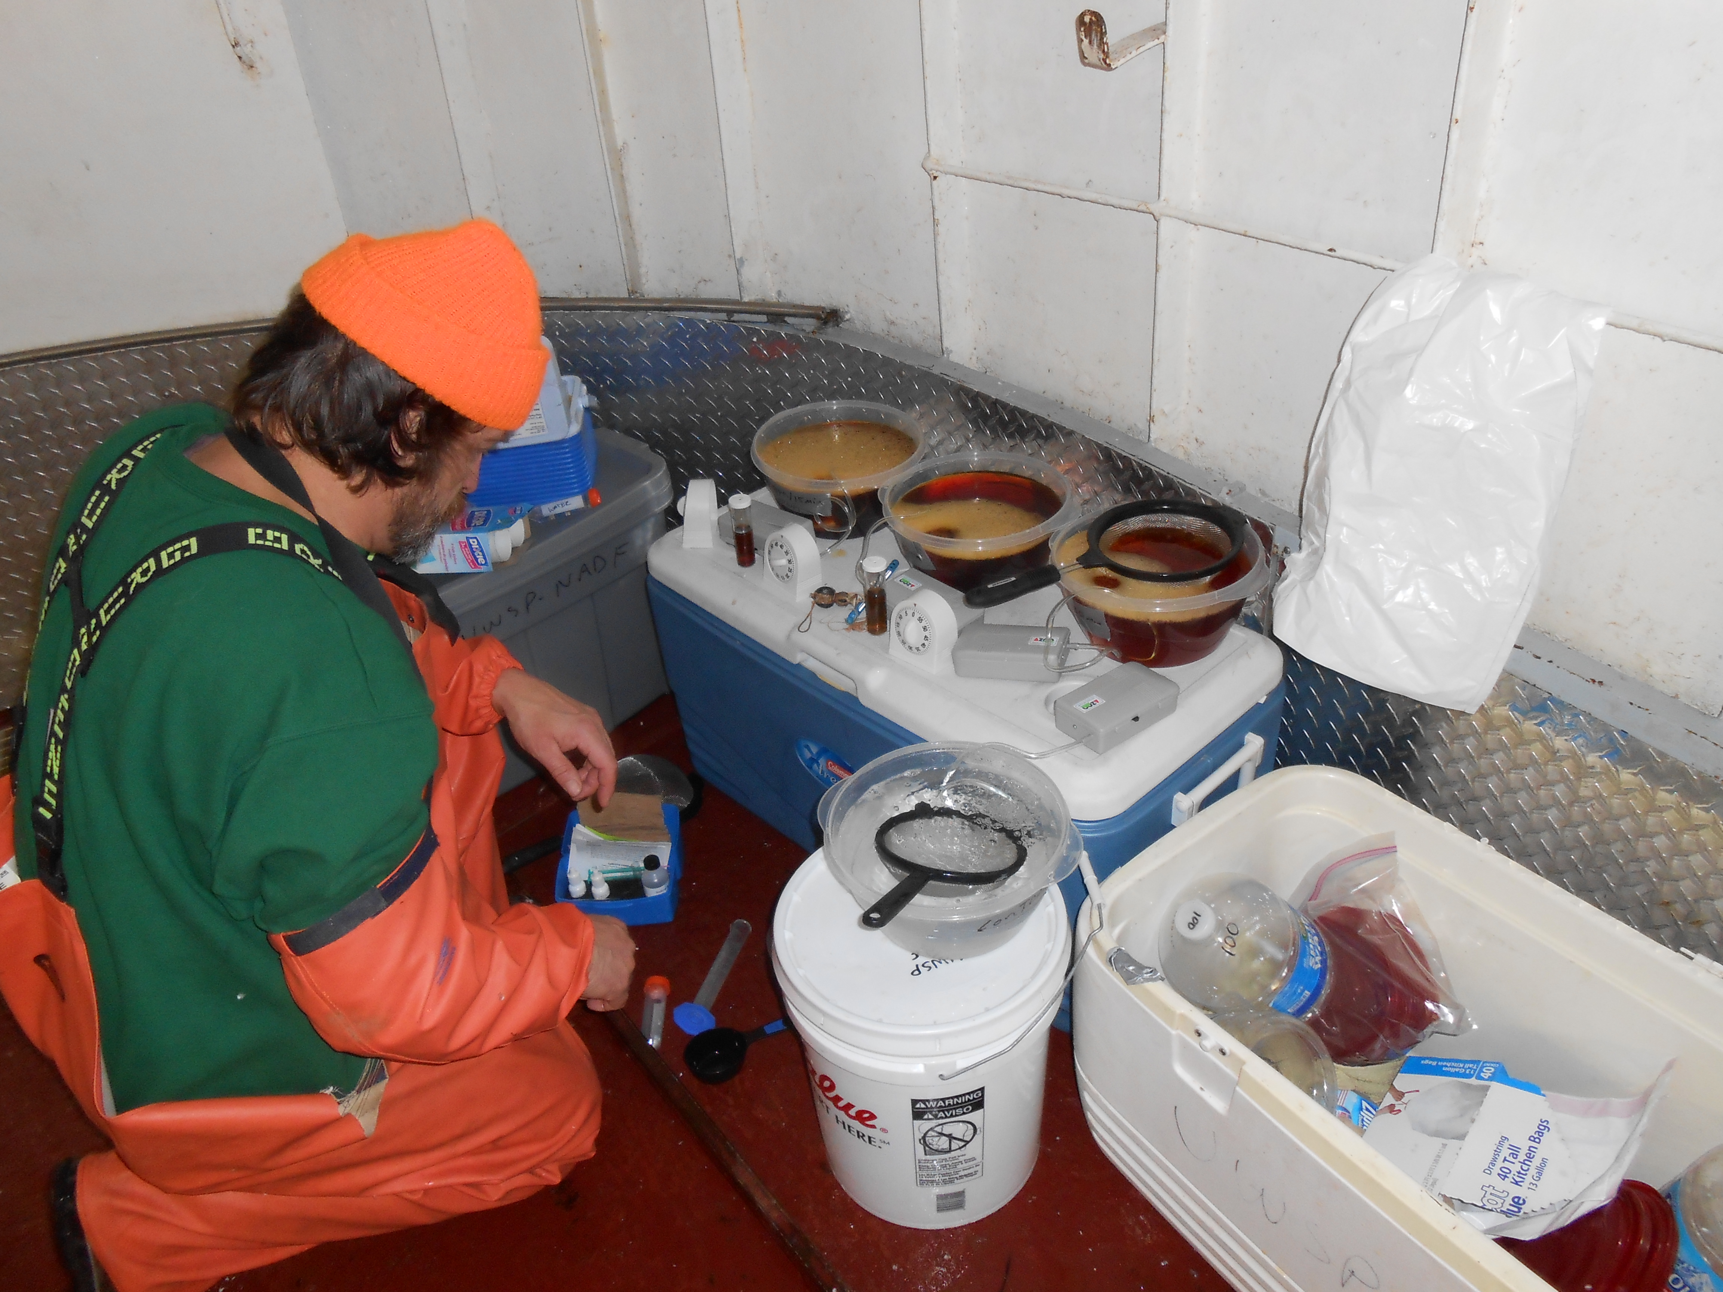
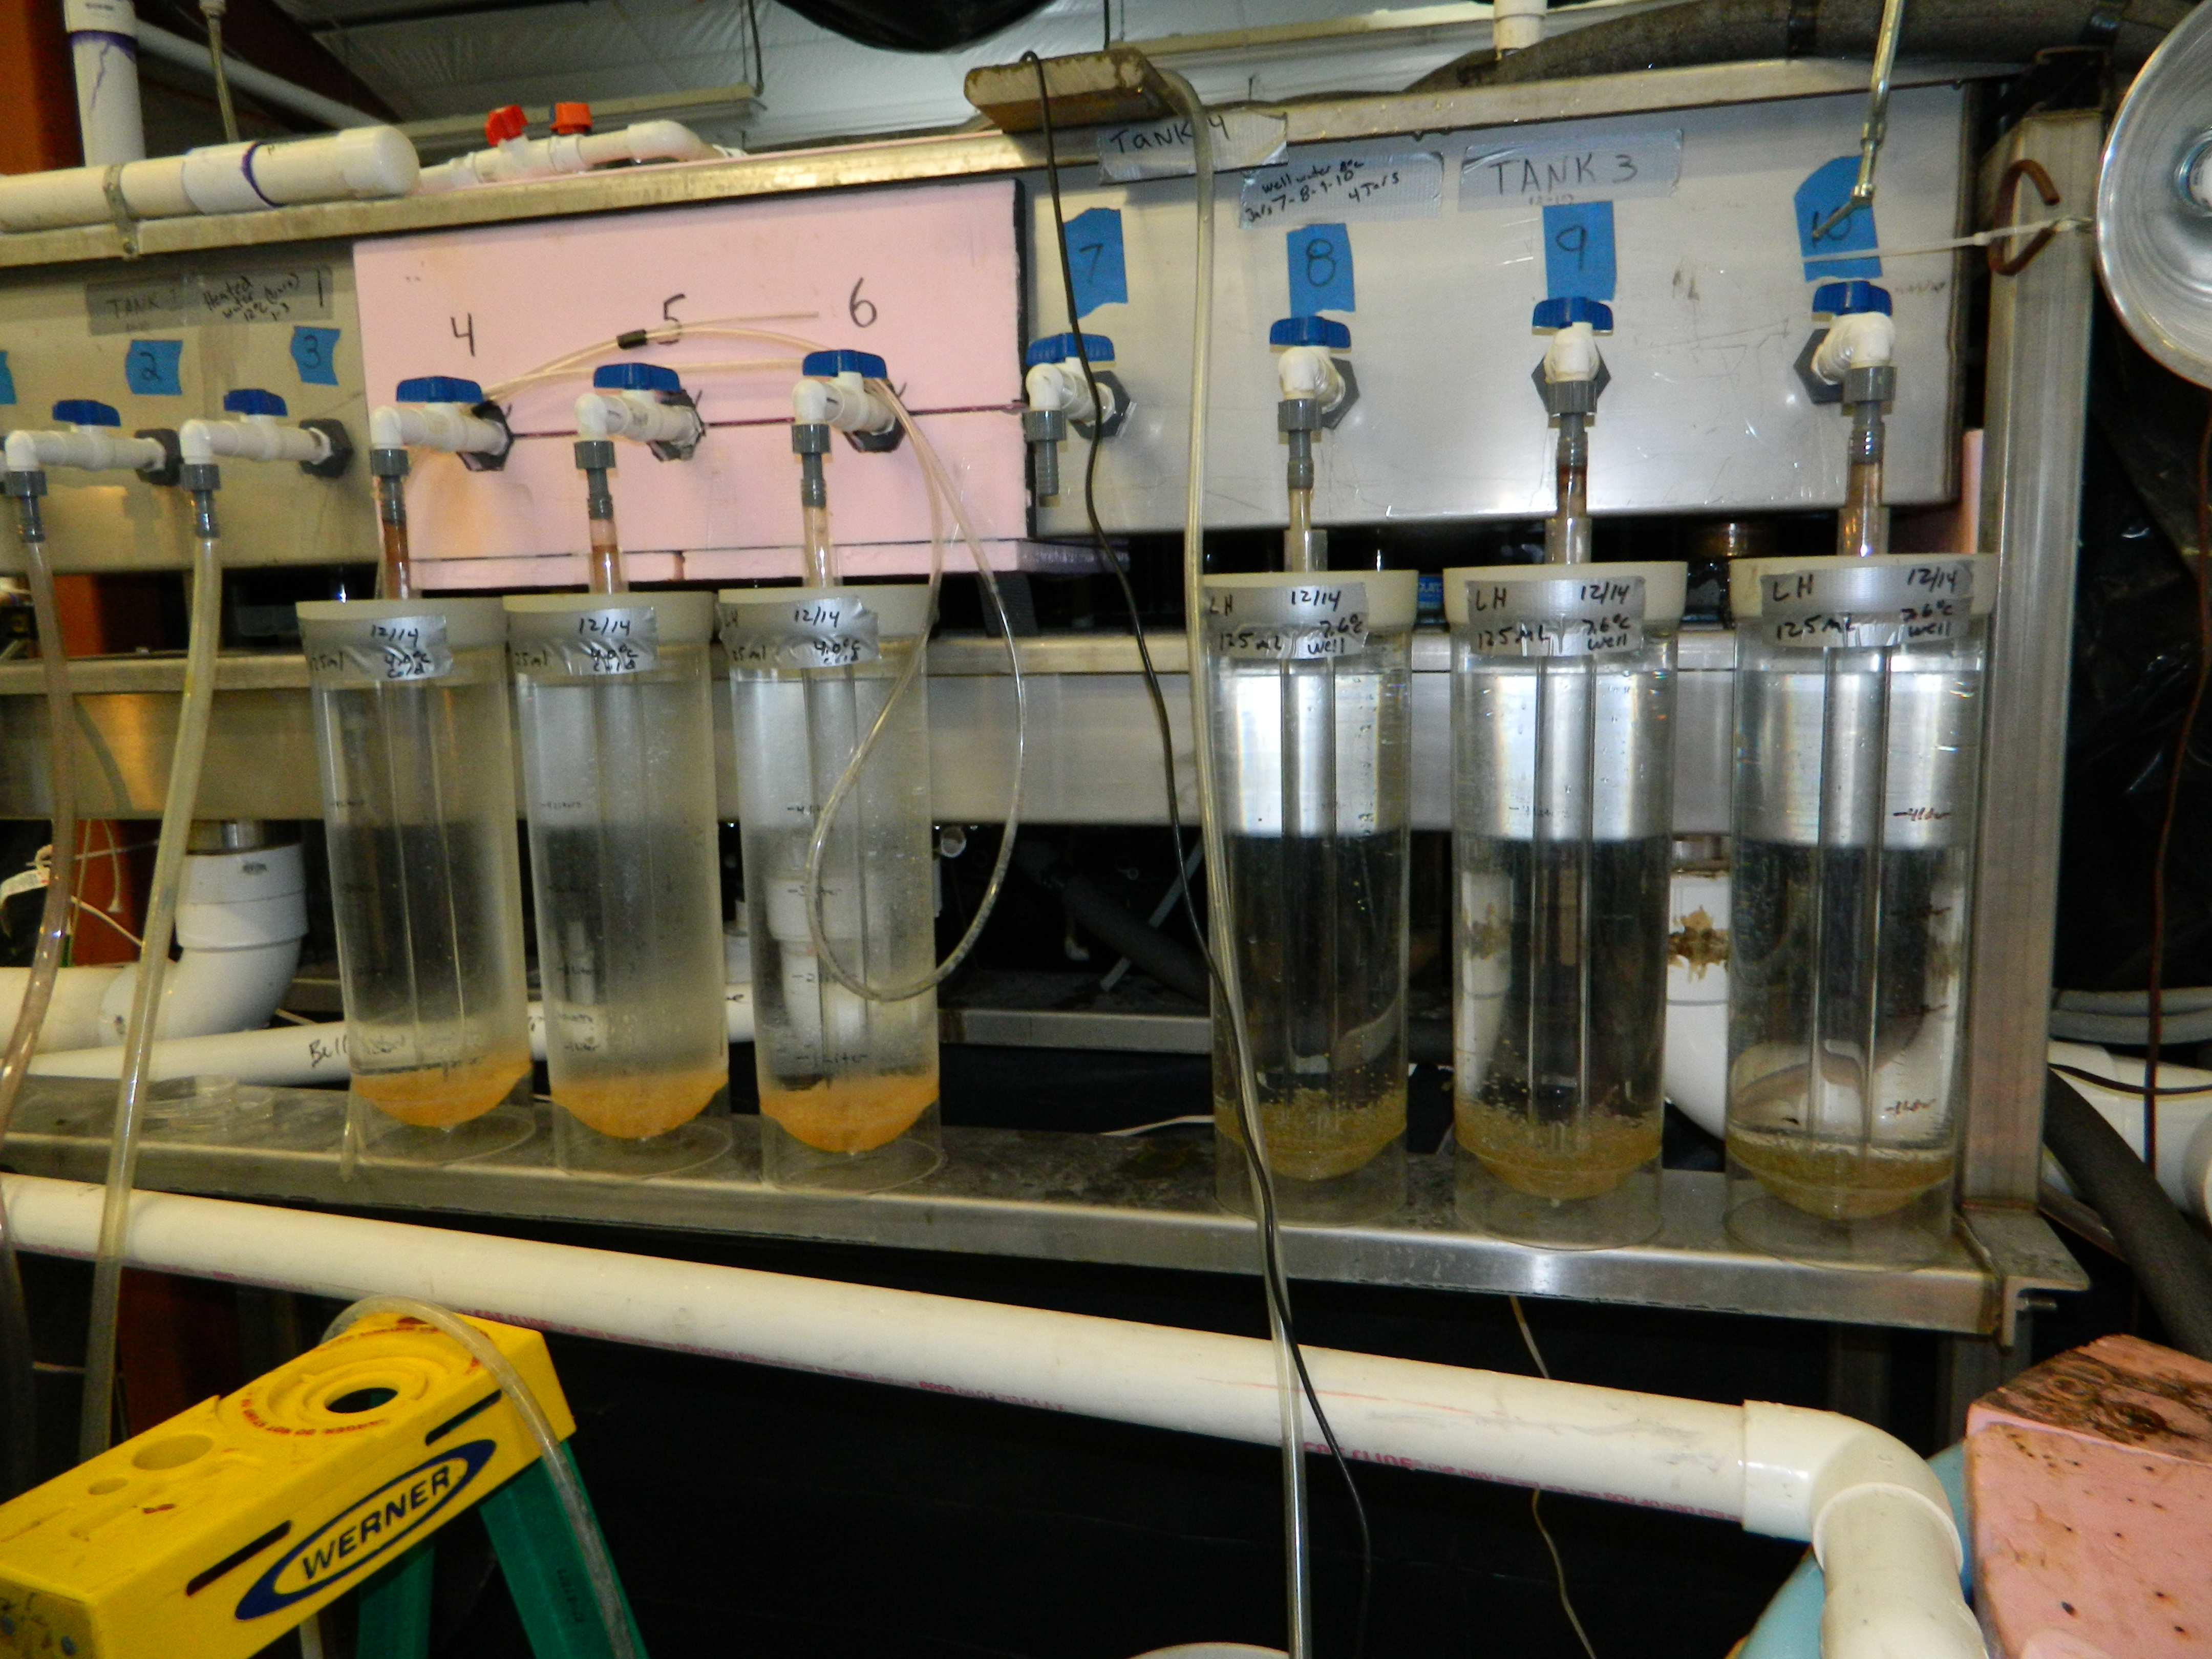
Problems we’re seeing in practice
Lake Herring fry (fry=little fish; old enough to eat itself!) study

Slide 16
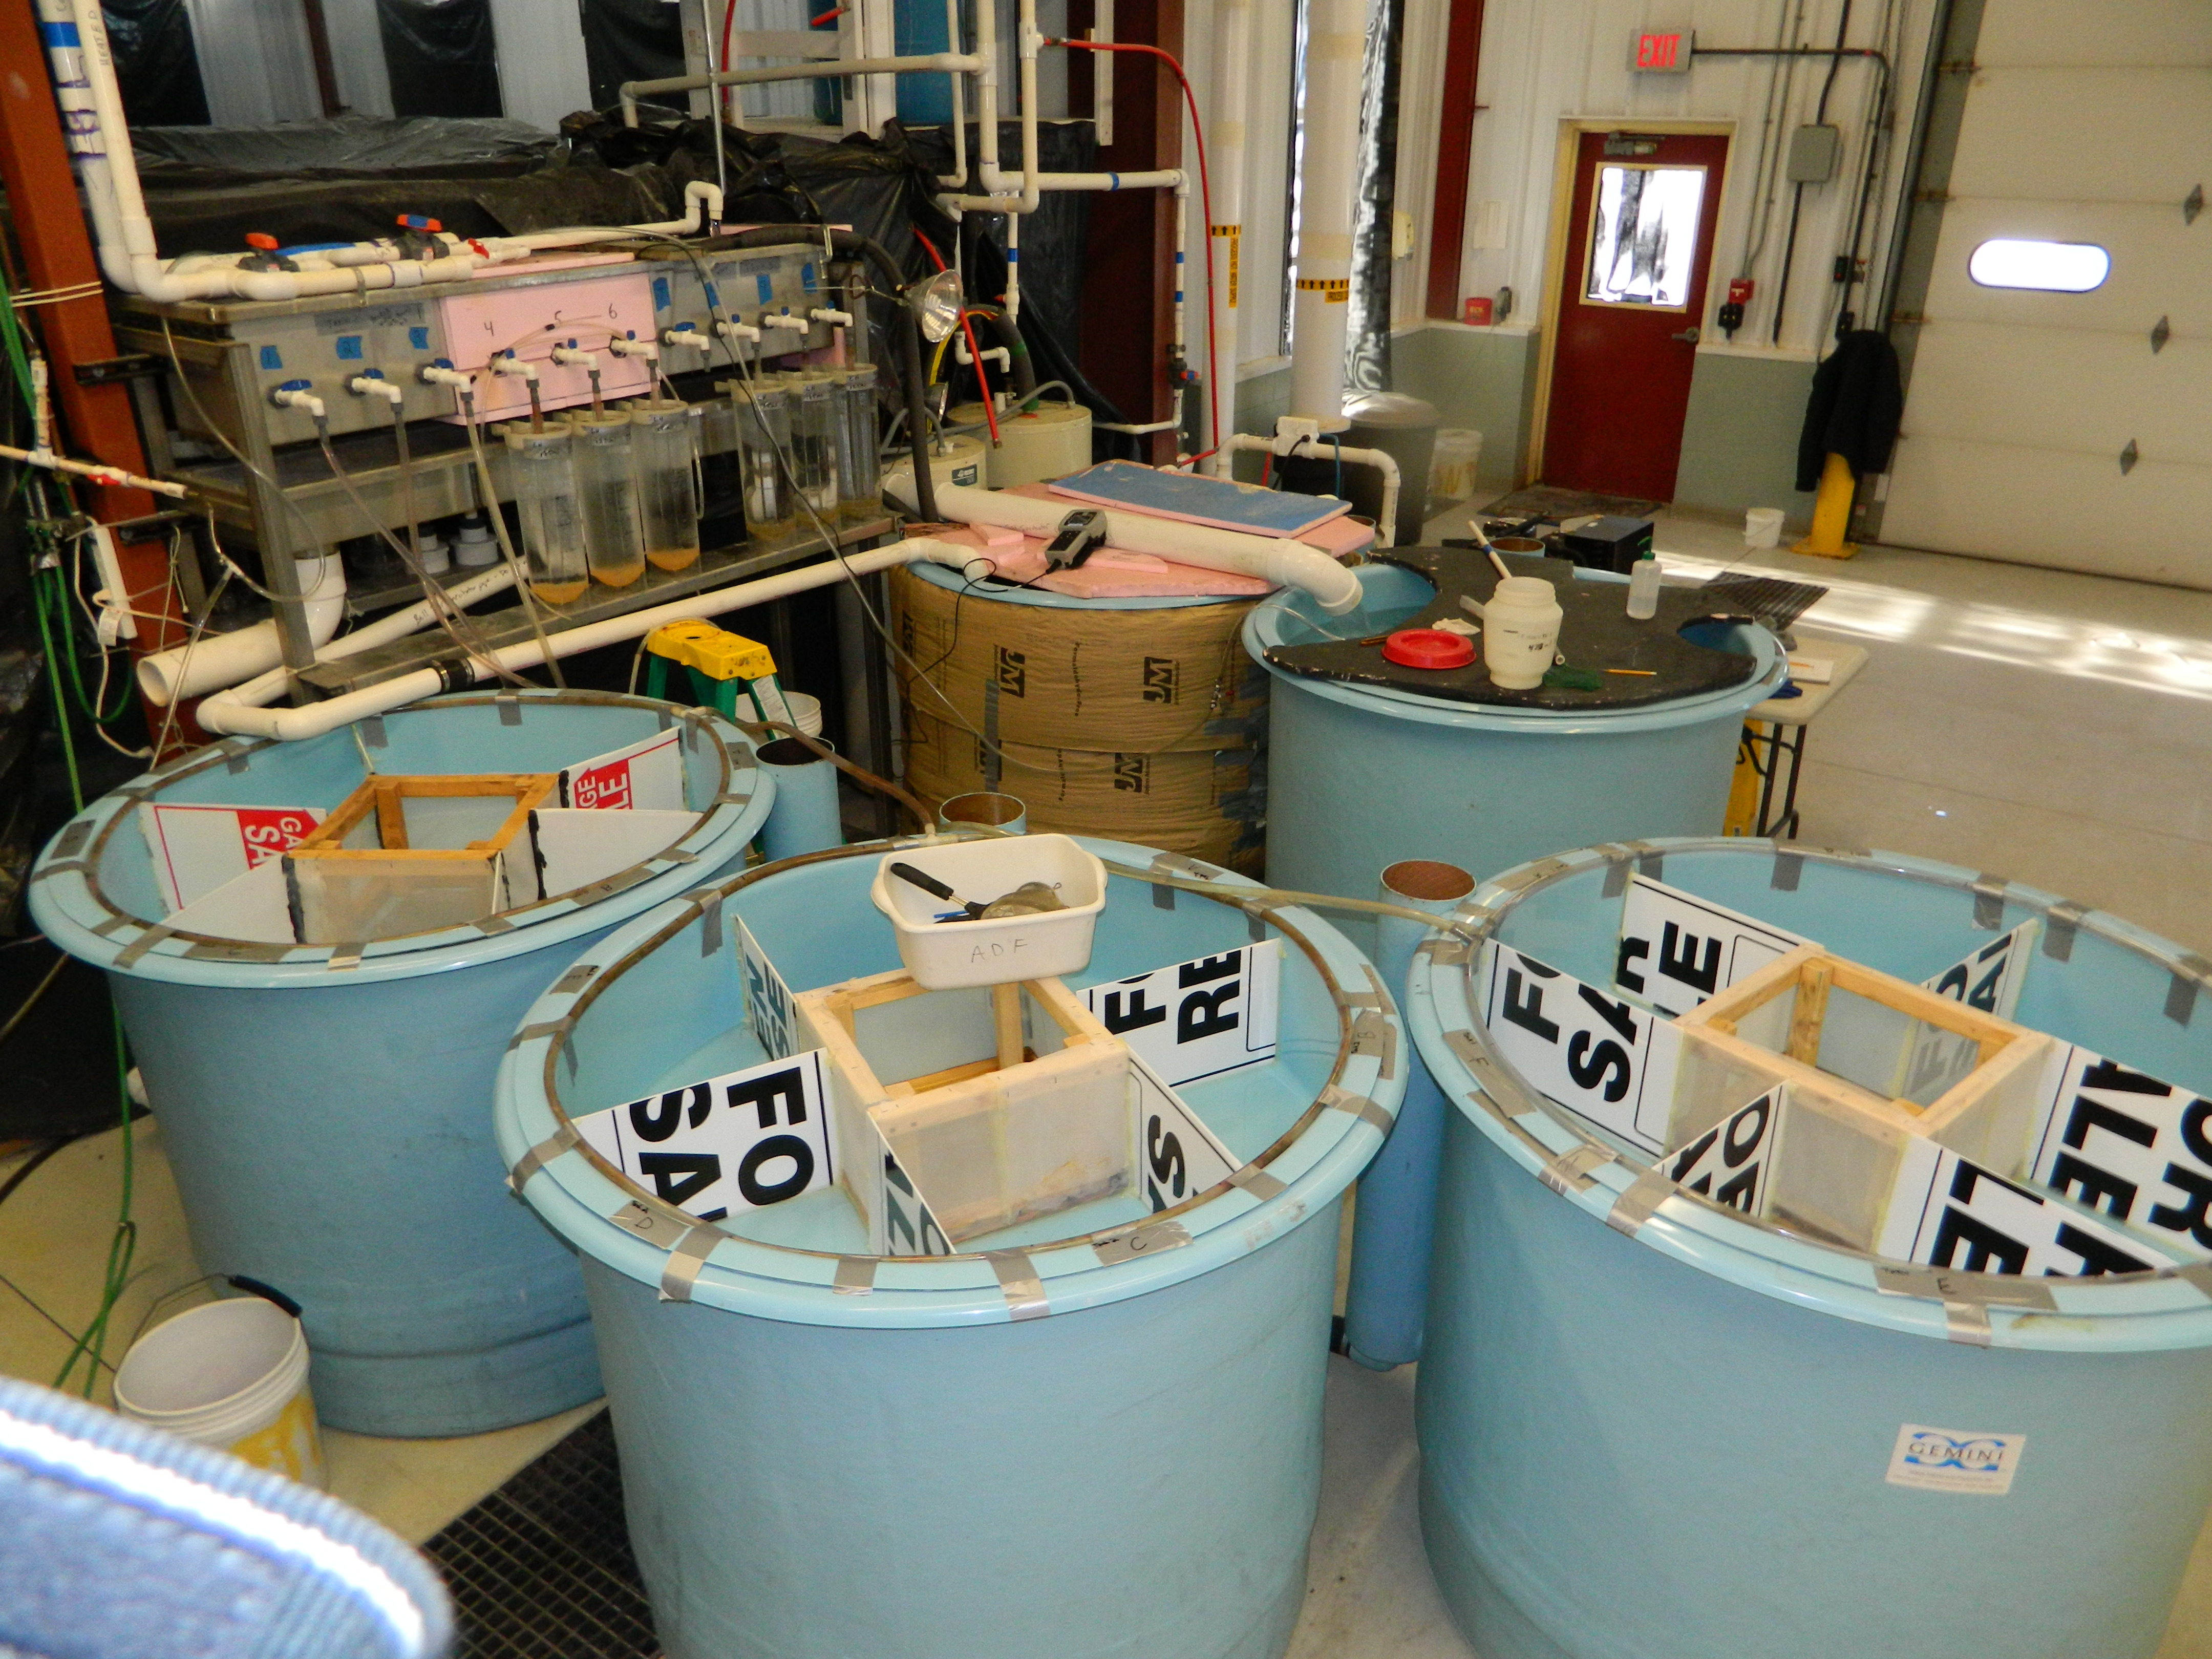
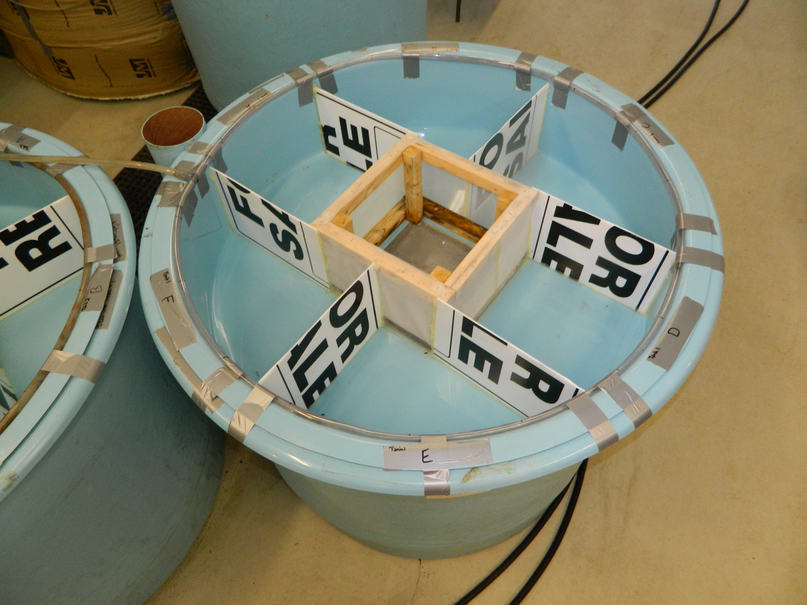
Lake herring fry study

Slide 17
Design
Each tank is broken into 6 sections:
  Water is the same
  Fish can’t circulate between sections
Each tank of fish (fry) is fed the same diet
Three diets →one diet per tank
Q+A time:
  Statistician question: Why have 6 sections?
  Researcher answer: Replication!
  Statistician question: Why replicate? What was the goal?
  Researcher answer: Replication is good, isn’t it? I don’t know why…

Slide 18
Design
Each tank is broken into 6 sections:
  Water is the same
  Fish can’t circulate
Each tank of fish (fry) is fed the same diet
Three diets →one diet per tank
Q+A time:
  Statistician question: Why feed the same diet for each tank?
  Researcher answer: Easy!
  Statistician question: Were you worried about confounding tank effects and diet effects?
  Research answer: Hmmm…

Slide 19
Fatty acids and health study
Predict death by omega 3 fatty acids (survival analysis)
  HR=0.91 95% CI (0.85, 0.98), p=0.02
Adjust for Linoleic acid (omega-6) level in the model
  E.g., Death predicted by Omega 3 + Linoleic Acid
  HR for omega 3 = 0.89 95% CI (0.83, 0.97), p=0.005
Researcher: You must have made a mistake. You adjusted for a variable and the relationship got stronger (HR dropped, p is smaller)
Statistician: Since omega-3 and omega-6 fatty acid levels are negatively associated (cor=-0.20), and omega-6 fatty acids levels are independently associated with death risk this makes sense
Researcher: But, if omega-6’s are confounding the relationship, how could the relationship get stronger? Impossible. Never seen it before. Check your code.

Slide 20
Common issues
Replication
Confounding
Adjusted associations
Etc.
A common theme -> Multivariable thinking (design and analysis)

Slide 21
Part 1 – Karen/Elena/Jamie – separate slide deck

Slide 22
Part 2 – Karen – separate slide deck

Slide 23
Part 3. Multivariable thinking in introductory statistics
How do we anticipate big ideas like multivariable thinking without getting students ‘stuck in the deep end’?
Opinion
  Not spending lots of time on data wrangling, cleaning missing values, R-coding (or any coding, etc. etc.)
  Focus on the big picture of statistical investigations
  Focus on the core logic of statistical inference
  Anticipate themes of explained variation
  Real projects
  Excite students for a second course and courses in their discipline

Slide 24
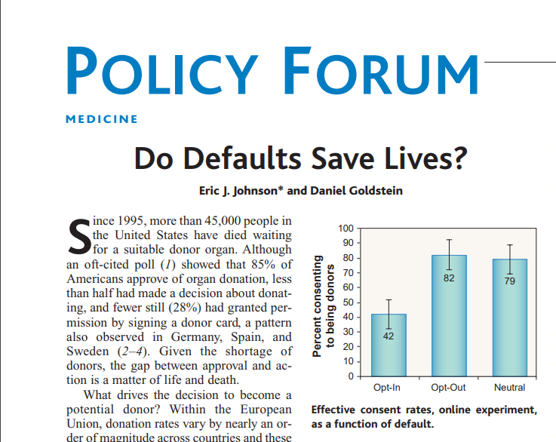
6-steps – Day 1
Background: 85% of Americans approve
of organ donation in principle, but
only 38% are registered
Step 1. Can a method be found to increase
likelihood that a person agrees to become an
organ donor? (Johnson 2003)

Slide 25
6-steps
Step 2. Recruit participants (161 of them)
and ask them to pretend to apply
for a driver’s license
Randomly assigned to one of three groups:
Opt-in, Opt-out or neutral (forced choice)

Slide 26
6-steps
41.8% 82.0% 78.6%
Step 3.

Slide 27
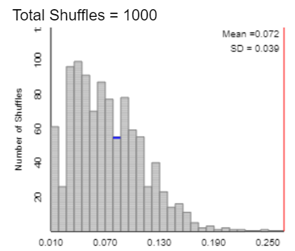
6-steps
Step 4. Beyond what would happen by chance?
MeanAbsDiff = average pairwise difference in
proportions
= 0.268
3S
Statistic: MeanAbsDiff=0.268
Simulate: Re-randomize
Strength of evidence: p<0.001
Shuffled MeanAbsDiff

Slide 28
6-steps
Step 4. Estimation. 95% CIs using 2SD or theory
opt-in - opt-out: (-0.5701, -0.2335)*
opt-in - neutral: (-0.5365, -0.1986)*
opt-out - neutral: (-0.1170, 0.1856)

Slide 29
Logic of statistical inference
Step 5.
  Generalize? Who were these 161 people?
  Causation? Why cause and effect?
Four pillars of statistical inference!
  Cause and effect
  Generalizability
  Significance
  Estimation

Slide 30
Logic of statistical inference
Step 6.
  Look back: experiment, 161 participants online
  Look ahead:
    What different next time?
    Implications for practice?
    Ethics?
    Real vs. hypothetical?
  Starting to lay foundation for random
  assignment and impact on confounding

Slide 31
Anticipating themes of explained variation
Sources of variation diagram for organ donation study
Observed Variation in: Organ donor (Yes/No) | Sources of explained variation | Sources of unexplained variation
 | Question wording (opt-in, opt-out or neutral) | State of origin Underlying beliefs about organ donation How carefully read question Demographic characteristics Unknown
Inclusion criteria Online volunteer Adult
Key Idea: A Sources of Variation diagram is a visual representation of our belief about possible sources which explain variation in the response variable.

Slide 32
Concluding remarks about organ donation
What we do on Day 1 is different than when we talk about this context later in the course
  Day 1. Emphasis on study design’s importance; Step 6- empowering students to think about other variables; statistics is relevant -> threading the needle on complexity and relevance (Out of the ‘bogs’)
  Later in the course
    Generalizability
    Control of confounding with randomization of treatments
    More specifics of the kind of follow-up study
    Etc.

Slide 33
What is multivariable thinking in a first course?
Recognize that variation in a response comes from many, many sources and be able to identify these sources
  Step 6 – Look back and ahead; Sources of variation diagram?
Recognize that relationships ‘discovered’ in a statistical analysis and/or data visualization between two variables (e.g., a response and explanatory variable) depend in large part on how the study has dealt with many other variables that may influence that response.
  Step 5 – Generalizability/Causation
Design studies that effectively control for the many variables that may influence the response
  Step 5 – Generalizability/Causation
Analyze data in the presence of confounding and bias
  Step 3. Explore data (multivariable graphs; tables); Simpson’s paradox
  Step 5. Generalizability
  Step 6. Look back and ahead
Draw appropriate conclusions from a data analysis and convey the limitations of these conclusions
  Step 6 – Look back and ahead

Slide 34
Other tips
Real data analysis project
  End of semester
  Balance of data wrangling and real data analysis, etc.
  Lots of deep thinking
Exciting students for further learning
  Keep it real data- that matters
  Keep it relevant
  Keep it focused on the big picture and not lost in the weeds
  Thread the needle on right/wrong and ‘can say anything’

Slide 35
Final remarks
NSF acknowledgments – DUE1140629, DUE-1323210, DUE-1612201, RCN-UBE 1730668
Team acknowledgments – George Cobb, Allan Rossman, Soma Roy, Todd Swanson and Jill VanderStoep; STUB steering committee
Learning more
  www.isi-stats.com – textbooks and applets; instructor resources (samples, videos, etc.) (2e first course; 1e second course – fall 2020!)
  www.causeweb.org/stub - statistical thinking in biology project
  www.causeweb.org/sbi - simulation-based inference blog
  Assessment initiatives – publications; email us for more information (nathan.tintle@dordt.edu or bchance@calpoly.edu)

Slide 36
Q+A
Are you talking about multivariable thinking in your first course? How?
What do you think about our comment that data wrangling, missing data, etc. shouldn’t be in a first course--- at least not early on?
  Note: Not all the presenters necessarily agree with what Nathan said! ☺
Other questions/comments?

