Slide 1
Part 1: Addressing Needs in Biology
Presenters:
Jamie Bunting
Elena Keeling
Karen McGaughey

Slide 2
Outline
Collaboration between biologists and statisticians at Cal Poly
Example 1: Introductory Biology Lab Course
Example 2: Workshops for M.S. students

Slide 3
Collaborations at Cal Poly
Between Biology and Statistics Faculty:
Need:
Students take bio courses that use statistics BEFORE their statistics course(s)
Bio grad students are coming in with only 1 statistics course, sometimes more than 2 or 3 years prior to entering their M.S. program
Goals:
Provide succinct, just-in-time materials based on sound statistics education pedagogy that Bio faculty and students can leverage
Focus on multivariable thinking (sources of variation, design, confounding, replication etc.)

Slide 4
Example: Introductory biology lab course
Course: 3rd in introductory biology sequence
Incoming Biology majors
most students take as freshmen, with no statistics coursework yet
weekly 3-hour lab
goals of lab include understanding of experimental design, data collection & basic analysis
Challenges:
broad & varied biology content in course- desire to expose students to many different concepts & techniques in lab
most labs taught by M.S. student TAs w/varying statistics background

Slide 5
Example: Introductory biology lab course
Changes (jointly developed by biologists & statisticians):
group worksheets guide through consideration of variables, confounding, & designing an experiment
data collection standardized so groups can pool data
students use simulation applets regularly
final report- includes t test, graph of class data, & questions about experimental design
TA training by statistics faculty
alignment of language with that used in statistics courses
Assessment: in progress
pre & post surveys of conceptual understanding & attitudes toward statistics

Slide 6
Sample worksheet questions
1. How will you set up the independent/explanatory variable? (w/specific prompts)
2. How will you measure the dependent/response variable? (w/specific prompts)
3. Multivariable thinking:
What conditions/variables outside of the independent variable may influence your results?
Which of the variables mentioned can be controlled, and how?
What can you do to minimize the effect of variables for which you cannot control?

Slide 7
Lessons learned/advice
For students:
need to repeatedly emphasize the connections and distinctions between statistics and biology
e.g. statistical significance vs. biological relevance
For faculty planning collaborations:
need multiple conversations between statisticians & biologists
challenging to find the time
statisticians & biologists use the same words to mean different things, and different words to mean the same things
having statistics faculty directly train graduate student teaching assistants is important

Slide 8
Example: Workshops for biological sciences M.S. students
Context:
M.S. students in interdisciplinary program (biology, biomedical engineering, animal science
Curriculum now includes 1 statistics course (assume 1 statistics course as undergraduates)
3 Workshops/year/cohort (prior to change in curriculum)
2-hours each (Fall, Spring, Summer)
Mostly short examples on various topics with Q&A

Slide 9
Example: Workshops for biological sciences M.S. students
Fall: Statistics refresher
Multivariable thinking
Replication
Measuring and thinking about sources of variation
Graphical displays
Inference (t-test, paired t-test)
Spring: Design of Experiments
Multivariable thinking
Inclusion criteria, direct control, random assignment, general randomization, confounding
Scope of conclusions
Blocking
Replication
Summer: Data Analysis
Multivariable thinking
Adjusting for covariates
Removing block effects
Interaction
Methods:
ANOVA
regression
logistic regression

Slide 10
Lessons learned/advice
For students:
For most students it’s been a year or more since the first statistics course and they’ve forgotten a lot
It can be overwhelming to think about carrying out own research study with only 1 or 2 stat classes under your belt
decisions about sources of variability, the design, the analysis which all need to be made before the study
Multivariable thinking is challenging
technical vs. biological replicates
For faculty:
short (1-2 hr) workshops lead by statisticians may be a good strategy to increase statistical training in client departments, not only for students, but faculty as well, could initiate collaborations
funding makes everything easier

Slide 11
Q&A
Do you have examples of ways in which you are collaborating with other disciplines at your institutions to improve statistical understanding?
Questions/comments?

Slide 12
Part 2: Multivariable Thinking in a Second Course in Statistics

Slide 13
Outline
The second course in statistics & multivariable thinking
Introducing multivariable thinking to students
Example 1: Sources of variability in a response
Reinforcing multivariable thinking throughout the course
Example 2: Blocking on a source of variability
Example 3: Adjusting for a confounding variable (categorical)
Example 4: Adjusting for a confounding variable (quantitative)

Slide 14
Second course in statistics
Non-stat majors (biology, marine science, psychology, communications, computer science, etc.)
Algebra-based
Required for a few majors, but the vast majority of students take it as an elective (some towards a minor in Statistics)
Over the last 3-years Cal Poly has gone from teaching 2-sections (~70 students) per year to 6-sections (210 students) per year
Often taught in a lecture/lab format

Slide 15
Second course and multivariable thinking
Recognize that variation in a response comes from many, many sources and be able to identify those sources
Recognize that relationships ‘discovered’ in a statistical analysis and/or data visualization between two variables (e.g., a response and explanatory variable) depend in large part how the study has dealt with many other variables that may influence that response.
Design studies that effectively control for the many variables that may influence the response (e.g., blocking, inclusion criteria, direct control, etc.)
Analyze data in the presence of confounding and bias
Draw appropriate conclusions from a data analysis and convey the limitations of these conclusions

Slide 16
Teaching multivariable thinking in the second course
Use data visualization as much as possible to teach the ideas of:
Explaining variation
Confounding
Adjusting for another variable
Interaction
Use simulation to reinforce:
Null distribution and variability arising from random assignment and/or random sampling
Statistical significance

Slide 17
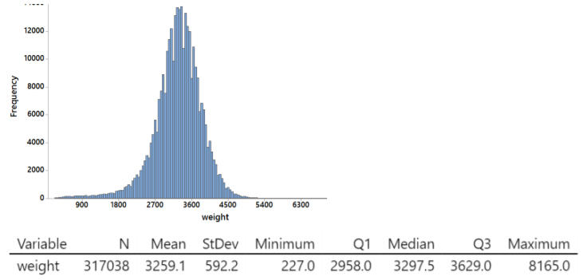
Thinking about reasons for variation
Example 1: Histogram of birthweights (in grams) for all babies born in the U.S. in January 2016
Brainstorm: What are some reasons for the variability in birth weights?
Answers:
Genetics
Premature birth or not
Mother’s nutrition
Mother’s stress
Mother’s body weight
Baby’s sex
Unknown

Slide 18
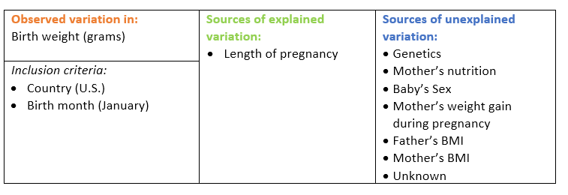
Sources of variation diagram
SD of birth weight = 592g

Slide 19
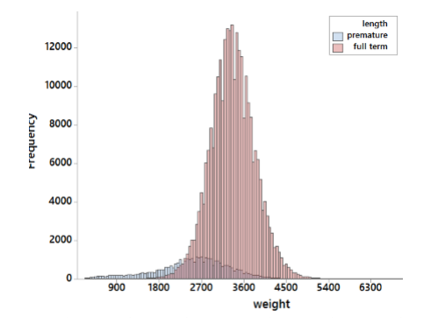
Explained vs. Unexplained variation
R² ≈ 22%

Slide 20
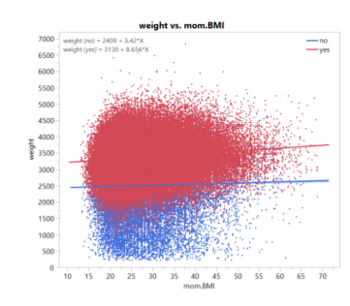
Accounting for a second source of variability in the model
SD of birth weight = 592g
R² ≈ 23.5%

Slide 21
Accounting for a source of variation by design
Example 2: Stimulants and finger tapping
3 stimulants: caffeine, theobromine (chemical in chocolate), placebo
Response: finger tapping rate measured 2-hours after ingestion
What are some potential sources of variation in finger tapping rates?
Type of pill/stimulant
Previous caffeine use that day
Size/amount of the pill
Time after ingestion at which the test is run
How finger tapping rate is measured
Time of day
Manufacturer
Age
Inherent finger tapping ability
Attitude/willingness to participate
Whether the person is regular caffeine user
Sleep
Metabolism
Unknown

Slide 22
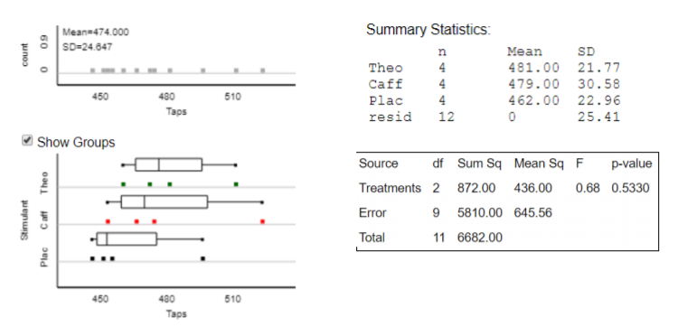
Analysis: One-variable model
Model: finger tapping rate ⬅ stimulant
Why is the F-statistic so small?
Answer: Lots of unexplained variation

Slide 23
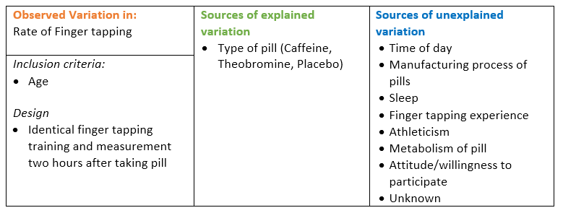
One-variable model sources of variation diagram
Person-to-person variation
$$predicted tapping rate= \left\{\begin{matrix}481 & if Theobromine \\ 479 & if Caffeine \\ 462 & if Placebo\end{matrix}, SE of residuals=25.41 \right.$$
R² ≈ 13%

Slide 24
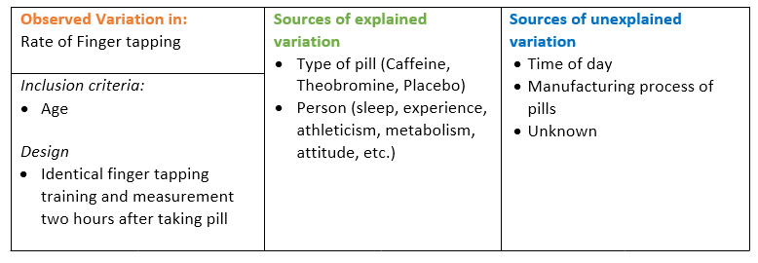
Accounting for variation by design
Actual study design: 4 study participants: each participant was measured using each stimulant (in random order)
Block or repeated measures design, blocking on person
Person-to-person variation

Slide 25
Analysis of a block design
Needs to take into account the person-to-person variation
Analysis #1: Adjust the simulation to reflect the within person random assignment used in the study
Analysis #2: Account for the person effects in the finger tapping rates…
➔ One Blocking Variable Applet

Slide 26
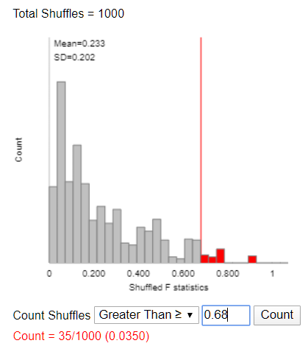
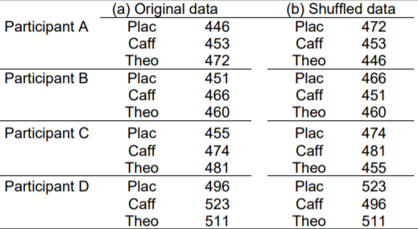
Account for the person-to-person variation by simulation
One Blocking Variable Applet
Shuffle within blocks

Slide 27
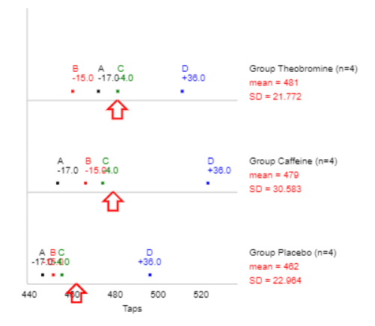
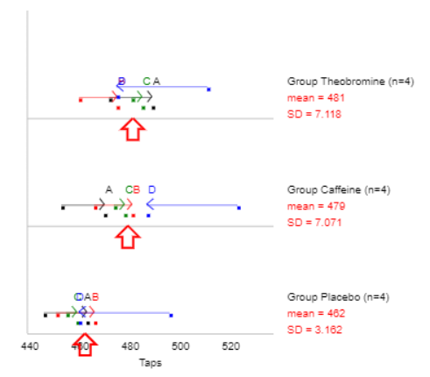
Account for person-to-person variation by removing the person effects
Treatment means stay the same
Within treatment variation decreases

Slide 28
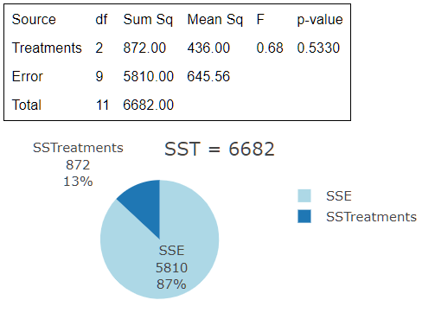
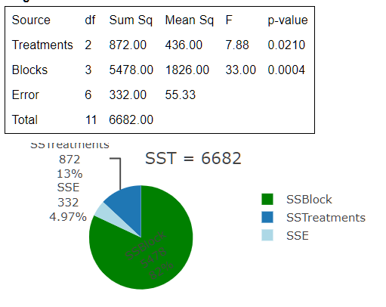
Person-adjusted ANOVA

Slide 29
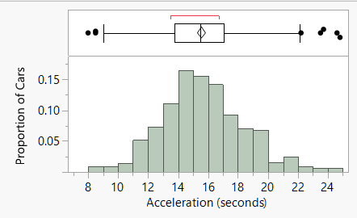
Adjusting for a confounding variable
Example 3: Car Acceleration
Time (in seconds) it takes a car to accelerate to 60 mph
What features of a car might explain faster acceleration times?
SD = 2.76 sec
R² ≈ 6.7%

Slide 30
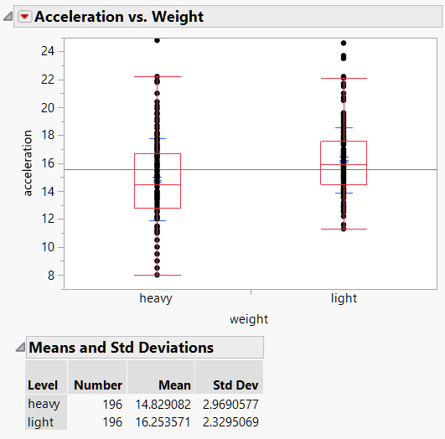
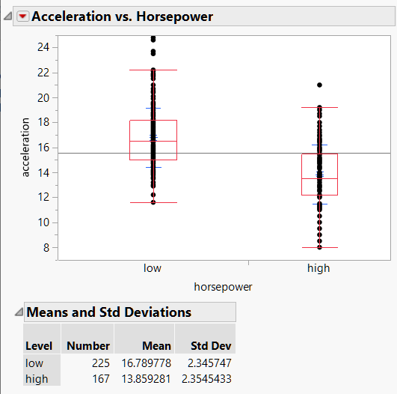
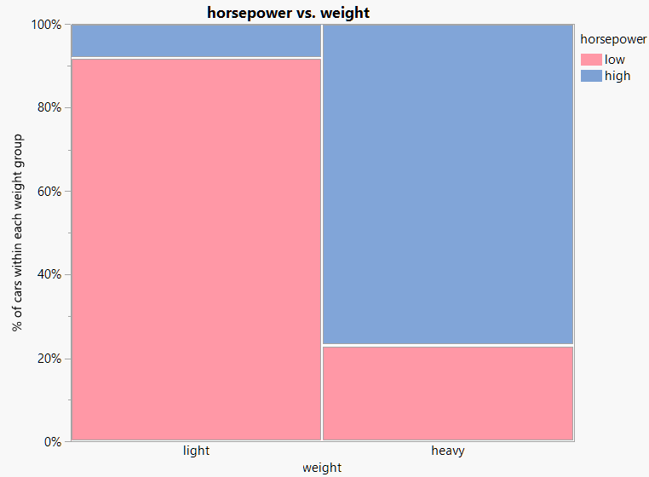
Pairwise relationships
Faster
RV: Acceleration
EV: Car Weight
CV
Horsepower

Slide 31
Adding horsepower to the model
RV: Acceleration
EV: Car Weight
+ Horsepower

Slide 32
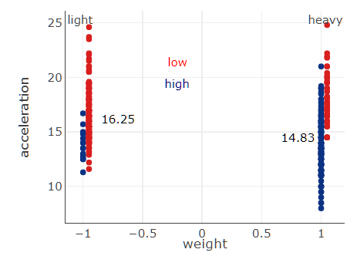
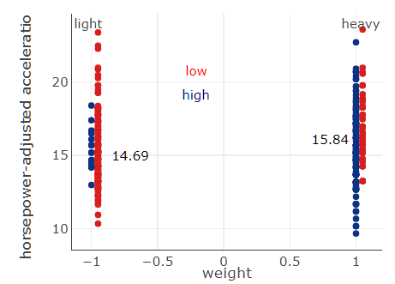
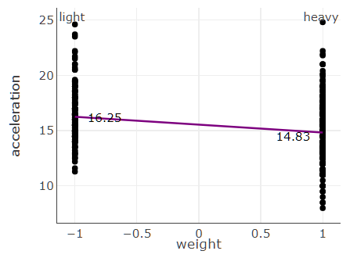
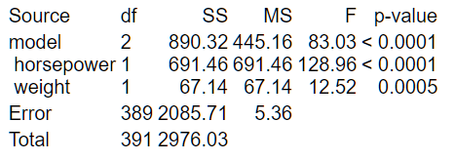
Adjusting for horsepower
Remove the ‘effect’ of horsepower from acceleration what will happen to the blue dots? The red dots?
Cars with higher hp have faster (lower) times
Cars with lower hp have slower (higher) times

Slide 33
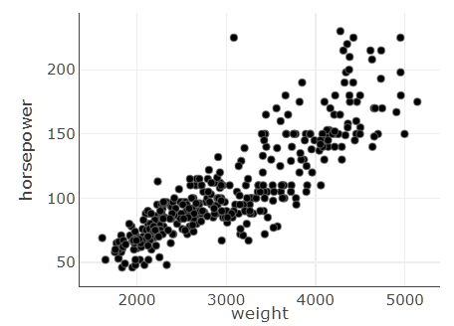
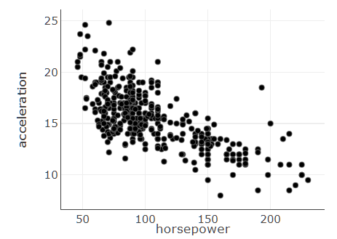
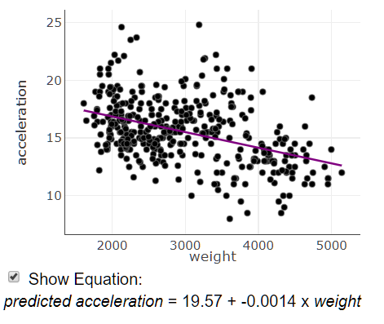
Adjusting for a continuous predictor
Example 4: Car Acceleration (regression)
RV: Acceleration
EV: Car Weight
CV
Horsepower

Slide 34
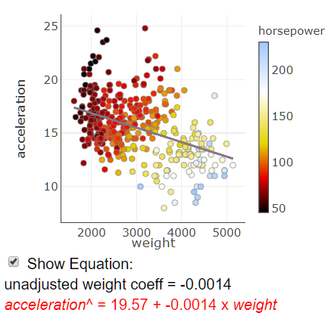
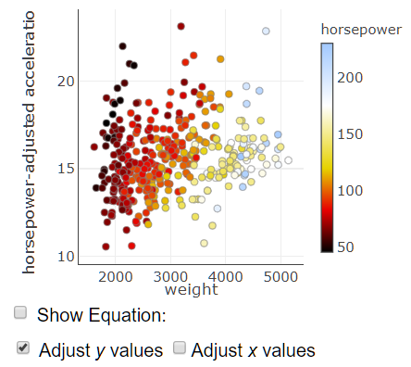
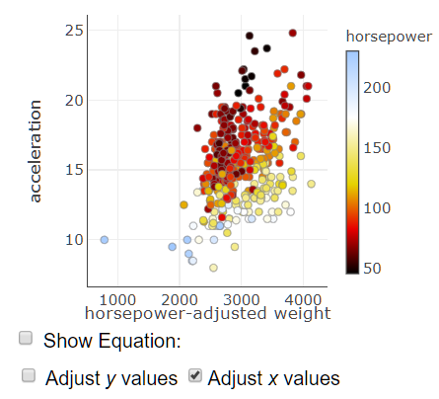
Adjusting for horsepower

Slide 35
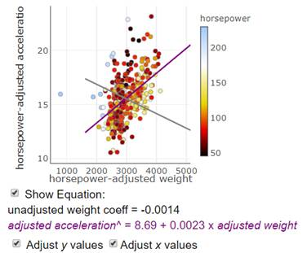
Hp adjusted linear association between acceleration and car weight

Slide 36
Summary
Thinking about sources of variation is an important skill (in both randomized experiments and observational studies)
Use simple data visualizations to show what it means to adjust for a variable (blocking variable or confounding variable)
Use simulation to reinforce the idea of the null distribution and statistical significance with an emphasis on the simulation matching the design
Additional multivariable topics:
Interaction in factorial studies and in regression models
Collinearity

Slide 37
Q&A
Second course is all about multivariable thinking, but often is taught as disparate analysis methods (e.g., t-test, ANOVA, regression, chi-square, etc.)
What are some ways you all try to weave this together and create a unified approach?
Are there other important multivariable ideas that need to be stressed in the second course so that students who only see 2 courses in statistics can be successful in a data-centric world and job market?
Other questions? Comments?

