Slide 1
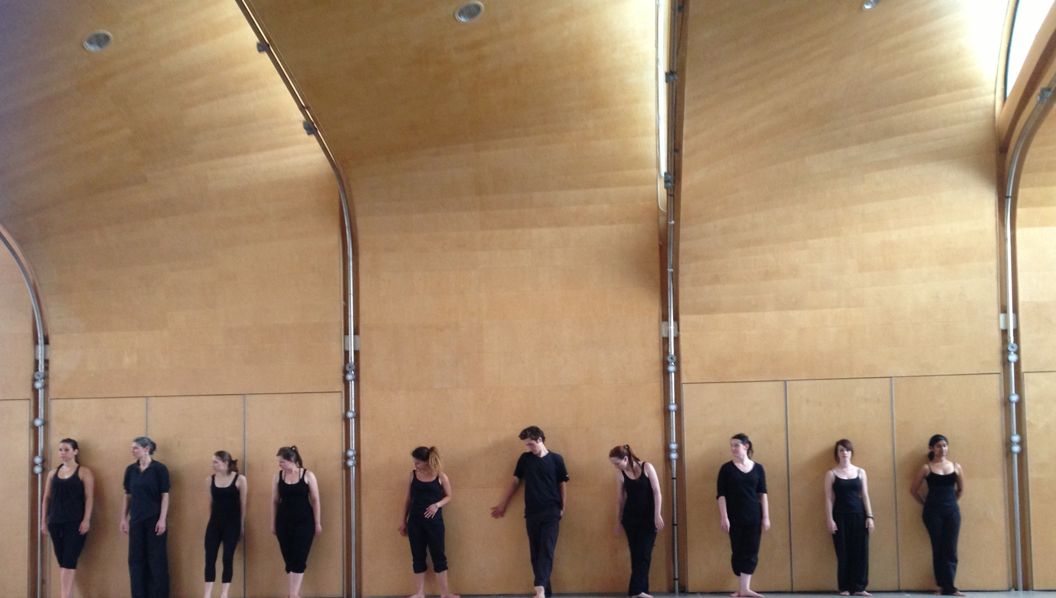
Engaging Students in Statistics through Art
Dancing Statistics
eCOTS 2020
Dr Lucy Irving
Notes:
Thank you for inviting me. The Dancing Statistics films were initially designed for Psychology students to help them get to grips with some concepts common to psychology degrees.
If you haven’t seen any of them, you could watch one while I speak. There’s no voice over, just music.

Slide 2
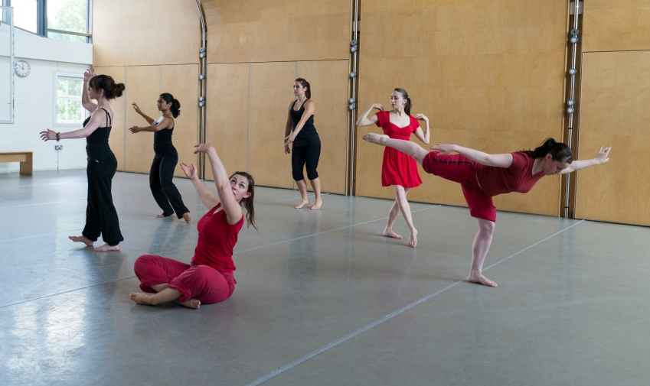
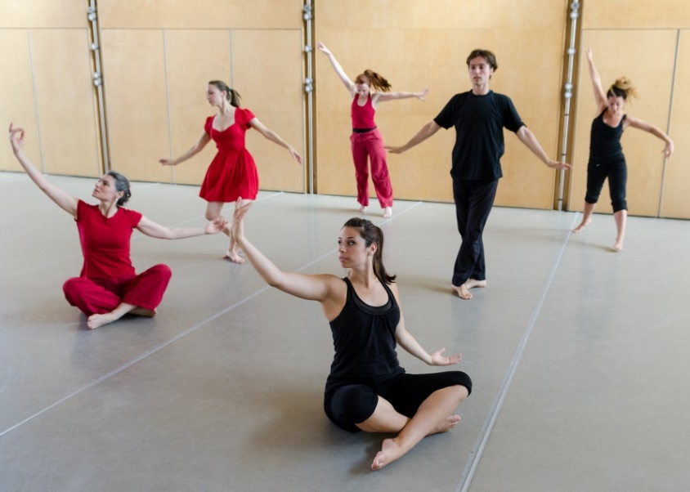
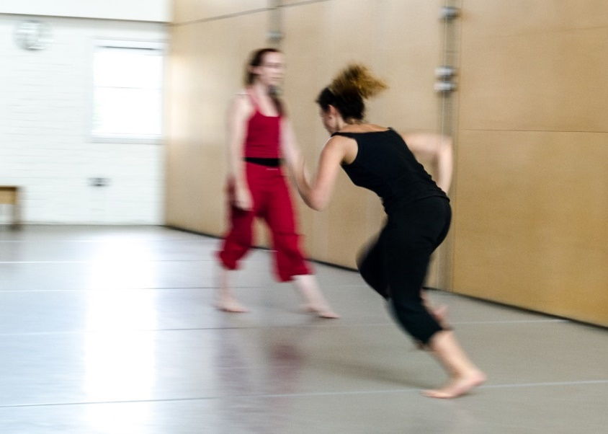
The Dancing Statistics Films
Search ‘BPS Official’ and...
‘Sampling and Standard Error’
‘Correlation’
‘Variance’
‘Frequency Distributions’
Notes:
You’ll find the films on the BPS Official YouTube channel.
The aim is to demonstrate these 4 statistical concepts using dance and movement.
Correlation | Sampling and Standard Error | Frequency Distributions | Variance
Dance has existed as a form of human expression for millennia and is found across all human cultures, like music and the visual arts. It can be traced back to rituals and social expression, and defies barriers of race and status, generation, social class, and geography.
The films were aimed at those who may lack confidence in the area of statistics, or who simply enjoy thinking about things in new ways.
Many undergraduate psychology students say that the statistical component is the most daunting and challenging aspect of their degree, and the most anxiety-inducing. I want to challenge that, as I’m sure many of you do too!
I’m going to tell you about some work I’ve done on the response to the films, as well as some related literature in the area.

Slide 3
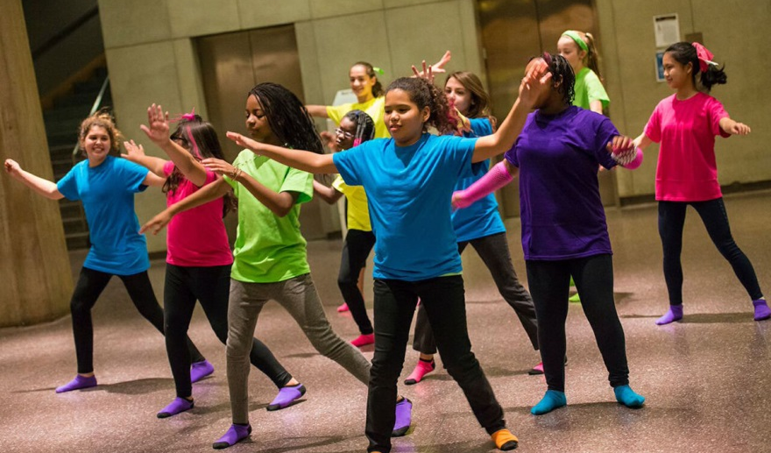
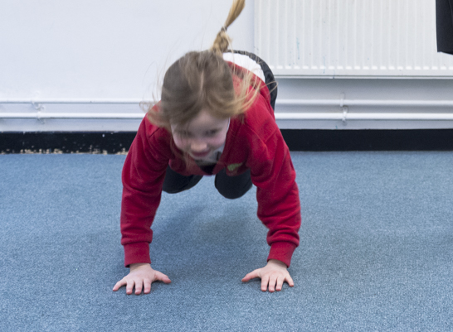
Merging of arts and science
Not entirely new
Rare in college/HE
Dancing Statistics
= no dancing required!
Notes:
The merging of science and the arts isn’t entirely new. Enhancing understanding of subjects like maths through the use of music and movement has been done with children for some time.
It is rarer in higher educational settings though, possibly because older individuals don’t all find this type of thing too appealing!
Once children hit teenage years, their appetite for dancing on-commend in-front of their peers declines somewhat…
The difference with my films is that viewers are not expected to dance; simply to observe.
I wanted to gain some understanding of what people thought about the films, so I conducted a qualitative piece of research

Slide 4
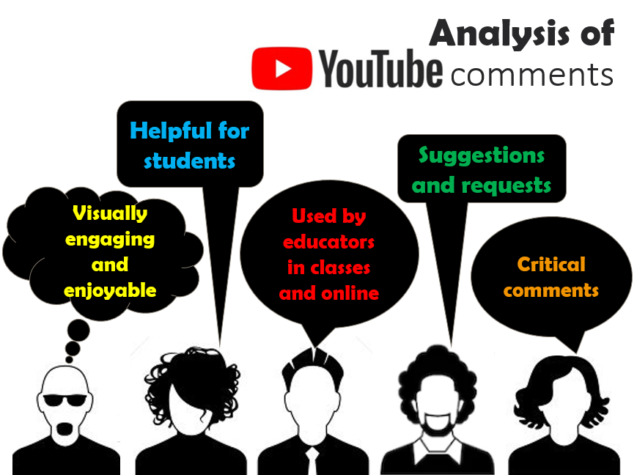
Notes:
I’m a quantitative researcher ‘by-trade’, and thematic analyses are not my usual style… (!)
However, it’s a good way to analyse text to extract common patterns, so I conducted one on the YouTube comments and found 5 themes. Here they are
1. Visually engaging/enjoyable | 2. Helpful for understanding concepts | 3. Useful as teaching aids | 4. Suggestions and requests | 5. Critical comments
These YouTube comments, alongside Tweets and personal communications I’ve received, demonstrate that it’s not only students who are engaging with the films, and that they are not only being viewed in HE settings.
I know the films have been enjoyed by sports scientists, vets, students of education, marketing students, journalists, dancers studying business, trainee nurses, and students of STEM subjects.
Demonstrating statistics in this way appeared to be enjoyable to many viewers, but of course the aim is to aid understanding. At present, there’s only anecdotal evidence that they do this, and my next aim is to look more closely at whether the films improve understanding of these concepts.

Slide 5
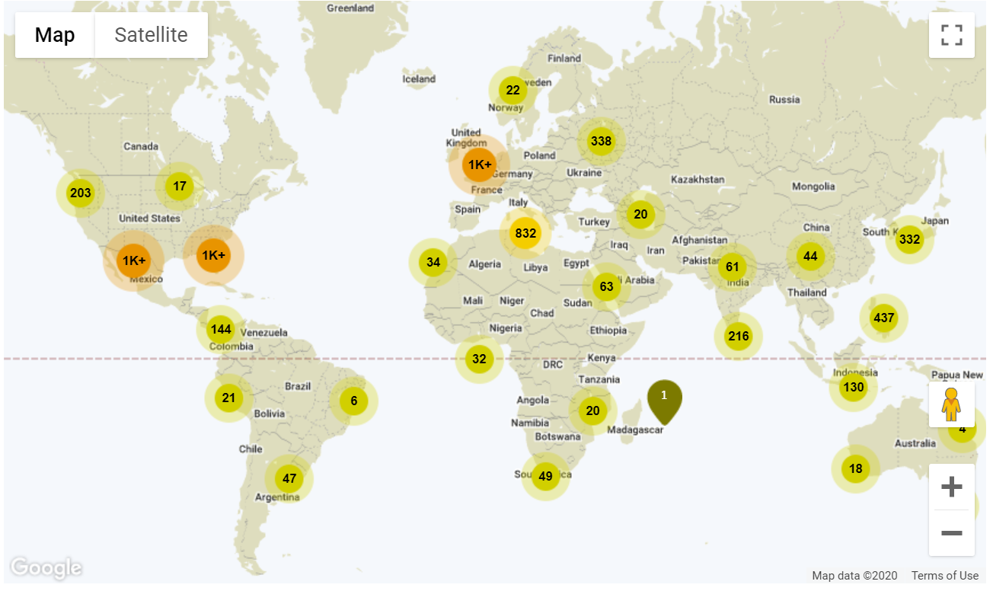
Irving, L. T. (2015). Teaching statistics using dance and movement. Frontiers in psychology, 6.
Notes:
I published a paper on using dance to teach statistics and related subjects, and this image shows how widely this paper was accessed.
It has been proposed that a benefit of using graphics is that “they communicate across cultures”, and the same has been said of dance.
It can be seen from the distribution of views that people from many different cultures have read about the films and about teaching in this way.

Slide 6
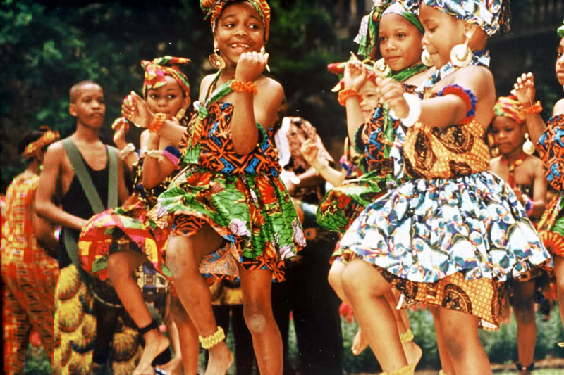
Embodied Learning
“When appropriate sensorimotor systems are engaged, the converging inputs can create stronger and more stable memory traces and knowledge representations”
People may recall more when they learn this way (Lindgren & Johnson-Glenberg, 2013)
Notes:
Embodied learning is a potential area relevant to understanding the response to Dancing Statistics.
Many of the examples in the literature focus on the benefits of actually doing some dance.
The idea with EL is that we use our physical experiences when engaging in higher-order thought processes and these can serve as a basis for new knowledge, and they may recall more.
We know there are benefits to learning from physical enactment, or embodied cognition, but can this also happen through watching others do something physical, like dance?
Well, observation can still produce a type of embodied learning, but it may not be as durable as higher-embodied experiences which combine core body engagement and strong neuromuscular activation.
One does not passively watch these films though. Rather, the audience is gently guided through and told what to consider as they watch.
One is still ‘active’ and (hopefully) engaged with the movements, but is not actually moving.
This brings an interactive feel to the pieces, and students often say that ‘interaction’ is important for their engagement with a subject.

Slide 7
Dance Chemistry (Tay & Edwards, 2015)
  Students said videos helped visualise chemistry ideas in a new and memorable way
    educational and entertaining
    grabbed my attention better than a traditional classroom setting would have
    got me more excited for the topic
    a very random way to teach a lesson but because it is so absurd and unusual, I wont forget it
“
”
Notes:
I did find one interesting piece of research which took place in a college about a project called Dance Chemistry.
This initiative teaches chemistry topics using videos which feature dance, and students involved said the videos helped them to visualise chemistry ideas in a new and memorable way.
Here are some quotes from the students.
Their results also showed an increase in students’ average scores after watching a 5 min video featuring dance. Students appreciated the visual way of learning as it grabbed their attention.
Tay and Edwards point out that art is often considered to be a universal language, though statistics is rarely thought of in this way. I think the surprising aspect of mixing stats with dance certainly intrigues some people.

Slide 8
What I’ve found (and what’s still unclear)
Dancing Statistics seems to engage students
Educators use films in lectures and research methods classes
International appetite for learning this way
Not for everyone
Unclear whether they improve statistical literacy
Do they increase engagement?
Perhaps ‘stats anxiety’ is reduced
Notes:
Here are some of my observations
It is unclear whether the films help to improve statistical knowledge, or whether they simply spark interest and (possibly) further engagement.
Perhaps stats anxiety is reduced by watching the films?
We all want to make statistics accessible to as many as possible, and the past few months especially have shown the importance of being able to comprehend statistics, and how valuable this skill actually is.
Arts-based teaching curricula are also known to develop creative thinking – something highly valued by many industries. It’s been recognised that linear approaches to teaching and learning, which focus primarily on repetitive skills development, tend to produce poor educational outcomes.

Slide 9
Conclusions
The Dancing Statistics films…
may help students with their understanding of statistics
demonstrate a tough subject in an unexpected and memorable way
are used by educators from wide ranging disciplines
have been shown to students of all ages
are a visual explanation of statistical concepts which appear to engage viewers on multiple levels
Notes:
So here are some conclusions …
Students certainly seem to like the films and they’ve been used in varied disciplines
Comments suggest the films aid understanding, but this is yet to be shown statistically!
We know that embodied learning works for a number of reasons, but also that not everyone wants to be made to dance.
These films may provide a happy medium where one gets some of the benefits of a type of embodied learning, but without the potential anxiety, or, l dare I say it, cringe-factor!
We’ve seen in this session that statistics can be beautiful, and that there certainly appears to be an appetite for merging the arts and statistics. Long may it continue.

Slide 10
Thanks for your time
l.irving@mdx.ac.uk
@StatsDancer
Some references
Bohannon, J. (2011). Dance vs. PowerPoint, a modest proposal. TEDx Brussels.
Harris et al 2019. Ready, Cell, Go! Guided Movement Exercises in an Introductory Cell Biology Course. Students solved spatiotemporal and energetic problems with their own bodies in constrained spaces. these exercises rearranged concepts learned in the classroom, facilitating that sense of discovery
Irving, L. T. (2015). Teaching statistics using dance and movement. Frontiers in psychology, 6.
Kalpana, I. M. (2015). Bharatanatyam and mathematics: Teaching geometry through dance. Journal of Fine and Studio Art, 5(2), 6-17.
Lobo, Y. B., & Winsler, A. (2006). The effects of a creative dance and movement program on the social competence of head start preschoolers. Social Development, 15(3), 501-519.
Stern, E., & Schaffer, K. (2012). Math dance: Erik Stern and Karl Schaffer at TEDx Manhattan Beach. Accessed from: https://www.youtube.com/watch?v=Ws2y-cGoWqQ.
Tay, G. C., & Edwards, K. D. (2015). DanceChemistry: Helping Students Visualize Chemistry Concepts through Dance Videos. Journal of Chemical Education, 92(11), 1956-1959.
If you have feedback, ideas, or suggestions, I’d love to hear from you

Slide 11
Embodied Learning References
Deans, J. (2016). Thinking, feeling and relating: Young children learning through dance. Australasian Journal of Early Childhood, 41(3), 46-57.
Johnson-Glenberg, M. C., & Megowan-Romanowicz, C. (2017). Embodied science and mixed reality: How gesture and motion capture affect physics education. Cognitive Research: Principles and Implications, 2(1), 24.
Lindgren, R., & Johnson-Glenberg, M. (2013). Emboldened by embodiment: Six precepts for research on embodied learning and mixed reality. Educational Researcher, 42(8), 445-452.
Skulmowski, A., & Rey, G. D. (2018). Embodied learning: introducing a taxonomy based on bodily engagement and task integration. Cognitive research: principles and implications, 3(1), 6.

