Slide 1

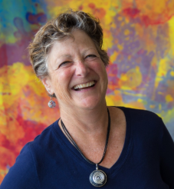
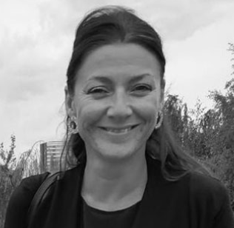
Larry Lesser Lesser@utep.edu
The University of Texas at El Paso
Merryl Goldberg goldberg@csusm.edu
California State University San Marcos
Lucy Irving L.Irving@mdx.ac.uk
Middlesex University, UK
Discussion (from questions you type in Q&A)
(general comments: type in Chat for panelists & attendees; tech issues: type in Chat for panelists)
eCOTS 2020 30-min. panel “Engaging Students in Statistics through the Arts” May 19, 2020

Slide 2
my STEAM trajectory
SONGS:
Started writing songs in college, STEM songs a decade later;
released albums of non-STEM songs in 1992 & 2020)
Usage: college/HS classroom motivation/instruction, outreach (lottery), conference plenary edutainment, NSF-funded research studies
Published ≈100 STEM lyrics (some won national educational song contests)
POEMS:
Published ≈50 STEM poems (including 8 statistics poems in current J. of Humanistic Mathematics and 1st-place haiku in 2020 ASA Day contest)
OTHER ART/FUN:
Contributed jokes and cartoon captions to CAUSEweb.org
Wrote (with Mark Glickman) 2009 MASA article on magic in statistics

Slide 3
this month, CAUSE launched its
8th biennial A-μ-Sing contest!
Seeks jokes, cartoons, poetry, songs, videos with fun content relevant to teaching statistics
Free to enter; up to $1000 in prizes awarded; winning entries featured with 2021 USCOTS
Deadline (no joke!): April 1, 2021
CAUSEweb.org/cause/a-mu-sing/2021/rules

Slide 4
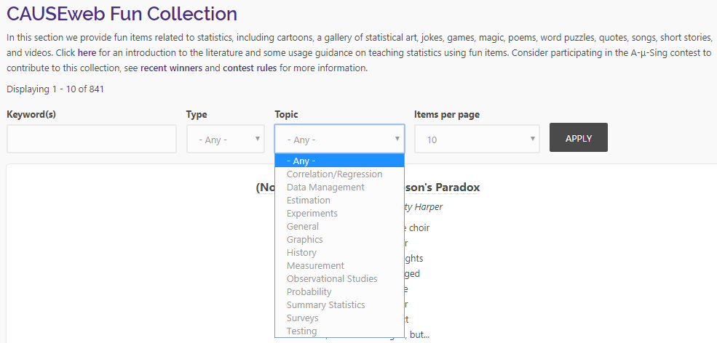
Dennis Pearl & I curate CAUSEweb.org/fun

Slide 5
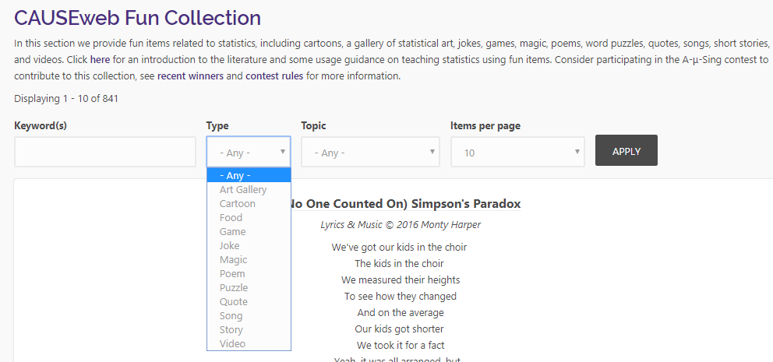
Most types of fun are a kind of “art”

Slide 6
the (178+) songs are my focus today

Slide 7
some resources
https://www.CAUSEweb.org/fun/ includes 178+ statistics songs
https://www.CAUSEweb.org/smiles/ has 27+ interactive statistics songs, supported by 2015-present NSF DUE EAGER grants #1544426 (PSU), 1544237 (UTEP), and 1544243 (GSU)
https://www.CAUSEweb.org/voices/ addresses using song across STEM (includes ≈ 100 archived presentations from 3 conferences!)
https://larrylesser.com/statistics-fun/ includes our fun-related work
(e.g., overview in Sept. 2017 Amstat News &
Teaching Statistics column launched fall 2019)

Slide 8
top 6 statistics song references
Lesser, Pearl, Weber, Dousa, Carey, & Haddad (fall 2019). Developing interactive educational songs for introductory statistics. Journal of Statistics Education, 27(3), 238-252.
Lesser, L., Pearl, D., & Weber, J. (July 2016). Assessing Fun Items' Effectiveness in Increasing Learning of College Introductory Statistics Students: Results of a Randomized Experiment, Journal of Statistics Education, 24(2), 54-62.
Lesser (fall 2018). Modulating misconceptions with musical means. Teaching Statistics, 40(3), 79-82.
Lesser, L. (2018). Student-created songs in statistics class, eCOTS videoposter, CAUSEweb.org/cause/ecots/ecots18/posters/4-04
Lesser, L. (2014). Mathematical lyrics: Noteworthy endeavours in education. Journal of Mathematics and the Arts, 8(1-2), 46-53.
Lesser, L. (fall 2001). Musical means: Using songs in teaching statistics. Teaching Statistics, 23(3), 81-85.

Slide 9
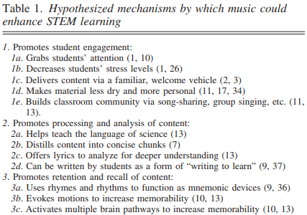
possible benefits/goals
(Crowther et al. paper in March 2020 Advances in Physiology Education)

Slide 10
and we could add….
Incorporates active learning (Freeman et al. metaanalysis in PNAS 2014)
Builds classroom community
Models creative process (with parallels to learning content)
Disrupts stereotypes (e.g., scary/nerdy images reflected in “Draw a Mathematician/Scientist” studies)

Slide 11
some takeaways
Uses (Lesser 2014 paper in J. of Mathematics and the Arts):
recall, introducing concepts/terms, reinforcing processes, connection to real world/history, humanizing
Memorable (songs/learning) (Crowther et al., 2020):
consistent rhythm, simple-to-sing melody, end rhymes, concise length
Student role (Lesser 2017 VOICES & 2018 eCOTS videoposters):
analyze existing commercial songs (e.g., what concepts? are lyrics focus or facet? do lyrics describe, just mention, or make analogy? accurate?)
listening, helping perform, completing, doing video/report on instructor-provided song
writing new songs

Slide 12
Larry Lesser Lesser@utep.edu
The University of Texas at El Paso
Merryl Goldberg goldberg@csusm.edu
California State University San Marcos
Lucy Irving L.Irving@mdx.ac.uk
Middlesex University, UK
Discussion (from questions you type in Q&A)
(general comments: type in Chat for panelists & attendees; tech issues: type in Chat for panelists)
eCOTS 2020 30-min. panel “Engaging Students in Statistics through the Arts” May 19, 2020

