Slide 1
It's as Easy As SASPy to Combine SAS® and Python in Teaching the Data Sciences
James Harroun
Data Science Initiatives Manager
Global Academic Program
James.Harroun@sas.com

Slide 2
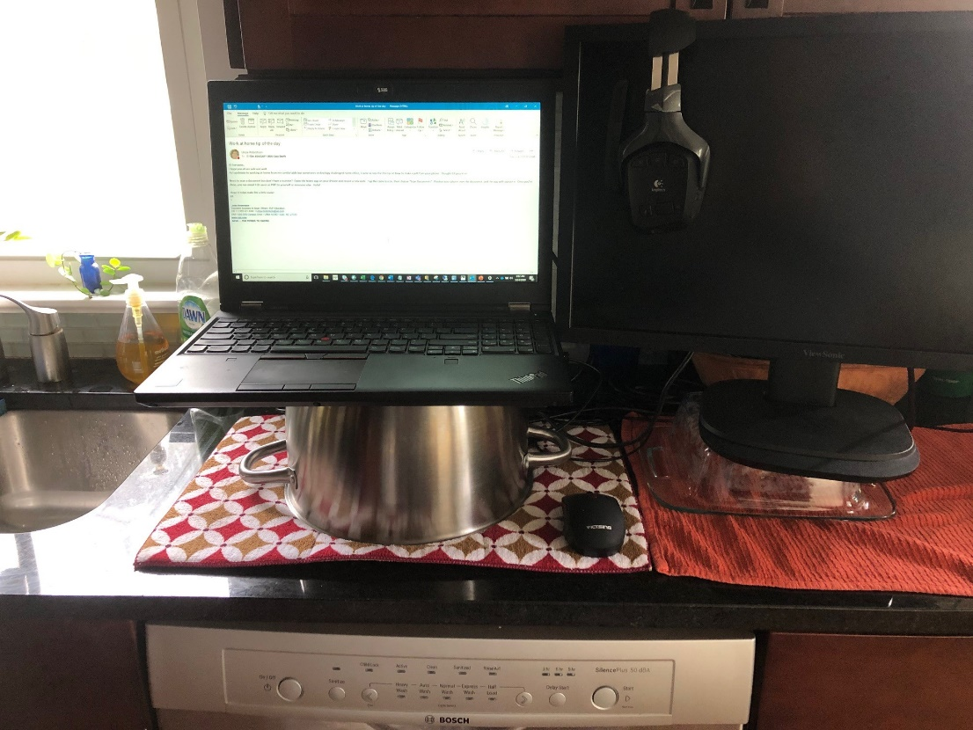
Broadcasting from My Kitchen Office
Notes:
Empowerment
SAS brand promotion

Slide 3

Our Mission:
The SAS Global Academic Program supports industry partnerships with academia, delivers technology and resources for teaching and learning, and provides products and services at no cost to schools.
Our “customers” are students, educators, independent learners, and academic researchers.
Notes:
Empowerment
SAS brand promotion

Slide 4

Hcb nn
Global Academic Program Goals
Increase SAS Consideration and Adoption Among Faculty
Build SAS Skill and Usage Among Students
Develop Academic-Commercial Connections

Slide 5
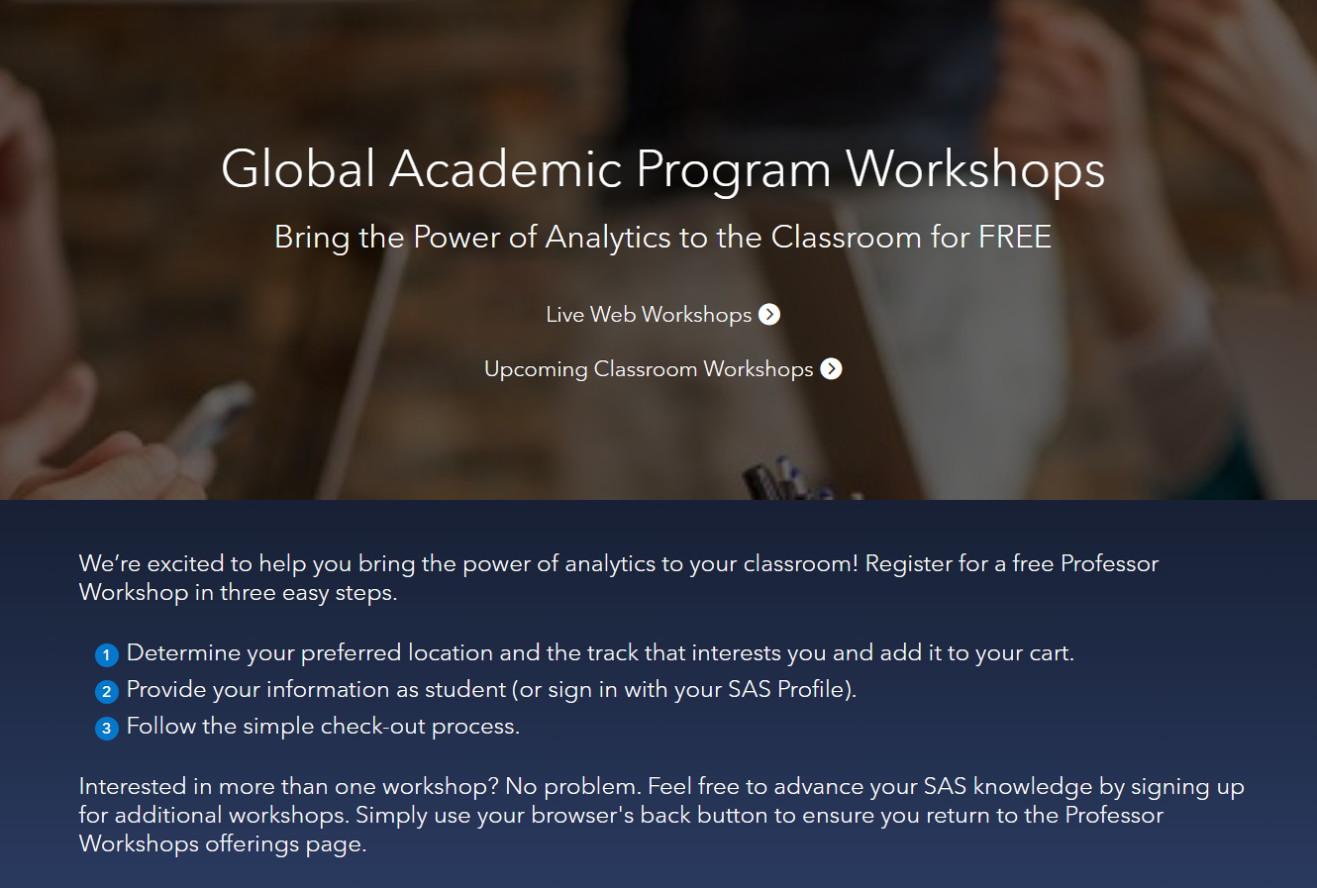
Free Training for Educators
Register Today!
You can select from:
Online Live Training
In-Person Training
www.sas.com/professor-workshops

Slide 6
Educator and Student Training
Sample Full Workshops | 2019
Foundational Courses
Data Manipulation and Analytics Using SAS University Edition
SAS Programming I and SAS Programming II
SAS SQL: Essentials
SAS Visual Analytics on SAS Viya
Statistical Courses
SAS Visual Statistics
Multilevel Modeling of Hierarchical and Longitudinal Data Using SAS
Advanced Analytics
Applied Analytics Using SAS Enterprise Miner
Text Analytics Using SAS Text Miner
SAS Visual Data Mining and Machine Learning on Viya: Interactive Machine Learning

Slide 7
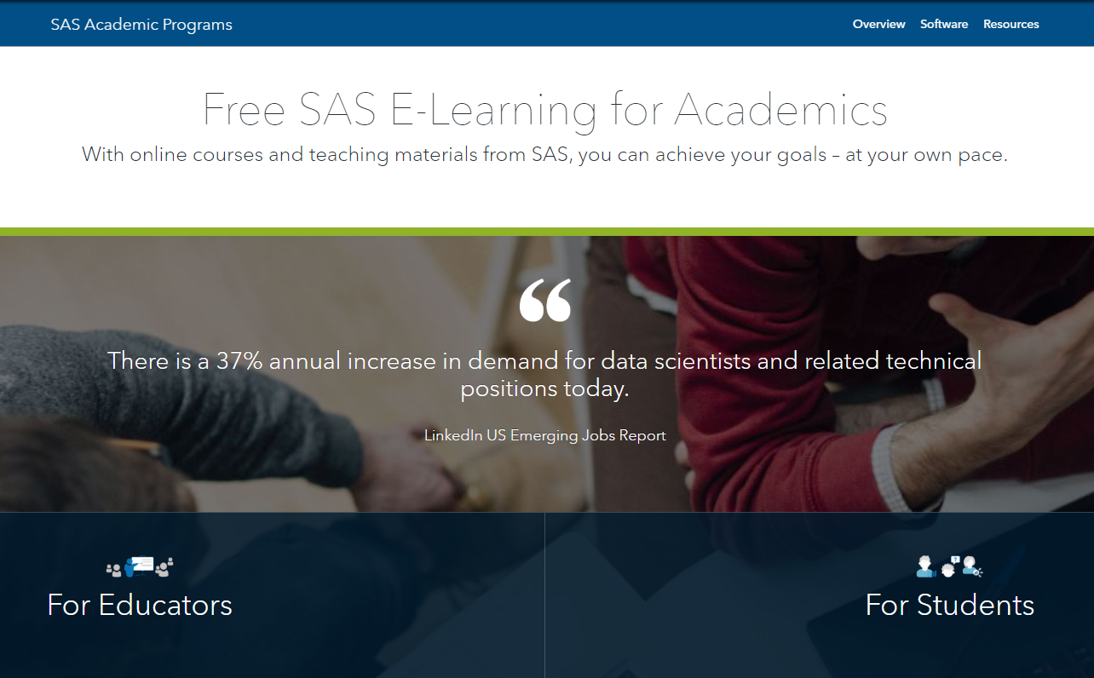
Free SAS Learning Resources for Academics
Check It Out Today!
You can now get access to free e-Learning and trainer’s kits online. Go to:
www.sas.com/academic-hub

Slide 8



Academic Access to SAS Teaching Kits
What’s Included
Course Notes
PowerPoints
Programs
&
Solutions
Data sets
Teaching Kit

Slide 9

Support for Educators and Learners
Academic Programs
Education Resources
SAS Software Promotion
SAS Specialization Programs
Academic Badging
Academic Workshops/SAS Days​
Teaching Materials​
e-Learning​
e-Textbooks​
Tutorials​
Curriculum Consulting​
Guest Speakers
SAS OnDemand for Academics
SAS Viya for Learners
SAS University Edition
Notes:
The major differences are that:
The Joint Certificate must include a minimum of 12 semester hours of course credit or the equivalent
For the Master’s Degree, program analytical courses must use SAS software, though other software may also be used.
Also, the program must offer capstone-type courses and provide students with opportunities to use real data

Slide 10
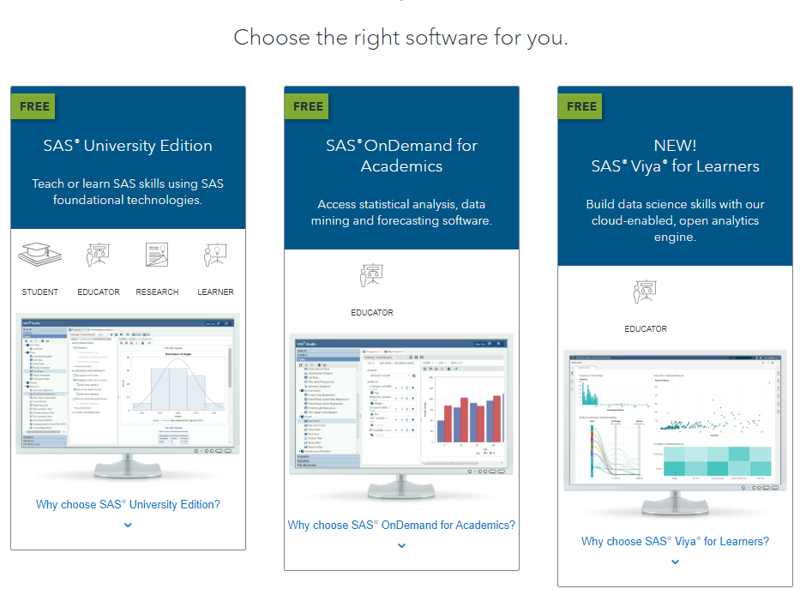
Free SAS Software for Academics
Notes:
SAS Software: First, we offer academics free access to software: SAS University Edition, SAS OnDeman for Academic, and SAS Viya for Learners.

Slide 11
Analytics Moves the World:
Start Small and Think Big

Slide 12
Analytics Moves the World:
Start Small and Think Big
Analytics Moves the World:
How to Win the Indianapolis 500
& Reduce Your Carbon Footprint

Slide 13
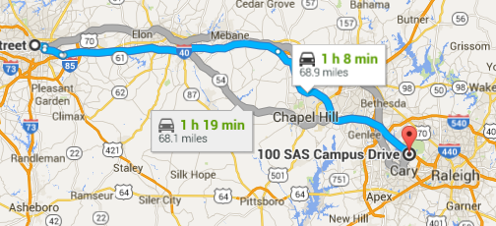

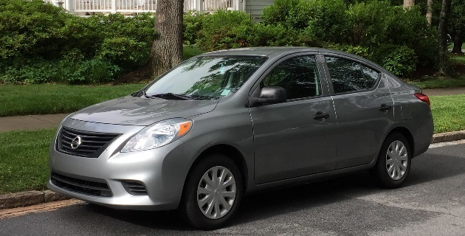
Analytics Moves the World: 2020
James Harroun's current commute and his stable of winning vehicles: 1997 Mercedes-Benz E320 and
2015 Nissan Versa

Slide 14



Which Side of the Fence Are YOU on?
VS.
and
Multiple technologies: multiple strengths
Current versions of SAS provide multiple integration points to popular open source software
Allows users to code in the language(s) of their choice
Notes:
Example of Big Analytics: It is not all about Big Data!
Even medium sized data can lead to intractable problems
Approach: Exploit problem structure; build custom solutions techniques
MO Example in Financial Services
20 million customers
240 communications
10 aggregate constraints: Overall budget, program offer counts
10 max contact policies: Max 2 offers overall, max 1 offer per program
...... Plus other constraints
Traditional MO: 01:46:08
Distributed MO: 00:03:05

Slide 15
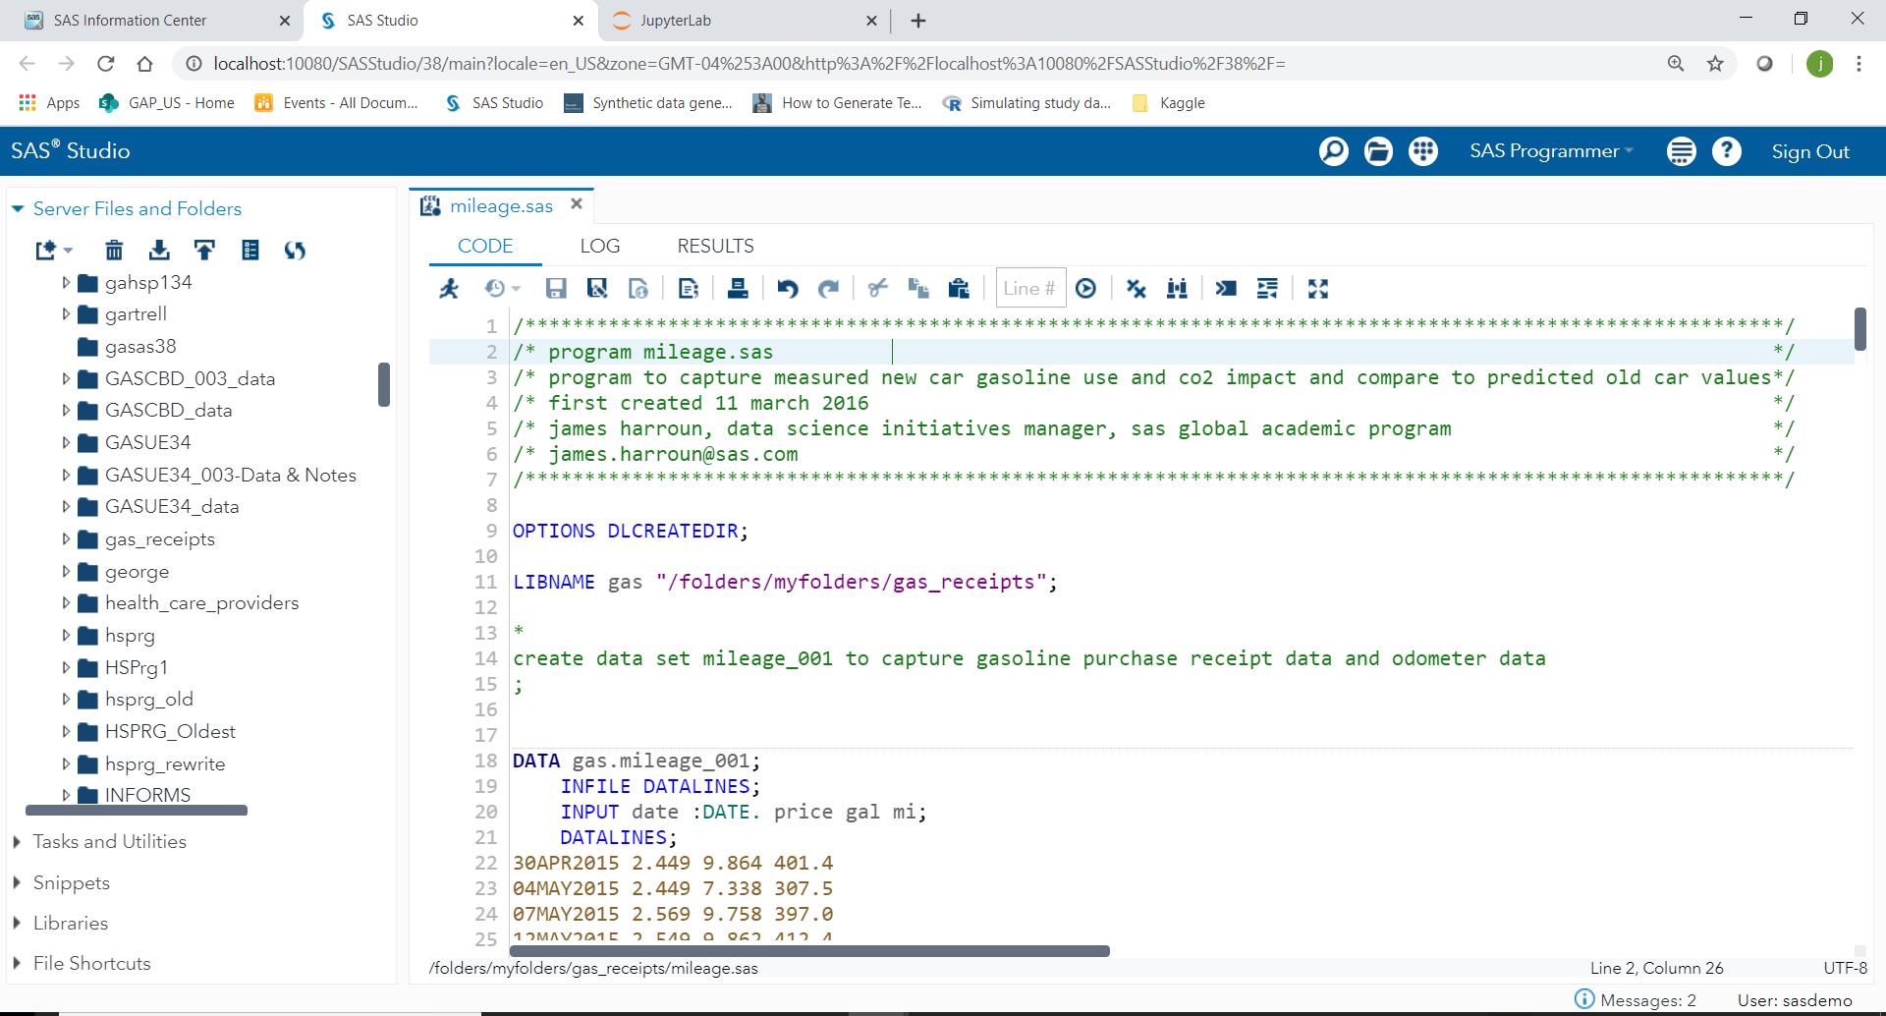
Demonstration of SAS Studio and Jupyter Lab
Notes:
Example of Big Analytics: It is not all about Big Data!
Even medium sized data can lead to intractable problems
Approach: Exploit problem structure; build custom solutions techniques
MO Example in Financial Services
20 million customers
240 communications
10 aggregate constraints: Overall budget, program offer counts
10 max contact policies: Max 2 offers overall, max 1 offer per program
...... Plus other constraints
Traditional MO: 01:46:08
Distributed MO: 00:03:05

Slide 16
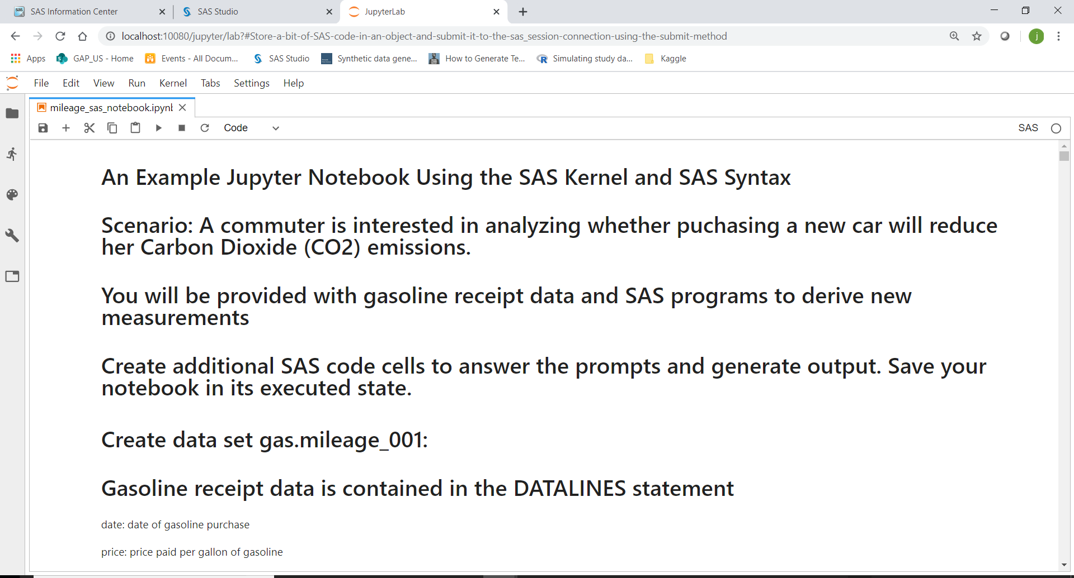
Demonstration of SAS Studio and Jupyter Lab
Notes:
Example of Big Analytics: It is not all about Big Data!
Even medium sized data can lead to intractable problems
Approach: Exploit problem structure; build custom solutions techniques
MO Example in Financial Services
20 million customers
240 communications
10 aggregate constraints: Overall budget, program offer counts
10 max contact policies: Max 2 offers overall, max 1 offer per program
...... Plus other constraints
Traditional MO: 01:46:08
Distributed MO: 00:03:05

Slide 17
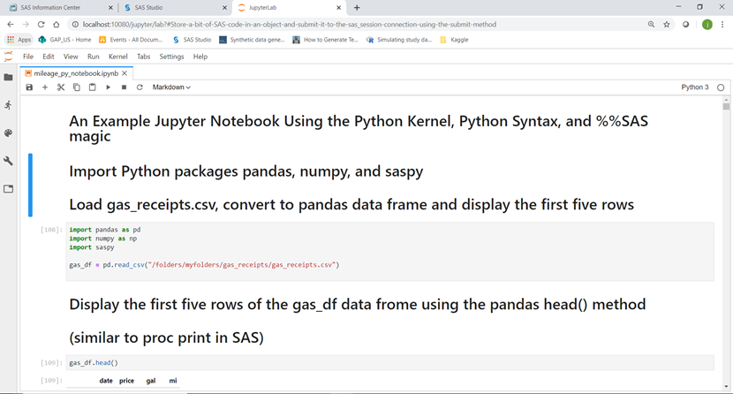
Demonstration of SAS Studio and Jupyter Lab
Notes:
Example of Big Analytics: It is not all about Big Data!
Even medium sized data can lead to intractable problems
Approach: Exploit problem structure; build custom solutions techniques
MO Example in Financial Services
20 million customers
240 communications
10 aggregate constraints: Overall budget, program offer counts
10 max contact policies: Max 2 offers overall, max 1 offer per program
...... Plus other constraints
Traditional MO: 01:46:08
Distributed MO: 00:03:05

Slide 18
Demonstration of SAS Studio and Jupyter Lab
Python Integration preconfigured in the following environments:
SAS University Edition
SAS Viya for Learners
sas_kernel and saspy packages can be configured for:
Local SAS installations
SAS OnDemand for Academics (coming soon)
For more information, Please visit the following:
https://sassoftware.github.io/saspy/
https://sassoftware.github.io/sas_kernel/
Notes:
Example of Big Analytics: It is not all about Big Data!
Even medium sized data can lead to intractable problems
Approach: Exploit problem structure; build custom solutions techniques
MO Example in Financial Services
20 million customers
240 communications
10 aggregate constraints: Overall budget, program offer counts
10 max contact policies: Max 2 offers overall, max 1 offer per program
...... Plus other constraints
Traditional MO: 01:46:08
Distributed MO: 00:03:05

Slide 19
Thanks for Attending!
Please take our quick survey!
http://tinyurl.com/PostSurveySAS
Event ID: 575821-01
Thank you!
James.Harroun@sas.com
sas.com/academic

