Slide 1
Engaging Everyone with Clickers
Kari Lock Morgan
Department of Statistics
Pennsylvania State University
eCOTS
May 19th, 2020

Slide 2
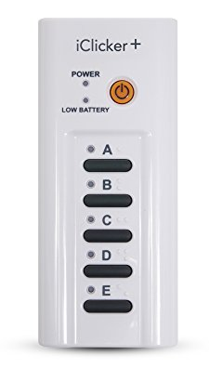
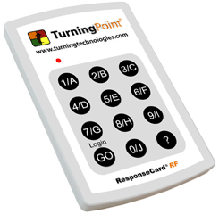
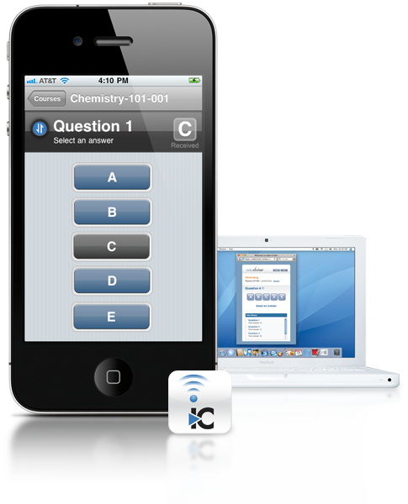
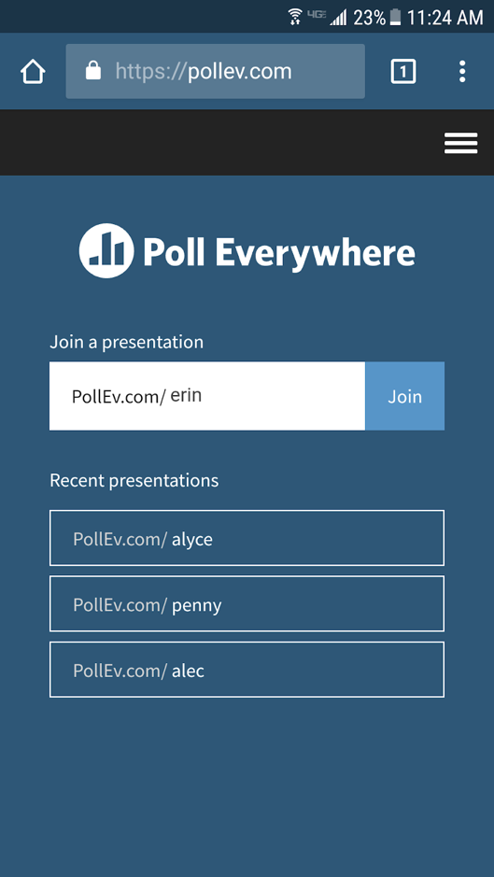
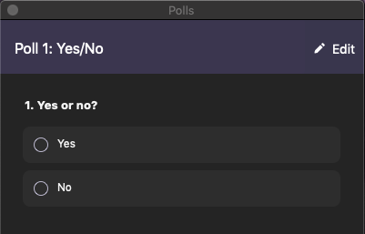
“Clickers”/PRS/CRS
Notes:
Multiple choice questions that students answer during class. (Approximate) frequency table of answers displayed.
POLL 1

Slide 3
Clickers can be used to…
Engage Everyone!!!

Slide 4
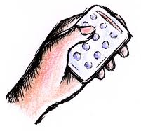
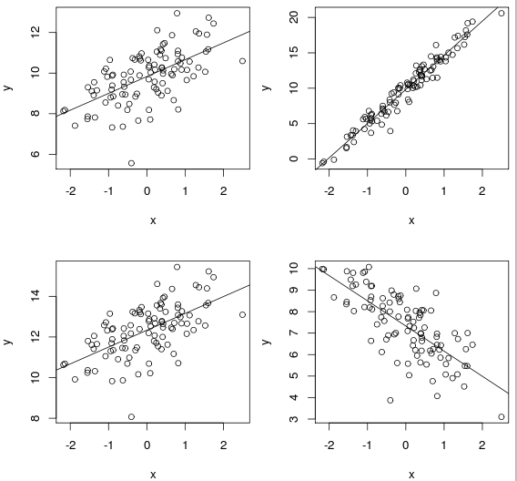
Regression Line
Which plot goes with the line
$\hat{y}=x+10$?
(a)
(b)
(c)
(d)

Slide 5
Bootstrap Sample
Your original sample has data values
18, 19, 19, 20, 21
Is the following a possible bootstrap sample?
18, 19, 20, 21, 22
Yes
No
22 is not a value from the original sample

Slide 6
Bootstrap Sample
Your original sample has data values
18, 19, 19, 20, 21
Is the following a possible bootstrap sample?
18, 19, 20, 21
Yes
No
Bootstrap samples must be the same size as the original sample

Slide 7
Bootstrap Sample
Your original sample has data values
18, 19, 19, 20, 21
Is the following a possible bootstrap sample?
18, 18, 19, 20, 21
Yes
No
Same size, could be gotten by sampling with replacement

Slide 8
Clickers can be used for…
Formative Assessment
Instant feedback for professors – are students getting it?
Instant feedback for students – am I where I should be?

Slide 9
Randomization Distribution
In a hypothesis test for H₀: μ = 12 vs H_{a}: μ < 12,
we have a sample with n = 45 and $\overline{x}=10.2$ .
What do we require about the method to produce randomization samples?
We need to generate randomization samples assuming the null hypothesis is true.
μ = 12
μ < 12
$\overline{x}=10.2$

Slide 10
Randomization Distribution
In a hypothesis test for H₀: μ = 12 vs H_{a}: μ < 12,
we have a sample with n = 45 and $\overline{x}=10.2$.
Where will the randomization distribution be centered?
Randomization distributions are always centered around the null hypothesized value.
10.2
12
45
1.8

Slide 11
Randomization Distribution
In a hypothesis test for H₀: μ = 12 vs H_{a}: μ < 12,
we have a sample with n = 45 and $\overline{x}=10.2$.
What will we primarily look for on the randomization distribution?
We want to see how extreme the observed statistic is.
How extreme 10.2 is
How extreme 12 is
How extreme 45 is
What the standard error is
How many randomization samples we collected

Slide 12
Clickers can be used to…
Promote Discussion
A class divided between answers presents a fantastic opportunity for peer discussion!!
Students click in – results show split
Let students discuss in small groups
make sure they find an opposite opinion
students figure it out!!
Students vote again – show correct answer
Ask someone who switched to explain
Notes:
Roxy’s “productive interaction”

Slide 13
Clickers can be used to…
Promote Discussion
Students very engaged in discussion!!
Students who initially got it wrong hear the reasoning of their peers, which in turn helps them figure out the correct answer
Students who initially got it correct get to explain their reasoning (learn best by teaching!) and convince their peers
Promotes active thinking and reasoning at a deeper level

Slide 14
Answers when asked the first time…
Notes:
Before Discussion…

Slide 15
Answers after discussion…
Notes:
After discussion…

Slide 16
Clickers can be used to…
Promote Attendance
(Although I’m not sure about forcing students to come to class?)
I have an “engagement” portion of the grade (only 5%) that students can satisfy either by
clicking in
engaging with the online adaptive practice that comes with our text
My students get credit just for clicking in… what about yours?

Slide 17
Clickers can be used to…
Review
Review previous class
Review content from earlier in the course

Slide 18
Mini Review Quiz
We will be analyzing our class survey data in lab tomorrow. Will this data allow us to draw any conclusions about causality?
(a) Yes
(b) No
(c) It depends on the data
The class survey data is observational.

Slide 19
Causal?
[After describing new dataset/example]
Does this study allow for causal conclusions?
Yes
No

Slide 20
Visualization
How could we visualize these data?
Bar chart
Segmented or side-by-side bar charts
Histogram
Side-by-side boxplots
Scatterplot

Slide 21
Statistic/Parameter
What would be an appropriate summary statistic and parameter of interest?
Mean
Proportion
Difference in means
Difference in proportions
Correlation

Slide 22
Clickers can be used to…
Summarize a Class

Slide 23
Takeaway #1
The uncertainty surrounding a sample statistic depends primarily on…
The value of the sample statistic
How much statistics vary from sample to sample
Where the sampling distribution is centered
The shape of the sampling distribution

Slide 24
Takeaway #2
The standard error measures
The average value of the statistic (mean)
The spread of the statistic (standard deviation)
The highest value of the statistic (max)

Slide 25
Takeaway #3
The higher the standard error, the
Wider the interval
Narrower the interval

Slide 26
Takeaway #4
A larger sample size gives
Smaller standard error
Larger standard error

Slide 27
Clickers can be used to…
Illustrate Concepts

Slide 28
Split into two groups.
ODD birthdays: keep your eyes open.
EVEN birthdays: close your eyes.
Notes:
16 to here

Slide 29
ODD Birthdays
Write down the name of your favorite athlete.
Close your eyes.

Slide 30
EVEN Birthdays
Write down the name of your favorite singer.

Slide 31
EVERYONE
Write down a famous person named “Michael”.
Who did you choose?
A singer
An athlete
Other
ODD BIRTHDAYS:
EVEN BIRTHDAYS:

Slide 32
Clickers can be used to…
Collect Data!

Slide 33
Tongue Rolling
Can you roll your tongue?
Yes
No

Slide 34
Clickers can be used to…
Gather Simulation Results
Each student contributes a data point
Each student contributes a statistic

Slide 35
One Randomization Sample
Have students do a real activity with a categorical outcome
Play rock-paper-scissors with each other
Try to use ESP with each other
Have them repeat the activity under the null of “just random”/equal probabilities:
Write out options on slips of paper
Crumple and mix them up
Draw one randomly (“random” RPS!)
Class makes one randomization sample
Turn to technology to repeat

Slide 36
Class p-value
[Each student generates their own randomization sample (e.g. flipping coins / shuffling cards / etc.)]
Did your simulated statistic exceed the observed statistic?
Yes
No

Slide 37
Clickers can be used to…
Gather Opinions

Slide 38
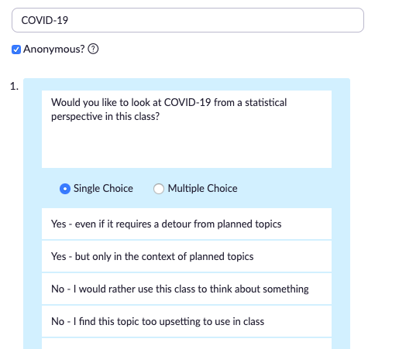
50%
50%

Slide 39
Clickers can be used to…
Arouse curiosity
Ask students to answer a question before being formally taught how to answer it
about stats
about the subject matter example

Slide 40
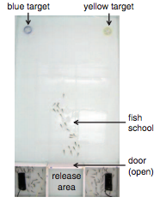
The Golden Shiner Experiment
Golden shiners: fish with a strong tendency to swim as a pack
Trained to swim to a particular color (yellow or blue) with treats
Golden shiners prefer yellow, so yellow-trained had stronger opinions/preferences

Slide 41
The Golden Shiner Experiment
Release strong-opinioned minority (yellow-trained) with weak-opinioned majority (blue-trained)
Which color do they swim to?
Strong-opinioned minority wins 83% of the time.
What’s the effect of adding in 10 indifferent fish?

Slide 42
Indifferent Fish
Do you think the addition of the indifferent fish will benefit the strong-opinioned minority, or the weak-opinioned majority?
The strong-opinioned minority
The weak-opinioned majority
Answer: The weak-opinioned majority.
The weak-opinioned majority won ${\hat{p}}_{1}=0.61$ of the trials with the indifferent fish, and only ${\hat{p}}_{2}=$0.17 without them.

Slide 43
A 40-year old woman participates in routine screening and has a positive mammography. What’s the probability she has cancer?
0-10%
10-25%
25-50%
50-75%
75-100%
I have no idea.
7.8%
9

Slide 44
Clickers can be used to…
Challenge Students!
Correct answer not immediately obvious
Great for discussion questions if enough students get them right
Perhaps leave as an open question for next class, prompting thought outside of class

Slide 45
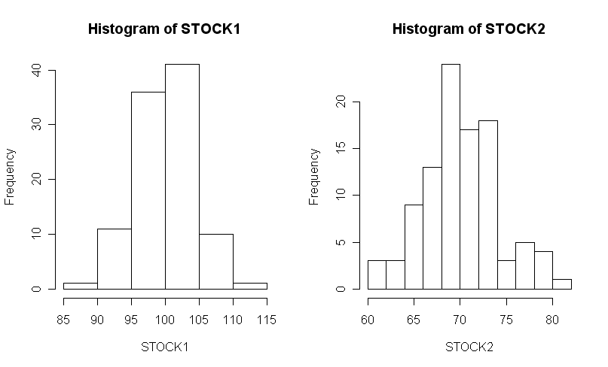
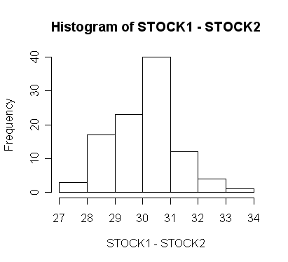
How are these two stocks related?
Positively Correlated
Negatively Correlated
Not Correlated
Not Enough Information
I have no idea
0

Slide 46
Clickers can be used to…
Quiz Students

Slide 47
p-value
n = 100
$\hat{p}$ = 56/100
When testing
$$H_{0}:p=0.5 vs H_{a}:p>0.5$$
the p-value is closest to…
0.03
0.13
0.23
0.33
0.43

Slide 48
Clickers can be used to…
Time Activities
If students are working on something on their own or in groups…
… ask them to click in (with any answer) when they are done
Or give possible answers with “I didn’t finish” and “I didn’t get any of these” options

Slide 49
Clickers can be used to…
Ask Impromptu Questions
Write options on the board
Allows for spontaneity

Slide 50
Why use clickers?
Clickers work with…
Small and large classes
Shy and outgoing students
Bright and struggling students
Engaging and not-so-engaging professors
Engaged and not-so-engaged students
Intro classes and upper level classes
Any topic

Slide 51
Why use clickers?
Formative assessment
Promote discussion
Promote attendance
Review
Summary
Illustrate concepts
Collect data
Gather simulation results
Gather opinions
Arouse curiosity
Challenge students
Quiz students
Time activities
Ask imprompu questions
ENGAGE EVERYONE!!!
How do YOU use clickers?

Slide 52
klm47@psu.edu

