Slide 1
The Evolution of Regression Modeling
Cheryl Pammer
Statistician, Technical Trainer/User Experience Designer
Minitab Inc.
May 24, 2018

Slide 2
Learning Objectives
What Is Machine Learning?
Basic Machine Learning Algorithms
Moving From Regression to Regression Trees
Why Teach Regression Trees

Slide 3

Introduction to Machine Learning
A machine learning algorithm “teaches” a computer to recognize patterns using available data.
Data is usually split into a training set and a test set:
Training (or learn) = creates model
Test = assesses model performance

Slide 4
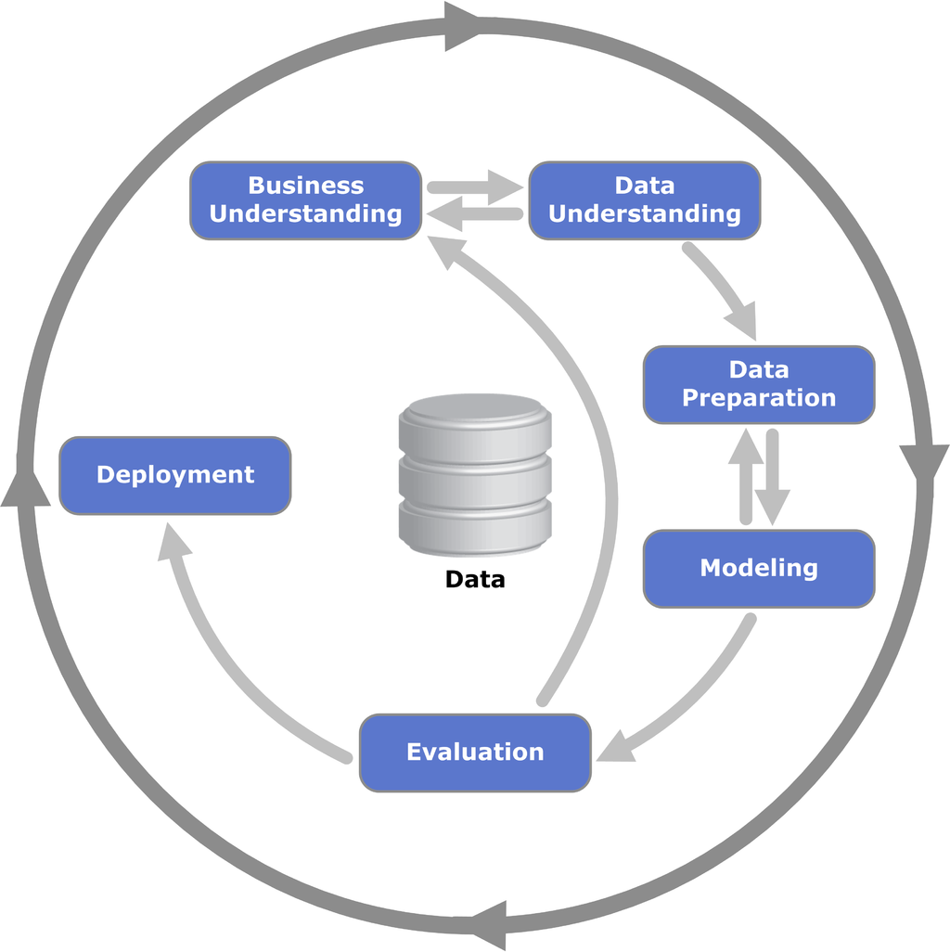
CRISP-DM
Cross-industry standard process for data mining

Slide 5
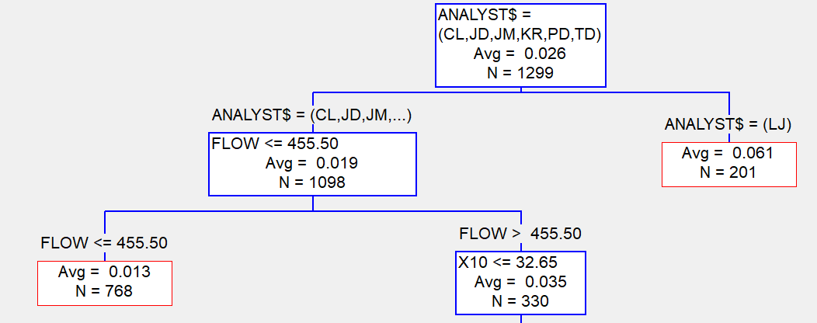
Basic Machine Learning Algorithms
Type | Tools
Supervised (Y and X’s) | Regression, Logistic Regression CART, Random Forests
Unsupervised (Only X’s) | K-Means Clustering, Hierarchical Clustering Principal Components Analysis

Slide 6
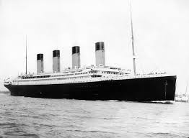
Who Survived the Titanic?
Target Variable: Survival (0 = No, 1 = Yes)
Predictor Variables:
Pclass (1st, 2nd, or 3rd class)
Sex
Age
Sibsp (# of siblings/spouses aboard)
Parch (# of parents/children aboard)
Fare
Embarked (C=Cherbourg, Q=Queenstown, S=Southhampton)

Slide 7
Binary Logistic Regression
Model the relationship between predictors and a response with two outcomes (Survived/Died).
Model (logit link function)
      Log_{e}[p/(1-p)] = β₀ + β₁x₁ + … + β_{k}x_{k}

Slide 8
Regression Challenges
Regression and logistic regression often don’t work well, particularly with larger observational data sets:
Everything is significant.
Determination of predictors to include in model is challenging.
Relationships are nonlinear.
Complex interactions exist.
Extreme outliers exist.
Many missing values.

Slide 9
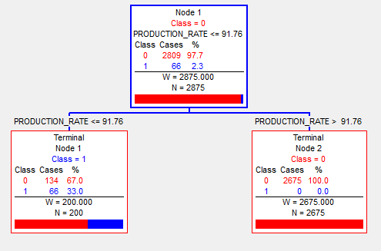
Classification and Regression Tree (CART)
Decision trees quickly find the X’s that best partition the data into distinct groups relative to Y.
Y can be continuous or categorical.

Slide 10
Classification and Regression Trees
Nonparametric machine learning for classification and regression.
Stepwise procedure in which predictors enter the model one at a time.
Procedure works by carving a high-dimensional data space into small to moderate set of regions.
A prediction is produced for each region.
Early data mining tool, developed between 1974-1983.
Leo Breiman, Jerome Friedman, Richard Olshen, Charles Stone. (1984) Classification and Regression Trees.

Slide 11
Regression Trees in Basic Stat Classes
Classes in machine learning algorithms typically start with regression and build from there.
Traditional statistics classes can easily extend from regression/logistic regression into regression trees.
As data sets grow larger, regression trees can be an important part of a data analyst’s tool kit.
Many professionals entering the workforce will encounter data scientists. They will benefit by having some knowledge around machine learning algorithms and terminology.

Slide 12
Thank you!
Feel free to contact me:
Cheryl Pammer
cpammer@Minitab.com
To try Salford Predictive Modeler or Minitab, contact
Christine Bayly, Academic Sales Manager:
Cbayly@minitab.com
800-448-3555 x 3304

