Slide 1
Visualizations Designed to Engage Student Learning
eCOTS 2016 - Virtual Poster Session
Shonda Kuiper, Krit Petrachaianan,
Ying Long and Zachary Segall
Grinnell College

Slide 2
Challenges in adapting to a data rich society
Making decisions with data is becoming an essential skill in almost any area of study

Slide 3
Challenges in adapting to a data rich society
Making decisions with data is becoming an essential skill in almost any area of study
Teach students how to think with data by having them work with real-world, messy datasets and train them to better communicate nuanced statistical ideas
Move beyond statistical analysis on only carefully vetted and cleaned textbook datasets
Emphasize how to address bias, confounding and common misunderstandings
Determine whether a dataset is appropriate to use
Start by finding patterns that matter (tell a story with your data), not the mathematical calculations

Slide 4
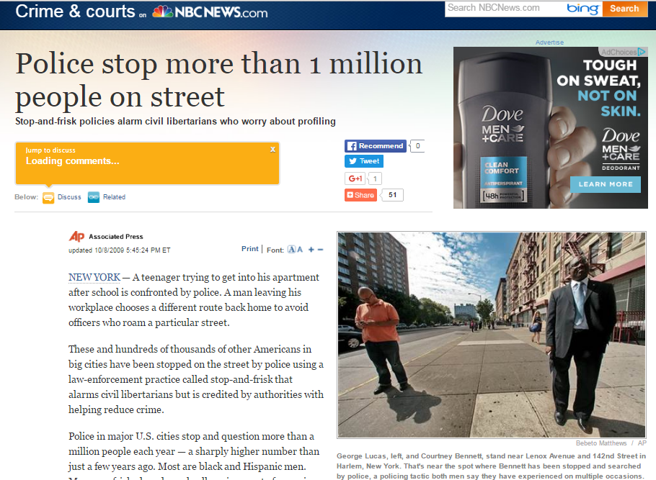
Exploring Racial Disparities in New York City's Stop-and-Frisk Policies
New York City’s Stop-and-Frisk policies gave police officers the right to stop, search, or arrest any suspicious person with reasonable grounds for action.
“Civil liberties groups say the practice is racist and fails to deter crime.”
“The NYPD has defended the…policy on the ground that most stops are conducted in high-crime neighborhoods with high concentrations of people of color.”
FREE online visualizations: rstudio.grinnell.edu
People stop more than 1 million people on the street. http://www.nbcnews.com/id/33230464/#.VyttSIQrLIU
NEW YORK CITY BAR ASSOCIATION REPORT ON THE NYPD‘S STOP-AND-FRISK POLICY (page 10) http://www2.nycbar.org/pdf/report/uploads/20072495-StopFriskReport.pdf

Slide 5
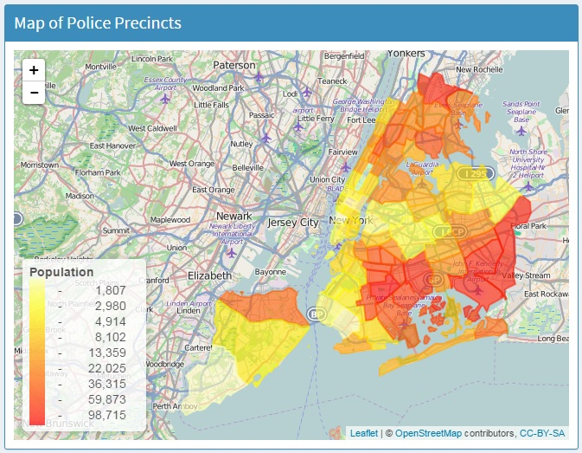
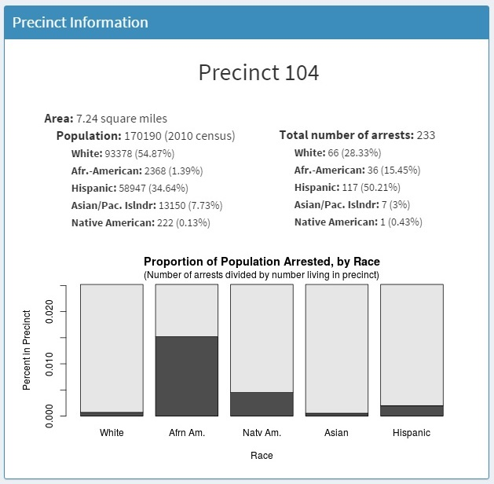
NYPD Stop-and-Frisk Policies

Slide 6
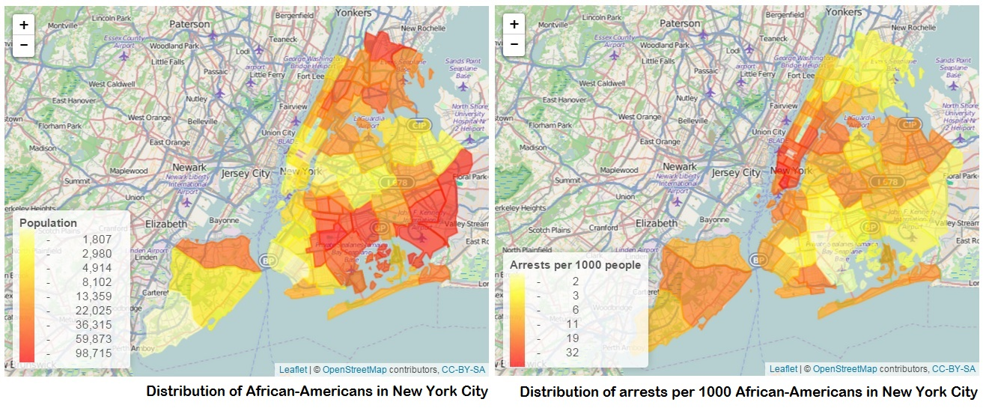
NYPD Stop-and-Frisk Policies

Slide 7
Resources
It is now possible to create more accessible materials due to the very recent advancements in accessible and free online materials, such as
RStudio, https://www.rstudio.com/: a web-based statistical software program,
SQLite, https://www.sqlite.org/: a database management system
R Markdown, http://rmarkdown.rstudio.com/: a format that combines the core syntax for journals or web content with embedded R code, and
Shiny, http://shiny.rstudio.com/: an interactive visualization tools within RStudio

Slide 8
Other Mapping Resources
Google Maps: https://mapping.withgoogle.com/
Google Fusion Tables: https://goo.gl/m9nyKj
CartoDB: http://academy.cartodb.com/
General Map Making: https://goo.gl/fJ5VWV

Slide 9
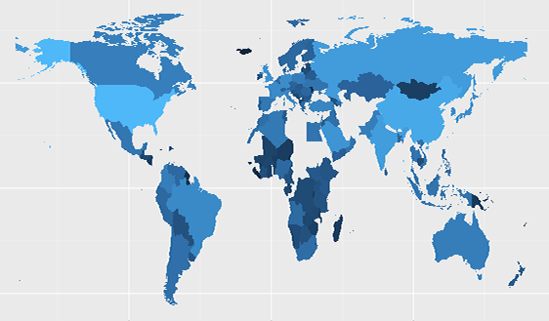
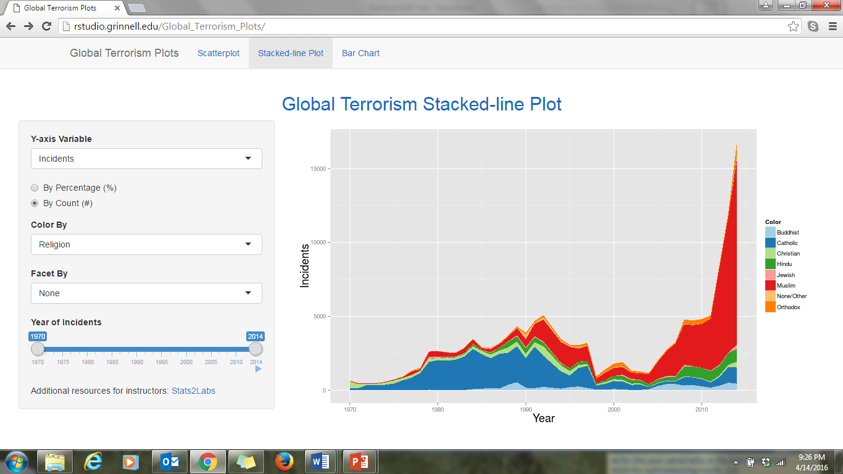
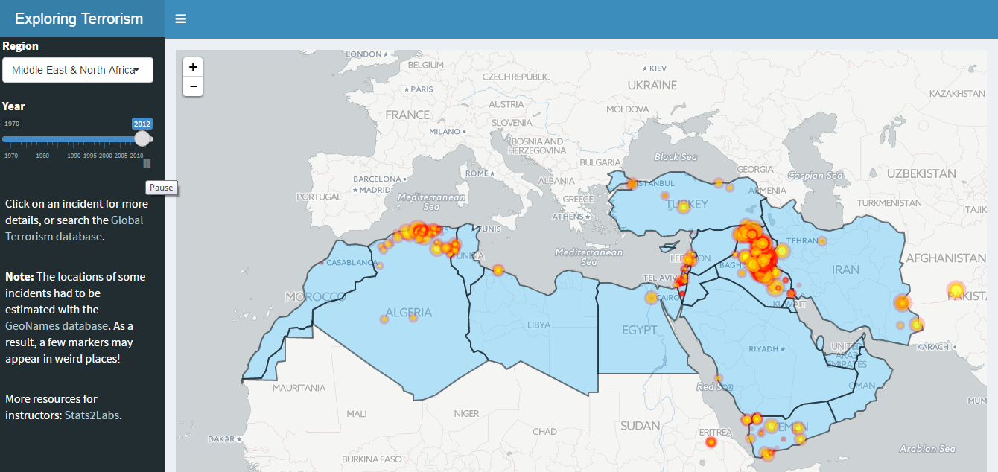
Visualizations Designed to Engage Student Learning
http://web.grinnell.edu/individuals/kuipers/stat2labs/visualization.html

