Slide 1

Beyond the SRS
A Weighted Survey Data Example
Pamela Fellers
Assistant Professor
Grinnell College
Ruby Barnard-Mayers
& Karin Yndestad
Grinnell College
Shonda Kuiper
Professor
Grinnell College

Slide 2
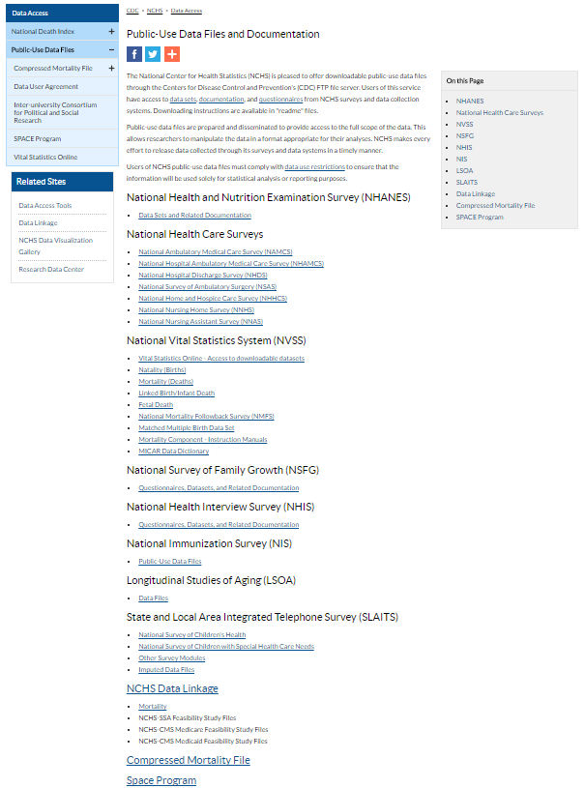
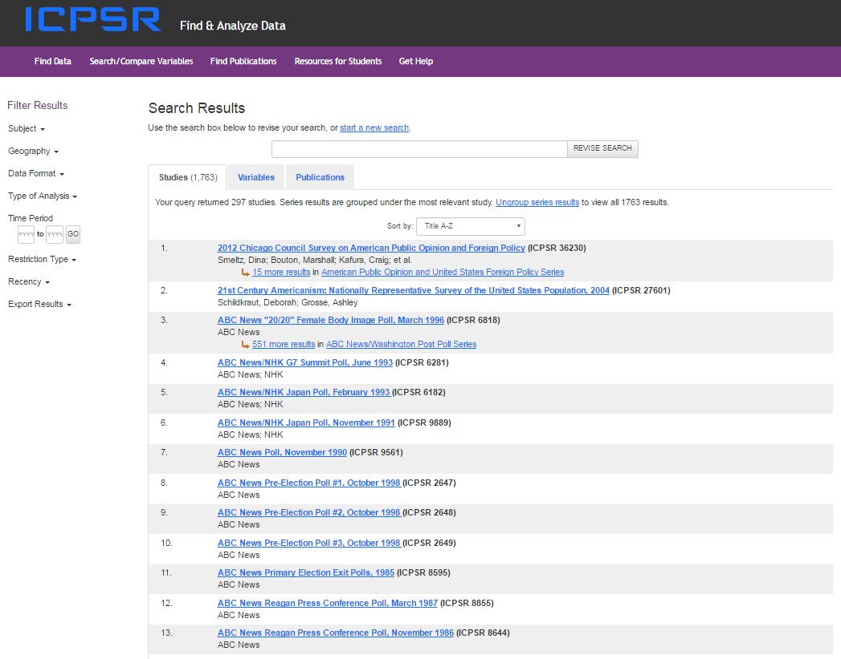

Surveys are a rich (and available) data source

Slide 3
…however they are rarely from a SRS
Most involve complex survey methods including stratification, clustering, probability sampling, and over-sampling
Most include a weight variable for each response
  Take into account how representative the individual is of the total population
  Adjustments for survey design, non-response, undercoverage, etc.
May also include stratification or clustering identifiers

Slide 4
What is the issue…
If students use traditional methods taught in general statistics courses (which assume SRS) results may not be accurate
Incorporating the weights appropriately is necessary
  For estimating (counts and proportions)
  For hypothesis testing
Students may come across weighted survey data after leaving our class…what do we want them to be aware of

Slide 5
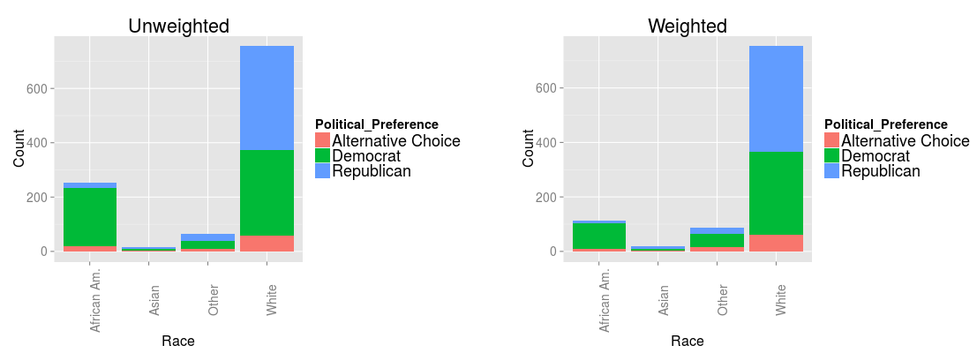
From a 2010 CBS/NYT Survey
  Interested in political party preference by race
The survey oversampled African Americans at nearly twice the rate of the actual population proportion of African Americans in the U.S.
The Weights for this survey take into account Race, Sex, and Gender among other adjustments for sampling methodology
Unweighted Count of Democrat Political Preference
African American (252) | White (756)
212 | 317
Weighted Count of Democrat Political Preference
African American (114.421) | White (753.77)
93.875 | 304.387

Slide 6
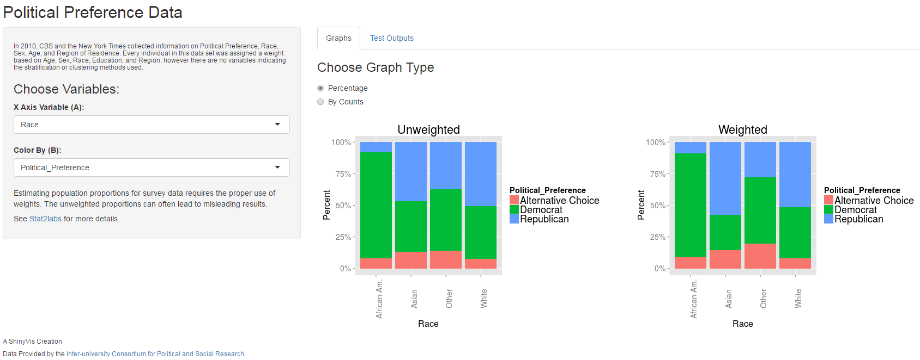
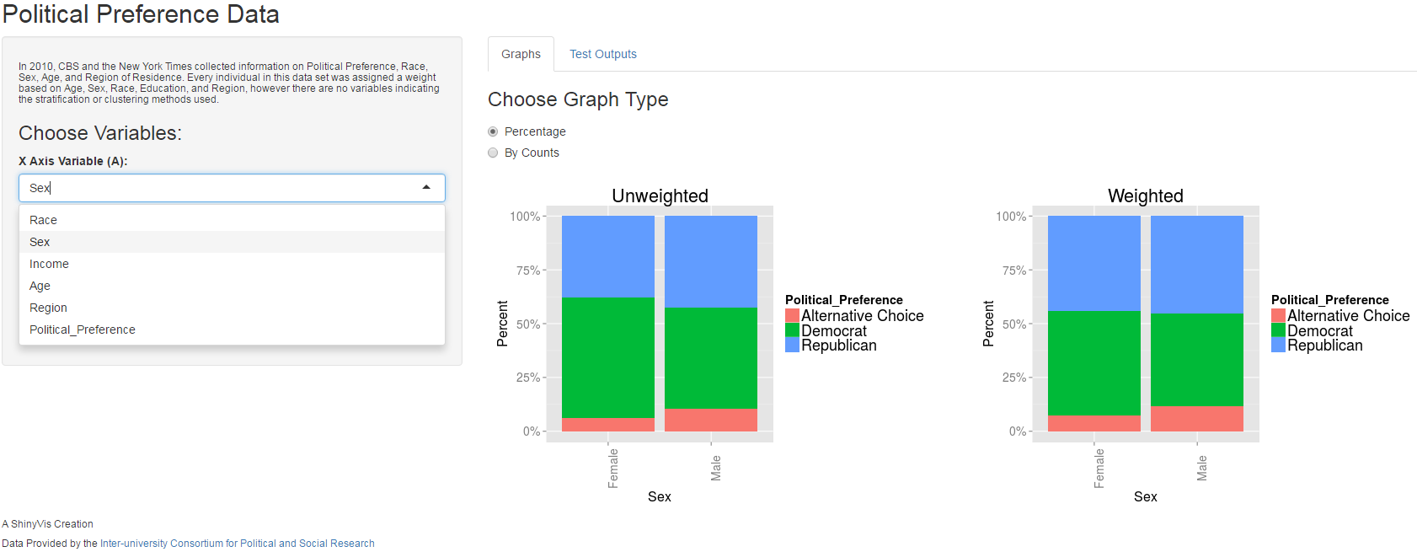

Slide 7
Examples and Materials
Variations for different levels and objectives
  Basic understanding of stratified sampling and weights
    College Survey – should it pass
  Estimating with weights
    Political Preference
    Complementary and Alternative Medicine (CAM)
    National Health and Nutrition Examination Survey (NHANES)
  Hypothesis testing with categorical weighted data
    Political, CAM, and NHANES Examples

Slide 8
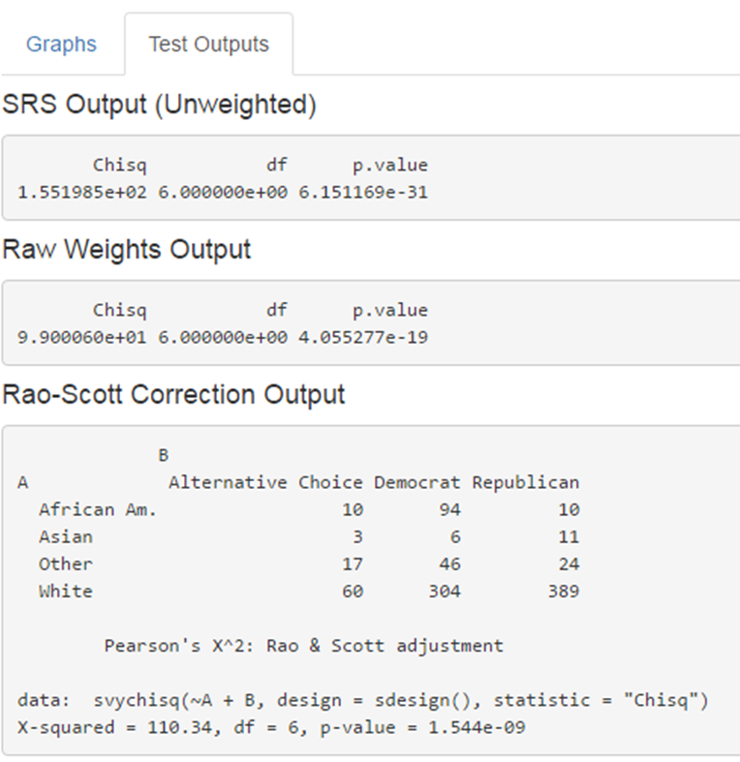
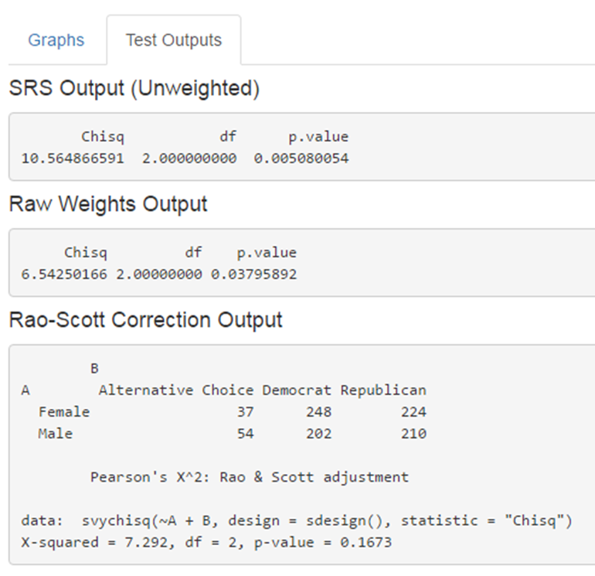
Hypothesis Test for Categorical Variables
Race and Political Preference
Sex and Political Preference

Slide 9
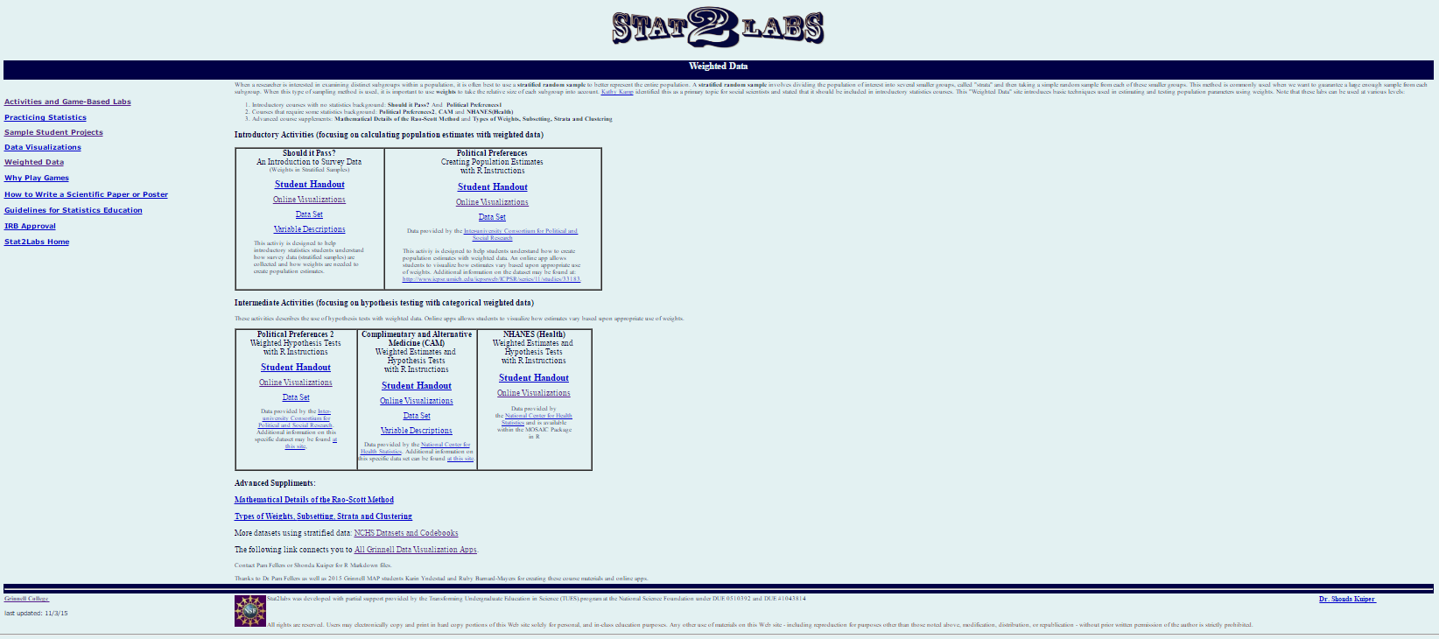
For more information and to view materials (student handout, visualization, data sets)
http://web.grinnell.edu/individuals/kuipers/stat2labs/weights.html
Thank You!
Pamela Fellers fellerspam@grinnell.edu

