Slide 1


Making Changes with Technology in Mathematical Statistics
Jennifer L. Green, Montana State University
Jennifer BroaTch, Arizona State University-West

Slide 2
Software Use
Can promote student exploration and understanding of concepts (Buttrey et al., 2001; Green & Blankenship, 2015; Horton et al., 2004; Nolan & Temple Lang, 2003)
Offers flexibility and creativity
  Homework
  In-class problems, activities, and examples
  Projects
Extends across multiple probability theory and mathematical statistics topics (http://www.amstat.org/education/pdfs/GuidelineTopics.docx)
  Probability and probability models
  Simulation and bootstrap methods
  Distributions of random variables
  Likelihood theory
  Statistical inference

Slide 3
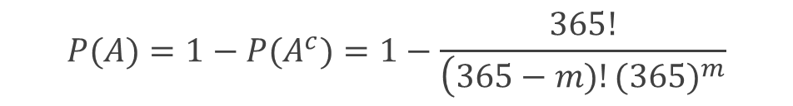

Example: Probability and Counting
If $m$ students show up at random in a classroom, what is the probability that at least two will have the same birthday? (Assumptions: There are 365 days in every year (ignore leap years) and every day of the year is equally likely to be a birthday.)
$$P(A)=1−P(A^{c})=1−\frac{365!}{\left(365−m)!{(365)}^{m}\right.}$$

Slide 4
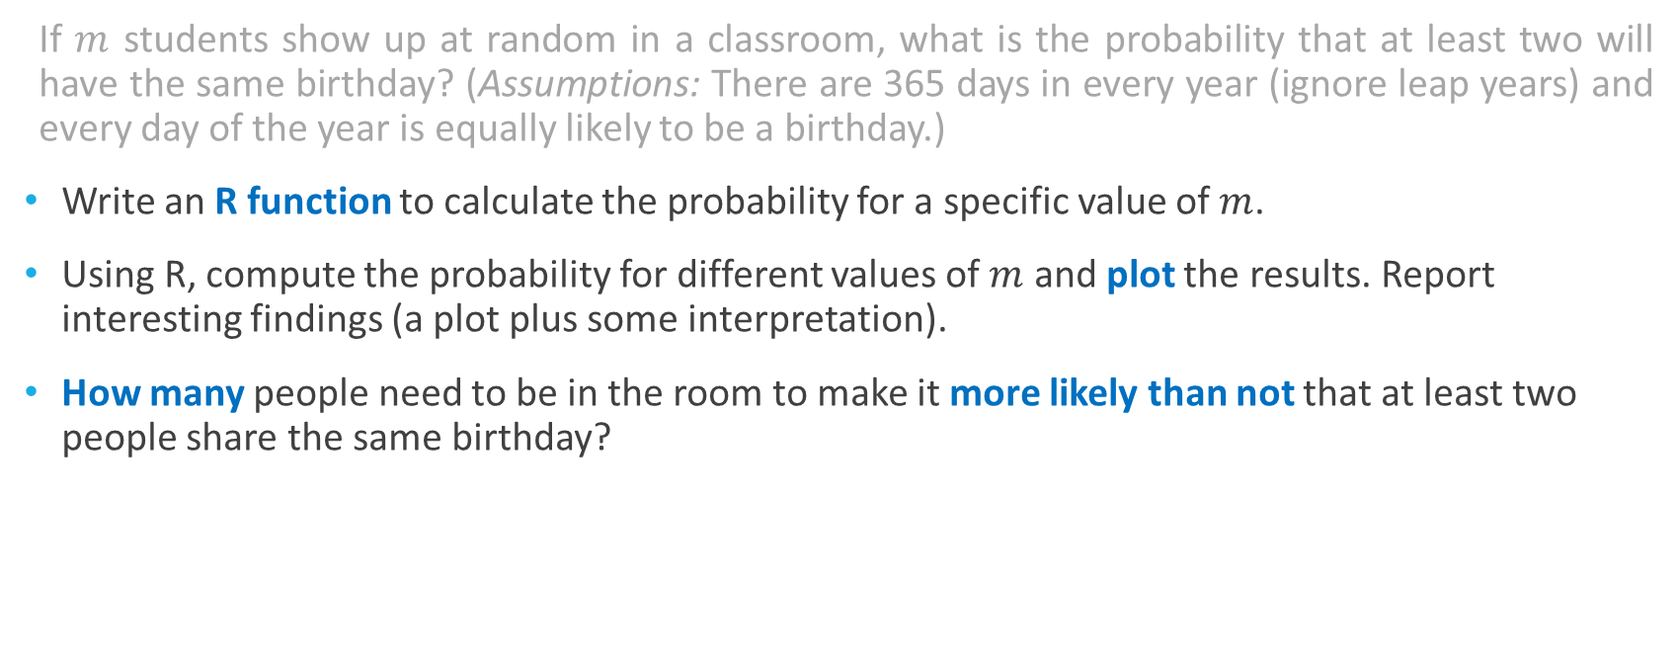
Example: Probability and Counting
If $m$ students show up at random in a classroom, what is the probability that at least two will have the same birthday? (Assumptions: There are 365 days in every year (ignore leap years) and every day of the year is equally likely to be a birthday.)
Write an R function to calculate the probability for a specific value of $m$.
Using R, compute the probability for different values of $m$ and plot the results. Report interesting findings (a plot plus some interpretation).
How many people need to be in the room to make it more likely than not that at least two people share the same birthday?

Slide 5
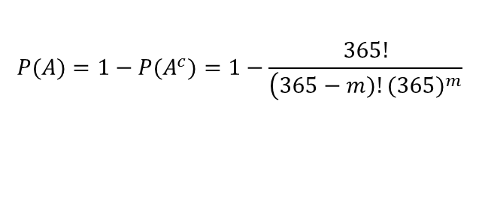
Example: Probability and Counting
.
$$P(A)=1−P(A^{c})=1−\frac{365!}{\left(365−m)!{(365)}^{m}\right.}$$

Slide 6


Example: Counting / Hypergeometric
Researchers want to estimate the number of whitefish, $N$, in a small lake. On day one, the researchers catch 50 whitefish, tag them, and return them to the lake. One week later, they catch another 50 fish and find that three of the fish were tagged.
Find an expression for the probability that this could happen if there are $N$ whitefish in the lake. Comment on any assumptions you are making.
$$P\left(X=3\right)=\frac{\left(\begin{matrix}50 \\ 3\end{matrix}\right)\left(\begin{matrix}N−50 \\ 47\end{matrix}\right)}{\left(\begin{matrix}N \\ 50\end{matrix}\right)}$$

Slide 7
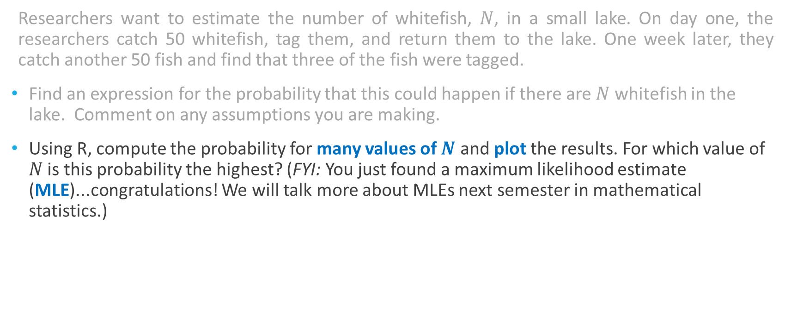
Example: Counting / Hypergeometric
Researchers want to estimate the number of whitefish, $N$, in a small lake. On day one, the researchers catch 50 whitefish, tag them, and return them to the lake. One week later, they catch another 50 fish and find that three of the fish were tagged.
Find an expression for the probability that this could happen if there are $N$ whitefish in the lake. Comment on any assumptions you are making.
Using R, compute the probability for many values of $N$ and plot the results. For which value of $N$ is this probability the highest? (FYI: You just found a maximum likelihood estimate (MLE)...congratulations! We will talk more about MLEs next semester in mathematical statistics.)

Slide 8

Example: Counting / Hypergeometric
$$P\left(X=3\right)=\frac{\left(\begin{matrix}50 \\ 3\end{matrix}\right)\left(\begin{matrix}N−50 \\ 47\end{matrix}\right)}{\left(\begin{matrix}N \\ 50\end{matrix}\right)}$$

Slide 9
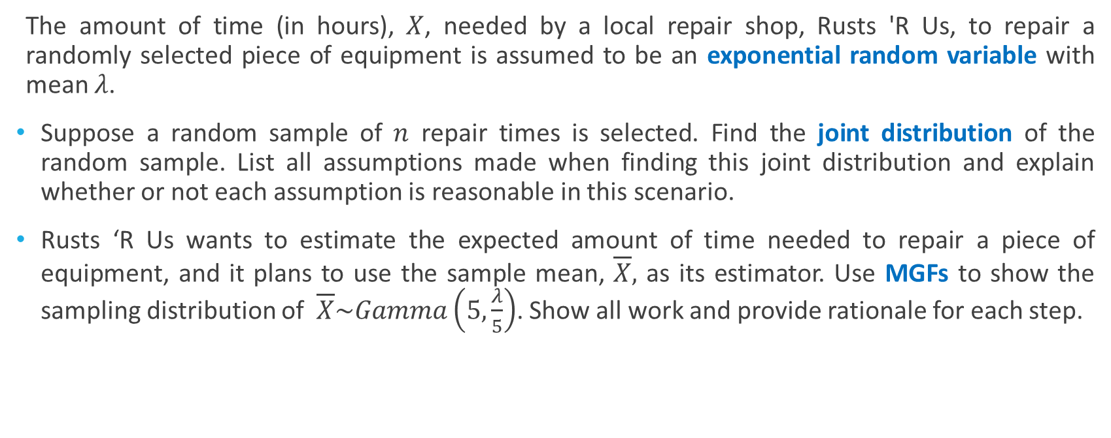
Example: Sampling Distributions
The amount of time (in hours), $X$, needed by a local repair shop, Rusts 'R Us, to repair a randomly selected piece of equipment is assumed to be an exponential random variable with mean $λ$.
Suppose a random sample of $n$ repair times is selected. Find the joint distribution of the random sample. List all assumptions made when finding this joint distribution and explain whether or not each assumption is reasonable in this scenario.
Rusts ‘R Us wants to estimate the expected amount of time needed to repair a piece of equipment, and it plans to use the sample mean, $\overline{X},$ as its estimator. Use MGFs to show the sampling distribution of $\overline{X}\sim Gamma\left(5,\frac{λ}{5}\right)$. Show all work and provide rationale for each step.

Slide 10
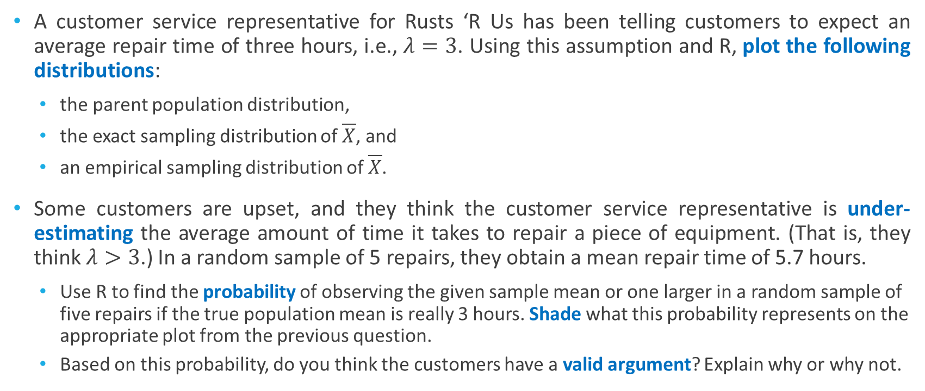
Example: Sampling Distributions
A customer service representative for Rusts ‘R Us has been telling customers to expect an average repair time of three hours, i.e., $λ=3$. Using this assumption and R, plot the following distributions:
  the parent population distribution,
  the exact sampling distribution of $\overline{X}$, and
  an empirical sampling distribution of $\overline{X}$.
Some customers are upset, and they think the customer service representative is under-estimating the average amount of time it takes to repair a piece of equipment. (That is, they think $λ>3$.) In a random sample of 5 repairs, they obtain a mean repair time of 5.7 hours.
  Use R to find the probability of observing the given sample mean or one larger in a random sample of five repairs if the true population mean is really 3 hours. Shade what this probability represents on the appropriate plot from the previous question.
  Based on this probability, do you think the customers have a valid argument? Explain why or why not.

Slide 11
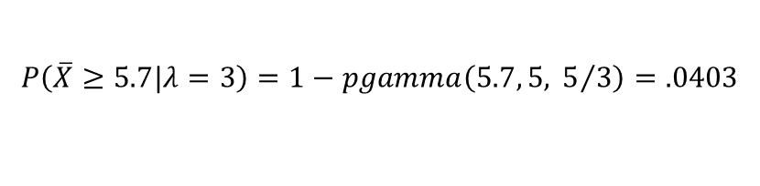
Example: Sampling Distributions
$$P\left(\overline{X}≥5.7|λ=3\right)=1−pgamma\left(5.7, 5, { 5}/3\right)=.0403$$

Slide 12

Example: Sampling Distributions
The customer service representative for Rusts ‘R Us still thinks the true average repair time is three hours. He claims that in this case the sample median is a better estimator than the sample mean.
  Use R to estimate the sampling distribution of the sample median of samples of size $n=5$.
  Based on this distribution, what is the estimated probability of observing the given sample median of 4 hours or one larger if the true population mean is really 3 hours?
  Based on this probability, do you think the customers have a valid argument? Explain why or why not.

Slide 13

Example: Sampling Distributions
$$\hat{P}\left(Median\left(X_{1},...,X_{5}\right)≥4|λ=3\right)=.135$$

Slide 14
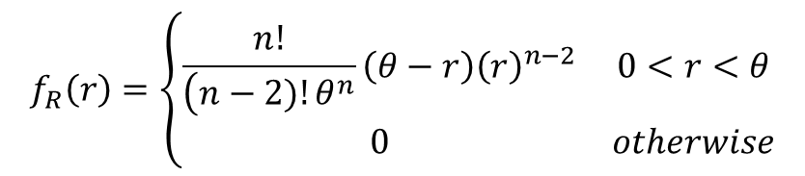


Example: Order Statistics
For a random sample of $Uniform(0,θ)$ random variables, the pdf of $R=X_{(n)}−X_{(1)}$ is:
Find the expected value of the sample range, $R$. What happens to $E(R)$ as $n$ increases?
$$f_{R}\left(r\right)=\left\{\begin{matrix}\frac{n!}{\left(n−2)!θ^{n}\right.}\left(θ−r\right){\left(r\right)}^{n−2} & 0<r<θ \\ 0 & otherwise\end{matrix}\right.$$
$$E(R)=θ\left(\frac{n−1}{n+1}\right)$$

Slide 15
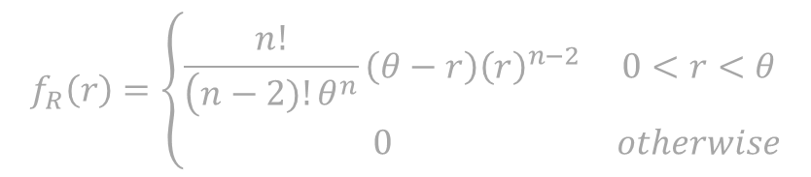
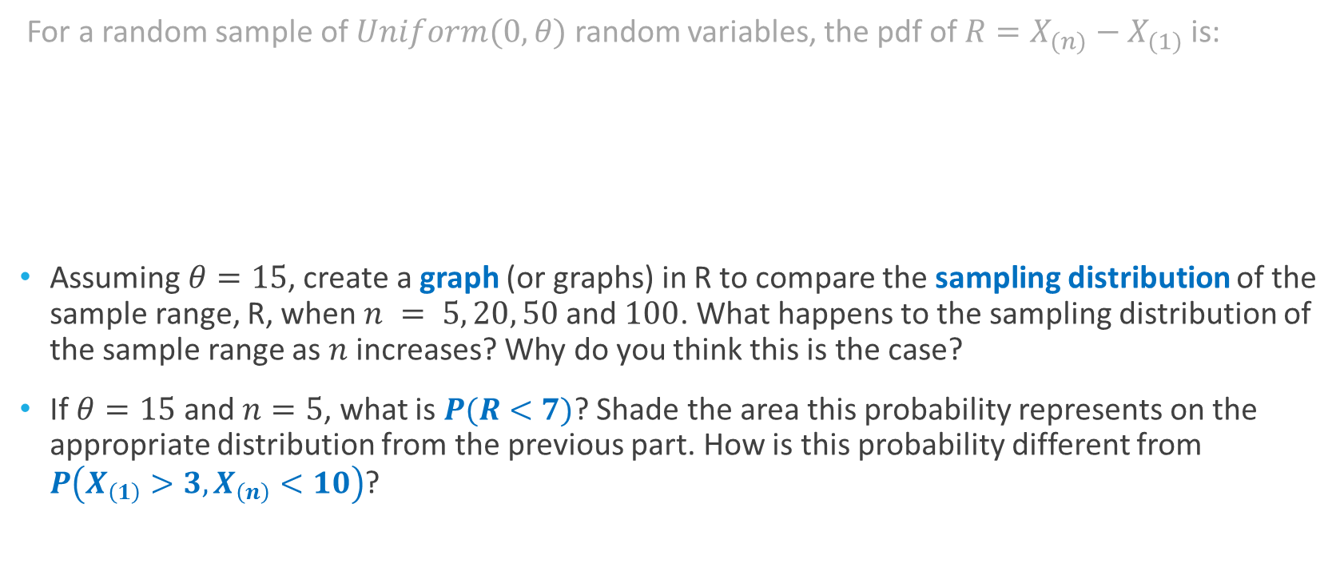
Example: Order Statistics
For a random sample of $Uniform(0,θ)$ random variables, the pdf of $R=X_{(n)}−X_{(1)}$ is:
Assuming $θ=15$, create a graph (or graphs) in R to compare the sampling distribution of the sample range, R, when $n = 5, 20, 50$and $100$. What happens to the sampling distribution of the sample range as $n$ increases? Why do you think this is the case?
If $θ=15$and $n=5$, what is $P(R<7)$? Shade the area this probability represents on the appropriate distribution from the previous part. How is this probability different from $P\left(X_{\left(1\right)}>3,X_{\left(n\right)}<10\right)$?
$$f_{R}\left(r\right)=\left\{\begin{matrix}\frac{n!}{\left(n−2)!θ^{n}\right.}\left(θ−r\right){\left(r\right)}^{n−2} & 0<r<θ \\ 0 & otherwise\end{matrix}\right.$$

Slide 16
Example: Order Statistics
$$\begin{matrix}If θ=15, n=5: \\ P\left(R<7\right)=.1486>P\left(X_{\left(1\right)}>3,X_{\left(n\right)}<10\right)=.0221\end{matrix}$$

Slide 17
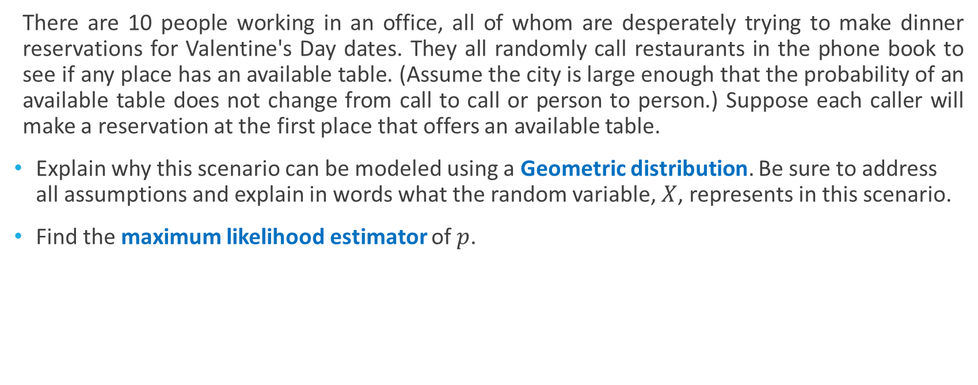
Example: Maximum Likelihood
There are 10 people working in an office, all of whom are desperately trying to make dinner reservations for Valentine's Day dates. They all randomly call restaurants in the phone book to see if any place has an available table. (Assume the city is large enough that the probability of an available table does not change from call to call or person to person.) Suppose each caller will make a reservation at the first place that offers an available table.
Explain why this scenario can be modeled using a Geometric distribution. Be sure to address all assumptions and explain in words what the random variable, $X$, represents in this scenario.
Find the maximum likelihood estimator of $p$.

Slide 18
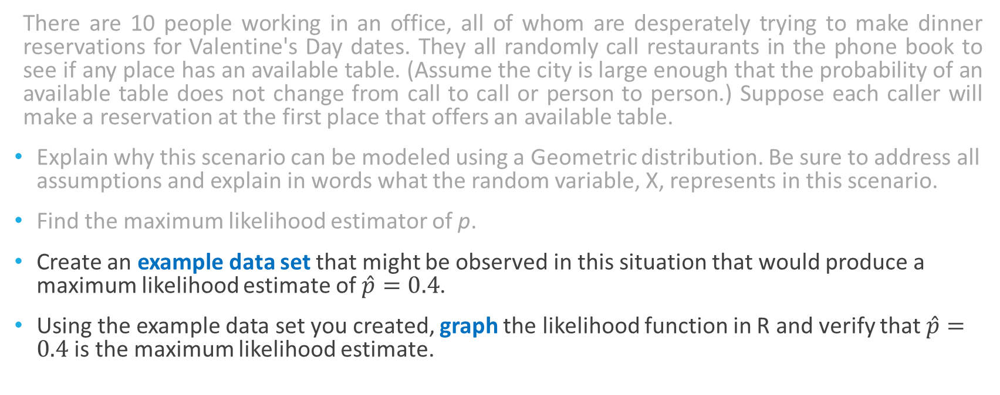
Example: Maximum Likelihood
There are 10 people working in an office, all of whom are desperately trying to make dinner reservations for Valentine's Day dates. They all randomly call restaurants in the phone book to see if any place has an available table. (Assume the city is large enough that the probability of an available table does not change from call to call or person to person.) Suppose each caller will make a reservation at the first place that offers an available table.
Explain why this scenario can be modeled using a Geometric distribution. Be sure to address all assumptions and explain in words what the random variable, X, represents in this scenario.
Find the maximum likelihood estimator of p.
Create an example data set that might be observed in this situation that would produce a maximum likelihood estimate of $\hat{p}=0.4$.
Using the example data set you created, graph the likelihood function in R and verify that $\hat{p}=0.4$ is the maximum likelihood estimate.

Slide 19

Example: Maximum Likelihood
$$\begin{matrix}x_{1}=5,{ x}_{2}=1,{ x}_{3}=4,{ x}_{4}=1,{ x}_{5}=2, \\ x_{6}=3,{ x}_{7}=1, { x}_{8}=4,{ x}_{9}=3,{ x}_{10}=1\end{matrix}$$

Slide 20
Reflections
No coding pre-req
  Varying levels of programming experience
    Optional “Intro to R” activity at beginning of semester (adapted from Torfs & Brauer, 2012)
  Provide “just-in-time” example code in notes and homework
  Challenging in beginning, but offers flexibility to explore later concepts, e.g., sampling distributions
Align with learning objectives
  Meaningfully and intentionally incorporate use of R for in-class examples and assignments
Start small
  Use examples already created and add on to “staples” you already have
  When creating your own examples, adapt “traditional problems” as an initial start
Communicate purpose, goals of software use with students
  Opportunities for problem solving, exploration, creativity, etc.

Slide 21
References
ASA (2014). 2014 Curriculum Guidelines for Undergraduate Programs in Statistical Science. Alexandria, VA: American Statistical Association. Available at http://www.amstat.org/education/curriculumguidelines.cfm.
Buttrey, S. E., Nolan, D., & Temple Lang, D. (2001). Computing in the mathematical statistics course. In Proceedings of the 2001 Joint Statistics Meetings, Alexandria, VA. American Statistical Association. Available at http://www.amstat.org/sections/srms/proceedings/y2001/proceed/00113.pdf.
Green, J. L., & Blankenship, E. E. (2015). Fostering conceptual understanding in mathematical Statistics. The American Statistician, 69(4), 315–325.
Horton, N. J., Brown, E. R., & Qian, L. (2004). Use of R as a toolbox for mathematical statistics exploration. The American Statistician, 58(4), 343-357.
Nolan, D., & Temple Lang, D. (2003). Case studies and computing: Broadening the scope of statistical education. In Proceedings of the 2003 International Statistical Institute Meeting. International Statistical Institute. Available at http://iase-web.org/documents/papers/isi54/3735.pdf.
Torfs, P., & Brauer, C. (2012). A (very) short introduction to R. Available at https://cran.r-project.org/doc/contrib/Torfs+Brauer-Short-R-Intro.pdf.

Slide 22
Contact Information
Jennifer L. Green, jgreen@montana.edu
Assistant Professor of Statistics, Montana State University
Jennifer Broatch, jennifer.broatch@asu.edu
Assistant Professor of Statistics, Arizona State University at the West Campus

