Slide 1
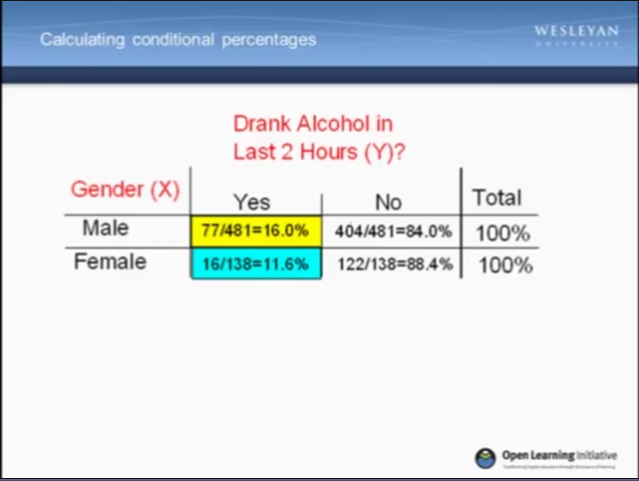
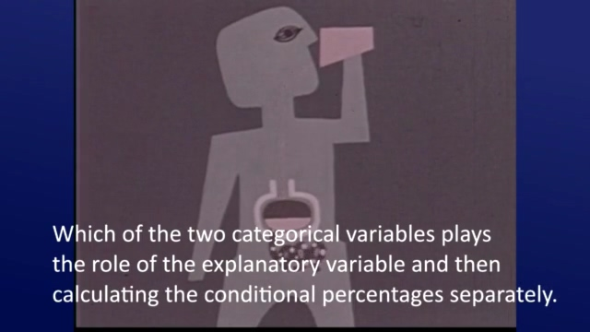
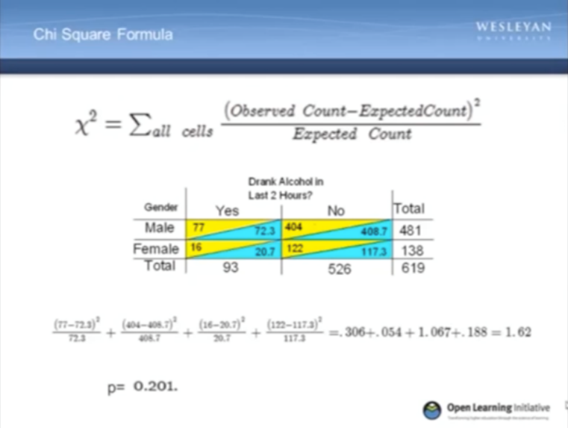
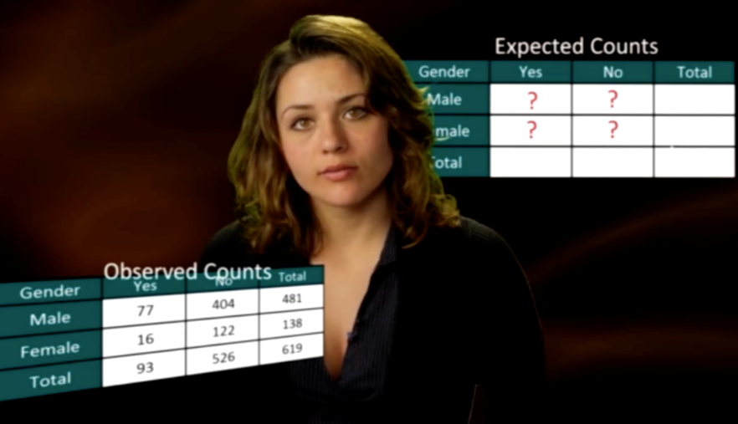
Learning and Motivation from
Basic versus Enhanced Statistics Video Lessons
Basic Format
Enhanced format
Jennifer Cooper
Wesleyan University
Notes:
Hello. My name is Jennifer Cooper, and I’ll be discussing the effects of different video formats in a lesson on chi square.
This study compares two video formats: the basic version in which an instructor narrated powerpoint slides and an enhanced version, which had the same spoken text, additional decorative imagery and animation, and closer alignment between the visual and verbal information.
Today, I’ll talk briefly about how the formats related to students’ learning and some of their reactions.

Slide 2
Instructional Design of Videos
Two Cognitive Principles of Multimedia Learning (e.g., Mayer, 2009)
  Relate verbal information to visuals = Multimedia Principle
  Retain only necessary text and visuals = Coherence Principle
But can engaging visuals better engage students and increase interest?
Notes:
Despite knowing that individuals learn better when information is presented visually and verbally, the coherence principle notes that there should not be extra or irrelevant material. This is because extraneous information can overwhelm our limited processing abilities.
On the other hand, one of the concerns of statistics educators is students’ often negative reactions to learning and using statistics.
Engaging visuals have the potential to attract the attention of learners or trigger interest, both of which support learning. Individual differences in attitude or ability also affect the applicability of these principles.

Slide 3
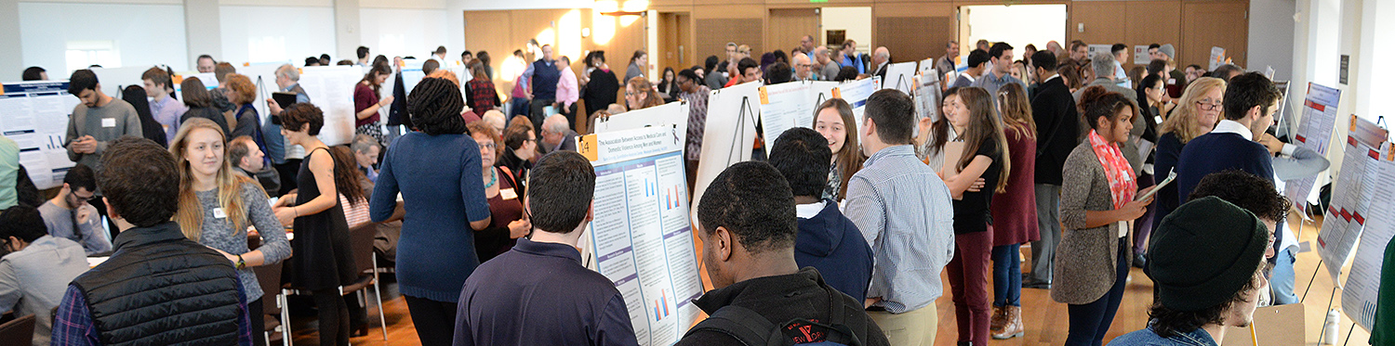
Passion Driven Statistics
Multidisciplinary, flipped, project-based course
  Introductory-level course
  Self-generated research question → poster presentation
  Videos viewed outside of class
  eCOTS ‘16 Workshop Wednesday (Woods & Dierker)
  http://passiondrivenstatistics.com
Notes:
In the research I’m discussing today, we used two versions of videos that are part of the Passion Driven Statistics approach that Lisa Dierker has developed at Wesleyan.
In this project-based, flipped course, students go from a self-generated research question all the way to a poster presentation. This works because of the videos that students watch outside of class.
Some of the sections this past fall saw both basic and enhanced videos depending on what topic was being covered. Students reactions varied – some reported the enhanced versions as easier to watch whereas other found them distracting.

Slide 4
ExperiMental Study
How do videos’ formats affect learning and reactions to a statistics lesson?
74 introductory psychology students
(65% had prior statistics coursework, but 77% reported knowing half or less of the content)
Background
Performance
Condition
Video Reactions
Initial
Comparative
Notes:
Here, I more systematically addressed students’ learning and reactions in an experimental study with introductory psychology students.
I’ll focus on how condition affected accuracy and participants’ reactions to the videos, as it is possible that their reactions also affected their learning.

Slide 5
ExperiMental Study
How do videos’ formats affect learning and reactions to a statistics lesson?
Background
Video Comparison
2 min clip (other condition)
Recall and Learning
Initial Video Evaluation
10 minute video lesson
Notes:
The initial video lesson was followed by questions about the video and its content, a short selection of the other video, and further questions asking students to compare the two videos.

Slide 6
Accuracy
Effect of statistics experience: p = .02
Notes:
As we might hope, participants with prior statistics experience did perform more accurately, but the video condition did not affect students’ accuracy. This is the case whether we consider their performance on all of the questions or just the harder ones.
In addition, contrary to expectations, content accuracy was not related to attitudes towards statistics.
Turning to students’ reactions to the videos,

Slide 7
Reactions to the Videos:
Comparative Evaluations in Open-Ended Responses
Possible to consider the enhanced format both more distracting and more engaging (n = 4)
“The [basic] video was incredibly boring with little to no interaction … The [enhanced] video was horrible at keeping my attention on the thing I was supposed to be concentrating on …, but it kept me more engaged.”
“the [enhanced video] was more captivating but also more distracting”
Tables show % of individuals in that cell.
Notes:
Students compared the two videos in an open-ended response. Two characteristics – distracting and engaging – were the most frequently used to describe the enhanced format. They’re also the most relevant to the underlying theories. Students without statistics experience and students in the basic condition were marginally more likely to report each characteristic.
In addition, 4 students reported that the enhanced format was both more engaging and more distracting than the basic format. Here we see two participants who noted that “it was horrible at keeping my attention but it kept me more engaged” and “it was more captivating but also more distracting”.

Slide 8
Reactions to the Videos:
Comparative Evaluations
n = 40 (54% of sample)
Basic: 65% prior stats
Enhanced : 85% prior stats
Notes:
Finally, we also asked participants to explicitly indicate their choice for the videos in three different situations.
The graph shows the percent of individuals who would prefer each video format. Overall, students selected the enhanced video as their option for better learning, for more motivation, and as their preference.
In general, these choices for the enhanced video are strongest in terms of students’ preferences and weakest in terms of which video they predicted would lead to better learning. In fact, the one spot where this pattern is reversed is for the students in the enhanced condition who felt that the basic video would lead to better learning. For other questions, they retained their choice of the enhanced condition.
Thus, this is an example of students recognizing that their preferences may not align with their learning. However, the impact of motivation should not be discounted given the choices for the enhanced condition.

Slide 9
Conclusions and Future Directions
Despite varied reactions to the videos, no effects on learning
  Theoretically unexpected and worth future exploration
  Indicative of the difficulties applying learning principles in authentic contexts
Competing predictions based on different features of the videos
Future Directions
  Classroom-based research
  Continue to address the role of prior ability and student attitudes
Notes:
Despite students’ varied reactions to the videos, we found no effect of video format on learning and the sample sizes ended up limiting the ability to investigate how reactions to the different formats affected overall learning. However, the variation in reactions suggests that background characteristics by themselves may not be enough information. As technology continues to play a large role in the classroom, understanding’ how students use the instructional materials is particularly important.
In the future, we hope to research students’ learning and reactions to the videos in a classroom situation where they are viewing multiple video lessons. This would also help us understand how student characteristics influence their learning from different visual formats in statistics.

Slide 10
Thank You
Acknowledgements
Undergraduate Researchers:
Binghui Zheng ‘17, Alison Lam ‘16, Tiffany Gordon ’16
Funding for Passion-Driven Statistics comes from grants TUES0942246 and 1323084 to Lisa Dierker from the National Science Foundation and the Lauren B. Dachs Grant in Support of Interdisciplinary Research in the Social Impacts of Science
Enhanced videos produced by StreamLearn
Notes:
Thank you very much for your time today. I would like to thank the undergraduate researchers who assisted in this research
and point you towards several resources that give you further information about the materials used in this study.
Please feel free to contact me with any questions.
Thank you.

Slide 11
Resources
http://passiondrivenstatistics.com/
Videos used in study:
  Basic version [0:11 – 10:00]: https://www.youtube.com/watch?v=BHuOOR7xcII
  Enhanced version [0:09 – 10:57]: https://www.youtube.com/watch?v=LqIq1Ra6Tac
For more information on this study or Passion Driven Statistics in general:
  Jennifer Cooper, jcooper01@wesleyan.edu
  Lisa Dierker, ldierker@wesleyan.edu
Notes:
Thank you very much for your time today. I would like to thank the undergraduate researchers who assisted in this research
and point you towards several resources that give you further information about the materials used in this study.
Please feel free to contact me with any questions.
Thank you.

