Slide 1
Implementing the Common Core’s Promise of Bringing Statistical Curricula into Line with Recommendations of NCTM, MAA, & GAISE
Beverly L. Wood, Ph.D. and Carl Clark, Ph.D.
Indian River State College
Department of Mathematics
Notes:
Abstract: We plan to make a case for the necessity of GAISE-aligned college courses in order to prepare future teachers to teach in Common Core K-12 classrooms. Beginning with an overview of the parallel evolutions of Cobb/MAA suggestions to GAISE recommendations for teaching and NCTM process standards to Common Core mathematical practices, we will emphasize that we should be modeling what researchers continually conclude are best practices for teaching/learning across the K-16 continuum. We will provide some examples to illustrate classroom tasks that satisfy both GAISE and Common Core and hope to generate some discussion of other activities already used by conference attendees that meet the same criteria.

Slide 2
Common core is a new package for not-new ideas
National Council of Teachers of Mathematics
Mathematical Association of America
American Statistical Association
Guidelines for Assessment and Instruction in Statistics Education
Common Core State Standards for Math
Notes:
These professional associations have long advocated for a deeper understanding so that the computations make sense.
NCTM (1980, An Agenda for Action; 1991, Professional Standards for Teaching Mathematics; 2000, Principles and Standards for School Mathematics)
MAA (1992, Heeding the Call for Change)
ASA’s GAISE (2005, College Report) – note that there was a companion report on K-12 teaching as well

Slide 3
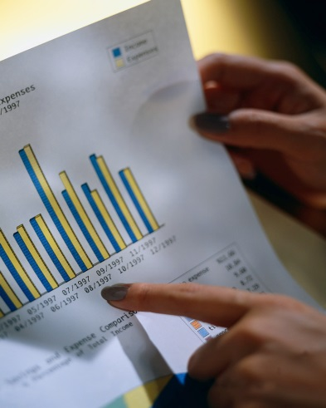
Mathematical (Statistical) Practice
Foster active learning in the classroom
Foster active learning
Stress conceptual understanding, rather than mere knowledge of procedures
Use real data
More data and concepts; less theory, fewer recipes
Emphasize statistical thinking
Emphasize statistical literacy and develop statistical thinking
Use technology for developing conceptual understanding and analyzing data
Use assessments to improve and evaluate student learning
Notes:
Cobb’s three suggestions
Emphasize statistical thinking
More data and concepts; less theory, fewer recipes
Foster active learning
Six recommendations from GAISE
1. Emphasize statistical literacy and develop statistical thinking
2. Use real data
3. Stress conceptual understanding, rather than mere knowledge of procedures
4. Foster active learning in the classroom
5. Use technology for developing conceptual understanding and analyzing data
6. Use assessments to improve and evaluate student learning

Slide 4


Mathematical (Statistical) Practice
Notes:
Five Process Standards
Problem Solving
Reasoning
Communication
Connections
Representation
Eight Standards for Mathematical Practice
MP1: Make sense of problems and persevere in solving them
MP2: Reason abstractly and quantitatively
MP3: Construct viable arguments and critique the reasoning of others
MP4: Model with mathematics
MP5: Use appropriate tools strategically
MP6: Attend to precision
MP7: Look for and make use of structure
MP8: Look for and express regularity in repeated reasoning

Slide 5
Comparison Chart
NCTM Process Standards | CCSS Standards for Mathematical Practice
Problem Solving | Make sense of problems and persevere in solving them (MP1) Use appropriate tools strategically (MP5)
Reasoning and Proof | Reason abstractly and quantitatively (MP2) Critique the reasoning of others (MP3b) Look for and express regularity in repeated reasoning (MP8)
Communication | Construct viable arguments (MP3a)
Connections | Attend to precision (MP6) Look for and make use of structure (MP7)
Representations | Model with mathematics (MP4)
Notes:
Robert’s chart

Slide 6

Consequences for K-12 Statistics Curriculum
Notes:
This is a significant paradigm shift away from plugging numbers into formulas and getting a numerical answer.
Many in-service teachers won’t have the statistical training required to implement the curriculum properly, for they have only “calculated” statistics – as opposed to using statistics. Professional development will need to demonstrate the use of statistics (the field is rife with real data to do so) in settings that pay close attention to GAISE recommendations for teaching introductory statistics.

Slide 7

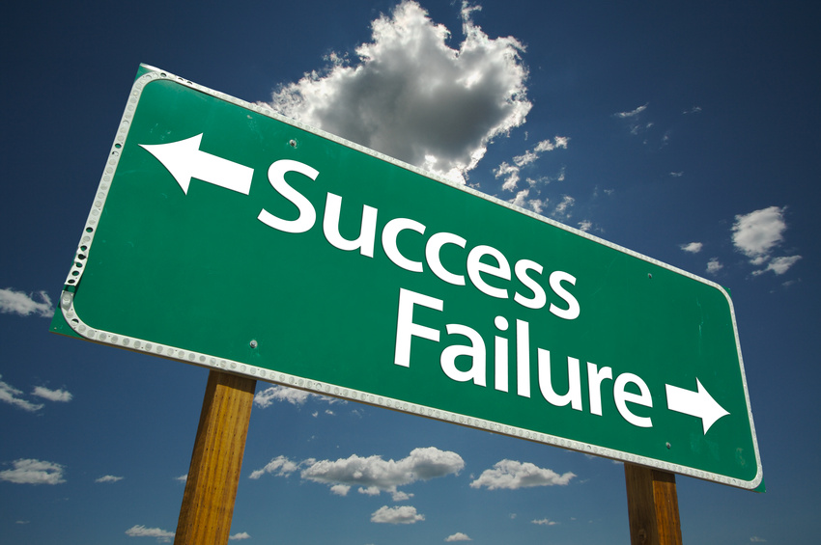
Consequences for Collegiate Statistics Curriculum
Notes:
As with the current Algebra curriculum mismatch, the statistical curriculum mismatch will grow. That is, with students entering the college with even fewer basic computational abilities, their success rates in a traditional Introductory Statistics course may get worse. Colleges may need to offer two courses: one for mathematician/statisticians and the second for consumers of data.

Slide 8


Consequences for Collegiate Mathematics Education Curriculum
Notes:
Education departments and mathematics departments may be at odds over what curriculum needs to be taught. Again, a separate statistical course may need to be offered for pre-service teachers that includes age appropriate activities that the pre-service teachers can take to the classrooms.

Slide 9
Recommendations
In-service mathematics teachers will need extensive professional development in creating relevant activities and assessment tools to accommodate less reliance on calculations.
College mathematics departments will need to create two entry level statistics classes: 1) for mathematicians and statisticians and 2) for everybody else.
Pre-service teachers will need to be taught how to develop lessons that will entice students to use data in decision making.
Notes:
As we migrate to the Common Core – which, recall, is just what NCTM, MAA, and GAISE have been recommending – there is going to be resistance to change from in-service teachers.
A computational course is still needed for students who major in mathematics or statistics to keep evolutionary process alive.
A dialog between mathematics and mathematics education departments needs to occur to ensure that development of data-rich lessons is taught in a methods unit.

Slide 10
Resources for Activities
CAUSE resources [causeweb.org]
AIMS resources (www.tc.umn.edu/~aims/index.htm)
WISE applets [wise.cgu.edu]
Publishers’ Software

Slide 11
References
American Statistical Association (2005). Guidelines for assessment and instruction in statistics education: College report.
Cobb, G. (1992). Teaching statistics. In Lynn A. Steen (ed.), Heeding the call for change: Suggestions for curricular action (MAA Notes No. 22), 3-43.
Koestler, C., Felton, M., Bieda, K., Otten, S. (2013). Connecting the NCTM process standards and the CCSSM practices. Reston, VA: NCTM.
National Council of Teachers of Mathematics (2000). Principles and standards for school mathematics. Reston, VA: NCTM.
http://www.corestandards.org/Math/Practice/
Notes:
http://www.Amstat.Org/education/gaise/
http://www.nctm.org/standards/default.aspx?id=58

