Slide 1

Exploring a “Flip” in Introductory Statistics
Bethany White
May, 2014
Project supported by the
Fellowship in Teaching Innovation
and the Department of Statistical & Actuarial Sciences
at
The University of Western Ontario, London, Ontario, Canada
Bethany White, David Bellhouse, Sohail Khan, Mary Millard, Duncan Murdoch
Elizabeth Renouf, Man-Kee Chu, Lori Murray, Xing Jiang

Slide 2
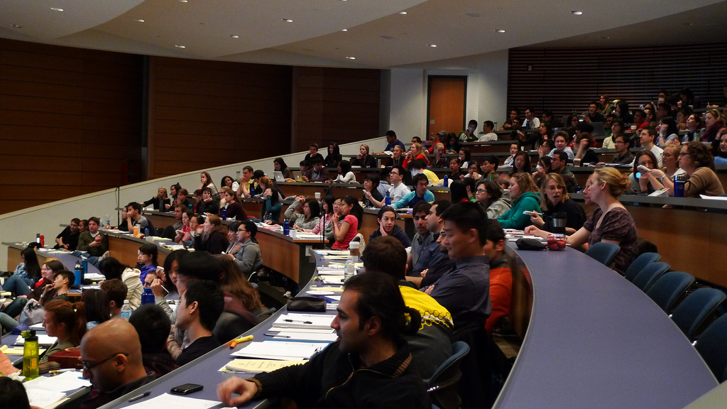


CC Image courtesy of velkr0 on Flickr - http://www.flickr.com/photos/velkr0/3472576304
CC Image courtesy of hackNY on Flickr
http://www.flickr.com/photos/61623410@N08/8675034596
CC Image courtesy of SalFalko on Flickr
http://www.flickr.com/photos/57567419@N00/6315269494

Slide 3
Online
Notes
Videos
Text
Forums
Messages
Quiz 1
Quiz 2
Quiz 3
Quiz 4
Quiz 5
Quiz 6
Face-to-face
Activity 1
Activity 2
Activity 3
Activity 4
Activity 5
Activity 6
Intro
Tutorial
Tutorial
Review
Tutorial
Tutorial
Review
Midterm & Final
Office Hours

Slide 4
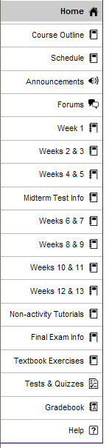
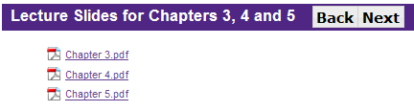
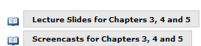
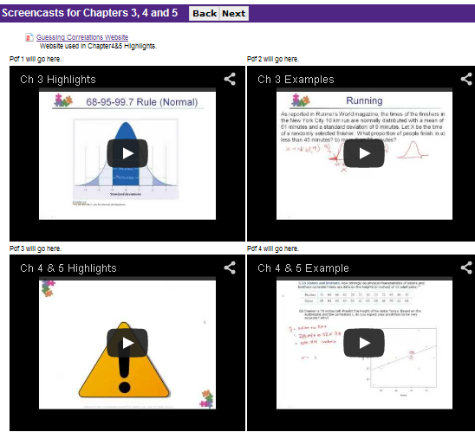
Notes & Videos (Online)
Tools:
LMS - Sakai
Powerpoint
Adobe Acrobat Pro
Camtasia Studio
Wacom tablet
R & web applets

Slide 5
Assessments
Each worth 2.5%
10 multiple choice questions (randomized)
1 hour time limit
Due Sunday night before activity week
Tools:
LMS - Sakai
Large Test Bank
R
6 Online Quizzes
Each worth 2.5%
Designed to build upon/reinforce material
Randomized groups of 5 students
Group assignments due at end of sessions
~ 90 minutes
6 Group Assignments
Midterm & Final
Worth 25% & 45%
proctored, multiple choice exams

Slide 6
Evaluation Time-line (Fall &Winter)
Pre-survey
Invitation
Email
Pre-survey
Invitation
Email
Final Exam
Week 1
Week 5
Week 7
Week 9
Week 11
Week 13
Week 15
Week 3
Invitation
Follow-up
Invitation
Follow-up
Each term:
blended section (2-4 activity session sections of 50 students each)
face-to-face section on main campus
face-to-face section at affiliated college (King’s)

Slide 7

CAOS - Comprehensive Assessment of Outcomes in a First Statistics course*
*delMas R, Garfield J, Ooms A, Chance B. (2007) “Assessing students’ conceptual understanding after a first course in statistics” Statistics Education Research Journal, 6 (2), 28-58.
 | FALL |  |  | WINTER
 | Blended | F2F Main | F2F King’s | Blended | F2F Main | F2F King’s
n | 33 (37%) | 74 (32%) | 4 (5%) | 54 (29%) | 63 (24%) | 20 (12%)
Score (/10): Mean Sd | 5.39 (1.56) | 5.39 (2.01) | 4.75 (2.5) | 5.17 (1.93) | 5.80 (1.87) | 4.65 (1.53)
Combined:
Blended: 5.25 (sd 1.79) & F2F: 5.45 (sd 1.94)

Slide 8
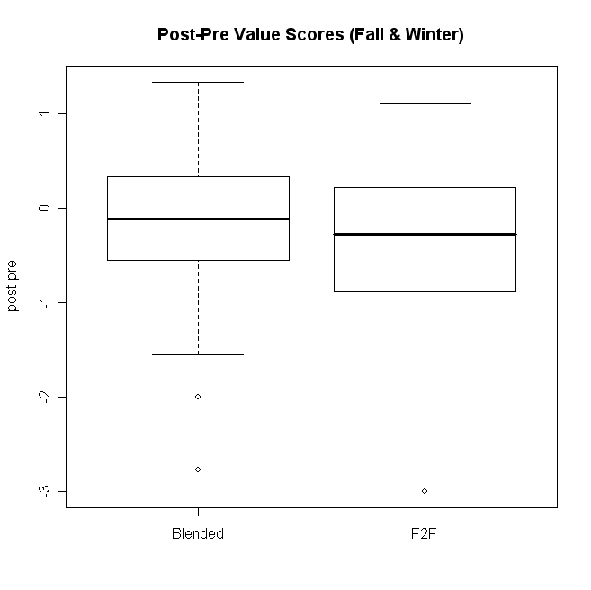
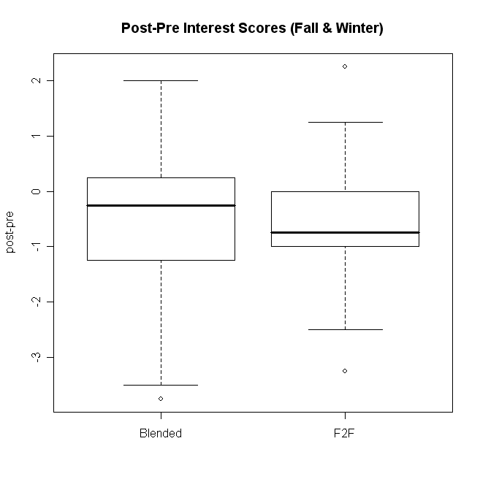
Survey of Attitudes Towards Statistics (SATS)©
Candace Schau * CS Consultants , LLC * 12812 Hugh Graham Road NE * Albuquerque, NM 87111

Slide 9
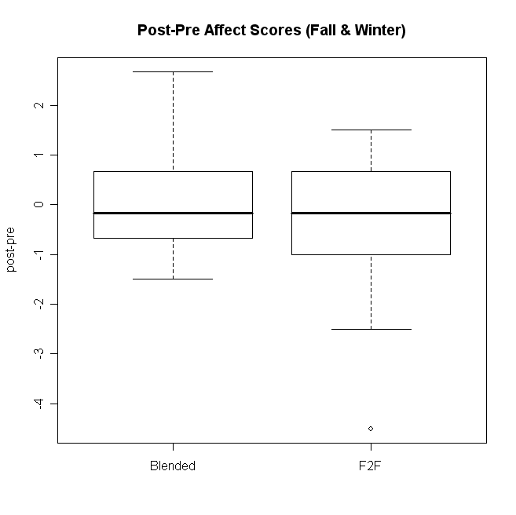
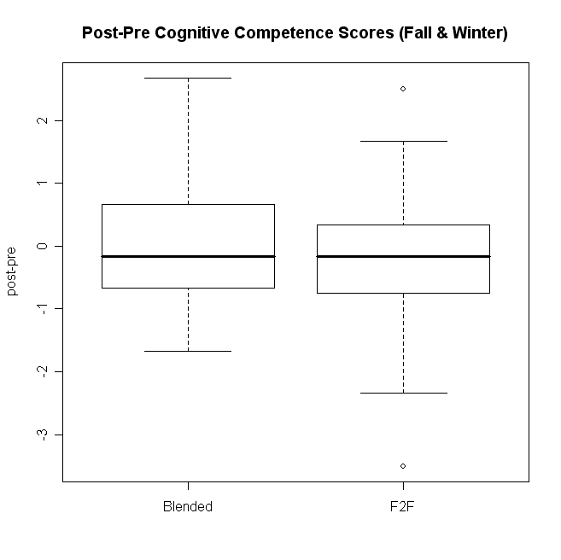
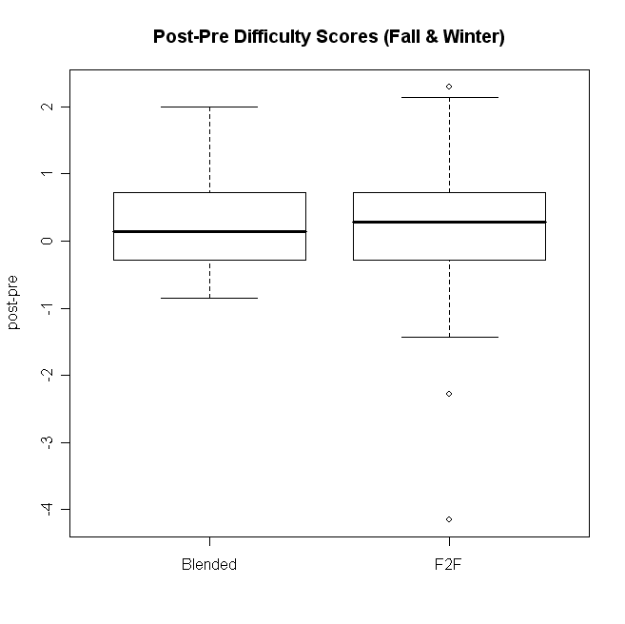
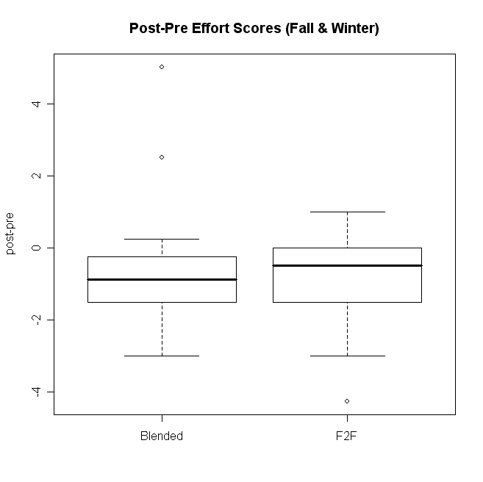

Slide 10
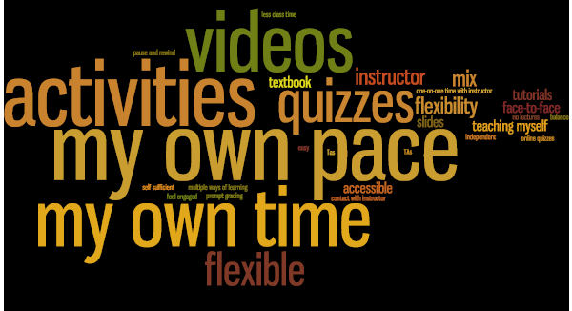
What they liked most....
and least....

Slide 11
What next….
Keep offering a blended section!
Rethink “non-activity” tutorials
Build instructor presence and online community
Obtain feedback on/improve lesson materials
Team building exercises/group contracts/etc.

