Slide 1




The Dog (or Cat) ate My Computer: Implementing Statistics Homework Online
Leigh Weiss, Capital University
Jacqueline Wroughton, Northern Kentucky University

Slide 2
Background
Many educators have theorized because the online "system is automatic, students may receive their graded homework almost instantly and master the materials through repetitive practice” (Peng, 2009, p.263). Therefore online homework (over pen and paper) would have a more positive effect on student achievement.
Most of the studies that have compared traditional pen and paper homework to computer-based homework have found no significant difference in student achievement (Kodippili and Senaratne, 2008; Ye and Herron, 2009; Palocsay and Stevens, 2008).
One study (Razzaq, Heffernan and Mendicino, 2009) showed that the type of online homework system and how it was implemented (specifically an "intelligent tutoring system") did significantly affect student achievement.

Slide 3
Background
Research has now shifted toward looking at what factors influence student achievement while using a computer based homework system.
Studies in mathematics and science courses have found that students generally tend to prefer online homework versus traditional homework (Smolira, 2008; Doorn, Janssen and O’Brien, 2010).
Students “like(d) its flexibility and immediate feedback”
“Learning style is not associated with student attitudes about homework.”
“Students reported that online homework increases the time in studying for the class and their understanding of the material” (Smolira, 2008, p.94).

Slide 4
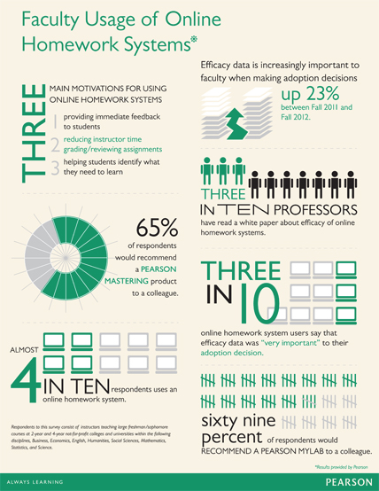
Background
However, the evidence also shows that students with a better attitude toward mathematics “put more effort into the homework and derive more benefit” (Doorn, Janssen and O’Brien, 2010, p.16).
Peng (2009) hypothesizes that online homework can help students with low motivation if they perceive that the homework system will truly help their learning.

Slide 5
Research Interests/Focus Questions
In the Fall of 2013, we conducted an exploratory study to better understand how our students used the online homework system. This helped us better define the questions we wanted to research. However, these questions are still evolving.
Does the number of attempts students are allowed have an effect on student achievement?
Are there noticeable differences between how certain groups of students use the system? For example, are there consistent early homework starters versus consistent last minute starters?
Is there any relationship between these differences and student achievement in the class?

Slide 6
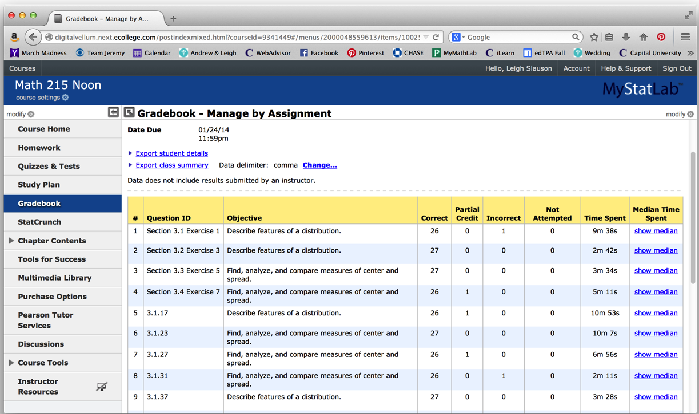
Methods
Both researchers taught two sections of introductory statistics at their respective institutions, using Intro Stats (Deveaux) and MyStatLab. Various data such as how long the students spend on homework, the number of attempts on each question and score on the assignment are automatically recorded by MyStatLab.

Slide 7
Methods
At the end of each homework there was a link to a short survey that asked students whether they utilized certain features of the homework website.

Slide 8
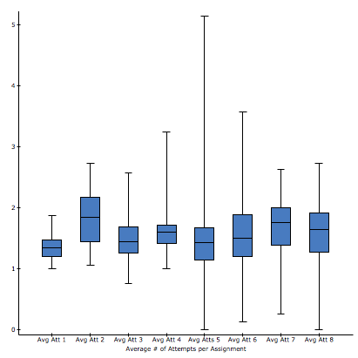
Preliminary Data Analysis
Capital University Noon Class
Average Number of Attempts on Each Question by Student
Correlations between Final Grades and Homework Scores and Average number of Attempts
 | Final %
 | Correlation | Two Sided P-value
Avg Att 1 | 0.10649663 | -0.597
Avg Att 2 | -0.34629237 | -0.0768
Avg Att 3 | -0.26874163 | -0.1753
Avg Att 4 | -0.43791649 | -0.0223
Avg Att 5 | -0.3277754 | -0.0951
Avg Att 6 | 0.090794762 | -0.6524
Avg Att 7 | -0.001869844 | -0.9926
Avg Att 8 | -0.16199012 | -0.4195
Score HW 1 | 0.43491261 | -0.0234
Score HW 2 | 0.23811506 | -0.2317
Score HW 3 | 0.20379176 | -0.3079
Score HW 4 | 0.34101264 | -0.0817
Score HW 5 | 0.22600136 | -0.257
Score HW 6 | 0.51767528 | -0.0057
Score HW 7 | 0.17341098 | -0.387
Score HW 8 | 0.36900559 | -0.0582

Slide 9
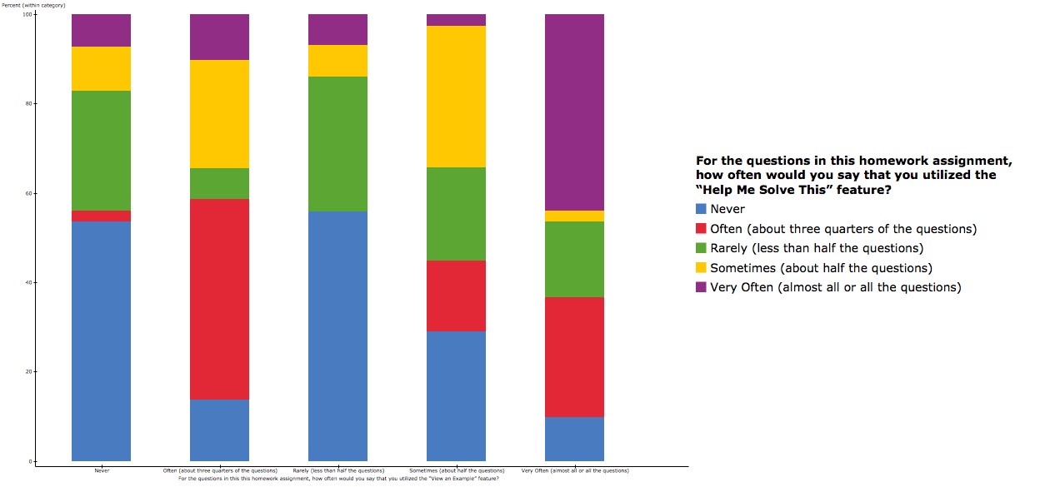
Preliminary Data Analysis
Northern Kentucky University Spring 2014
Help Me Solve This vs. View an Example
Chi-Square test:
Statistic DF Value P-value
Chi-square 16 104.20794 <0.0001

Slide 10
Further Work
Data analysis is very much in the exploratory phase.
So far, very little evidence that the number of attempts has any effect on students scores. However, the data for Northern Kentucky has not yet been analyzed.
There is a relationship, not surprisingly, between whether students use the Help Me Solve This feature and the View an Example feature.
Data related to time spent on homework has not been analyzed at all. Looking at trends over the course of the semester are of interest as well.

