Slide 1


Incorporating Statistics into the AP Biology Classroom: Meeting Common Core Standards
Lynn Waterhouse ^{1,*}
Joanne “JJ” Johnson ²
¹Scripps Institute of Oceanography University of California, San Diego 9500 Gilman Drive La Jolla, 92093-0202 USA.
*Communicating author: lwaterho@ucsd.edu
²Kearny High School, The School of Science, Connections and Technology, San Diego Unified School District, 7651 Wellington Street, San Diego, CA 92111
Notes:
eCOTS 2014
Title: Incorporating Statistics into the AP Biology Classroom: Meeting Common Core Standards
Authors:
Lynn Waterhouse ^{1,*}
Joanne “JJ” Johnson ²
Author Affiliations:
¹Scripps Institute of Oceanography University of California, San Diego 9500 Gilman Drive La Jolla, 92093-0202 USA.
*Communicating author: lwaterho@ucsd.edu
²Kearny High School, Science Communication Technology, San Diego Unified School District, San Diego, California

Slide 2
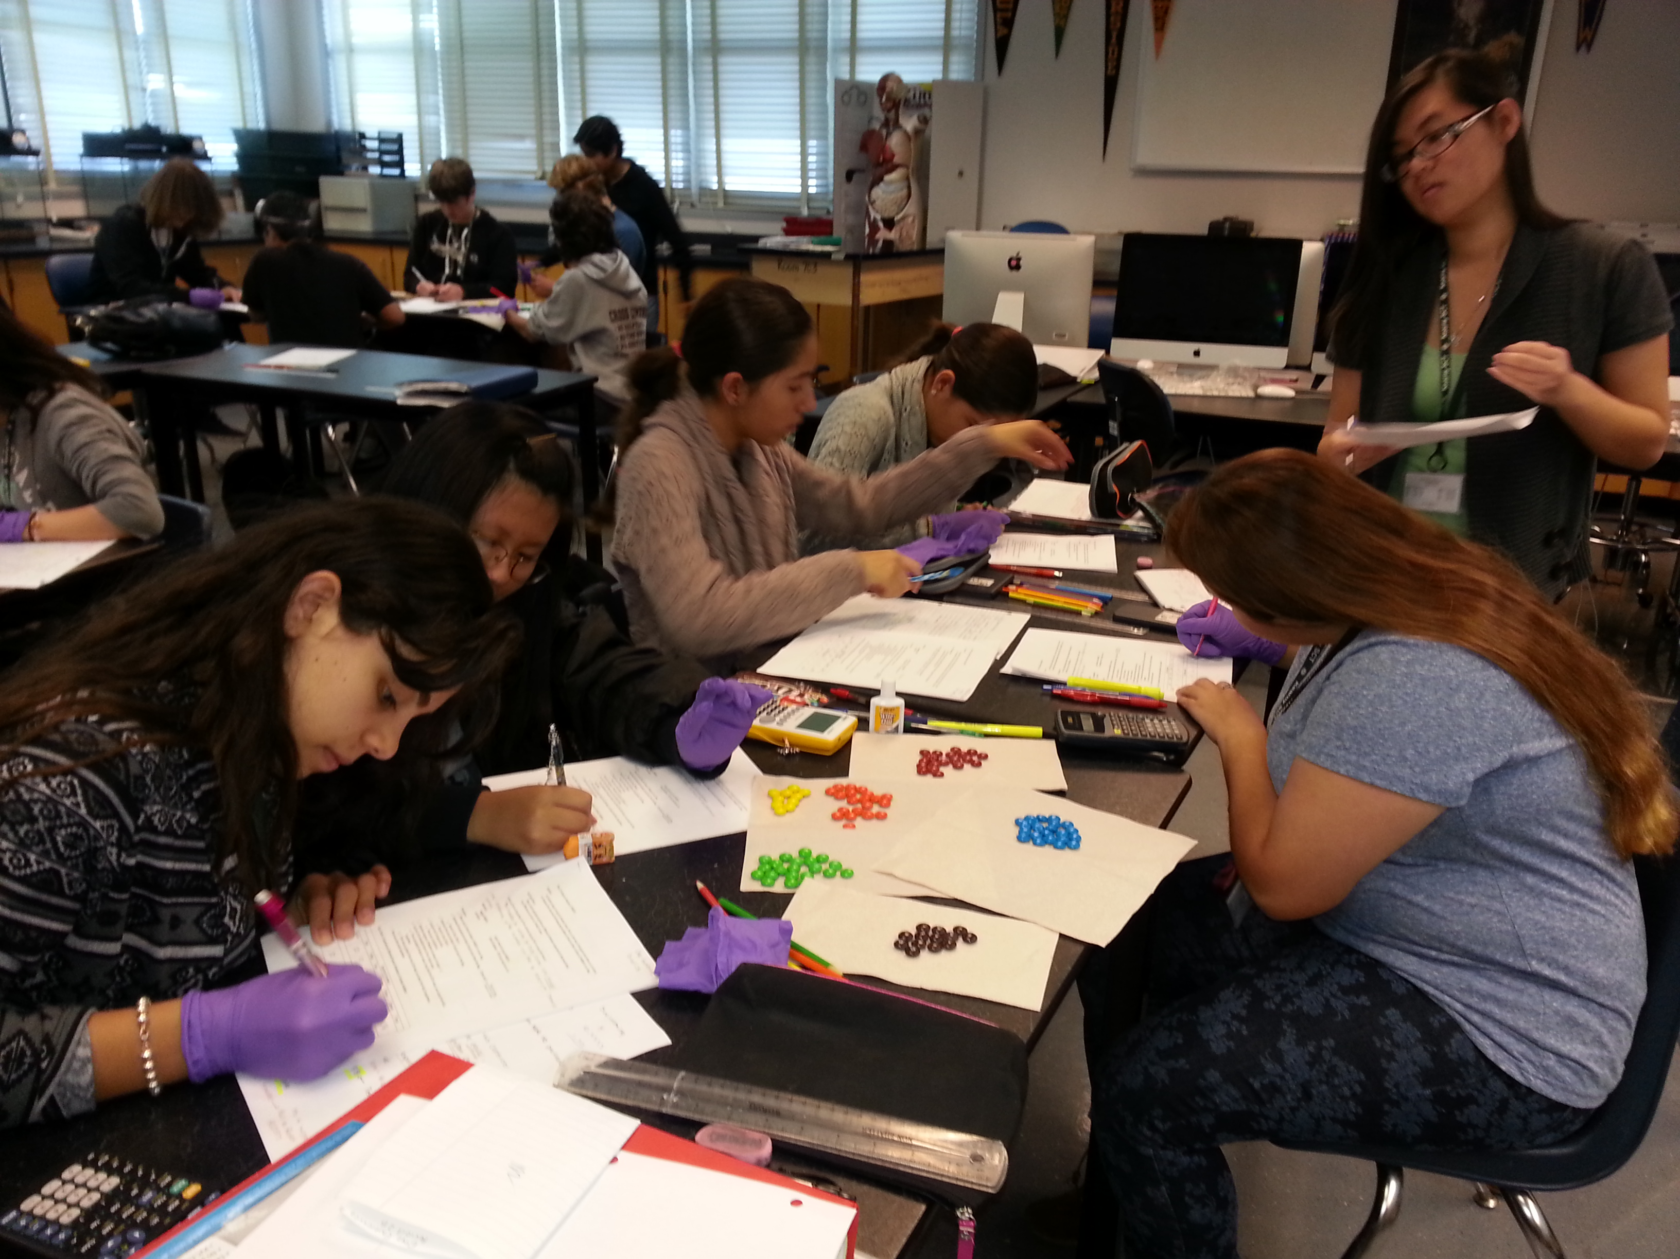
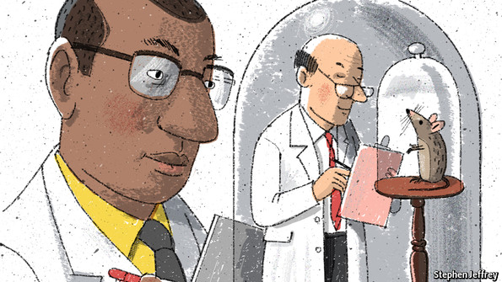
Integrating Quantitative Skills Into a Biology Classroom
Types of Mathematical/Statistical Skills
Chi-square analysis
Hardy-Weinberg Equilibrium
Rates
Interpreting graphs
Surface area
pH/log scale
Exponentials
Flow diagrams
Interdisciplinary teaching
Time balance
“Math fear”
Getting the math concepts right
Biologists are quantitative
Notes:
What sort of skills are required in the biology classroom?
AP exam requires knowledge of chi-square analysis, hardy-weinberg equilibrium, rates, population growth (exponential and logistic), interpretation of graphs (also set in a biological framework), calculating surface area, pH/log scale, exponentials, and flow diagrams → lots of word problems
It’s worth noting that these are the required skills- may be worth taking a step back and thinking of what are the necessary skills in order to be the best biologist possible
Why integrate quantitative skills into the biology classroom?
biologists by definition are quantitative
basis of scientific theory- hypothesis testing is a quantitative one
certain skills required by the AP Biology exam and introductory biology classes
Fears in integrating quantitative skills into the classroom
How to do the interdisciplinary instruction- will the core biological concepts suffer as a result of the added mathematical/statistical instruction
How to balance the two subjects- time management implications
Math fear
for students who feel “they aren’t good at math” will this cause them to do worse at biology (lump the two together)
Given time constraints and that the class is intended to be a biology class is it possible to teach these basic concepts without placing them in a broader context?
Without the background mathematical/statistical theory will the students be missing out?
Regardless of how it happens, this is something that needs to happen.
All types of biology (even medical sciences) require a basic quantitative understanding.
Lack of quantitative skills has made news recently leading to discussions of publication bias, poor experimental design, incorrect sample size (pseudo sample), multiple testing and development of centers such as the Meta-Research Innovation Centre at Stanford (known as METRICS for short).
Cartoon Image- from Economist: http://www.economist.com/news/science-and-technology/21598944-sloppy-researchers-beware-new-institute-has-you-its-sights-metaphysicians
Citations:
Madlung, A., Bremer, M., Himelbau, E., and A. Tullis. 2001. A study assessing the potential of negative effects in interdisciplinary math-biology instruction. CBE-Life Sciences Education. 10: 43-54.

Slide 3
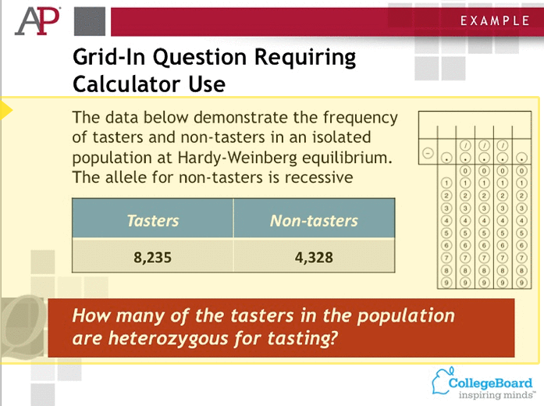
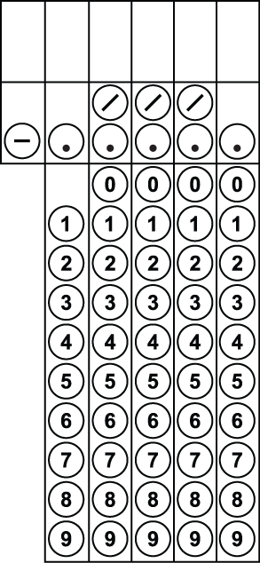
AP Biology: Grid- In Questions
5 Grid-In Questions
2013 results, 36% average correct score
Notes:
In 2013 the AP Biology exam added a new type of question to match with the new common core standards, which require mathematics/statistical concepts to be taught in conjunction with the life sciences.
On the left we have an example of what a blank grid-in looks like.
Points to make:
5 grid-in questions aimed at meet college biology’s standards for use of mathematics to solve biological problems and understand biological concepts.
2013 Results- average correct score for grid-ins was 36% correct (less than 2 of 5)
7.5% of students answered all 5 grid-ins correctly
11.7% of students answered 4 grid-ins correctly
14.3% of students answered 3 grid-ins correctly
16.1% of students answered 2 grid-ins correctly
18.7% of students answered 1 grid-in correctly
31.7% of students answered 0 grid-ins correctly
Found that performance on grid-in questions had nothing to do with length of exam or uncertainty of whether or not to answer these questions.
Have an example grid-in question from the College Board (published online by the New York Times).
To do this problem
non-tasters are homozygous for the recessive so q^2=4328/(4328+8235)= 0.3445037
take square root to get q = 0.5869444
p = 1-q =0.4130556
heterozygous for tasting- 2pq = 0.4848814
number of people = 0.4848814*(4328+8235) =6091.564 round to 6092
FROM AP Board:
Answer: An acceptable answer would be any number from 6,030 to 6,156, depending on how students round the variables in the Hardy-Weinberg equation.
range most likely based on ability of calculators to hold decimals – students use very simple ones for the exam
Citations:
Grid-in question blank. http://www.clearbiology.com/ap-biology-teaching-tools/
Grid in explanation. http://documents.nytimes.com/sample-questions-ap-biology

Slide 4
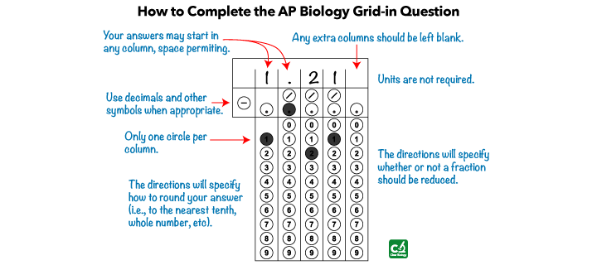
AP Biology: Grid- In Questions
5 Grid-In Questions
2013 results, 36% average correct score
Notes:
Why did students do poorly??
many didn’t bubble in the answer
not good with word problems- get lost (can’t see the trees through the forest)
Things that could have thrown them
need to bubble (and write answer)
spacing doesn’t matter
units are presented in the question, don’t need to put them in the answer
if you need a fraction they will tell you (can sometimes do fraction or decimal)
→an continual goal with my students has been to practice answering these type of questions (hammer in how to do grid-ins)
Citations:
Grid-in question blank. http://www.clearbiology.com/ap-biology-teaching-tools/
Grid-in questions explained. http://www.clearbiology.com/grid-in-response/
Statistics on result of 2013 AP Biology exam. http://galileoweb.org/chinnc/ap-biology-08-09/ap-biology-exam-data-2013/

Slide 5
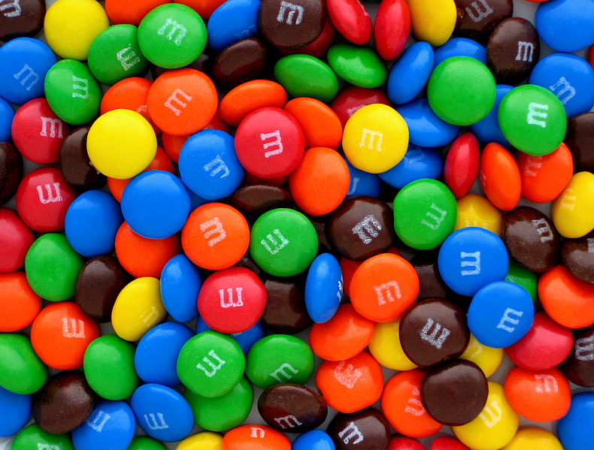
Chi-Square Analysis Labs:
M&M Lab Activity
Basic:
Students investigate if the different colors of M&M’s are found in equal proportions in a bag of plain M&Ms.
Advanced:
Compare to published color proportions. Generate explanations for why the deviance .
Class favorite sport
M&M colors
Birds migrating to wetlands
Zebrafish behavior (generational changes)
Pharmaceutical side effects (occurrence of dizziness)
Continuous values to discrete categories
Notes:
One skill I’ve taught the students this year- chi-square analysis
Did a lot of repetition, incorporating these skills into other labs they were already doing
1) introduced concept
2) used an in-class example based on their preferences for sports (basketball, football, swimming– let the class choose the three)
led to a discussion of hypotheses
3) hands on lab- M&M colors- they love this lab because they get to eat the M&M’s at the end
kept a basic lab- gave extra credit for them to take home
4) development of worksheets
5) analyzing various lab data in the context of chi-square

Slide 6
Common Misconceptions/Sticking Points of Chi-Square Analysis
Misconceptions/Sticking Points
Solutions
“Chai-square”
Tests for equality**
Hypotheses
Expected values
p-value
Sum of chi-square
Degrees of freedom
Test statistic
Materials directed at teachers
Repetition
Familiar/unfamiliar examples
Explanation of other types of tests
Crash course in probability**
Notes:
Issues/problems/misunderstandings
“Chai-square”– was actually how an AP biology teacher was pronouncing it when I attended a meeting (minor, but this teacher also had a lot of other questions related to how chi-square works)
Tests for equality**- this is the only type of test the AP exam requires- starting to see a test of proportions (goodness of fit)
Hypotheses- generation of null and alternate
reject null, or fail to reject null (don’t accept the null)– sticking point with how the AP teaches this
interpretation of these hypothesis after you have your test statistic
Expected values
p-value
why 0.05?
explanation repeat the experiment 20 times, 1 time out of 20 will come to wrong conclusion just by chance
Sum of chi-square
calculated chi-square for each category and then forgot to add them together
Degrees of freedom
why is it number of categories minus 1
Test statistic & Critical value – relation between the two
Solutions
-materials for teachers- really hammer home all these questions- need to make the teachers experts on chi-square so they can better instruct the students
-repetition (different types of problems, hands on labs, word problems, etc.)
-goodness of fit tests
-go ahead and provide students a crash course in probability… but this takes time
main working solution- more materials for instructors

Slide 7
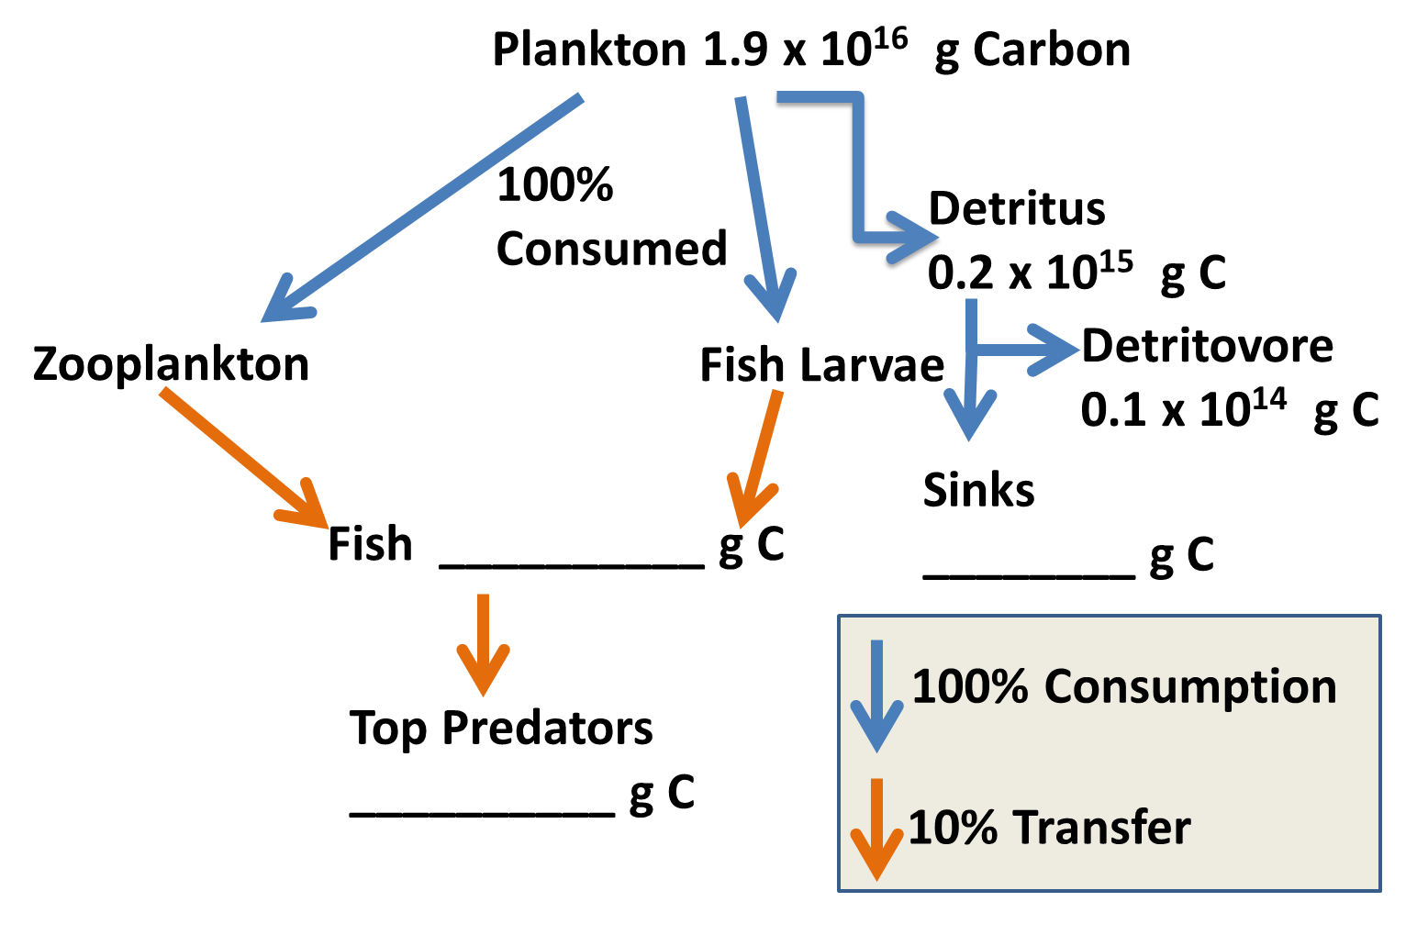
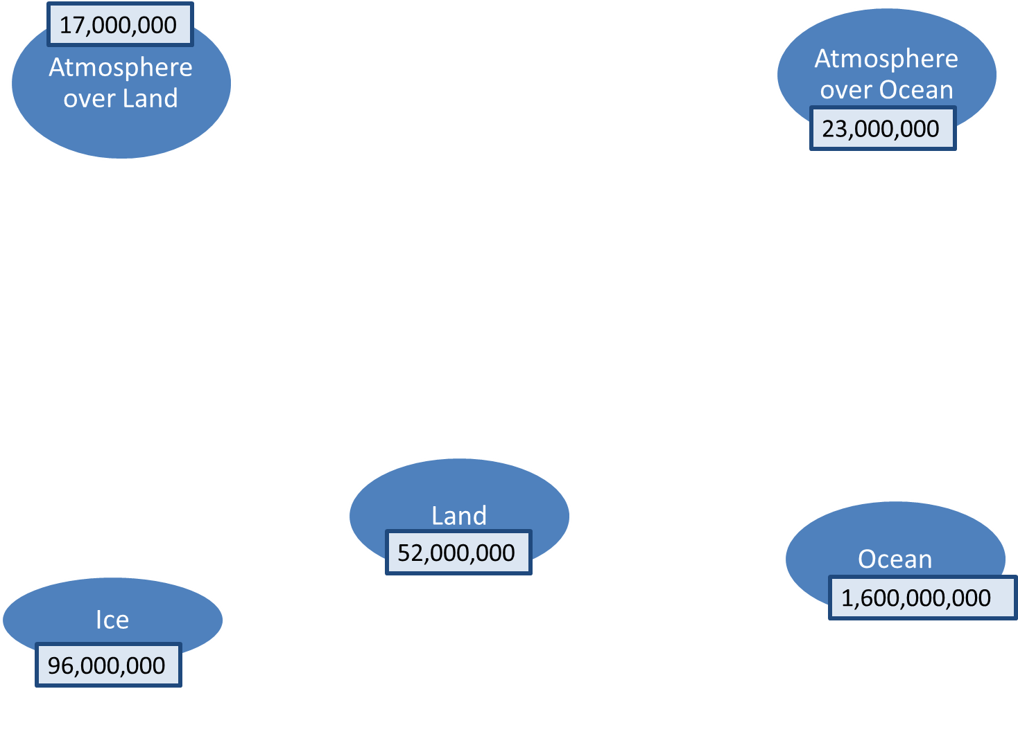
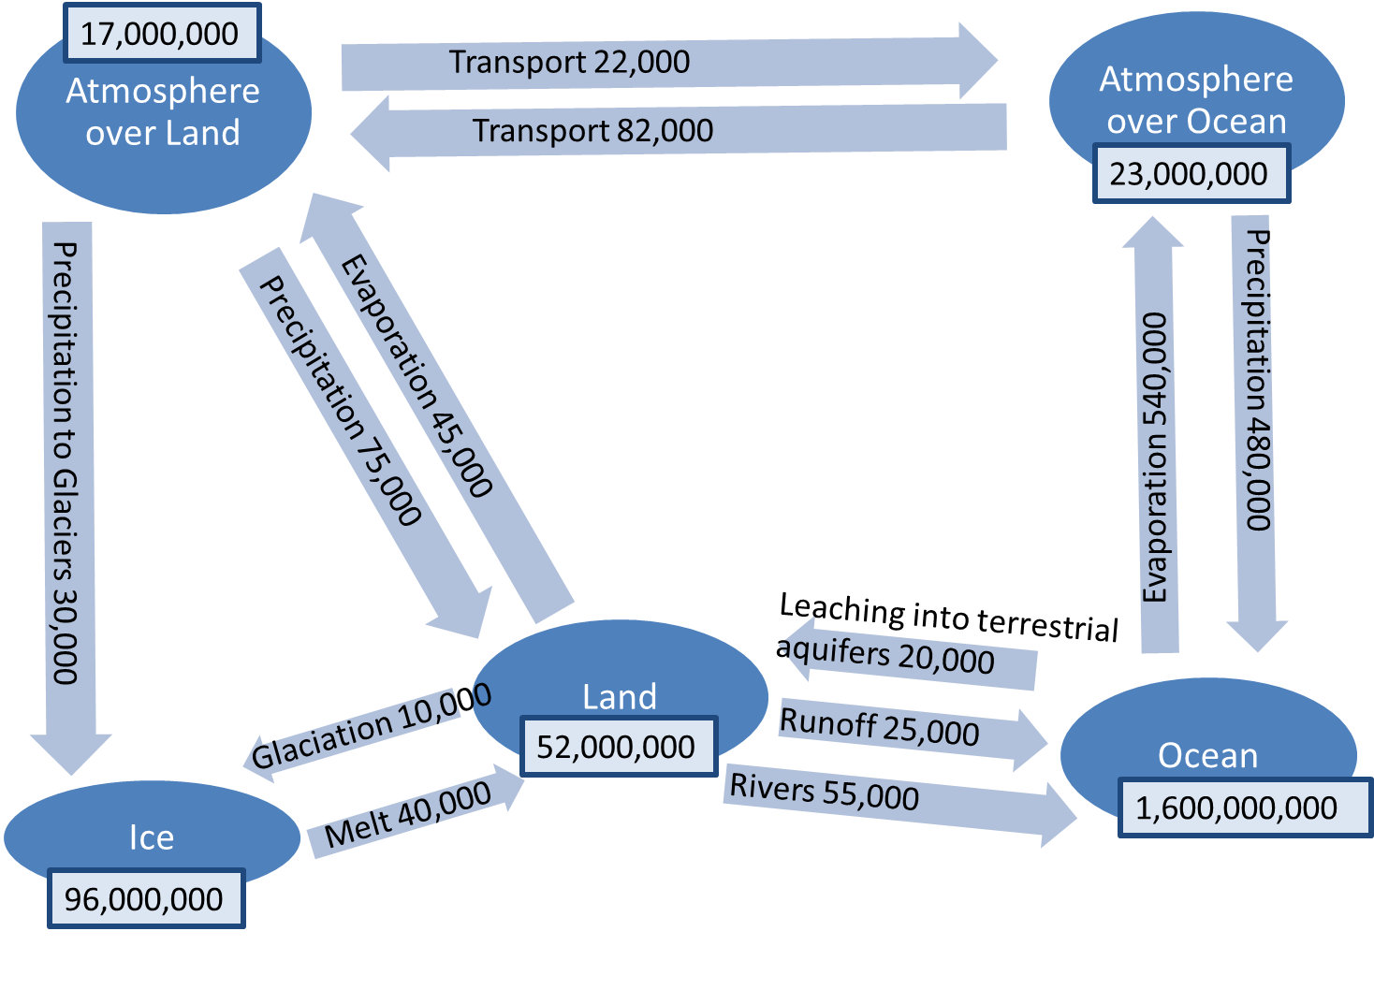
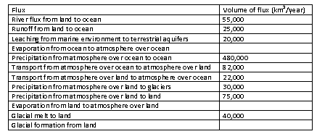
Flow Diagrams
Similar issues with word problems
Repetition
Novel & familiar concepts
Notes:
Another type of problem we have worked on- flow charts
Essentially word problems put to infographics

Slide 8
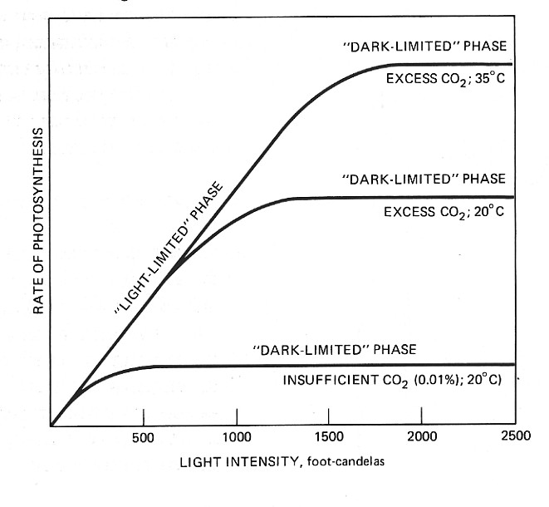
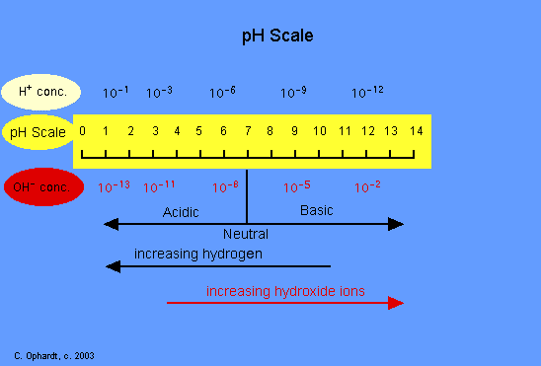
Basic Concepts
Solutions
Quantitative bootcamp
Worksheets
Develop interactive quizzes
Time as limiting factor
pH scales
Exponentials
Log₁₀ transformations
Unit conversions
Graph Interpretations
Rates
Notes:
Story- one week before AP exam- realizing 11th grader can’t convert 1.9 x 10 ^5 into ___x10^6
Picture credits:
pH scale. Elmhurt College. Virtual chembook. http://www.elmhurst.edu/~chm/vchembook/184ph.html
Photosynthesis rate curve. Discovering the secrets of photosynthesis. http://users.rcn.com/jkimball.ma.ultranet/BiologyPages/P/Photosynthesis_history.html

Slide 9
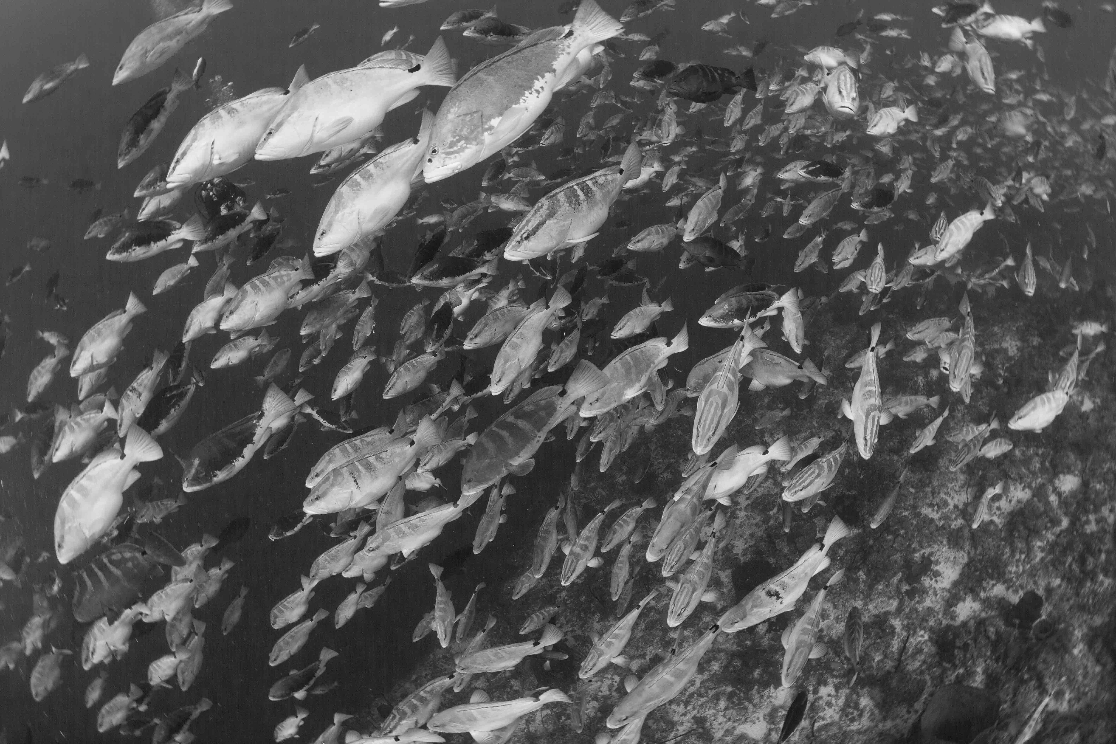
Conclusions
Common core standards (next generation science standards for state of California) and the new AP Biology exams require integration of mathematics/statistical concepts into the Biology classroom
Seamless integration of materials to avoid missing out on biology concepts
Notes:
Picture citation:
Background photo from Josh Stewart.

