Slide 1
Flipping the Statistics Classroom: Enhancing Course Redesign with the Flipped Classroom
Dr. Melissa M. Sovak
California University of Pennsylvania

Slide 2
What is Course Redesign?
Course Redesign is a systematic way of improving student learning while cutting instructional costs. The basic philosophy of Course Redesign is that the traditional large lecture format has proven to be one of the least effective and efficient ways to produce measurable results in student learning.

Slide 3
What is Flipped Classroom?
The flipped classroom is a pedagogical model in which the typical lecture and homework elements of a course are reversed. Short video lectures are viewed by students at home before the class session, while in-class time is devoted to exercises, projects, or discussions.

Slide 4
Cal U’s Implementation
Classes meet Tuesday/Thursday for 1 hour and 15 minutes
Students complete lectures before Tuesday class
Tuesday class is devoted to limited lecture and skill-building activities
Thursday class is devoted to homework sessions

Slide 5
MAT 215 Statistics Course Implementation
Students complete a guided lecture using videos from the instructor and the authors of the text.
Assigned videos are accompanied by an outline of notes for students to fill in
Video check questions are also assigned for students
Activities teach students how to use statistical software for analysis
Homework sessions give students practice on concepts
Quizzes assess student knowledge at the end of each week

Slide 6
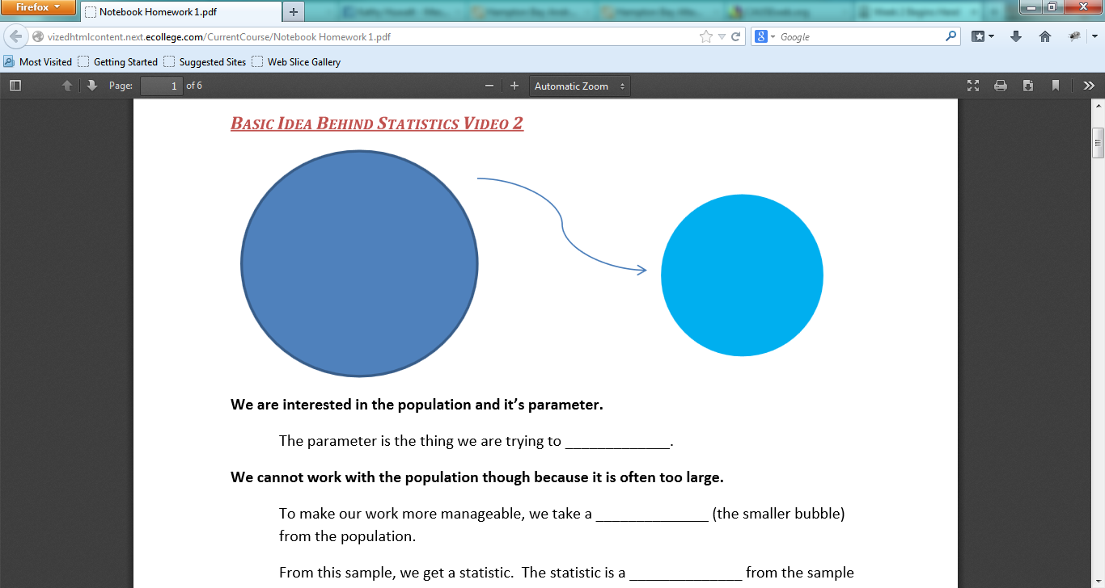
Video Notes Example

Slide 7
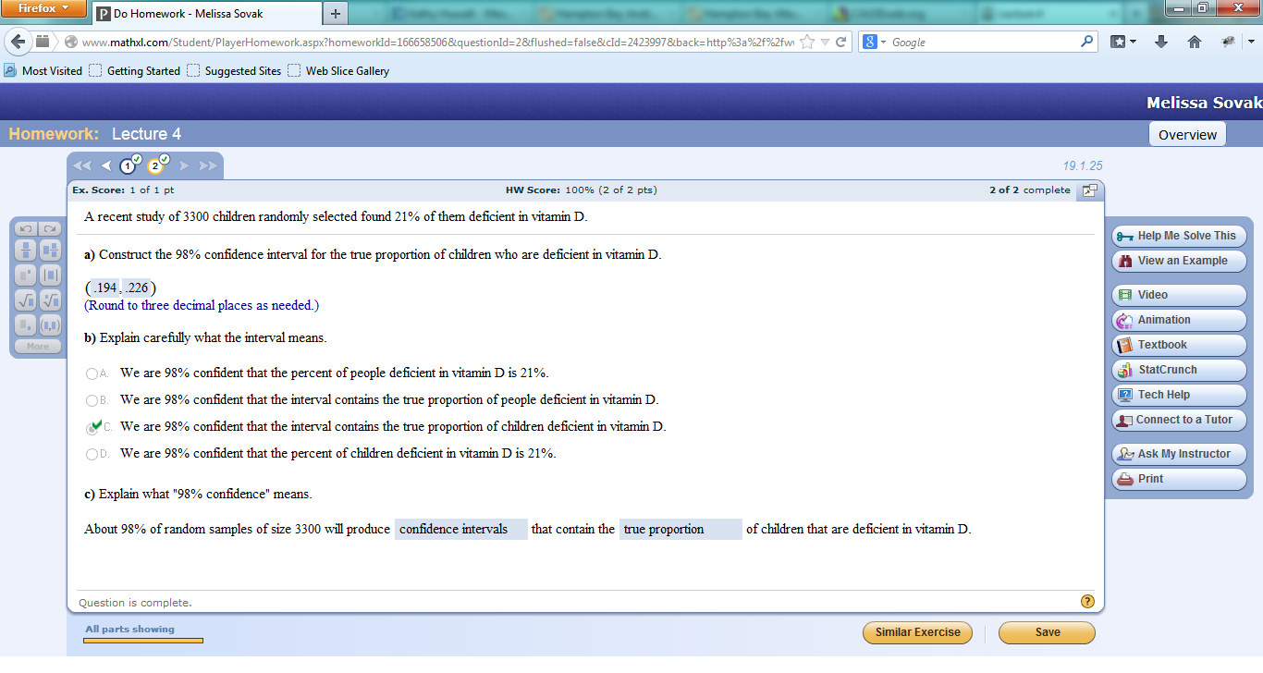
Lecture Example

Slide 8
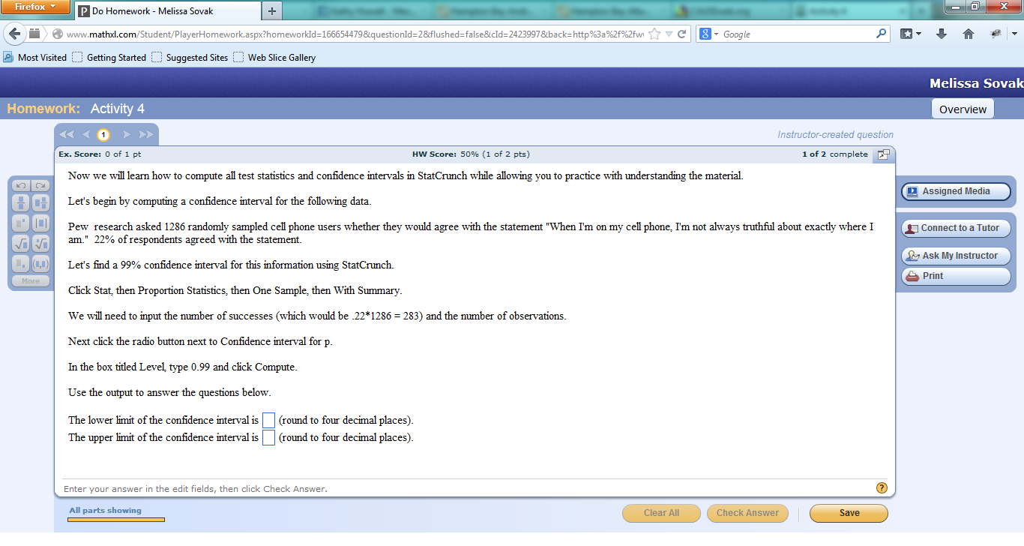
Activity Example

Slide 9
Changes Made
Implementation of this redesign has spanned two semesters (Fall 2013 and Spring 2014)
Several changes were made
  Notes are no longer graded in Spring 2014
  Instructor-led lectures were added in Spring 2014
These changes have resulted in a higher level of achievement for students

Slide 10
Student Reception
Students seem to like this method; they get help when they need it!
Test scores have improved dramatically
Number of questions to instructor during office hours or via email has reduced dramatically

Slide 11
Thank you!
Thank you for checking out my poster. If you have any questions, please leave them in the comments section!

