Slide 1
An overview scheme for introducing statistical inference by labeling inference actions
Frank J. Matejcik
South Dakota School of Mines & Technology
Oglala Lakota College
vimeo.com/86650563
An Overview of Inference
Helpful for Global Learners
& hopefully many others

Slide 2
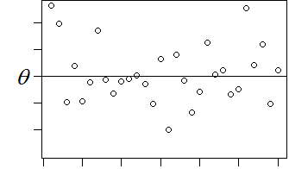
4 Uses Statistical Inferences
view statistics as random variables
And assume characteristics
Adjust Excite
Measure Decide

Slide 3
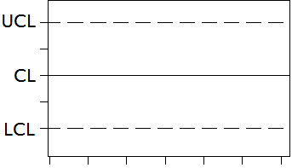
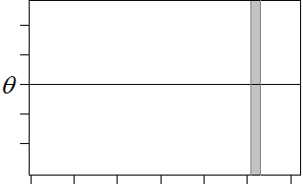
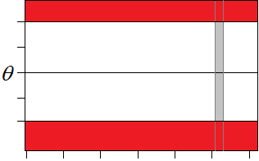
All 4 Uses
Make different data forms (or plans)
Adjust Excite
p-value is _______
Measure Decide

Slide 4
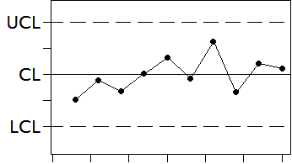
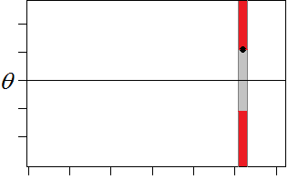
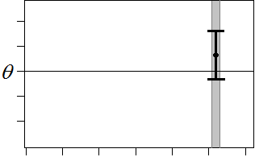

4 Uses no change shown
Adjust Excite
In control p-value is high like 0.3
Measure Decide
Interval covers assumed value Accept the assumption

Slide 5
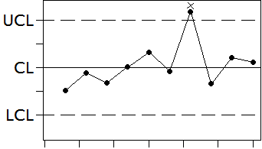
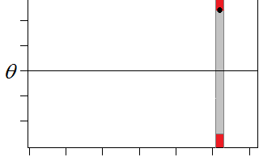
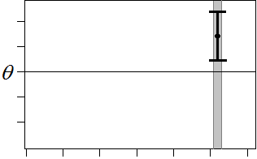
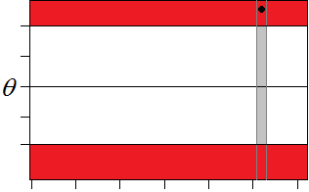
4 Uses change shown
Adjust Excite
Out of control p-value is low like 0.001
Measure Decide
Interval excludes assumed value Reject the assumption

Slide 6
4 Uses called often
Adjust Excite
(Shewhart) p-value method of
Control charts Hypothesis Testing
Measure Decide
1-α Confidence Critical Region method
Intervals of Hypothesis Testing

Slide 7
4 User Preferences
Adjuster, Measurer, Exciter, Decider
Map to Aristotle's 4 Temperaments?
Adjuster - Phlegmatic
Measurer - Melancholic
Exciter - Sanguine
Decider - Choleric
Can motivate nearly every student?
Can we test for preferences?

Slide 8
4 Uses Remember by
DAME Offensive
MADE Homophone
MEAD Corporation
AMED a name
Ahmed Al-Asfour is a colleague at
Oglala Lakota College
Amed means “greatly praised”, which is appropriate for the topic of Statistical Inference

Slide 9
What comes next?
See you at JSM 2014 Boston
177 Quantitative Literacy and Introductory Statistics — Contributed Papers
10:50 AM Mon, 8/4/2014 Introducing Hypothesis Testing with a Reflection Exercise and Student Selected Synonyms —
Frank Matejcik, South Dakota School of Mines Ahmed Al-Asfour, Oglala Lakota College

