Slide 1
Stay Calm &
Think Critically!
Marc ISAACSOn
Augsburg College
ECOTS Poster
May 2014

Slide 2
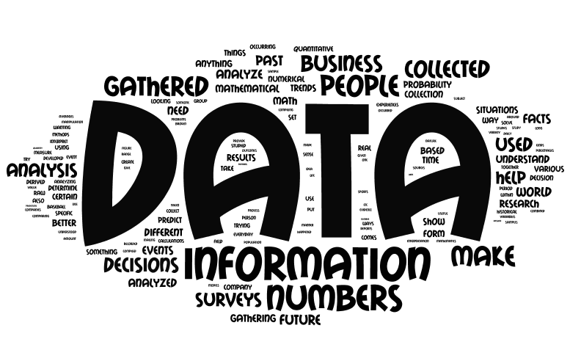
Class Survey on First Day
“Where Do Statistics Come From?”

Slide 3

Saying “Statistics Come From Data” is like saying
“Babies Come from Hospitals”
It’s true but leaves out the interesting details

Slide 4
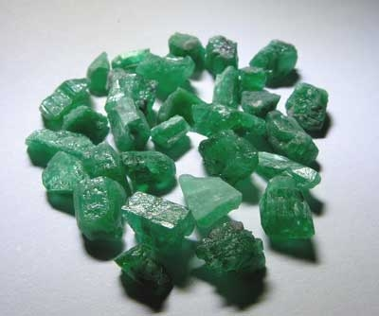

Statistics Come From a Logical Process
The Process:
  A Question of Interest
  Data Collection / Gathering
  Data Analysis
  Statistical Analysis
  Reporting of Results

Slide 5


Class Survey on First Day
2. Which phrase describes you best when exposed to arguments involving statistics used by others in the media or at work. Briefly Explain…
Awestruck / Naïve about Numbers
Critical Thinker
Complete Cynic

Slide 6
Student Surveys
(n = 89 students)

Slide 8
Impact of Student Perceptions on STAT 101
Awestruck Students
  See a jumble of methods, techniques, formulas
  Desire for 1 correct answer
  Focus on #’s as pure facts
  Unaware of influences on data and statistics
Cynical Students
  Believe numbers are modified on a whim
  Lack appreciation for scientific method
  Tend to dismiss statistics based on the source
Ultimate Goal of Intro Statistics:
Developing the habit of mind to evaluate statistical evidence in a critical manner.

Slide 9
Faculty Response:
Critical Thinking as a Learning Objective?

Slide 10
Recommendations
Ask your students where they stand on this spectrum before and after the course.
Educators should include “Thinking Critically about Numbers” as a learning objective in introductory statistics courses.
    Awestruck students need to see the variety of ways that statistics can be influenced in the process flowing from the “Where Do Statistics Come From?” question
    Cynical students need to see the process as a logical process that they can evaluate at each step

Slide 11
Conclusions
The primary goal of Intro Statistics should be to develop the habit of mind to evaluate statistical evidence in a critical manner.
Students should recognize that choices made in creating a statistic influence its value, its statistical significance and its usefulness.
Leaving STAT 101 without being critical consumers (e.g. naïve or cynical) of statistical information will disadvantage students in the future.
Realities / Challenges:
    Not an easy task. Can’t outsource critical thinking. It takes time, teacher role modeling and lots of practice.
    Balance is required to prevent converting Awestruck students into Cynics with the presentation of bad practice.

