Slide 1
LOCUS as a Tool to Measure Teachers’ Preparation to Teach Statistics
Catherine Case, Douglas Whitaker, Steven Foti, and Tim Jacobbe
University of Florida

Slide 2
The challenge of teacher preparation
MET2 recommends that all pre-service middle and high school teachers take a statistics course in addition to introductory statistics.
MET2 also calls for professional development of in-service teachers.
STEM majors
Theoretically-oriented
Emphasis on probability
Traditional inference
Pre-service teachers
Application-oriented
Emphasis on data exploration
Randomization-based inference

Slide 3
The challenge of teacher preparation
Preparation should span developmental levels.
Example: Variability in data at levels A, B, and C
What do new and experienced teachers know about statistics?
New courses and professional development programs necessitate an assessment tool to evaluate impact.

Slide 4
LOCUS Assessments
Development based on Evidence-Centered Design
Mapping of GAISE onto CCSSM
Creation of Evidence Model
Test Specifications
The Levels of Conceptual Understanding in Statistics (LOCUS) assessments can be used as a formative assessment or as a research tool.
Pilot Administration
Item Revision
Assembly of Final Forms
Item Writing and Revision
LEVEL | DESCRIPTION | EVIDENCE STATEMENT | WORK PRODUCTS
A.2.3 | Students understand how to conduct simple experiments with assignment of treatments. | Students demonstrate the understanding that an experiment can be designed to measure the effect of treatments … | … Students should be able to identify the experimental units, treatment groups, response variable and other variables.
Category | Beginning/ Intermediate | Intermediate/ Advanced
Formulate Questions | 10-15% | 15-20%
Collect Data | 25-30% | 20-25%
Analyze Data | 30-35% | 25-30%
Interpret Results | 25-30% | 30-35%
LEVEL | GAISE | LEVEL | CCSS
A.2.3 | Collect Data/Students conduct simple experiments with nonrandom assignment of treatments. | S-IC.3 | Recognize the purposes of and differences among sample surveys, experiments, and observational studies; explain how randomization relates to each.
B.2.3 | Collect Data/Students design and conduct comparative experiments and begin to use random assignment.

Slide 5
Sample items
We’ll give four sample Multiple Choice items.
The % of students in the pilot sample that chose each option will be given after a few seconds.
Feel free to pause the presentation if you want more time to read the question.
Sample Constructed Response Items are being released with sample student responses in the Statistics Teacher Network newsletter this year.

Slide 6
A 13-year study of 1328 adults randomly selected from a population carefully monitored the personal habits and health conditions of participants. Personal habits included tobacco use and coffee consumption. Health conditions included incidence of stroke. Which of the following questions about this population CANNOT be answered using data from this study?
Are coffee drinkers more likely to smoke than adults who do not drink coffee?
Does coffee consumption cause a reduction in the incidence of stroke?
Do coffee drinkers have fewer strokes than adults who do not drink coffee?
What percentage of the population are coffee drinkers?
29%
19%
11%
40%
Point-Biserial Correlation 0.34
GAISE Level C, “Formulating Questions”, “Students should be able to formulate questions and determine how data can be collected and analyzed to provide an answer.”
CCSS-M Grade 6 SP.1

Slide 7
Lee wants to answer the question, “What proportion of sophomores at my high school plan to take a foreign language class during the next school year?” Which of the following methods would best allow Lee to answer his question?
Randomly select 50 students from the high school and ask them if they intend to take a foreign language class next year.
Randomly select half of the foreign language teachers in the high school and ask them how many students are taking their classes this year.
Randomly select half of the sophomores taking Spanish this year and ask them if they intend to take Spanish next year.
Randomly select 40 sophomores from the high school and ask them if they intend to take a foreign language course next year.
20%
8%
10%
62%
Point-Biserial Correlation 0.48
GAISE Level C, “Collecting Data”, “Students should understand what constitutes good practice in conducting a sample survey.”
CCSS-M High School S-IC.3

Slide 8
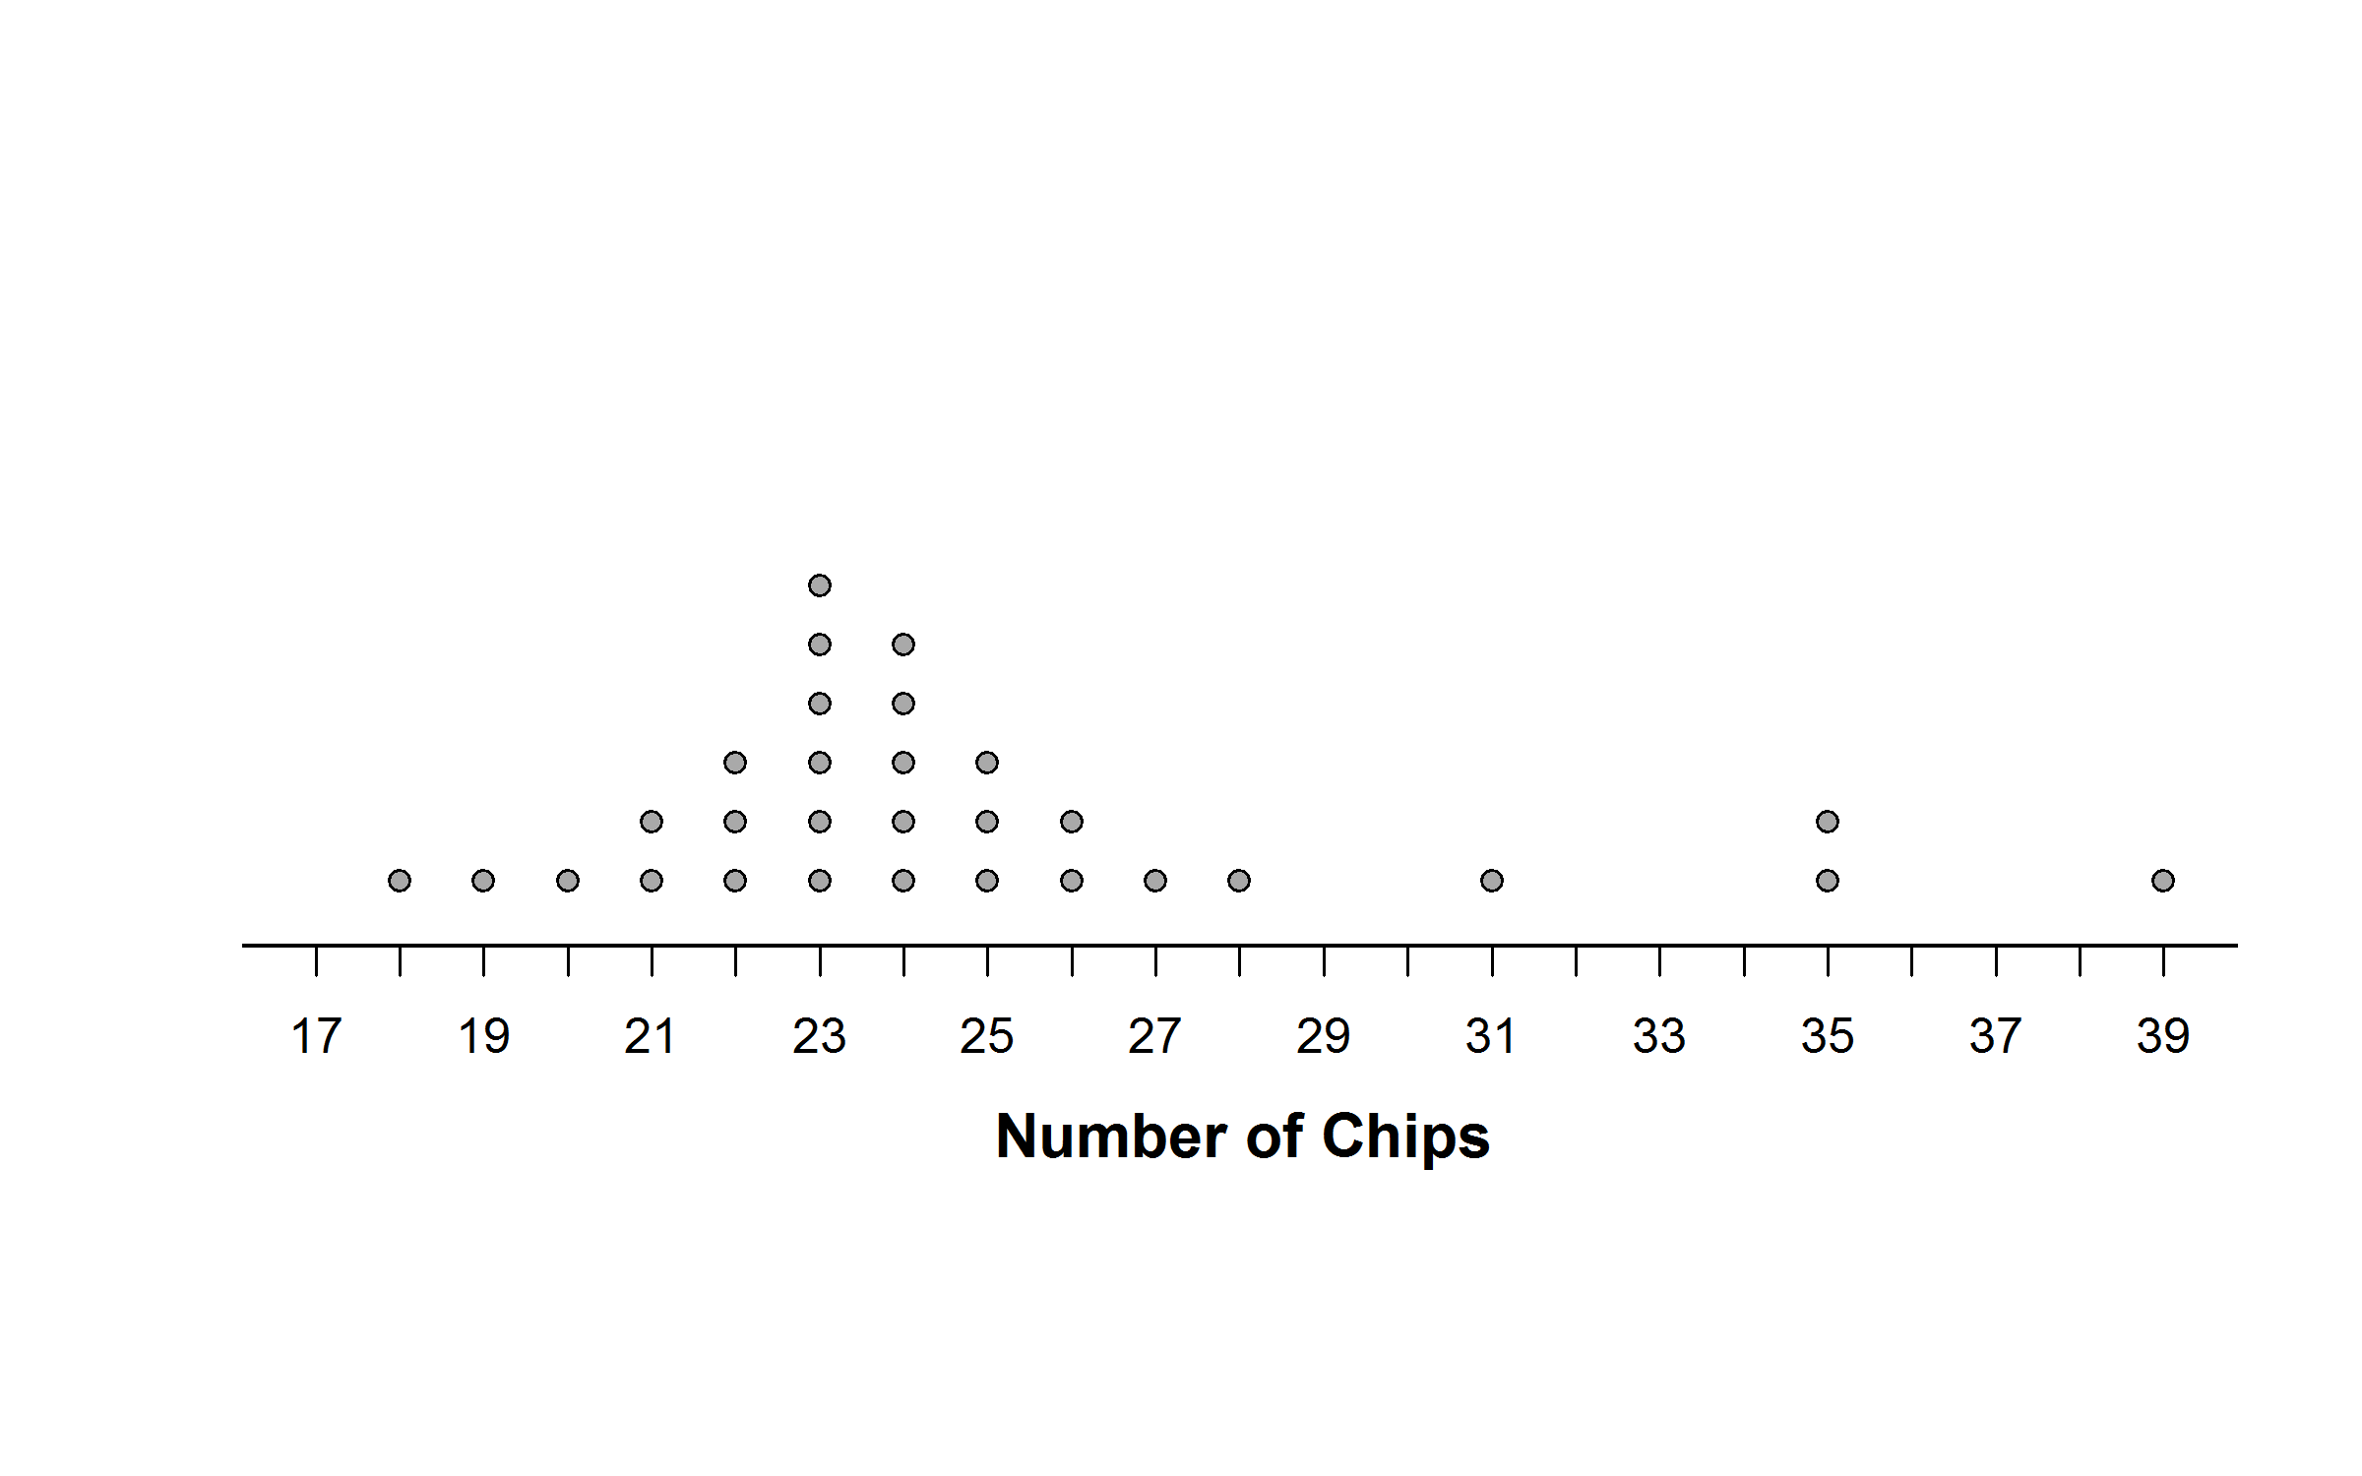
A fifth-grade teacher had each of his 30 students choose a chocolate chip cookie and count the number of chips in the cookie that was chosen. The data are displayed below.
The teacher’s chocolate chip cookie had 27 chips in it. Compared to the students’ results, why would his 27 chips be considered typical for these cookies?
Because one cookie had 27 chips.
Because one cookie had 39 chips.
Because 26 out of 30 cookies had between 18 and 28 chips.
Because all cookies had between 18 and 39 chips.
8%
2%
59%
30%
Point-Biserial Correlation 0.41
GAISE Level A, “Analyzing Data”,
“Students compare individual to individual.”
CCSS-M Grade 5 MD.2

Slide 9
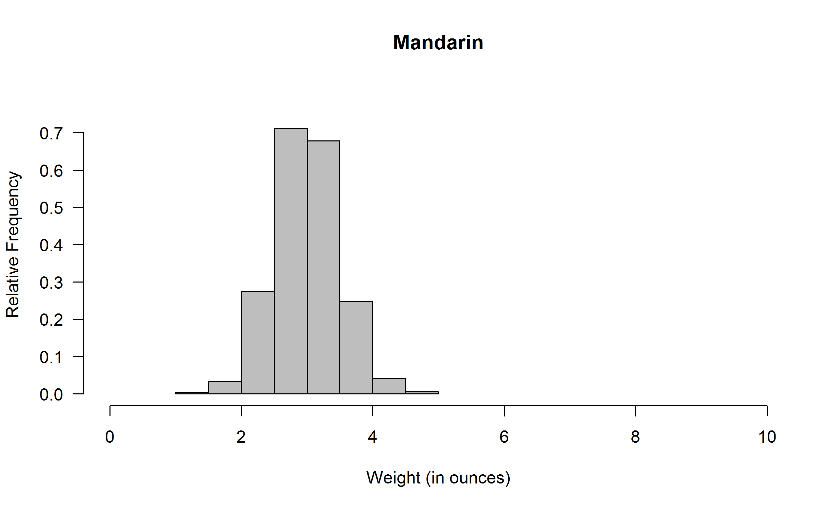
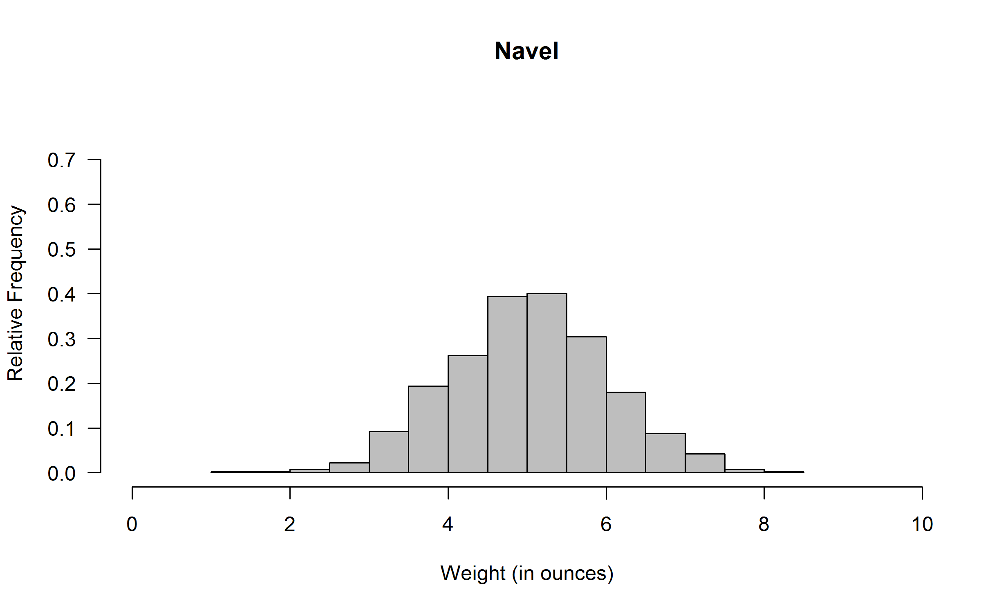
A citrus farmer grows two types of oranges: mandarin and navel. The distributions of weight for each type of orange grown on his farm are shown in the histograms below.
The farmer will select a random sample of 100 mandarin oranges and a random sample of 100 navel oranges. Which sample is more likely to produce a sample mean within 1 ounce of the mean weight for its population?
The sample of mandarin oranges because the weights of mandarin oranges are less variable than the weights of navel oranges.
The sample of navel oranges because the weights of navel oranges have a greater mean than the weights of mandarin oranges.
Both samples are equally likely to produce a sample mean within 1 ounce because the sample sizes are the same.
It is impossible to know which sample is more likely to produce a sample mean within 1 ounce without the actual data from the samples.
55%
13%
18%
13%
Point-Biserial Correlation 0.44
GAISE Level B, “Interpreting Data”,
“Students describe differences between two or more groups with respect to center, spread, and shape.”
CCSS-M High School S-ID.3

Slide 10
LOCUS resources
Beginning/Intermediate and Intermediate/Advanced forms
With pre- and post- versions for use in research
Choice of formats
Paper and pencil available soon (MC and CR items)
Online forms available soon (extended MC only)
Diagnostic reports for targeted instruction
Website with commentaries for sample items under development
COMING AUGUST 2014

Slide 11
Thanks!
Questions will be taken Wednesday, May 21 at 1:15pm Eastern Daylight Time
LOCUS website (updates coming soon)
http://education.ufl.edu/locus/
LOCUS PI: Tim Jacobbe, jacobbe@coe.ufl.edu
Co-PIs: Bob delMas, Jeff Haberstroh, and Brad Hartlaub
Graduate Assistants: Catherine Case, Steven Foti, and Douglas Whitaker

