Slide 1
Statistical Methods for Engineers Developing a Flipped Pedagogy 15 years before its invention Marc Bourdeau Professor Emeritus PolytechniqueMontréal e-Cots, May 2014 (For the slides, see WikiStat.ca: last line of the page)

Slide 2
Every term
3 to 4 sections
of around 60 students
A coordinating professor
Other professors
One TA for each group

Slide 3
Weekly theoretical workload (4; 1; 4) (Lectures, Labs, Personal study) …In practice (1,5; 0,25; 1)
One mid-term, one final; Fail rate: 20%
(unacceptable for our administration)
Decreasing level of the course over the years
2 homeworks (teams of 4) widely copied;
grade inflation

Slide 4
In brief, at the turn of the century
Students show no interest
…as well as the staff!
Dying course
«Hopeless !»

Slide 5
New pedagogy for the course
«Reading maketh a full man; conference, a ready man; writing, an exact man.» (Of Studies, Francis Bacon [1561-1626])
Real data, team work, project based learning
wall to wall work ‘within’ the software
Simulating the work in an industrial context

Slide 6
A website
For the students to get information on the course
and express themselves
their own grades, extra documents, their own evaluations of the course, etc.

Slide 7
Student evaluation of the course Crucial Innovation the pedagogical relation is based on confidence
Mostly open questions
Closed questions on the
student’s workload

Slide 8
Rigorous Protocol
The evaluation form is given to the students with their marked mid-term copies
Which they hand in to 2 ‘reporters’, fellow class mates, who count them put their initials on the page, and give their report with the evaluation forms to the professor
The professor compiles the students’ evaluations, reports to the students at the following meeting of the class, gives them back to the students who can annotate, comment, discuss them
The whole process again during the last period of the course

Slide 9
Developing a ‘new’ pedagogy
Reading
A new textbook
Only one adapted to our needs: Ostle &al. (1996)
«Engineering Statistics. The industrial experience.»
Term after term, I write, rewrite a new one (Pdf-Latex) with hyperlinks, historical notes, animations, simulations, lots of simple exercices

Slide 10
Professors and TAs less and less sages on the stage more and more guides in the aisles
Beginning of the course: lectures on the elements,
then an experiment in data collecting: variation
All along the course: less and less lectures
The professor is less and less a ‘sage on the stage’
For the students, more and more: reading the textbook,
writing and discussing simple problems (labs) with team mates
Homeworks are case studies that introduce new material
Report writing with team mates
Students attend classes to discuss their work with the professor and fellow class mates, ask questions
Reading, meeting & writing

Slide 11
10 labs, 20-25% of the final grade
Teams of 2, both team mates hand in their copy
10-12 ‘short’ exercices: weekly suggestions
At the start of the lab: 3 «are chosen at random»: writing
One, «randomly chosen», is carefully marked
The staff and the TAs serve as guides
Reading, meeting & writing

Slide 12
2 case studies (35%)
The closest we can get to the type of work practised In the industry
15-20 pages of definition: statistical questioning and reasoning
Teams of 4
20-30h from each team-mate: study/report writing, approx. 20 pages: hard team-work
Students come in class for discussion, questions (they all come!)
Reading, meeting, writing

Slide 13
Course validation (40%)
A mid-term exam 15% (2h)
A final exam 25% (2h30)
Individual work
Reading & writing

Slide 14
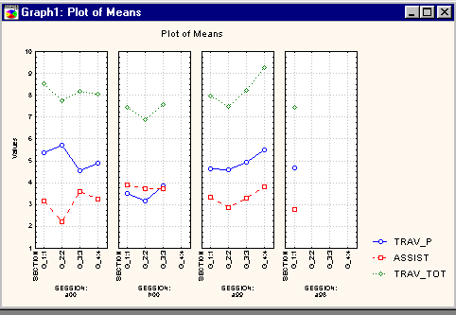
Post-hoc situation
Course ‘triplet’: (4; 1; 4)
Situation ante: (1,5; 0,25; 1,0)
post: (3,5; 1 ; 4)
‘Assist’: class attendance (noted 4)
‘Trav_P’ : personal study (noted 4)
Trav_Tot’: Total workload
Failure rate: close to 0%
All the students attend the labs
(worth 25%...)
Students (not all) are enthousiastic: «We are learning something usefull.»
The staff (not all) are enthousiastic: «We are proud of our students, feeling of usefulness»
Notes:
Les pétulance juvénile: si on leur demande beaucoup, des choses qui vont servir. On leur fait confiance, ils donnent beaucoup.

Slide 16
Drawbacks 1
‘Large’ workload for the students
…old habits
‘Huge’ workload for the staff
…old habits!

Slide 17
Drawbacks 2
Really too much work for the professors
Lack of institutional resources ($$)
The case studies cannot be reused nor recycled:
the students have their own websites!
The ‘other’ workload of professors (research, etc.)
Annoyances with
…certain students (very tenacious and well organised), …certain colleagues (very tenacious and …envious),
…certain administrators (very tenacious, side in with students)
« I don’t want no bothering »

Slide 18
All in all
We have shown that
The students are not stupid, on the contrary!
Many can be made to be enthousiastic for Statisistics
Pedagogy is crucial
Reading, meeting, writing; decent evaluation
No cheating, no grade inflation, increasing levels…
Professors can be proud of their students!
More resources have should be given to the teaching sector in colleges and universities

Slide 19
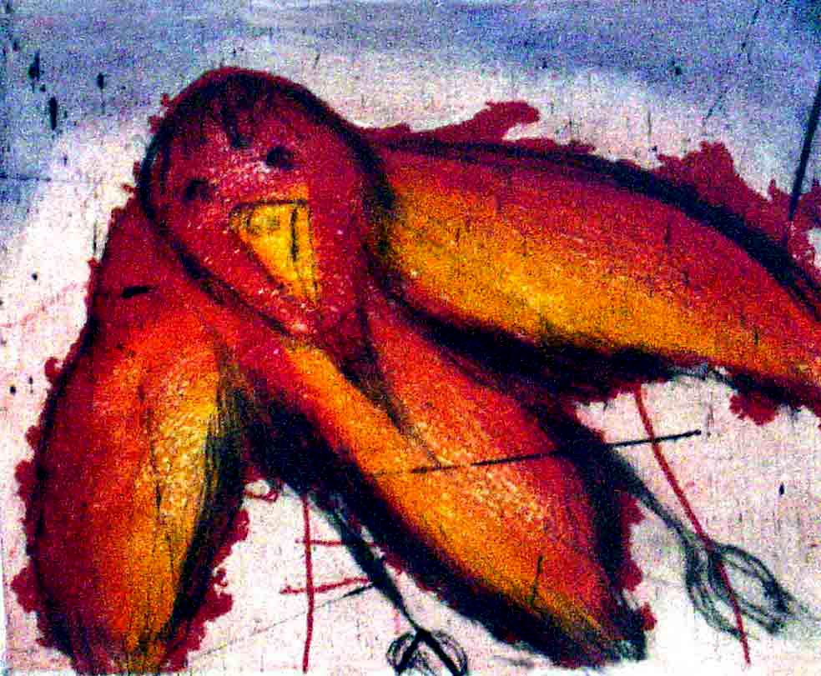
PrixPoly1873 for outstanding merit (2001) For pedagogical efficiency
This experiment has lasted 5 terms, 1999-2001
Sabbatical leave… My successor went back to our old textbook, old slides
…old ways, same effect
Offered etching: «L’oiseau rare»

Slide 20
Some references
Recent and modern textbooks
Some articles

