Slide 1
The impact of the SCHEMATYC workshop
“Identifying and Addressing the Difficult Concepts for Students in the Introductory Statistics Course”
Stephanie Jernigan
May 23, 2014

Slide 2
Introduction
Stephanie Jernigan
My background is operations research
  Last year was the first year I’ve taught stats
I teach Intro to Business Stats at Boston College
  mostly freshmen
  at least 25% have had AP stats

Slide 3
The workshop
Was my introduction to teaching statistics
Most valuable resources
  List of questions provided by Deb and Marjorie that students have problems with
  The discussion about how other teachers help students really understand those concepts
  The link to the ARTIST database of test questions hosted by U of Minnesota
    tests mastery of concepts, not calculations

Slide 4
Inspiration question from workshop
Class goal: assess understanding of measures of spread (esp variance)
Order histograms from LOWEST amount of variability (listed first) to HIGHEST amount of variability (listed last).
    1, 2, 3
    3, 2, 1
    3, 1, 2
    None of these
Notes:
First semester I lectured on the topics a little, then next class gave this as a pre-class self-quiz to students: on projector, they answered with voting cards, and then we discussed the answer.

Slide 5
Our current class approach
Students are responsible for reading definition of each in textbook before class
  range
  interquartile range/5-number summary
  variance/standard deviation
Quick review of definitions: discuss definition of variance, standard deviation
Then ask them a series of multiple choice questions to deepen their understanding
  emphasize the difference between reading a definition and knowing it
  what each measure of spread tells you and what it doesn’t
  the meaning of each measure of spread in real-life situations
Students in groups of 3 or 4
Notes:
Students really liked our pre-class “quizzes”, so we’re expanding them into more learning tools

Slide 6
Example: Salary inequity
The career office at BC tracks the starting salaries of its graduates: below are histograms of the starting salaries from 1980 and from 2005, both in 2005 dollars.
  Each group prepare arguments that
    income inequity has not changed from 1980 to 2005
    income inequity has changed from 1980 to 2005
Notes:
each group, both sides; cold call
Income equality hasn’t changed: mean, median, range all the same
has changed: standard deviation has increased in 2005
if they use natural language, ask about statistical measures, and vice versa

Slide 7
Example: Movie making
You’re advising the head of a major movie studio about what type of movie they should make next, either an action movie or a comedy. You have information about the profit of the action movies and comedies made by the studio in 2013.
  Each group prepare arguments
    in favor of action movies
    in favor of comedies
Notes:
action: higher mean, if willing to take risk of big failure in pursuit of big blockbuster
comedy: sure thing: less variability = less risk
if they use natural language, ask about statistical measures, and vice versa

Slide 8
Our goals
Extend these questions to increasingly more complex concepts

Slide 9
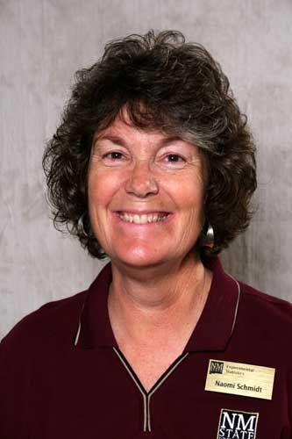
Naomi Schmidt
New Mexico State University

