Slide 1
Strategies for
Flipping Your Classroom
Ruth Whitmore
Educational Technology Advisor
W.H. Freeman / Macmillan Higher Education
Notes:
Presentation May 23, 2014 at 11:30 Central time
Welcome, and thank you for your attendance at this session on the last day of eCOTS. In the next half-hour we will be discussing strategies for flipping your classroom. The research on the efficacy of this model continues to flow. It has convinced many instructors to try a flipped model for themselves. Perhaps you are one of those people.
In our short session today, I will not be addressing whether or not you should flip your classroom. I am assuming that you have decided that a flipped classroom is worth doing – or at least exploring what is available to help accomplish this. I think you will like what you see in the next 20 minutes or so.

Slide 2
Flipped Classroom
aka
Inverted Classroom
Participatory Learning
Student-Centered
Active Learning
Problem-based Learning
Notes:
Flipping the classroom has other names: Inverted classrooms, Instruction promoting Participatory Learning, Active learning, Problem-based learning, all of which describe a student-centered pedagogy that may not have been your experience when you were students.
So.. To start, I would like to begin with a poll, What attributes do you associate with Flipped Classrooms? Choose as many as apply in the list of possibilities.
=================================================
Lets look at the results…
….. Yes, I sort of stacked the deck here. As I expected most of you checked most of the responses.

Slide 3
Flipped or Inverted Classroom:
An inverted (or flipped) classroom is a specific type of blended learning design that uses technology to move lectures outside the classroom and uses learning activities to move practice with concepts inside the classroom.
~~~Jeremy F. Strayer
Learning Environments Research
July 2012, Volume 15, Issue 2, pp 171-193
http://link.springer.com/article/10.1007/s10984-012-9108-4
Notes:
So, let’s start with defining what I mean by a Flipped Classroom,
An inverted (or flipped) classroom is a specific type of blended learning design - that uses technology to move lectures outside the classroom - and uses learning activities to move practice with concepts - inside the classroom.
… Whatever, you call this model, in essence, it is a fundamental shift in expectations for students and instructors. Students are expected to prepare for class – gaining their first exposure to new material outside the classroom. Instructors are expected to provide the materials for this first exposure, AND provide an enriching active-learning environment in the classroom.

Slide 4
Key Elements for success in a flipped classroom
Provide an opportunity for students to gain first exposure prior to class.
Provide an incentive for students to prepare for class.
Provide a mechanism to assess student understanding.
------------
Provide in-class activities that…promote deeper learning.
Source: http://cft.vanderbilt.edu/guides-sub-pages/flipping-the-classroom/ Accessed 5/6/2013
Notes:
Key Elements for success in a flipped classroom are listed here.
In this session, I intend to address the first three key elements, the pre-lecture elements.
Provide an opportunity for students to gain first exposure prior to class.
Provide an incentive for students to prepare for class. – This is human nature… we react positively to incentives. Students are no different. They will be more prepared for your in-class activities - if there are due dates, and credit given for preparing for class.
…And to help you address the needs of your students:
Provide a mechanism to assess student understanding of the concepts delivered prior to class.
The last element listed here encapsulates the changed focus of your classroom in the flipped model.
Provide in-class activities that promote deeper learning.
While this list is not long, it presents challenges for you as instructors.

Slide 5
Challenges for an instructor
Preparing first exposure activities
Designing incentives for the preparatory work
Creating assessments to gauge a student’s understanding
Developing the active in-class environment activities
TIME to do it all …….
Notes:
The Challenges you face:
Preparing first exposure activities
Designing incentives for students to do the preparatory work
Creating assessments - to give you feedback about your students understanding
Developing the active in-class activites
…and lastly, TIME to do it all ….
time to do it all is not a minor problem…. As I am sure you are all aware. This is where we can help.
Before we go on, I would like you to respond to another poll to indicate your experience level with flipped classrooms.

Slide 6
www.WHFreeman.com/Stattools for success in a flipped classroom
StatsClips and SnapShots
  Lecture videos by Alan Dabney, Texas A&M,
  Questions centered on videos are included in question bank, if quizzing is desired
StatTutors
  Interactive lecture activity with embedded quizzing
Applets with built-in formative quizzing activity
Stepped-out Tutorials
LearningCurve – a formative, adaptable, concept-oriented activity in a game-like format
Notes:
Thank you for giving me that background information about your experience with flipped classrooms.
For the rest of this session I would like to highlight some resources. These can be central in your strategy to implement a successful flipped classroom – one with the goal of success from the first semester of implementation. The huge investment of time, that is too often required, can be made manageable with use of these resources. That is KEY for success.
Rather than look at a slide listing the resources, please stay with me as I switch to a browser window. Thanks….

Slide 7
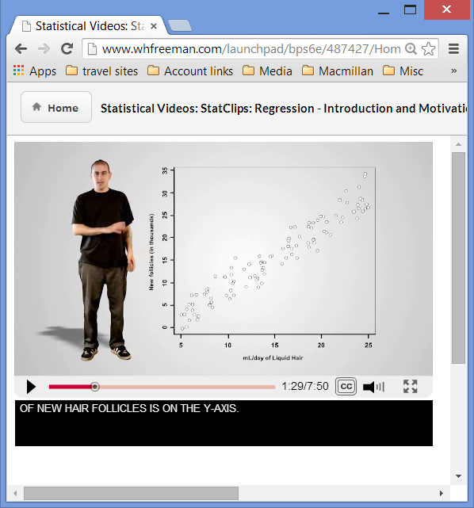
StatClips
Videos by
Alan Dabney of Texas A&M
~~~
Closed captioned
Questions about videos are available in the question bank

Slide 8
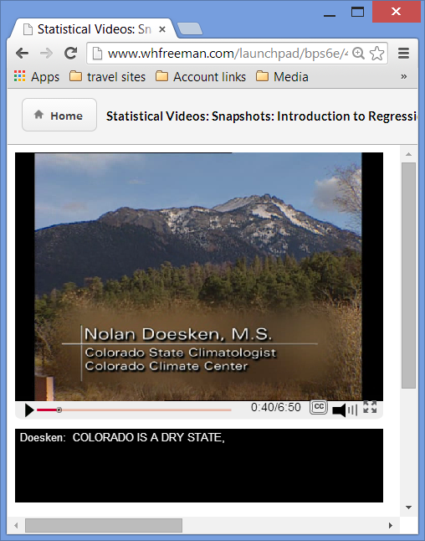
Snapshots
Application oriented videos

Slide 9
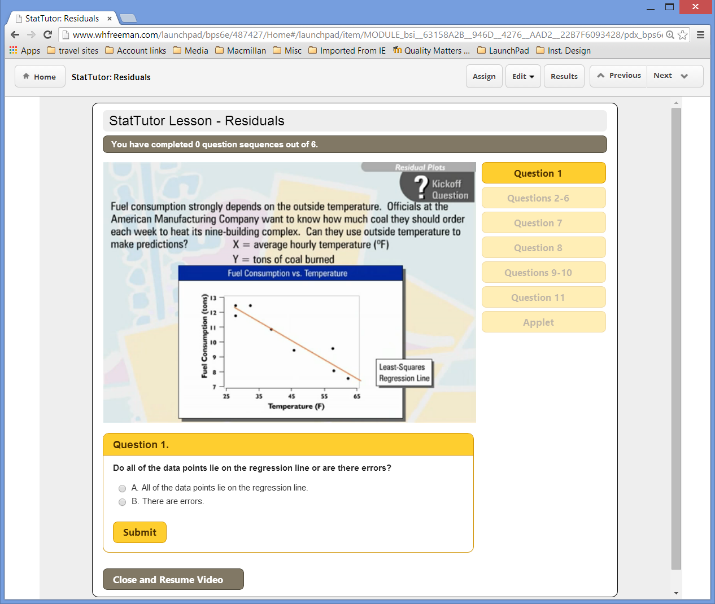
StatTutor
with embedded quizzing
Notes:
This portion of the slide show would be for the handouts. In the presentation, I would switch to the live LP site.

Slide 10
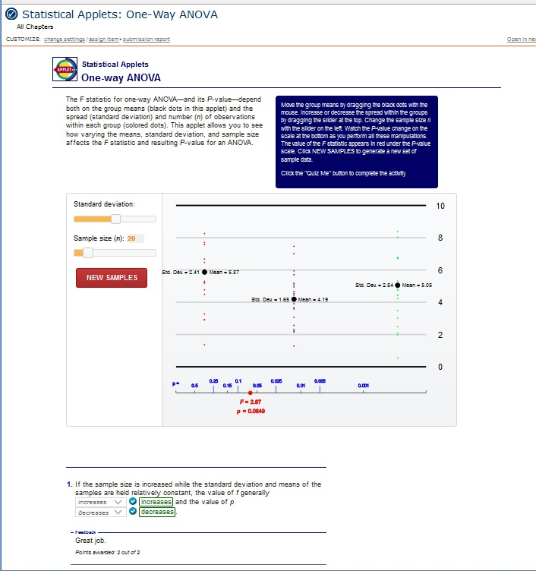
Applets
Add image
With embedded quizzing that leads the student to use the applet to illustrate the concept.

Slide 11
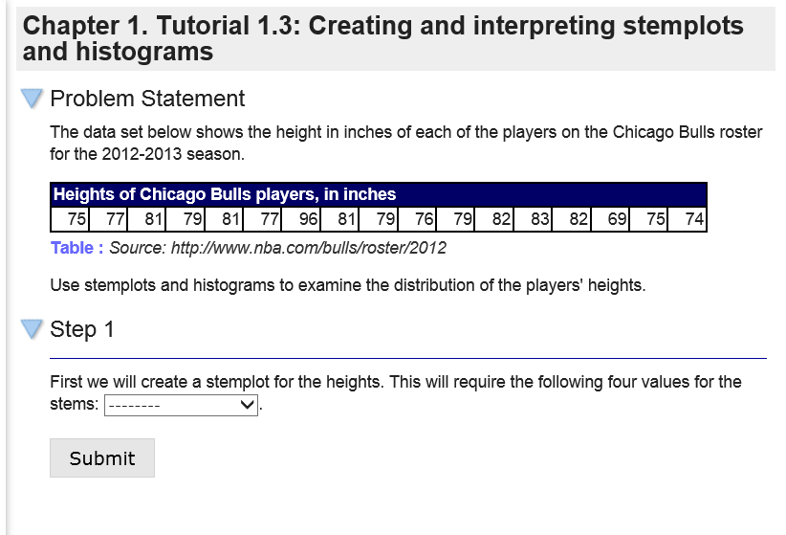
Stepped Tutorials
Students are led through the steps of a problem to understand the concepts and process.

Slide 12
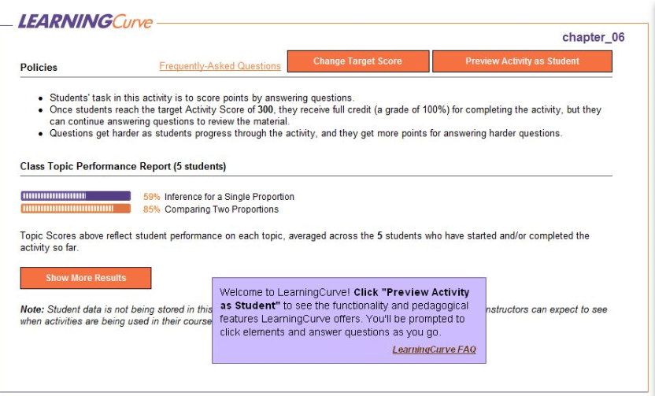
Learning Curve
An adaptive quizzing and personalized conceptual learning program – in a game-like format.

Slide 13
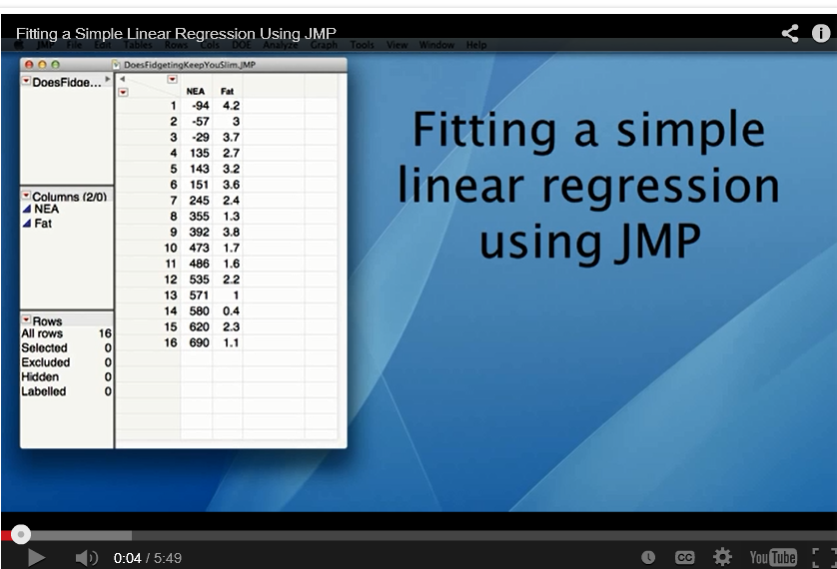
Video Tech Manuals
Brief, instructional videos for using statistical software. Available for Excel, SPSS, TI-83/84 calculators, JMP, and Minitab

Slide 14

CrunchIT!
A web-based statistical program for statistical operations and graphing

Slide 15
StatTools: a strategy for success in your flipped classroom
Meeting the needs of students in their first exposure to statistical concepts
Providing incentives for students to prepare for class.
Providing a mechanism for you to assess student understanding
Notes:
We have just reviewed some of the StatTools available from W.H. Freeman. These have purpose, and can be used to address specific learning objectives.
They can be part of your course design to meet the challenges listed here:
Meeting the needs of students as they gain first exposure to concepts
Providing incentives to prepare for class - the incentives are there because all of these resources are assignable with or without grades being associated to them.
And
Providing a way for you to know - what your students know.

Slide 16
How do I use these
StatTools Resources?
Available with all W.H. Freeman introductory statistics textbooks
Assignable with or without associated grades from W.H. Freeman course platforms which include an integrated eBook – media resources – homework .
  Talk to us about which platforms are available for the text of your choice
Notes:
It is not enough for me to just show you all these well-developed resources. I also need to let you know how you might use them.
First, all our introduction to statistics textbooks are integrated with these resources.
All resources are assignable - with or without grades – and these are delivered within a full course management system - on several different platforms.
As I said at the beginning of the session, the flipped model is truly a fundamental shift in the way we provide education. The amount of time required for successful implementation - from the first semester on … is a definite challenge. W.H Freeman’s resources give you a strategy for success in your classroom.
Let me point you in the right direction to find out more information.

Slide 17
To obtain more information about
W.H.Freeman media offerings:
Contact any one of the following:
Ruth Whitmore, Educational Technology Advisor
ruth.whitmore@macmillan.com
920-723-5128
Karen Fusco, Digital Solutions Specialist
karen.fusco@macmillan.com
212-561-8248
Your local W.H. Freeman Representative
Notes:
In conclusion, I would like to reiterate that the resources I have just shown - are available within our course delivery platforms - With just a few clicks to assign due dates and grade points, your students will get credit for doing this work. Quizzes and homework would take a few more clicks, but are available for your use.
As I said at the beginning of the session, the flipped model is truly a fundamental shift in the way we provide education. The amount of time required for successful implementation from the first semester on …is a definite challenge. Our resources give you a strategy for success in your classroom.
Thank you for attending this session with me.
Are there questions?

