Slide 1
Using Creative Inquiry to Understand the Role of Statistics in Undergraduate Research
Rose Martinez-Dawson, Ph.D.
Department of Mathematical Sciences
Paul L. Dawson, Ph.D.
Department of Food, Nutrition and Packaging Sciences
Clemson University
Clemson, S.C. USA

Slide 2
Why do I need to take a Statistics course?
Creative Inquiry
Understand the role of Statistics in Undergraduate Research
What does Statistics have to do with my major?

Slide 3
What is Creative Inquiry (CI)?
University-wide initiative at Clemson University
Discovery-oriented approach to learning
Promotes
Reasoning and critical thinking skills
Ethical judgment
Development of communication skills
Use of scientific methods of research
Use of methods in humanities research
Develops teamwork
Promotes meaningful experiences
http://www.clemson.edu/academics/programs/creative-inquiry/

Slide 4
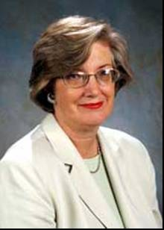
Motivation for CI
Former President James F. Barker
“The most stimulating and memorable intellectual experiences are ones which are a journey without a clear destination, led by faculty members engaging a small group of students.”
Former Provost Dori Helms
“Research is faculty learning and education is student learning - - let’s put these two concepts together and learn together.”

Slide 5
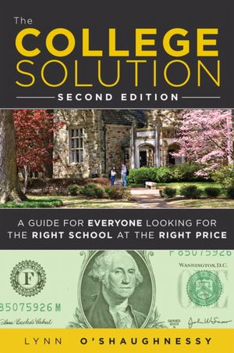
“The College Solution: A Guide for Everyone Looking for the Right School at the Right Price,” financial writer Lynn O’Shaughnessy profiled Clemson’s Creative Inquiry program as a best practice in undergraduate research. She wrote: “Unfortunately, the experiences that Clemson students enjoy are not nearly common enough.”

Slide 6
Creative Inquiry Program
Students receive course credit
Typically 1 credit hour per semester
Credit hours can be variable
Project usually lasts one semester but could be multiple semesters
Can enroll in any CI class throughout University
Clemson University provides financial support for CI teams
Based on number of students
Supports purchase of supplies and equipment
Goals of finding, experimenting, analyzing, evaluating, and communicating information

Slide 7
How CI is implemented
In Foods, Nutrition and Packaging Science Department (FNPS)
Teams are formed around projects with faculty mentor(s)
Usually 5 to 15 students

Slide 8
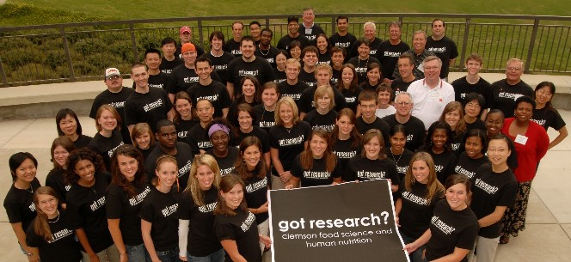
“CREATIVE INQUIRY”
Growth of Student Majors and Student Teams

Slide 9
How CI is implemented
Research projects relate to food science, human nutrition, or culinary science
Examples of projects:
http://www.clemson.edu/academics/programs/creative-inquiry/projects/current-projects.html
Project: Testing Food Advertising Claims
Our CI class includes faculty member from FNPS and statistician from Mathematical Sciences
Reinforce role of statistics in research
Research is conducted by a team
Students have usually completed an introductory Statistics course

Slide 10
Integrating Statistics in CI
Project: Testing Food Advertising Claims
Selection of Research Topic
Students decide on team research within project
Students propose research topics
Discuss and vote on choice

Slide 11
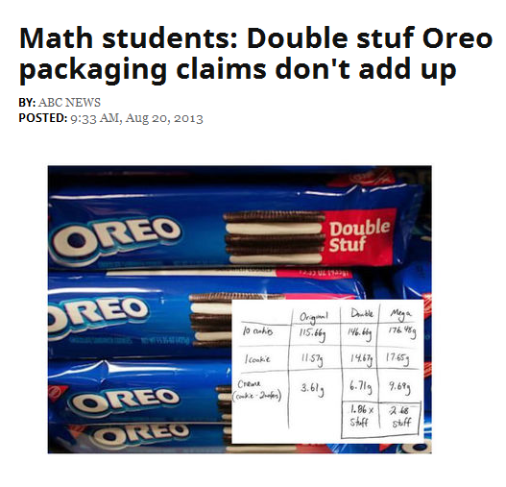
Integrating Statistics in CI
Project: Testing Food Advertising Claims
Selection of Research Topic
Sources of research topics:
Interest, Current events, Commercials

Slide 12
Integrating Statistics in CI
Project: Testing Food Advertising Claims
Selection of Research Topic
Develop Hypotheses

Slide 13
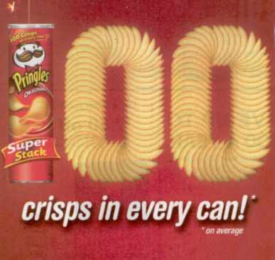
Examples of CI Topics/Hypotheses
Test Kellogg’s Raisin Bran 2 scoops claim
Test Dairy Queen Blizzard claim
Test Pringles Super Stack claim

Slide 14
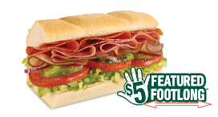
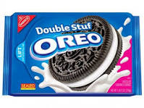
Examples of CI Topics/Hypotheses
Test Dr. Pepper versus Diet Dr. Pepper taste challenge
Test Subway foot long claim
Test Dr. Pepper 10 claim
Test Double Stuf Oreo claim

Slide 15
Integrating Statistics in CI
Project: Testing Food Advertising Claims
Selection of Research Topic
Develop Hypotheses
Data Collection
Survey
Laboratory

Slide 16
Data Collection Issues
Survey versus Laboratory
Survey
Create items for survey
Are you asking what you really want to ask?
Online versus paper survey
Taste tests
IRB training and approval for projects involving human subjects
Selection of participants
Sampling method and sample size
Laboratory
Sampling method and sample size
Equipment
Technique

Slide 17
Data Collection Issues
Variable definitions
For the Pringles’ Super Stack claim that on average 100 crisps per can, what is a “crisp?”
Only complete crisps are counted?
How many raisins are in a “scoop” of Kellogg’s Raisin Bran cereal?
Measuring “length” of Subway foot long sub

Slide 18
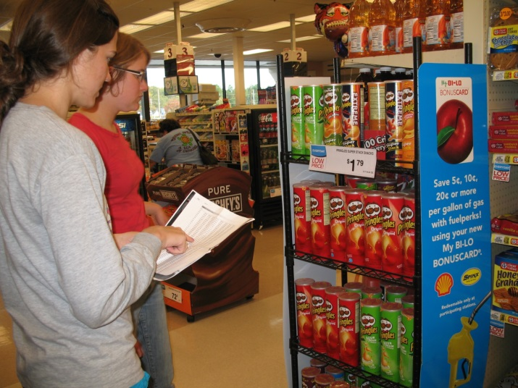
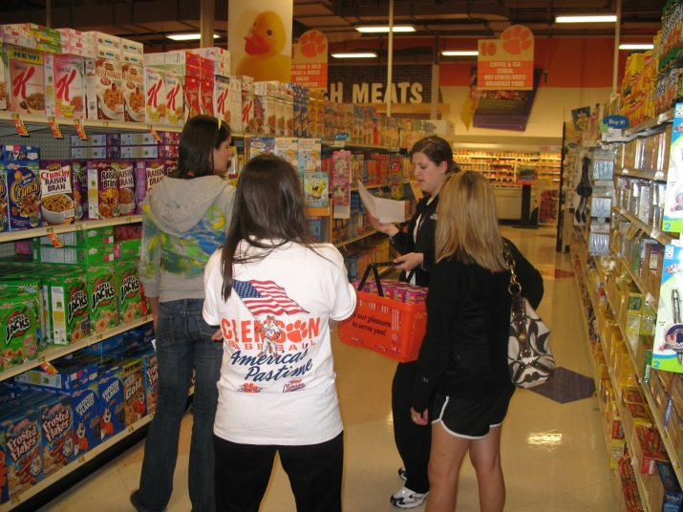
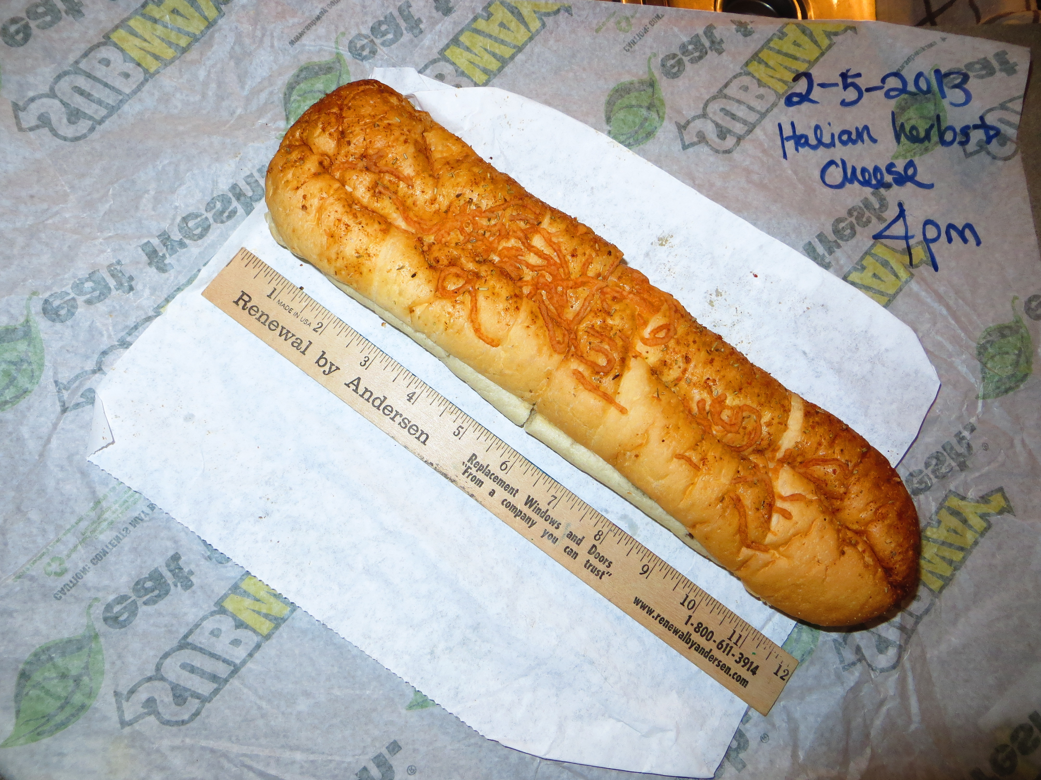
Selection of units off campus

Slide 19
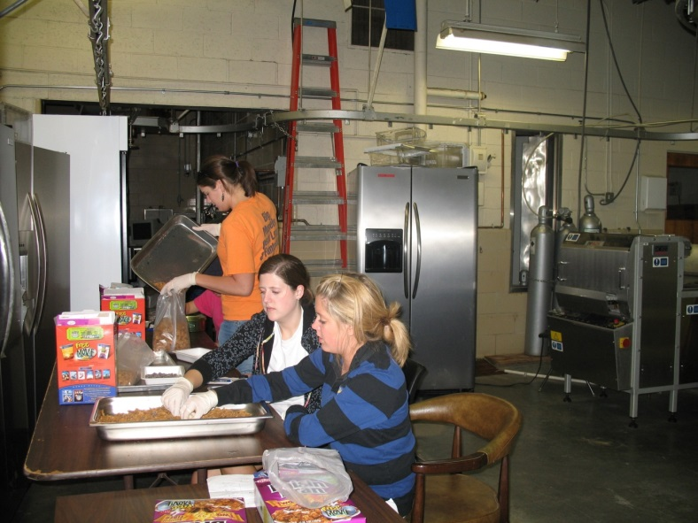
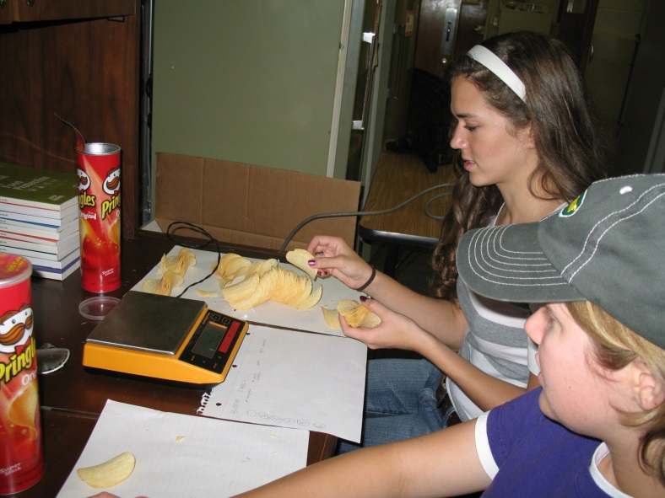
Collecting samples on campus

Slide 20
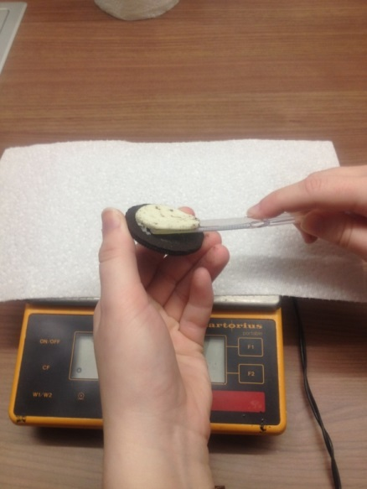
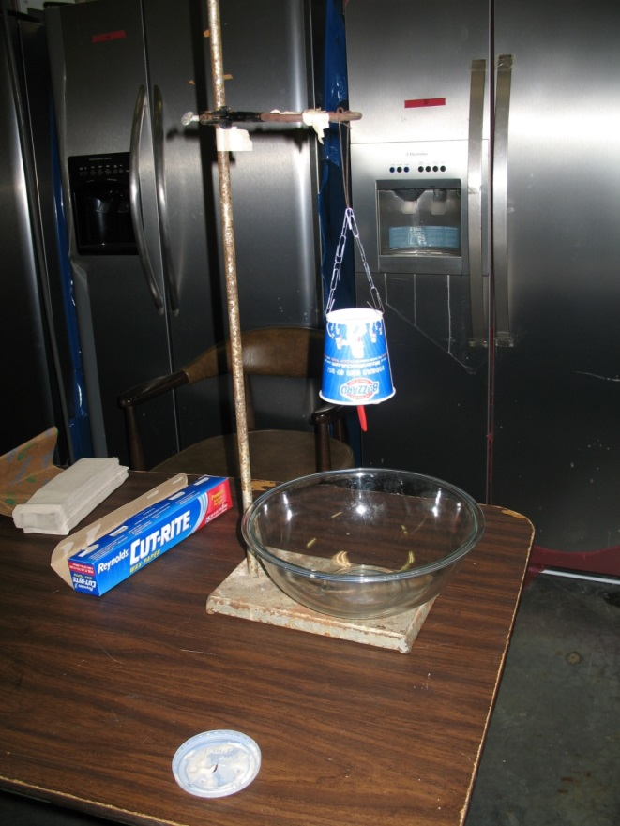
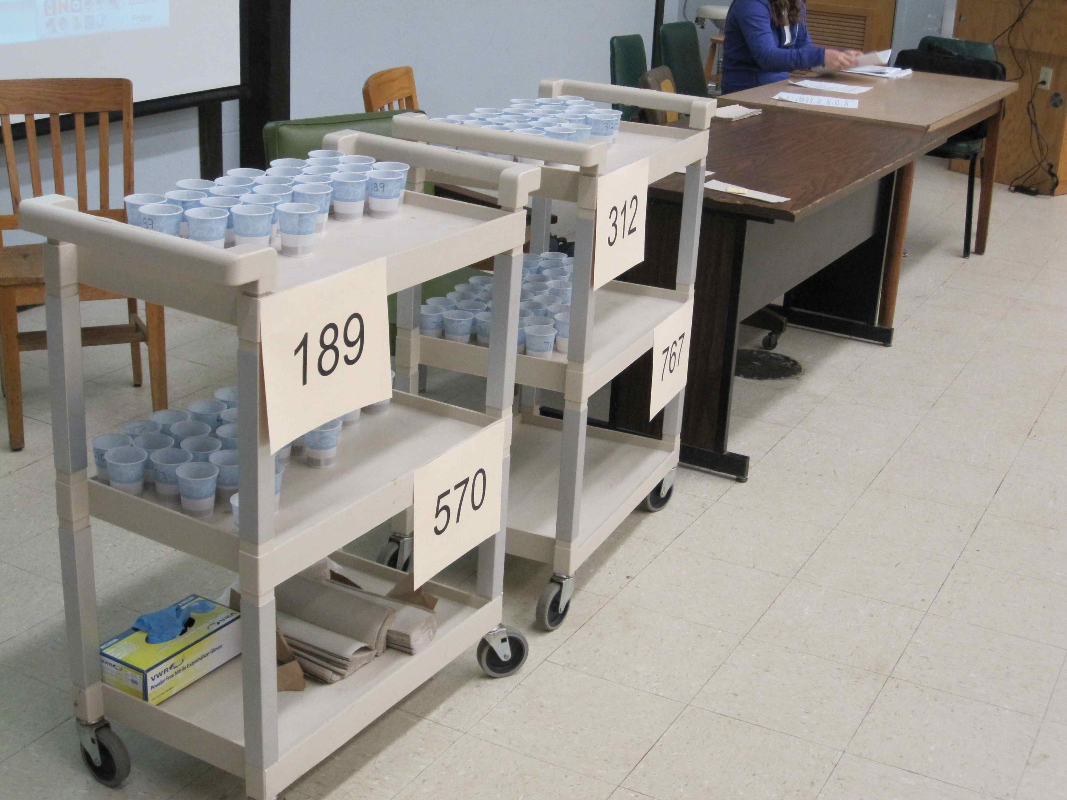
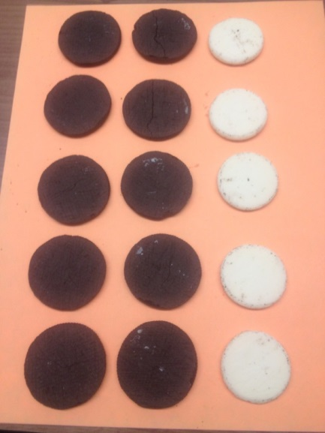
Data Collection
Use existing equipment
for data collection
Create device for data collection
Taste Tests

Slide 21
Data Collection Issues
Sources of variation
Understand how data collected affect results
Consider
Type of bread for Subway foot long subs
Product to product variation
Measurement error (Double stuf Oreos)

Slide 22
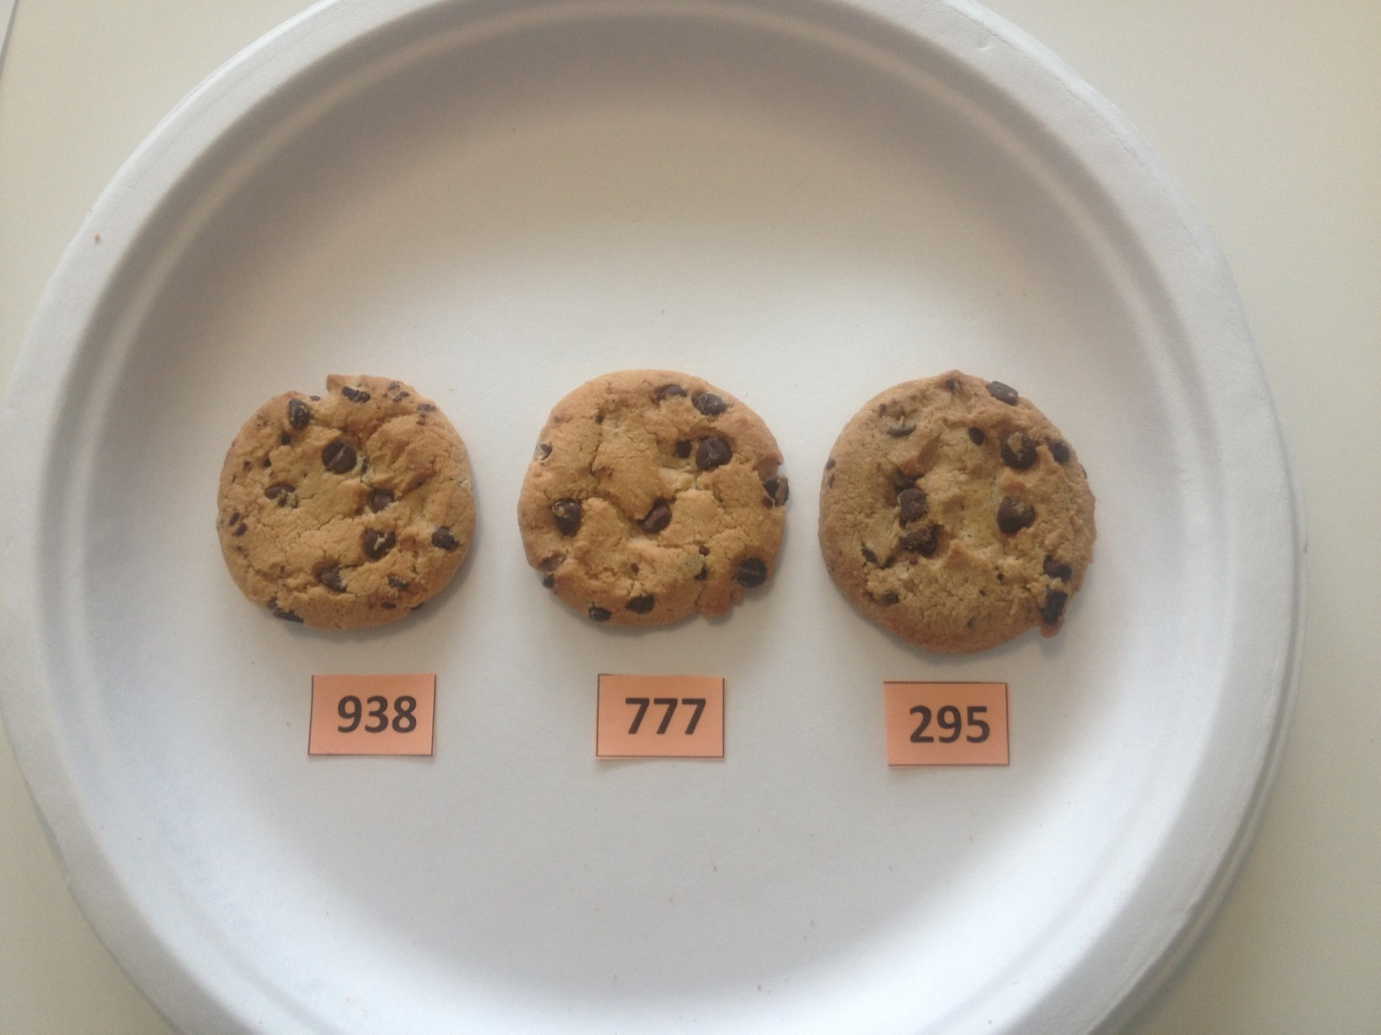
Demonstration of a Triangle Test
In this picture, there are 2 brands of chocolate chip cookies. Two of the cookies are the same brand.
Which cookie is different?
938
777
295

Slide 23
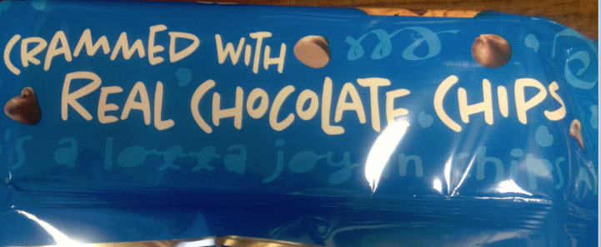
Chips Ahoy VS Keebler Chips Deluxe
From Chips Ahoy package:

Slide 24
Integrating Statistics in CI
Project: Testing Food Advertising Claims
Selection of Research Topic
Develop Hypotheses
Data Collection
Survey
Lab Setting
Statistical Analyses

Slide 25
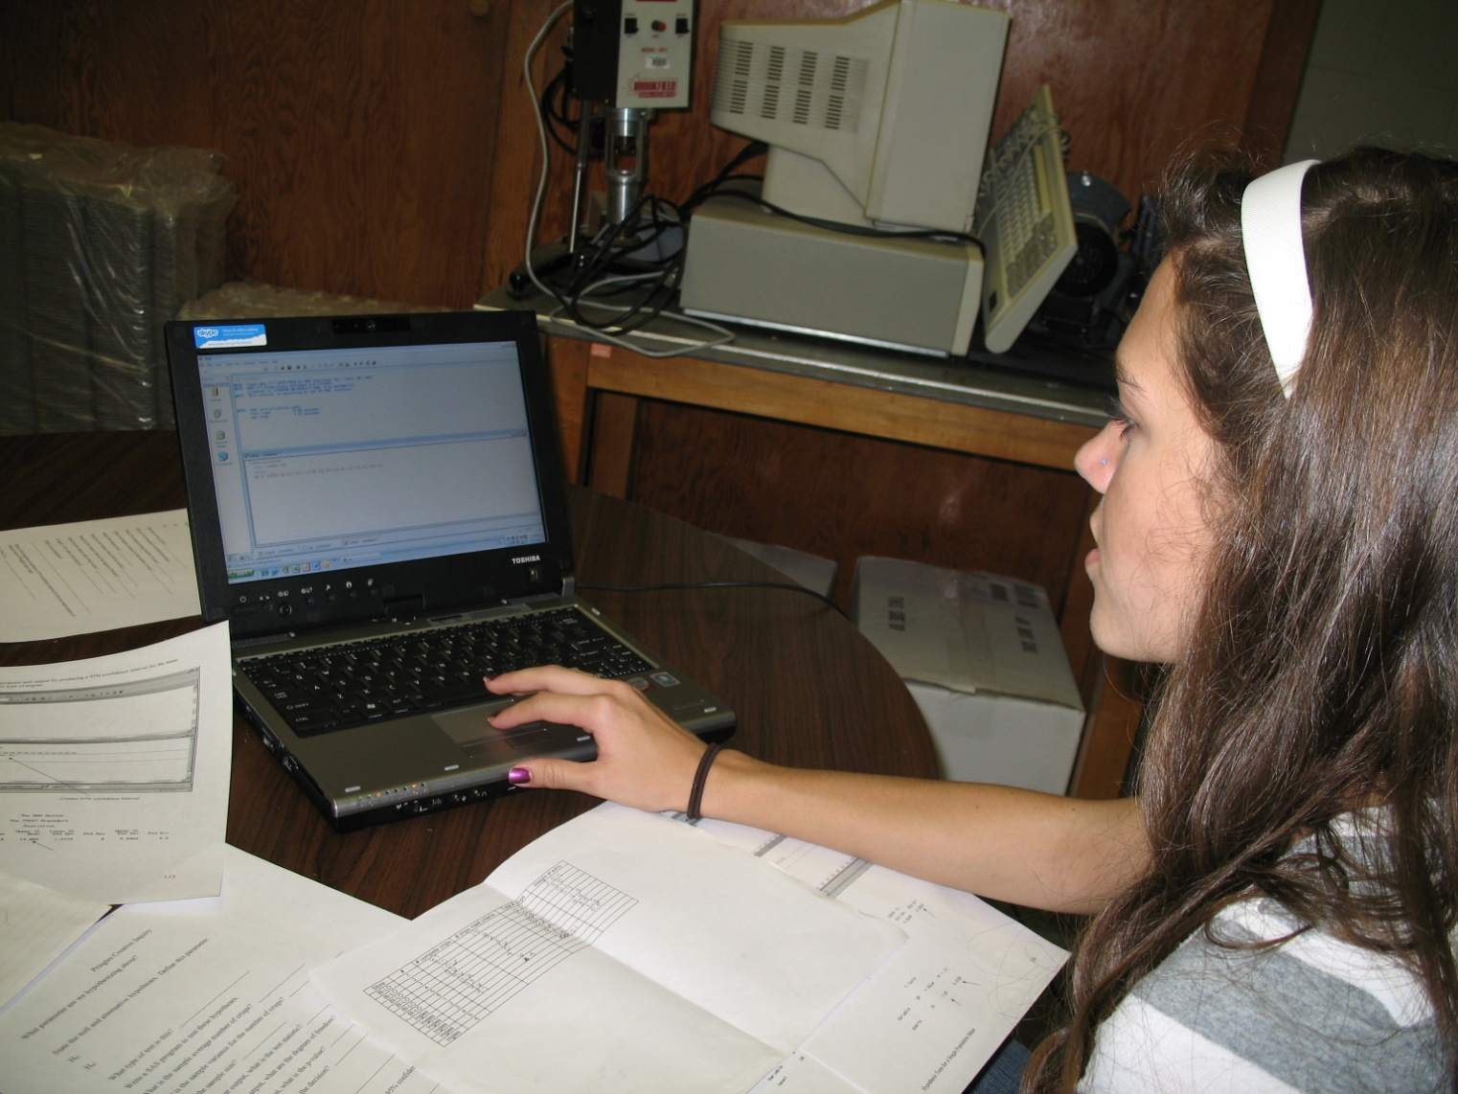
Statistical Analyses
Analyses by statistical software or by hand
Based on analyses from introductory Statistics class

Slide 26
Integrating Statistics in CI
Project: Testing Food Advertising Claims
Selection of Research Topic
Develop Hypotheses
Data Collection
Survey
Lab Setting
Statistical Analyses
Communication of Results

Slide 27
Communication of Results
Teams communicate project progress in several ways:
Clemson University CI poster symposium held near end of spring semester (http://www.clemson.edu/ci/assets/documents/foci/2013.pdf)
Decipher magazine (http://www.clemson.edu/academics/programs/creative-inquiry/program/decipher/)
Presentation at national meetings
Publication in peer reviewed journals
Travel grants (http://www.clemson.edu/academics/programs/creative-inquiry/opportunities/)

Slide 28
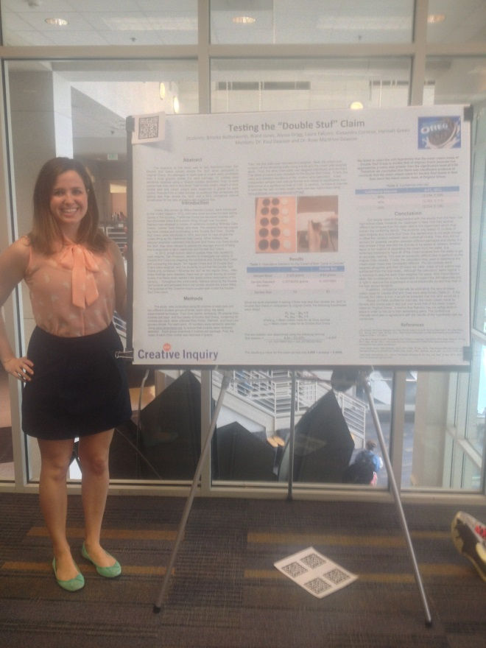
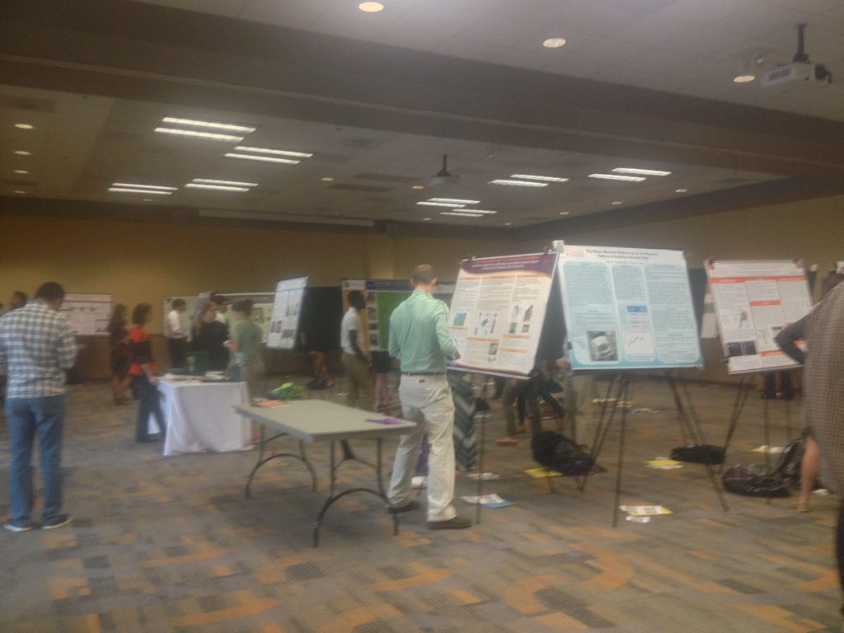
Creative Inquiry Symposium

Slide 29
Student Comments
“I liked that we got to select our topic for research. The course is very relevant to the real world, as we should evaluate food advertising claims both as consumers and food scientists. Additionally, being able to design and analyze a research study is a useful skill to have.”
“It was interesting, informative, and applicable to the food science world.”

Slide 30
Conclusion
Use real life data
Students take ownership of project
Research is not done in isolation – teamwork
Understand research process
Understand the role of Statistics in research

Slide 31
Now it’s your turn…
In a Creative Inquiry format, what food advertising claim would be of interest to test?

Slide 32
Questions?

