Slide 1
Big Data, Data Science and
Next Steps for the Undergrad Curriculum
Nicholas Horton (Amherst College)
and Johanna Hardin (Pomona College)
nhorton@amherst.edu
May 19, 2014

Slide 2
Acknowledgements
Main task of the American Statistical Association committee to update the undergrad guidelines in statistics
Also supported by NSF Project MOSAIC 0920350 (building a community around modeling, statistics, computation and calculus, http://www.mosaic-web.org)

Slide 3
Plan
Challenges and opportunities
Importance of data-related and computational capacities
Specific recommendations
Feedback and suggestions
(please see handout at eCOTS website)

Slide 4
Related eCOTS Talks
Mine Cetinkaya-Rundel (Duke) Planting seeds of reproducibility in intro stats with R Markdown
Conrad Wolfram: Fundamentally changing maths education for the new era of data science
John McKenzie (Babson) How intro stats instructors can Introduce big data through four of its Vs
Richard De Veaux (Williams) & Daniel J. Kaplan (Macalester) Statistics for the 21st century: Are we teaching the right course?
Horton, Prium, & Kaplan Teaching using R, RStudio, and the MOSAIC package

Slide 5
Related eCOTS posters
David Kahle (Baylor): visualizing big data
Dean Poeth (Union Graduate College): ethics and big data
Snyder and Sharp (Clemson): Intro to statistical computing
Amy Wagaman (Amherst): An introductory multivariate statistics course

Slide 6
Opportunities
“Age of Big Data” arrived
Tremendous demand for graduates with skills to make sense of it
Number of students has increased dramatically (+ more with Common Core)
Prior guidelines approved by ASA Board in 2000, widely promulgated and used
What should be rethinking in terms of the undergraduate statistics curriculum?

Slide 7
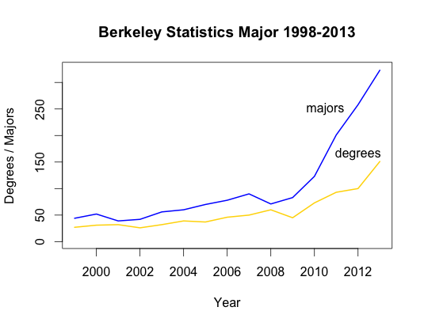

Slide 8
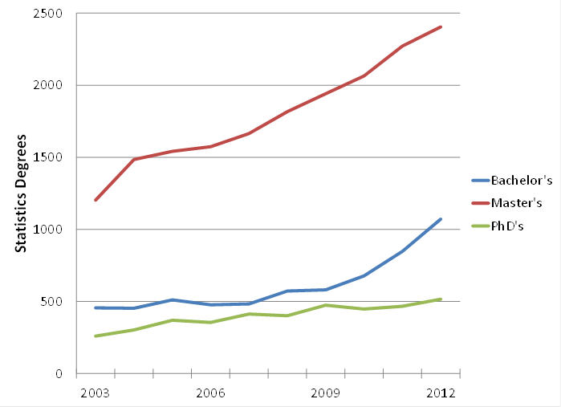
Statistics degrees at the bachelor’s, master’s, and doctoral levels in the United States. These data include the following categories: statistics, general; mathematical statistics and probability; mathematics and statistics; statistics, other; and biostatistics. Data source: NCES Digest of Education Statistics.
Notes:
Bachelor degrees for these combined categories are up 26% over the year before; Master’s are up 6%; and PhD’s are up 10% (mostly because biostatistics PhD’s jumped from 125 in 2011 to 173 in 2012.)

Slide 9
Challenges
ACM White Paper on Data Science www.cra.org/ccc/files/docs/init/bigdatawhitepaper.pdf
(first line) “The promise of data-driven decision-making is now being recognized broadly, and there is growing enthusiasm for the notion of Big Data.”

Slide 10
Challenges
ACM White Paper on Data Science www.cra.org/ccc/files/docs/init/bigdatawhitepaper.pdf
“Methods for querying and mining Big Data are fundamentally different from traditional statistical analysis on small samples” (first mention of statistics, page 7)
Do statisticians just provide old-school tools for use by the new breed of data scientists?

Slide 11
Challenges
Cobb argued (TISE, 2007) that our courses teach techniques developed by pre-computer-era statisticians as a way to address their lack of computational power
Do our students see the potential and exciting use of statistics in our classes? (Gould, ISR, 2010)
Finzer argued for the development of “data habits of mind” for K-12 (Finzer, TISE, 2013)

Slide 12
Challenges
Nolan and Temple Lang (TAS, 2010) state that "the ability to express statistical computations is an essential skill"
how do we ensure that students can “think with data” in the manner described by Diane Lambert (while posing and answering statistical questions)
major changes to foster this capacity are needed in the statistics curriculum at the graduate and undergraduate levels

Slide 13
Challenges
How do we respond to these external and internal challenges?

Slide 14
Process and structure
ASA President Nat Schenker appointed a working group with representatives from academia, industry and government to make recommendations
Goal: draft of revised recommendations and supporting materials by JSM 2014 in Boston (Go Sox!)
Now soliciting feedback and suggestions

Slide 15
Proposed guidelines
Principles
Skills needed
Curriculum topics (Degrees)
Curriculum topics (Minors/Concentrations)
Additional resources
(detail and draft guidelines available on eCOTS program)

Slide 16
Updated key principles
Equip students with statistical skills to use in flexible ways
Emphasize concepts and tools for working with data
Provide experience with design and analysis
Distinct from mathematics: requires many non-mathematical skills

Slide 17
Skills needed
Statistical
Programming
Data-related skills
Mathematical foundations
Communication
We will focus on “data science” skills today, as part of the Big Data theme
Notes:
----- Meeting Notes (5/13/14 08:37) -----
Jo to take over for the skills needed slide

Slide 18
But first, a little about you…
Notes:
----- Meeting Notes (5/13/14 08:37) -----
Nick to handle poll questions, Jo to prompt when ready to stop poll and release results (note that slides aren't visible while polls are underway)

Slide 19
Computational Thinking
Computational thinking is “the thought processes involved in formulating problems and their solutions so that the solutions are represented in a form that can effectively be carried out by an information-processing agent.” (Cuny, Snyder, and Wing, 2010)

Slide 20
Skills needed
Programming topics: Graduates should have
knowledge and capability in a programming language
the ability to think algorithmically
the ability to tackle programming/scripting tasks
the ability to design and carry out simulation studies.
Notes:
----- Meeting Notes (5/13/14 08:37) -----
Jo to present

Slide 21
Skills needed
Data-related topics: Graduates should have
prowess with a professional statistical software package
demonstrated skill in data management and manipulation
knowledge of database technologies
experience with project management and reproducible analysis tools
Notes:
----- Meeting Notes (5/13/14 08:37) -----
Jo to present

Slide 22
How to make this happen?
Start early and often
Build precursors into intro courses, build on these skills in second courses, integrate with capstone
No silos!
Requires reshaping many (all?) foundational and applied courses
Notes:
----- Meeting Notes (5/13/14 08:37) -----
Jo to present

Slide 23
How to make this happen? (Intro)
Markdown in intro stats (Baumer et al, TISE, 2014, see Mine’s talk immediately following this)
Big Data: bring flight delays dataset – airline on-time performance (120 million records) in intro and second courses (Data Expo 2009, JCGS article by Hadley Wickham)
Data Collection: have students find (scrape) data from the web
Notes:
----- Meeting Notes (5/13/14 08:37) -----
Jo to present

Slide 24
How to make this happen? (Later)
Statistical computing courses (e.g., Berkeley and Davis, see model curricula at http://www.stat.berkeley.edu/~statcur)
Updated second courses
Capstone experiences
DataFest
Notes:
----- Meeting Notes (5/13/14 08:37) -----
Jo to present

Slide 25
One final polling question

Slide 26
Questions for Discussion (I)
What do you feel is lacking in the guidelines and/or accompanying resources?
Notes:
----- Meeting Notes (5/13/14 08:37) -----
Jo to present
Should more be done with “data issues” before analysis? Non-traditional data? Where do students learn data visualization skills? Where do students see “big data”?
How do professors train themselves in skills like database competence in order to then bring it into the classroom?
What skills/topics do you think need to be added to the guidelines? Are there any that could be deleted?

Slide 27
Questions for Discussion (II)
What do you feel should not be included in the guidelines?
Notes:
----- Meeting Notes (5/13/14 08:37) -----
Jo to present

Slide 28
Questions for Discussion (III)
What are the biggest barriers towards implementation?
Notes:
----- Meeting Notes (5/13/14 08:37) -----
Jo to present
How do we let go to grow?
How do we provide faculty development opportunities?

Slide 29
Your turn…
Thoughts? Questions? Please submit them via the chat window
We welcome your feedback (ideally by the end of May!) to nhorton@amherst.edu
More information about the existing curriculum guidelines, background materials plus our recorded webinars can be found at:
http://www.amstat.org/education/curriculumguidelines.cfm
Notes:
----- Meeting Notes (5/13/14 08:38) -----
Nick to take over here

Slide 30
References
Baumer, B., Cetinkaya-Rundel, M., Bray, A., Loi, L. & Horton, N.J. (2014) R Markdown: Integrating a reproducible analysis tool into introductory statistics, TISE.
Cobb, G. W. (2007). The introductory statistics course: a Ptolemaic curriculum?, TISE 1(1).
Wing, JM (2010) Computational thinking: what and why?
Finzer, W (2013). The data science education dilemma. TISE.
Gould, R. (2010). Statistics and the modern student. ISR, 78(2):297-315.
Horton, NJ (2013). I hear, I forget. I do, I understand: A modified Moore-Method mathematical statistics course, The American Statistician, 2013; 67:4, 219-228.
Nolan, D. & Temple Lang, D. (2010), Computing in the statistics curricula, The American Statistician, 64, 97–107.
Wickham, H (2009). ASA 2009 Data Expo, JCGS. 20(2):281-283.
Notes:
----- Meeting Notes (5/13/14 08:38) -----
Nick to take over here

Slide 31
Big Data, Data Science and
Next Steps for the Undergrad Curriculum
Nicholas Horton (Amherst College)
and Johanna Hardin (Pomona College)
nhorton@amherst.edu
May 19, 2014

