Slide 1
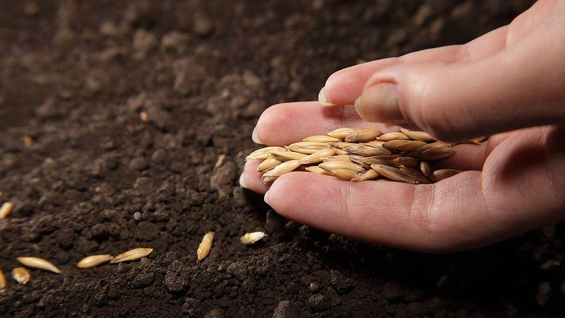
Planting Seeds of Reproducibility
in the Introductory Statistics Course
with R Markdown
Mine Çetinkaya-Rundel, Duke University
Andrew Bray, Mt. Holyoke College

Slide 2
Which of the following data analysis tools do you use?
Command line (R, SAS, python, etc.).
Menu-based (Minitab, SPSS, Fathom, StatCrunch, etc.).
None of the above.
poll

Slide 3
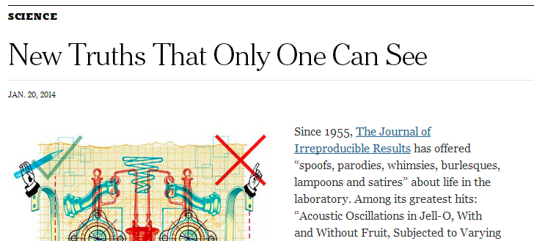
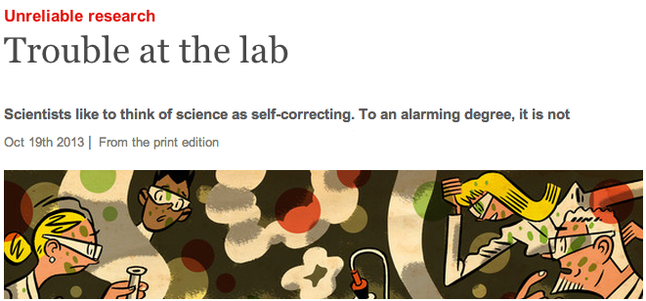
popular press

Slide 4
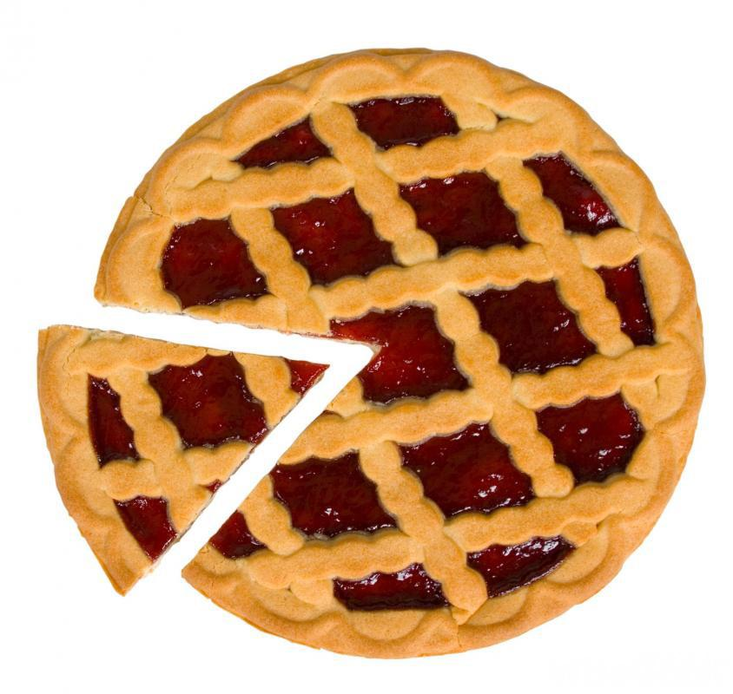
role of statisticians
reproducibility of the data analysis

Slide 5
My students do collaborative work (such as a project) that has a writing and a computing component.
Yes
No
poll

Slide 6
data analysis
write-up
- research question & context
- interpretations
- conclusions
- descriptive stats
- plots & tables
- model output
- familiar format (Word)
traditional
copy-paste
copy-paste
lab report
- impossible to reproduce
- very difficult to update
- very easy for mistakes to creep in
- messy

Slide 7
text block
- easy to reproduce
- easy to collaborate
- easy to update
- standardized format
- faster
data analysis
a better approach
text block
data analysis
- must learn syntax
- must be immaculate to compile
text block

Slide 8
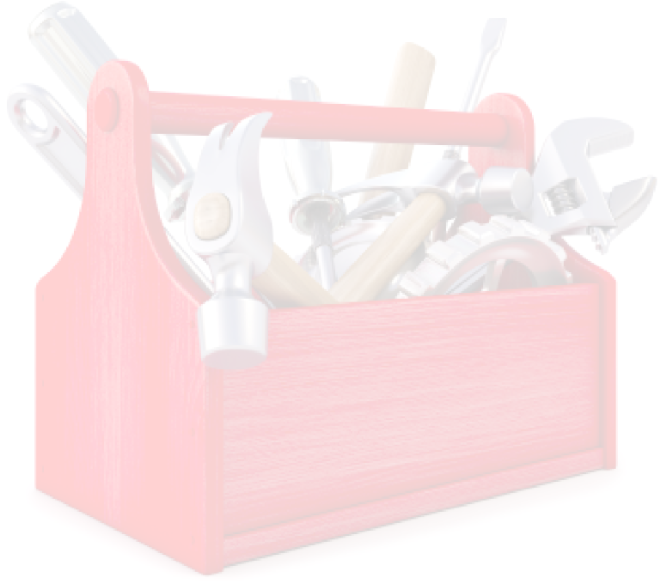
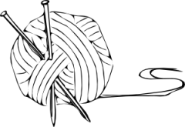
+
+
toolbox

Slide 9
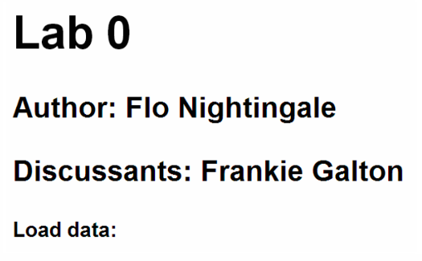
text block
syntax

Slide 10
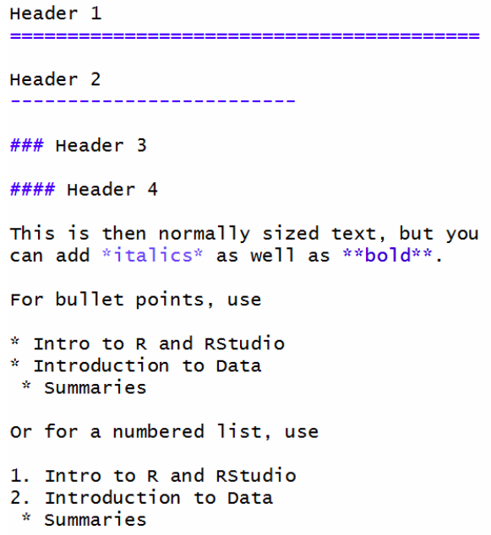
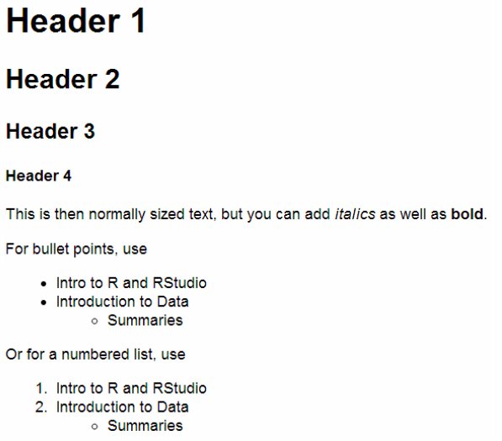
text options
syntax

Slide 11
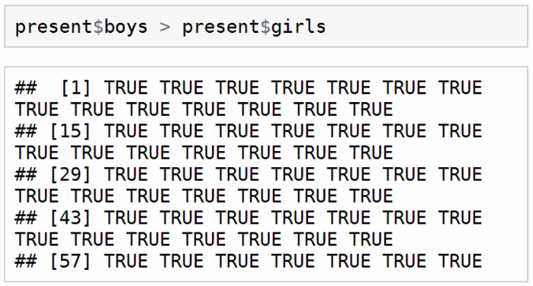
data analysis
(aka the R chunk)
syntax

Slide 12
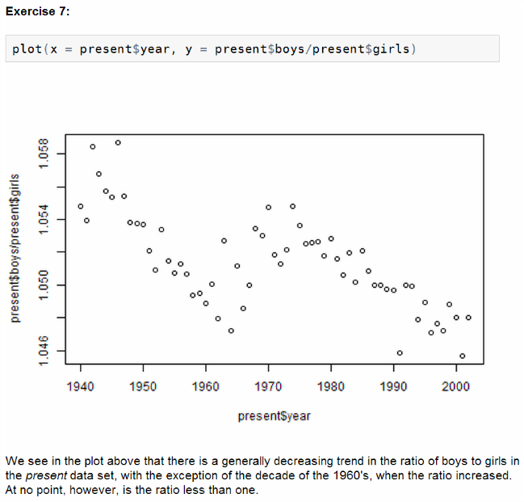
text block
R chunk
text block
syntax

Slide 13
demo

Slide 14
duke university
smith college
in use since Fall 2012
large non-calc based
intro courses
students typically have no programming background
weekly labs
individual + team-based project
in use since Fall 2012
intro course with calc pre-calc + regression course
students typically have no programming background
weekly labs + homeworks
team-based project
with a technical appendix
experience

Slide 15
instills early the idea that all analysis must be done in a reproducible framework
eases collaboration on labs and projects
reproducible science…
and better teaching
markdown workflow emphasizes iteration
removes ambiguity from grading

Slide 16
- Paper:
Ben Baumer, Mine Cetinkaya-Rundel, Andrew Bray,
Linda Loi, and Nick Horton (2014).
R Markdown: Integrating A Reproducible Analysis Tool
into Introductory Statistics.
Technology Innovations in Statistics Education, 8(1).
http://escholarship.org/uc/item/90b2f5xh
further reading
- Slides: http://bit.ly/ecots2014_reproducible
- Sample lab document at
http://stat.duke.edu/~mc301/talks/ecots2014/sample_lab.pdf.
- Sample markdown template at
http://stat.duke.edu/~mc301/talks/ecots2014/template.Rmd.

Slide 17
What is your primary reservation about teaching a reproducible data analysis framework?
My students will find it too difficult.
I don’t have the time; the intro course is already packed as is.
Other reservation…
None - I’m sold.
poll

Slide 18
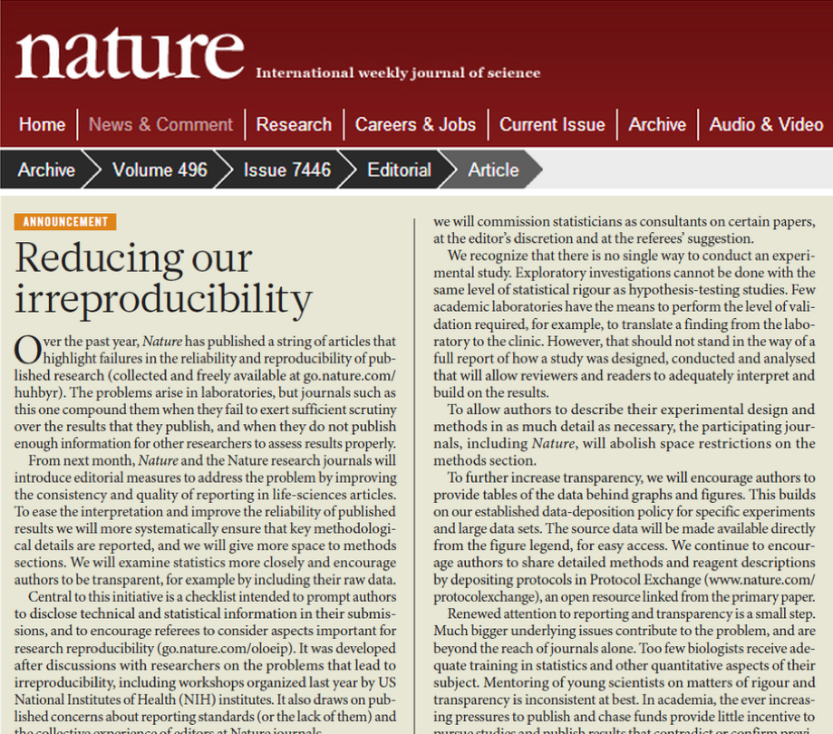
parting thoughts
“We urge others to take note . . . and do whatever they can to improve research reproducibility.”

Slide 19
Mine - mine@stat.duke.edu / @minebocek
Andrew - abray@smith.edu
questions

