Slide 1
When Mathematics and Statistics Collide in Assessment Tasks
Anna Bargagliotti & Randall Groth
Notes:
Anna

Slide 2
Background
The disciplines of mathematics and statistics have a complex relationship with one another
Statistics makes heavy use of mathematics
Yet, it has been argued that statistics is not a branch of mathematics because it has its own unique modes of discourse and reasoning
Notes:
Anna

Slide 3
Teacher Understanding
The complex relationship between statistics and mathematics presents a unique challenge for teachers needing to interweave statistics in the mathematics classroom
Statistical objectives are prominently featured in mathematics curriculum documents (e.g., Common Core)
Teachers must attend to statistics within a mathematics framework
  They must disentangle the disciplines to accurately portray the two
Notes:
Anna

Slide 4
Assessments
Writing and giving assessments is a key task that teachers at all levels do
Challenges can be encountered in disentangling the assessment of individuals’ mathematical and statistical reasoning
As part of the NSF-funded Project-SET, we gave open-ended assessments meant to elicit statistical reasoning to a group of 9 teachers
Notes:
Anna

Slide 5
Project-SET
As part of Project-SET, we designed a professional development (PD) course for mathematics teachers that focused on the concepts of sampling variability and regression
Today we will focus only on sampling variability
Notes:
Anna

Slide 6
Sampling Variability Learning Trajectory
Teachers participating in the PD were given a series of open-ended assessment tasks that were based on items from the Illustrative MathematicsTM Project (IMP)
The Project-SET team chose released items that discussed aspects of sampling variability and then developed assessment tasks around them
IMP tasks are typically double-blind reviewed
At least two Project-SET team members reviewed each task
Despite the numerous sets of eyes reviewing the tasks, several examples emerged of how tasks geared towards eliciting statistical thinking unintentionally activated mathematical thinking
Notes:
Anna

Slide 7
Valentines Day Marbles
You should have the Valentines Day Marbles task in front of you as a handout
The Project-SET Valentine Marbles task was adapted from an IMP illustration aligned with CCSS standard 7.SP.2http://www.illustrativemathematics.org/illustrations/1339.
Given the data and graphical display, participants were asked to answer four questions
Lets take a few minutes to answer the question on your handout
Notes:
Randall

Slide 8
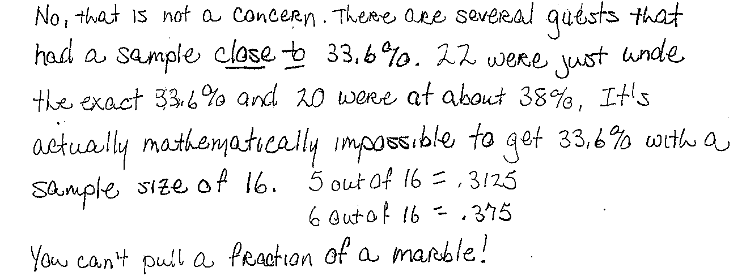
Teacher Results
Question A was intended to elicit statistical thinking about variation, but instead lent itself to mathematical thinking
For this question, some participants successfully responded by using mathematical rather than statistical thinking
A mathematical response given was:
Notes:
Randall

Slide 9
Teacher Explanation
“I started writing my explanations and then I said it is mathematically impossible. Well 5 out of 16 is .3125 and 6 out of 16 is .375 and you cannot get a fraction out of a marble. I did not think about that until I started writing, and then I said it is not possible to get with a small sample size”
Although the mathematical response is correct, it does not help draw attention to the idea that statistics from random samples tend to cluster around the population parameter—the concept the task was designed to develop and assess
Notes:
Randall

Slide 10
Teacher Response
The answer provides an accurate, comprehensive mathematical explanation
Although the teacher appeared to begin to consider sampling variability when she noted that 22 were just under the exact percentage and 20 were just above, once she found the mathematical solution, she set the idea of variability aside and did not develop it further
Notes:
Randall

Slide 11
Another Issue
One other feature of the Valentine’s Marbles task triggered mathematical thinking that might overshadow statistical ideas embedded in the task
A teacher pointed out that the marble container was clear and conjectured that this would influence people’s estimates because they would be able to see some of the color composition of the population of marbles
This would change the problem completely from a sampling problem to a geometric estimation problem where one would be looking at one side of the jar and counting the number of reds on that side and then treating that as a cross-section
Notes:
Randall

Slide 12
Discussion
What changes could be made to the task to draw attention to the statistical ideas?
Notes:
Randall

Slide 13
Possible Changes
Change the numbers slightly
  Number of marbles in the jar = 11,000,
  But change to 4,125 marbles red and 6,875 marbles white
  This made the percent of red marbles in the entire jar 37.5%
  The size of the sample was left as 16 so that if six of the marbles sampled were red, one could obtain 37.5% of red in the sample
  Change the jar slightly
    Description of the jar was changed from clear to opaque
  Respondents would thus not be able to rely solely on mathematical thinking to answer the question
Notes:
Randall

Slide 14
Mira Beach
You should have the Mira Beach task in front of you as a handout
The Project-SET Mira Beach task was adapted from an IMP illustration entitled Strict Parents http://www.illustrativemathematics.org/illustrations/122
The Project-SET task focused on census data for the town of Mira Beach
The task included four questions about study design and appropriate sampling methods
Lets take a few minutes to answer question A on the handout
Notes:
Anna

Slide 15
Teacher Results
Every teacher provided the mean and the median as their two plausible values
Few teachers made any connection to the plot of the approximate sampling distribution they had constructed
Statistical thinking would entail examining the approximate sampling distribution in order to make a decision about which values seemed central
Using formal statistics to describe a distribution without first doing an informal visual analysis of the distribution can lead to ill-grounded and inaccurate distribution descriptions
Notes:
Anna

Slide 16
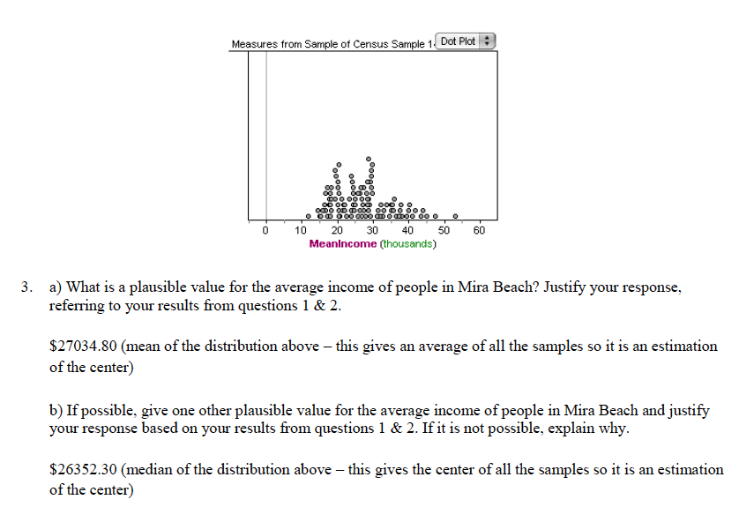
Sample Response
Notes:
Anna

Slide 17
Result
The task responses indicated that mathematical algorithms for the mean and median can draw attention away from the statistical concepts of variability and distributions
Notes:
Anna

Slide 18
Discussion
What changes could be made to the task to draw attention to the statistical ideas?
Notes:
Anna

Slide 19
Possible Changes
Before asking the plausibility questions, during the class discussion, we asked:
What is an implausible value for the average income of people in Mira Beach? Justify your response, referring to your results from the graphical display.
Discussing implausible before plausible values proved to force the teachers to rely on the graphical displays they had created
Notes:
Anna

Slide 20
Mira Beach Cont.
Lets take a few minutes to answer question B on your handout
Notes:
Randall

Slide 21
Teacher Results
This task is different from the other examples provided in that it does not offer a mathematical “straw” to grasp
The core of this task is non-mathematical, however, it is a task that is central to the practice of statistics
Teachers’ lack of comfort with this non-mathematical task that led some of them to seek deterministic answers like one would expect in mathematics
Notes:
Randall

Slide 22
Teacher Response
Teacher 2: “…I would like to know what are some questions that you can [use]. If I know what is perfect then I know where to gauge myself and my students or may be close to perfect.”
Teachers tended to write questions such as:
  “Is your curfew before 9pm?,” and,
  “Do your parents require you to complete homework before turning on the television?”
Notes:
Randall

Slide 23
Teacher Discussion Results
During the lengthy discussion regarding this task (over 20 minutes), teachers had difficulty understanding why questions of this type might not address the goal of the council
Teacher 1: “In order for teacher 2’s first question to show parents are really strict the curfew needs to have a set hour. For instance parents have set a curfew of 9 p.m. for their students are stricter compared to parents who have set a curfew of 1:00a.m. That is you need an hour.”
Notes:
Randall

Slide 24
Things to Point Out
While several of the questions developed by the teachers could garner data on whether the parents are actually strict, they did not touch upon the students’ opinion of their parent’s strictness
Opinions could be elicited with questions such as:
  “Do you believe your parents are strict?,”
  “Do you think your curfew is too early?,” and
  “Do you feel there are social things you want to do that your parents will not allow you to do?”
Notes:
Randall

Slide 25
Discussion
What other types of tasks might be relevant to statistics and not mathematics?
Notes:
Anna

Slide 26
Conclusions
As our examples have illustrated, when teaching and assessing statistical thinking within the context of school mathematics, learners may employ deterministic mathematical discourse and procedures that short-circuit the statistical reasoning being encouraged and assessed
Assessment writers must be vigilant in monitoring student responses to determine the extent to which they elicit intended thinking
As students’ thinking is used to re-design assessment tasks as necessary, the tasks can become progressively more effective in focusing on central statistical ideas
Notes:
Anna

