Slide 1
The Canadian Statistics Educator Network (CSEN) Experience
Dr. Bethany JG White
bwhite@stats.uwo.ca
eCOTS 2012

Slide 2
Outline
CSEN development
CSEN activity
Rejuvenating the CSEN
Presentation Title Here
eCOTS 2012

Slide 3
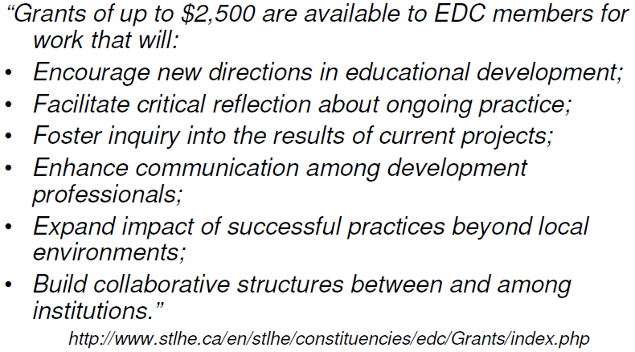
Funding CSEN Development
Presentation Title Here

Slide 4
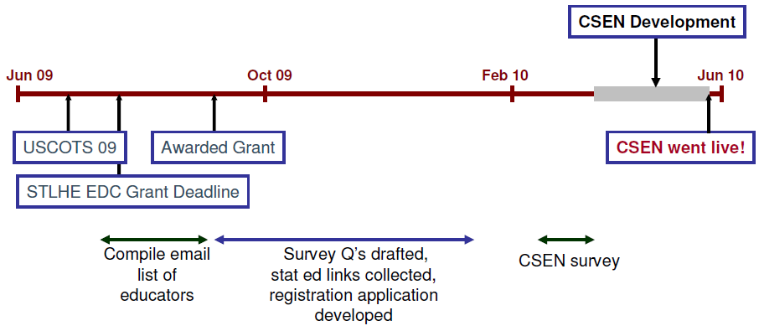
CSEN Timeline
Presentation Title Here

Slide 5
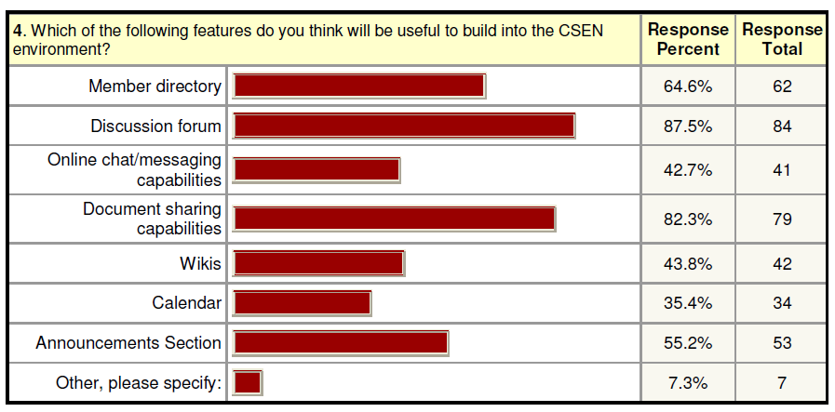
Select Results
Presentation Title Here

Slide 6
Presentation Title Here

Slide 7
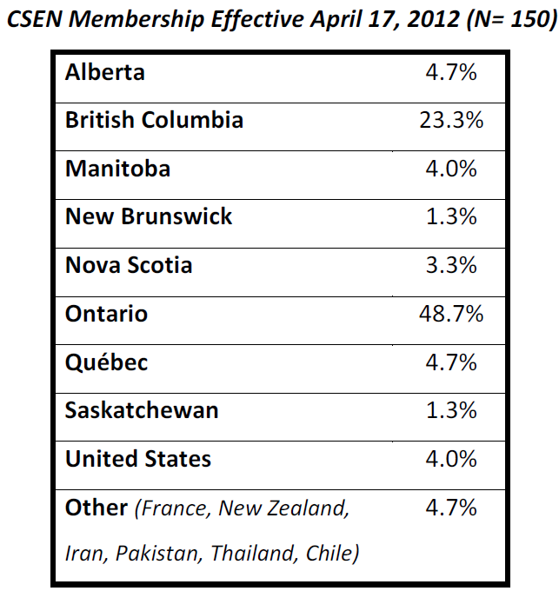
CSEN Stats
Presentation Title Here

Slide 8
CSEN Developments
Revisit 2010 survey participant suggestions for CSEN…
Positive response
- exchange ideas, resources, experience
Concerns
Time constraints
Presentation Title Here

Slide 9
CSEN’s Next Chapter
Move away from LMS ‘environment’..
Move toward a moderated email discussion list
Contributed resources posted on website
Presentation Title Here

Slide 10
Thanks!
Questions and Feedback welcome
Bethany White
bwhite@stats.uwo.ca
CSEN
www.stats.uwo.ca/CSEN
csen_mail@uwo.ca
Presentation Title Here

