Slide 1
Be the statistician: An Approach for the Modern Student
Melissa M. Sovak, Ph.D. California University of Pennsylvania Sovak@calu.edu

Slide 2
BackGRound
Why do we need a different method of assessment?
Traditional paper and pencil tests often fail to capture student’s knowledge
Traditional paper and pencil tests are limited in time (and hence limited in the number and complexity of questions)
What about other assessment methods?
Projects?
These often are not individual assessments
These often are structured in parts

Slide 3
The need…
Often traditional assessments focus more on LITERACY
We ask students to compute test statistics
We ask students to compute probabilities
Often traditional assessments focus more one small aspect of a problem?
We ask students to compute a test statistics ONLY
We ask students to find p-values ONLY
Why do we need another assessment?
We want to test students REASONING ability
We want to see if they can select methods appropriately
We want to see if they can draw contextual conclusions
We want to see them look at the problem in the BIG PICTURE

Slide 4
How is this different?
“Be the Statistician” asks students to take on the role of statistical consultant
What does this entail?
Students are presented with true to life questions
Students must present an entire analysis plan (just as a statistician would!)
Students must answer questions about WHY a particular analysis plan does not work (just as a statistician would!)
Students are awarded points for correct analysis techniques AND COMPLETENESS

Slide 5
Can you Give me an example?

Slide 6
How do I grade this?
This question is worth 10 points in total
Rubric as follows:
Student receives 2 points for identifying that researchers should begin analysis with side-by-side boxplots split by gender (0 points if no or inappropriate display provided)
Student receives 2 points for identifying that the appropriate hypothesis to test is H₀: µ₁ = µ₂ versus H₀: µ₁ ≠ µ₂ (1 point if a one-sided hypothesis is indicated; 0 for incorrect hypotheses)
Student receives 2 points for identifying that the appropriate inference test is a two-sample (independent sample) t-test (0 points for incorrect test or no test)
Student receives 1 point for discussing specifics of the t-test including that the p-value comes from a t-distribution and is two-tailed (0 points if not provided or incorrect)
Student receives 1 point for suggesting an appropriate significance level to test against (0 points in inappropriate or none given)
Student receives 2 points for suggesting using a confidence interval for the difference of means to give an estimate for the difference of the means (0 points if not suggested)

Slide 7
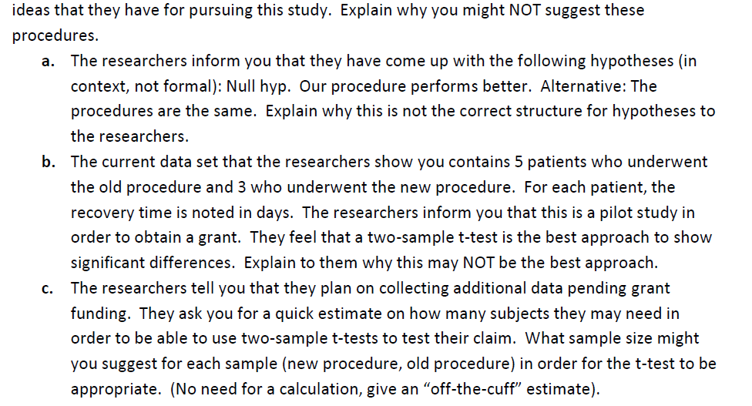
Can I have another example?

Slide 8
How do I grade this?
This question is worth 10 points in total
Rubric as follows:
Part A:
Student receives 2 point for describing to the researchers that the hypotheses are reversed (0 for incorrect or no response)
Student receives 2 points for describing why the equality hypothesis should occur in the null hypothesis (0 points if incorrect or no response)
Part B:
Student receives 1 point for describing that the sample size is too small for a two-sample t-test to apply (0 points if no response or incorrect)
Student receives 2 points for indicated that a nonparametric test may work best with this sample (0 if not included)
Part C:
Student receives 3 points for giving an estimate of 30 or above with appropriate reasoning (0 if below 30 or not included)

Slide 9
What are the benefits of this?
In order to receive full credit, students must give a FULL analysis plan for each question
Students are required to use the knowledge from the ENTIRE course to answer nearly every question
Students are required to gather key information from a written description in paragraph form
Students incorporate writing into their assessment (students are required to write in paragraph form their analysis plan using appropriate college-level English and statistical language)

Slide 10
THANKS FOR CHECKING THIS OUT! Please leave comments and questions for me!

