Slide 1
How to Teach Modern Statistics When You Don’t Have Modern Technology
Jon Oaks
Macomb Community College
ECOTS Poster Presentation

Slide 2
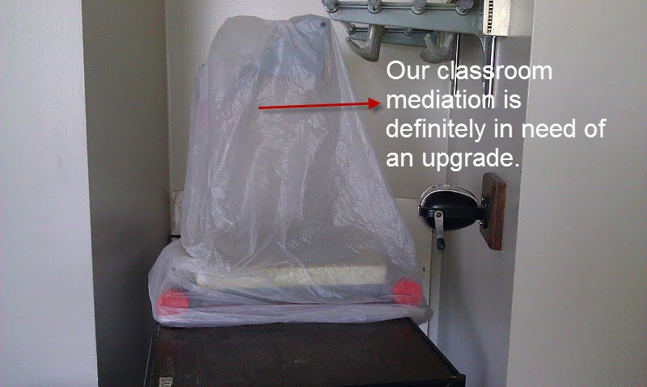
The Problem

Slide 3
The Steak Problem
One purpose of displaying data graphically is to provide clues about trends. The given values are weights (ounces) of steaks listed on a restaurant menu as "20 ounce porterhouse" steaks. The weights are supposed to be 21 ounces because they supposedly lose an ounce when cooked. Create a frequency distribution with 5 classes. Based on your distribution, comment on the advertised "20 ounce" steaks.
17 20 21 18 20 20 20 18 19 19
20 19 21 20 18 20 20 19 18 19
Source: Test Bank for Elementary Statistics, 11th Edition, Triola.

Slide 4
Extending the Problem
Summarizing and Graphing Data
Cumulative Frequency Distribution
Relative Frequency Distribution
Percent Frequency Distribution
Histogram
Relative Frequency Histogram

Slide 5
Extending the Problem
Describing and Exploring Data
Mean
Median
Mode
Midrange
Mean from Frequency Chart
Standard Deviation
Quartiles
Percentiles

Slide 6
Extending the Problem
Probability
Suppose that in addition to steak, the restaurant also serves chicken. The weights of 20 pieces of chicken are as follows:
17 19 17 21 17 21 18 21 19 21
20 17 20 18 19 20 20 17 21 20

Slide 7
Extending the Problem
Find each of the following probabilities:
P(chicken)
P(not steak)
P(chicken or 17oz)
P(steak and 20oz)
P(not chicken or 18oz)
P(not chicken and 18oz)
P(not chicken and not 18oz)
P(chicken and 19oz)
P(not 21oz)
P(not chicken and not steak)
P(not chicken or not steak)

Slide 8
Other Initiatives
Rearranged classroom desks so that students are working in small groups of six students.
Used In-Class Activities, some of which I have posted online at http://bit.ly/algebragames
Implemented Mathematics On Target Tutoring (MOTT) Supplemental Instruction Sessions for Statistics Courses

Slide 9
Other Initiatives
Required use of TI-84 with Updated Operating System
Used ‘StatViz’ app on the iPad to help students visualize statistics
Encouraged students to do homework online and to only buy the eBook.
Supplemented course materials via ‘Web Enhancement’ with the College’s Learning Management System

Slide 10
Contact Information
Jon Oaks
Macomb Community College
http://www.jonoaks.com

