Slide 1
Making Statistics Make Sense with Web Applets
Jonathan Lee and Bethany White
eCOTS Conference
May 14-18, 2012
Department of Statistical and Actuarial Sciences
Notes:
Intro Title Page

Slide 2
The Purpose
To measure the effectiveness of web applets in increasing student comprehension, engagement, and sense of mastery.
To examine how student attitudes towards statistics changes over time.
Making Statistics Make Sense with Web Applets

Slide 3
The Subjects
All students registered in the class BIO/SS 2244B – “Analysis and Interpretation of Biological Data”/”Statistics for Science” (421 students)
This is a required course for many science and medical science students.
6 out of 7 required lab activity sessions
Incentive: Random draw for cash prize
$200 1st place
$100 2nd place
$100 3rd place
Making Statistics Make Sense with Web Applets

Slide 4
The Applets
Descriptive statistics applets
Measure of central tendency
Measure of spread
Hypothesis testing/Confidence Interval applets
Hypothesis testing
Confidence intervals
All applet activities made available to all students after Term Test 2
Making Statistics Make Sense with Web Applets

Slide 5
Flowchart of Study(number of participants)
Randomization of 10 lab sections
Descriptive Statistics
Randomization of 10 lab sections
Hypothesis Testing
Measures of Center Applet
(197)
Hypothesis Test Applet
(182)
Pre-study (395)
Term Test 1 (421)
Term Test 2 (412)
Post-study
(233)
Final Exam
(?)
Measures of Spread Applet
(176)
Conf. Interval Applet
(171)
Post-SATS survey
Draw for prize
Letter of information
Obtain consent
Pre-SATS survey
ARTIST CAOS multiple choice items measuring descriptive statistics objectives
ARTIST CAOS multiple choice items measuring hypothesis testing/ confidence interval objectives
ARTIST CAOS multiple choice items measuring descriptive statistics and hypothesis testing/ confidence interval objectives
Making Statistics Make Sense with Web Applets

Slide 6
Preliminary Results
Making Statistics Make Sense with Web Applets

Slide 7
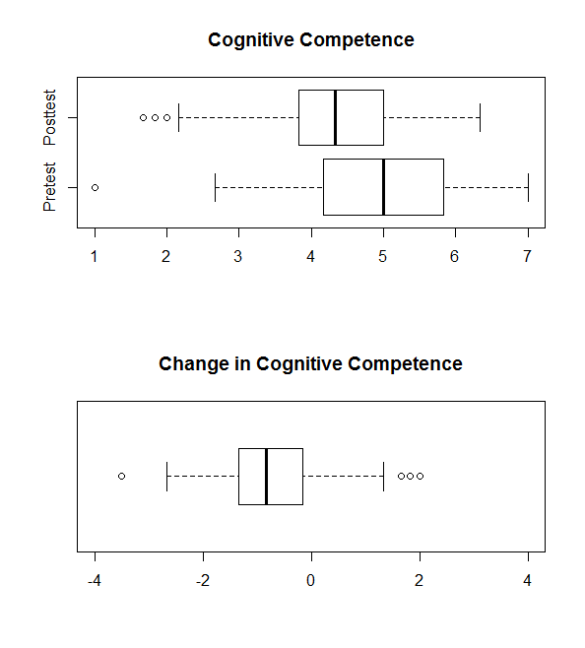
Preliminary Results
Individual attitude components from SATS-36 computed and compared from pretest and posttest
Cognitive competence (sense of mastery) might be useful as a predictor of exam outcomes.
Making Statistics Make Sense with Web Applets

Slide 8
Next Steps
Examine results from final exam
Look at demographics as explanatory factors (gender, major, lab section etc.)
Reliability analysis of tests and final exams.
See forthcoming paper for more details and complete analysis
Making Statistics Make Sense with Web Applets

Slide 9
Thank you.
Making Statistics Make Sense with Web Applets
Notes:
Main Page

