Slide 1
Second Stats Course:
What should it be?
Marc Isaacson
Augsburg College Dept of Business Administration
MILO SCHIELD
Augsburg College Dept of Business Administration
Director, W. M. Keck Statistical Literacy Project
eCOTS: 10 May 2012
www.StatLit.org/pdf/
2012-Isaacson-Schield-eCOTS6up.pdf
Notes:
Welcome to our e-COTS 2012 webinar on the “second stats course: What should it be?”
By “second stats course” we don’t mean the second stats course taken by students.
We mean the second stats course most strongly promoted by statistical educators in addition to intro stats.

Slide 2
Audience Vote
You are authorized to select a second course in statistics “in addition” to the traditional intro-inference course. The new course will be funded for five years.
You are considering two options:
* Pre-inference statistical-literacy course
* Post-inference advanced-topics course
Given limited resources, which one would you choose for all US four-year colleges?
Notes:
We are asking each of our to vote for one of these two options:
A pre-inference statistical literacy course: Stat 100.
A post-inference advanced topics course. Stat 201.
This second course will be offered “in addition to” the regular “Stat 101” course.
This second course will be funded for five years at all four-year US college.
Select the option that you think would be more valuable.
Please vote now. We will watching the results.

Slide 3
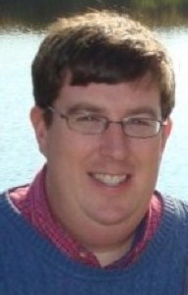
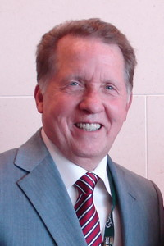
Introductions
Statistical Literacy
Marc Isaacson
Augsburg College
Advanced Topics
Milo Schield
Augsburg College
Notes:
MILO: While you are voting, let us introduce ourselves.
I am Milo Schield, Augsburg College. I am arguing that statistical educators should support a post-inference advanced topics course.
My slides will say Advanced Topics on the right margin.
I have taught such courses that covered a variety of topics for business majors.
===============================================================
MARC: I am Marc Isaacson, Augsburg College. I am arguing that statistical educators should support a pre-inference statistical literacy course.
I have designed and taught such a course entirely on-line. I’ve also designed and taught a course called “Statistical Literacy for Managers”.
When I am talking, my slides will say “Stat Lit” on the right margin.
Notice the results of our poll:
[With ~75 people voting, the results were 50% for each of the two options]
I’m going to start my section the way I’ve started my Intro Stat courses for the last several years… With a question.

Slide 4
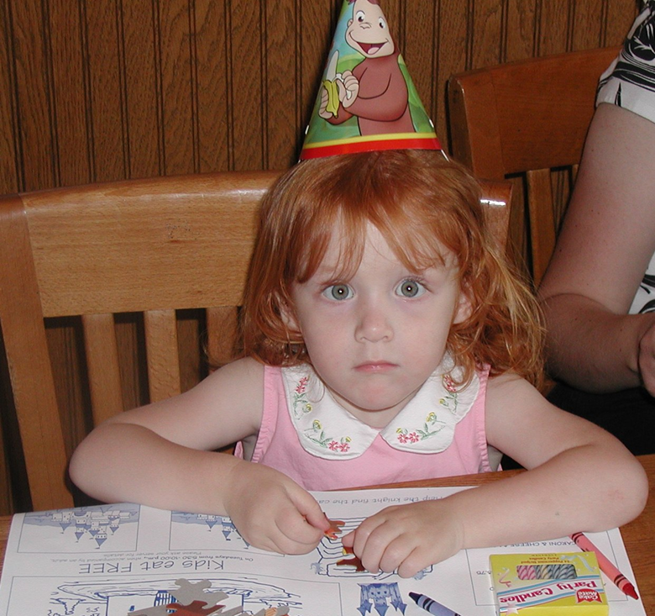
Where Do Statistics Come From?
STAT LIT
Notes:
I’m going to start my section the way I’ve started my Intro Stat courses for the last several years… With a question.
“Where do Statistics Come From?” – This picture of my daughter on her birthday is representative of the look I get from my students when I ask them this question.
Last year I presented a summary of several hundred student responses at USCOTS as a poster and they are certainly quite varied. By far, the most common answer is that statistics come from some form of data. Obviously there are a lot of answers which are correct to this question depending on how it’s thought of.
You might think of how you would answer this question if asked.
I’ve done this with other instructors and the look on their face is very similar.
My argument is that there is a need for a pre-course (call it Stat 100) that gives students the background to appreciate and value statistics as critical consumers. This is certainly a valuable life skill needed by those in non-quantitative majors who don’t already require statistics but also for those preparing to take the traditional Stat 101 where the agenda is often much different.

Slide 5
Let’s Look at Textbooks….
STAT LIT
Chapter 1
“There is Data”
And it is..
Quantitative vs Categorical
Discrete vs. Continuous
Nominal vs. Ordinal
Etc., Etc…
Notes:
If I take that same question and look at most Intro Stat textbooks, I get a very similar answer.
Chapter 1 is almost always “There is Data”. And it is then broken down and defined (Quant / Categorical), (Discrete vs Continuous), etc and we’re off and running into calculations and analysis.
My thought is that…

Slide 6

Saying “Statistics Come From Data” is like saying
“Babies Come from Hospitals”
STAT LIT
It’s true but leaves out the interesting details
Notes:
Saying “Statistics come from Data” is like saying “Babies come from hospitals”
It’s certainly true but it leaves out the interesting details. And it’s those interesting details that make all of the difference in statistics.
Think about the students in your Intro Stats course on Day 1. How do they view statistics? Would you describe them as healthy critics of the numbers and statistics in the world around them? Would you describe them as completely cynical and untrusting of most, if not all, statistics? Or are they naïve and simply believe every number put before them?
In our recent survey, stat ed instructors estimated that nearly half of their students entered “Stat 101” as Naïve or Awestruck by numbers.
The issue is that…

Slide 7

Naïve Students View Statistics as Rocks
STAT LIT
Notes:
Naïve students view statistics as rocks. Things that researchers must simply wade into the waters and pull from the ground as distinct, separate, unchanging objects that one might never question. They just are….

Slide 8
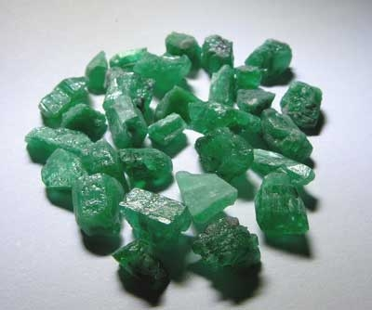

Statistics Come From a Process
STAT LIT
The Process:
  A Question of Interest
  Data Collection (Sampling)
  Data Analysis
  Statistical Analysis
  Reporting of Results
  To Evaluate Reported Statistics Requires Understanding the Process from Which They Came.
Notes:
But we all know that statistics come from a process. As Joel Best has described in his books on statistics, Objects that look like green rocks can be mined from the earth, undergo a series of human interventions that result in the sparkling diamond. It’s that shiny rock that ends up in a Jewelry store for lots of money. Ask students about diamonds and they won’t envision or mention the green rocks in the top picture. They have always experienced diamonds as items for sale in the jewelers display case.
It’s much the same for statistics. Students see them as objects in the display case (i.e. the newspaper, media, advertisements) and don’t think much about the process of their creation. Statistics become part of the argument that naïve students buy without thinking or the cynical students completely dismiss without regard.
Students need to understand that statistics start with a question of interest by someone and then flow from there. They are really the output of a process For students to evaluate statistics on display as consumers, they need a Stat 100 type course centered around the process from which Statistics came.

Slide 9
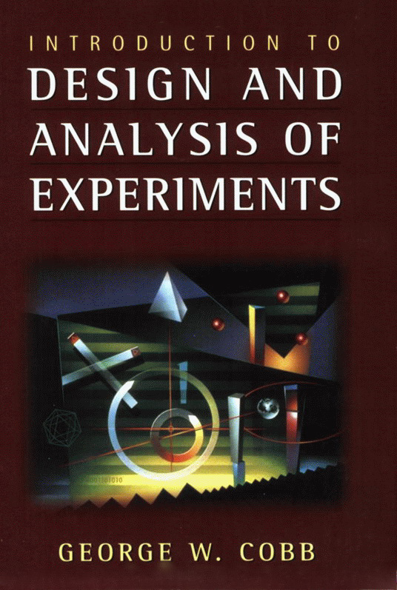
ADVANCED STATS
Advanced Topics:
#1: Design of Experiments
Study three kinds of variability
1. Planned systematic variability
2. Chance-like variability
3. Unplanned, systematic variability
This kind threatens disaster!
Control these by:
Randomization
Blocking
Replication
Notes:
This is Milo arguing for an advanced-topics course.
Here’s my thesis: If statistical educators are to select offering a second course at ALL four-year US colleges it should be a post-inference advanced topics course. This is a no-brainer. Most of us have taken a second course or more. You may have taught this course. This idea is not new so it doesn’t require a lot of explanation. Let me review. The inference course doesn’t really have time to study the design of experiments. This is the core topic in statistical education. Inference is just the appetizer. Students need to understand the different sources of variability and how to control them. Any student who doesn’t understand the design of experiments is statistically illiterate.

Slide 10
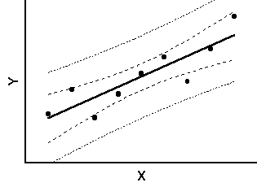
ADVANCED STATS
Advanced Topics:
#2: Multivariate Analysis
Multivariate Regression: Linear and Logistic
Principle Component Analysis
ANOVA and MANOVA
Discriminant Analysis
Factor analysis
Cluster Analysis
Notes:
But there is more.
A statistically-educated student must understand multivariate modeling -- both linear and logistic.
Confounding requires at least three variables.
Confounding is an important topic in the social sciences and in professional studies.
There is ANOVA and MANOVA. Discriminant, factor and cluster analysis.
Students that have no idea these tools exist can not be expected to use them when needed.
Students need more depth if they are to be statistically competent.
If statistical educators really love their discipline, they would give whole-hearted support for an advanced topics course.

Slide 11
Agreed: Confounding is important
STAT LIT
Too important to wait for the 2nd course!
Predictions from Regression Model “depend” on what factors are included.
Students need to be able to understand the concept of confounding as consumers of statistical arguments.
Notes:
This is Marc arguing for a statistical literacy course.
I’m completely with you on the idea of multivariate. Students realize that they live in a complex world. The idea of looking at things in terms of a single variable just doesn’t happen much in their lives other than in very simple situations.
The idea of contemplating the effect of other factors is too important to wait for the second course. If a student is studying the salaries of professionals in two different cities and trying to decide where to live after graduation, they need to know whether or not the data has been adjusted for differences in the cost of living. If a student is comparing salaries in New York City vs Minneapolis, it may be that the average salary difference between cities is statistically significant in the raw data but not statistically significant after we adjust the data for cost of living differences.
To be educated consumers of statistical arguments, students need to understand the concept of confounding and practice thinking about alternate explanations and how they might influence the given data. For many students, the idea that something could be significant in one sense but not in another is a bit of a mind puzzle since they think of statistics as rocks.
[Slide change]

Slide 12
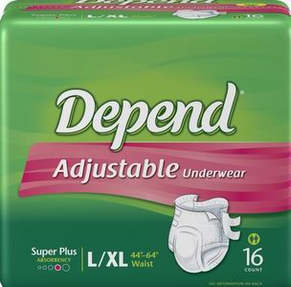
Students Must Get Comfortable with “Depends” in Introductory Statistics
STAT LIT
Confounding:
What is taken into account
What’s not accounted for
Choices in the Process:
“Assembly”
How things are defined
How things are measured
How population was chosen
How things are compared
How things are presented
Notes:
It’s our job as statistical educators to get students comfortable with Depends in Intro Stats. Not only with confounding and what is and what is not accounted for in multivariate situations but also with the idea that changes in the process of where statistics come from have a direct influence on the numbers displayed to consumers of statistics.
How things are defined, How things are measured, How the Population was chosen, etc all are choices in the process of Where do Statistics come from? While the cynics might think these choices are all “rigged” to support a given conclusion, the truth is that decisions must be made on all of these things in order to generate statistics. And like all decisions, some are certainly better than others. It’s for that reason that we must teach students to become critical consumers of statistics.

Slide 13


Assembly: How Things are Defined
STAT LIT
What % of Statistical Educators are Golfers?
  “It Depends”: A Change in definition leads to a change in proportions.
  This Change in %’s can be:
  Persuasively Significant
  Statistically Significant
Notes:
Take for example a simple question. What % of Statistical Educators are Golfers? In a textbook problem, we might just be told that p=x% and be off and running into inference calculations.
In reality, the answer to the question is really “it depends”
It depends on how we define a golfer. If I say a golfer is one who played 18 holes of golf in the last week, I would get some number of responses.
If I say a golfer is one who played 18 holes of golf in the last month, I’d get an even bigger number. Move the time frame to a year and the proportion gets even bigger.
If I redefine golfer as anyone who’s played a round of 18 holes, hit balls at the driving range or indulged in a game of mini-golf in their lifetime, I’d get the biggest response of all.
In this case, the change in definition leads to a change in proportions. Depending on how far I raise or lower the bar of the definition, I can certainly influence the numbers in ways that would be persuasively significant and if used in inference the use of different definitions could change the results of statistical significance tests.

Slide 14
Assembly: How Things are Defined
STAT LIT
Compare % of Faculty and Students who have received a moving violation
  “It Depends”: A Change in Definition leads to a change in proportions.
  This Change in %’s can be:
  Persuasively Significant
  Statistically Significant
Notes:
Now how about a comparison of two groups? If I was interested in whether faculty or students were more responsible drivers, I might compare the percentage of Faculty and Students who have received a moving violation. Who would have a higher percentage?
Again, the answer at this point is “It depends”.
It depends on how I raise or lower the bar of the definition. Certainly the definition of a moving violation is important although there are some pretty standard definitions for that one.
It also depends on what time frame I’m looking at.
It might be that over the last year, the percentage of students (less experienced / more risk taking driving) with moving violations might be higher than the percentage of faculty (who are more experienced, responsible drivers).
But, if I look at things over a lifetime, and remember that Faculty were once young too, It could be that
The percentage of faculty with moving violations is actually higher than the percentage of students with the same violations. Not because they’re any worse drivers but rather because they’ve simply had more time to accrue a moving violation.
In this case the difference between the definitions and results might not only be persuasive or statistically significant but we actually get a complete reversal of the results.
For those the naïve student, the thought may never have crossed their mind about changing the timeframe in the definition. For the cynics, this might be more ammunition that you can make up statistics to say whatever you want. The goal of my proposed STAT 100 course is to get them to be better thinkers about statistics.

Slide 15
Hypothetical Thinking
STAT LIT
Key to becoming comfortable with “depends” in Statistics
When encountering a statistical argument:
  1. Decipher what was done
  2. Contemplate what might have been done
  3. Envision how the statistic might change
Requires high level critical thinking!
Notes:
One way to do this is with what I call Hypothetical thinking. It’s actually a high level critical thinking skill that forces students to
Decipher what was done in a statistic presented to them
Contemplate what might have been done
Envision how the statistic might change.
For the mathematician within us, this is a bit uncomfortable. It’s also something that students are rarely called to do in their educational lives. In math classes, We are trained to make assumptions and then move forward to calculate the answer. Here, we start with the presented result and have to “think” our way back to what was done and what could have been done. There is seldom just a single right answer.

Slide 16
Balance:
Naivety vs. Critical vs. Cynical
STAT LIT
Current Course:
  Data assumed to be “Rocks”
  Silent on Definitions
  Focus on Calculations
  Briefly Mention Confounding
Current Result:
  Mathematically Competent
  Lack of Skills to “Value” Statistical Arguments
A Primary Goal of Statistical Literacy is To Convert the Naïve and Cynic to Critical Thinkers
Notes:
Again, the goal of this STAT 100 course is to convert those that are naïve or cynical about numbers to better appreciate statistics. And it appears that this is something that a lot of us can agree on. In our recent survey, about 88% of those responding said that moving students to the center of this spectrum from naïve/ awestruck to cynic should be a learning objective of introductory statistics.
I’m not sure the current traditional course does this quite so well and I’m not aware of anyone assessing this outcome at this time.
The current traditional course assumes data to be “rocks” which are presented without any discussion of the impact of definitions. The goal in our traditional course is inferenced-based and often focused on calculations and formulas which might be assisted by technology.
The result of that course is students who might be very well mathematically competent and yet they lack the awareness to the influence of choices made in the process of creating a statistic.
I often wonder why we remain silent about things we know can make a difference in the results (and possibly change their persuasive or statistical significance)
If we do not find room for these important concepts, who else is going to teach them?

Slide 17
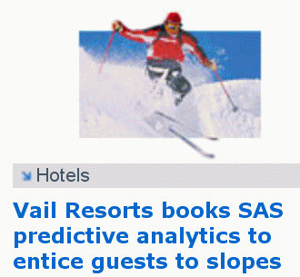

ADVANCED STATS
Advanced Topics:
#3: Analytics, etc.
Students in quantitative majors should be
exposed to a variety of advanced topics:
Monte-Carlo Simulation
Data Mining
Data Analytics
Coincidences
Epidemiology
Demography
Data manipulation
Data Visualization
Notes:
This is Milo arguing for an advanced-topics course.
There is more to an advanced topics course that design of experiments, modeling and multivariate analysis.
Data analytics is a big topic with data mining. Students need more exposure to coincidence, epidemiology and demography.
Data manipulation and data visualization are required no matter what kind of analysis is involved.

Slide 18
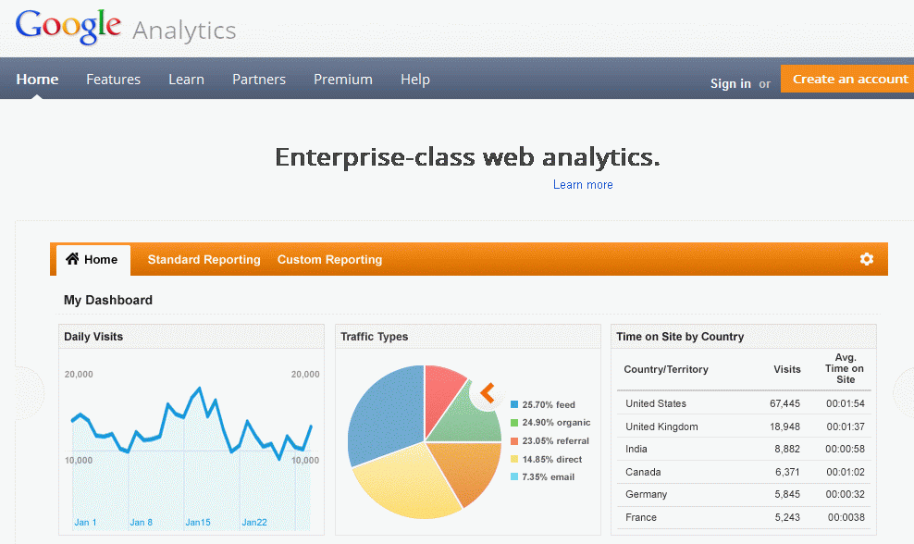
ADVANCED STATS
Advanced Topics:
#4: Web Analytics
.
Notes:
Web analytics is a hot topic today.
"Experiment or die, there is no try." Avinash Kaushik, Google Evangelist
“If you have two different pages you want to test, it takes six and a half minutes for you to configure, test and launch an A/B test.”
Prepare your students for the hottest careers on the web today. Watch the students flock to your class room.
--------------------------------------------
Bottom line: Students in quantitative majors need an advanced topics course.
Statistical educators should support requiring this post-inference advanced-topics course for ALL students in quantitative majors.

Slide 19
ADVANCED STATS
Milo’s conclusion:
Statistical educators should strongly encourage – if not require – students in quantitative majors to take a second statistics course:
a post-inference course involving Advanced Topics.

Slide 20
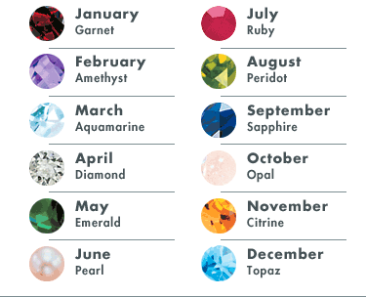
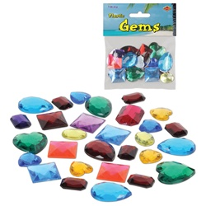

Students Must Learn to “Value” Statistics
STAT LIT
“Statistics are jewels used to decorate arguments”
Competent Consumers Must Be Knowledgeable
A gemstone? Colored Glass? A Plastic Toy?
Notes:
Statistical literacy is really a Statistics Valuation course. I don’t mean “appreciate” or any of the good things on student attitudes about the course that we all might like to see. I mean it is a course where students should learn how to decipher “good” statistics from the “not so good”.
I like to tell my students that Statistics are jewels used to decorate arguments. If I’m going to be a competent consumer of any product, I must be knowledgeable.
If I’m going to “buy” an argument decorated with statistics, I need to know what it is that I’m agreeing with.
Is it a gemstone? Is it a piece of colored glass? Or is it a plastic toy made to look like a gem?
Again, this is a set of skills that we don’t tend to focus on in the traditional STAT 101 course. Whether you are in a quantitative major or not, these are valuable skills that all students and future citizens are going to need to possess.

Slide 21
Head to Head Competition
Advanced Topics
  Students in Quantitative Majors need skills to be practitioners
  Data Drenched World requires statistical competence
  Quant Majors need the depth of an Advanced Course
Statistical Literacy
  Students in Non-Quantitative Majors need to “value” statistics
  As statistics proliferate, students need to be critical consumers.
  Breadth of topics will encourage “Hypothetical Thinking”
  Statistical educators should be leaders in the QL movement
Notes:
MILO: Let’s cut to the chase.
An advanced topics course is the only way for students in quantitative majors to become statistically competent.
They need statistical competence to flourish in our data-drenched world.
Students in quantitative majors need the depth offered in an advanced-topics course.
The only way to get this is to take an advanced-topics course.
A post-inference advanced-topics deserves your full support.
MARC:
Statistical Literacy is needed by non-quantitative majors to convert the naïve and cynics
With the proliferation of statistics and data, all students need to be better consumers of statistics
Teaching Hypothetical thinking about numbers requires a breadth of topics and time to concentrate on important concepts.
With the QL gaining momentum on many campuses as a graduation skill, Statistical Educators have an opportunity to be leaders in this movement.

Slide 22
Now is the Time… To Vote Again!
You are authorized to select a second course in statistics “in addition” to the traditional intro-inference course. The new course will be funded for five years.
You are considering two options:
* Pre-inference statistical-literacy course
* Post-inference advanced-topics course
Given limited resources & this discussion, which one would you choose for all US four-year colleges?
Notes:
MILO: Now is the time to vote again for one of these two options:
A pre-inference statistical literacy course: Stat 100.
A post-inference advanced-topics course. Stat 201.
This second course will be offered “in addition” to the regular “Stat 101” course.
This second course will be funded for five years at all four-year US college.
Select the option that you think would be more valuable.
Please vote now. We will watching the results.

Slide 23
Now is the Time….
For a Second Course!
Common Core
Quantitative Literacy Movement
Big Data / Data Deluge
Notes:
While your voting, we want to argue that now is the time for statistical educators to get behind offering a second course.
We see three reasons:
First, the common core. As more students come to college with a good foundation in statistics, what do we offer?
We need to have courses in place for this next generation of students.
Second, the quantitative literacy movement. In 2009, a survey of all US four-year colleges found that almost a fifth of those that replied are offering a course they call statistical literacy. QL is growing as a graduation requirement for all students.
Third, big data – the data deluge – is a reality. The Harvard Nurses study includes 238,000 nurses. The IRS processes millions of tax forms every year. WalMart captures point-of-sale transactions from over 2,900 stores in 6 countries for storage in their massive Teradata warehouse. Alexa ranks 30 million website world-wide.
Statistical educators need to ride this wave, capture the energy and provide value-added courses for today’s students.
--------------
Let’s look at our survey results.
[With 80 Votes, there are 68% in favor of Statistical Literacy and 32% in favor of Advanced Topics]

Slide 24
“Second Course” = Additional Course
Joint Conclusion:
Statistical educators should require all students to take an additional statistics course.
Statistical Literacy for Non-Quant Majors
Advanced Course for Quant Majors
Notes:
MILO: Here is our joint conclusion.
Statistical educators should recommend that ALL students be required to take an additional statistics course.
Statistical Literacy for students in non-quantitative majors.
Advanced-topics for students in quantitative majors.
We should recommend both, develop standards for both and be evangelists for both.
Our students deserve nothing less as they take on the problems of making better decisions using data.
Thank you for listening to our part of this webinar.

Slide 25

Questions / Discussions
Notes:
We are now opening up for your written questions, comments or suggestions. Our moderator will read them to all of us.
---------------------------------------

