Slide 1
Quick Assessment of Open ended Activities in R Commander
Serrano, V.¹, Cuadros, J.¹, Martori, F.¹,
Calvo, M. ², Miñarro, T. ², Gorina, V. ¹
¹ IQS Universitat Ramon Llull, Barcelona (Spain)
² Departament de Genètica, Microbiologia i Estadística, Universitat de Barcelona, Barcelona (Spain)

Slide 2
Open-ended activities
Open-ended activities are commonly used in teaching STEM disciplines (problems, cases, projects...)
Assessment is commonly done through reports or closed-form questionnaires
Difficult to grade (Time-consuming)
Activities are hard to evaluate
Assessment does not reflect students' work and/or students' learning difficulties

Slide 3
Using traces to capture students' work
Tracing user actions provides powerful information for educational research and for generating useful feedback for users and instructors:
classification of students
identification of plagiarism
adaptive behaviour detection
disengagement detection
Approach to an assisted assessment of open-ended activities

Slide 4
R Commander TR
R Commander
It’s a graphical user interface (GUI) widely used for teaching Statistics.
R Commander allows the use of R without compromising the learning process as command line interface to R can be an obstacle to many students (Fox, 2005).
R Commander TR
It’s a modified version of R Commander that captures users’ actions in a log file in the working directory

Slide 5
R Commander TR
R Commander
It’s a graphical user interface (GUI) widely used for teaching Statistics.
R Commander allows the use of R without compromising the learning process as command line interface to R can be an obstacle to many students (Fox, 2005).

Slide 6
R Commander TR
R Commander TR
We intercept the functions justDoIt and doItAndPrint to obtain most activity done in R Commander
To capture the manual editing of data, we intercept the activeDataSet function
We have created a trace function that collects all the information we need and writes it in a log file in the working directory
http://asistembe2.iqs.edu/rcmdrtr/

Slide 7
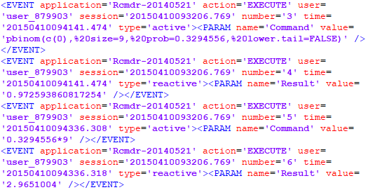
Traces

Slide 8
Traces

Slide 9
RCmdrTR dashboard
Dashboard
We have created a web platform that allows the visualization and analysis of the collected traces
Both the traced version of R Commander and the dashboard are available at
http://asistembe2.iqs.edu/rcmdrtr/

Slide 10
RCmdrTR dashboard
Let's see it running...
http://asistembe2.iqs.edu/rcmdrtr/rcmdrbd_demo/

Slide 11
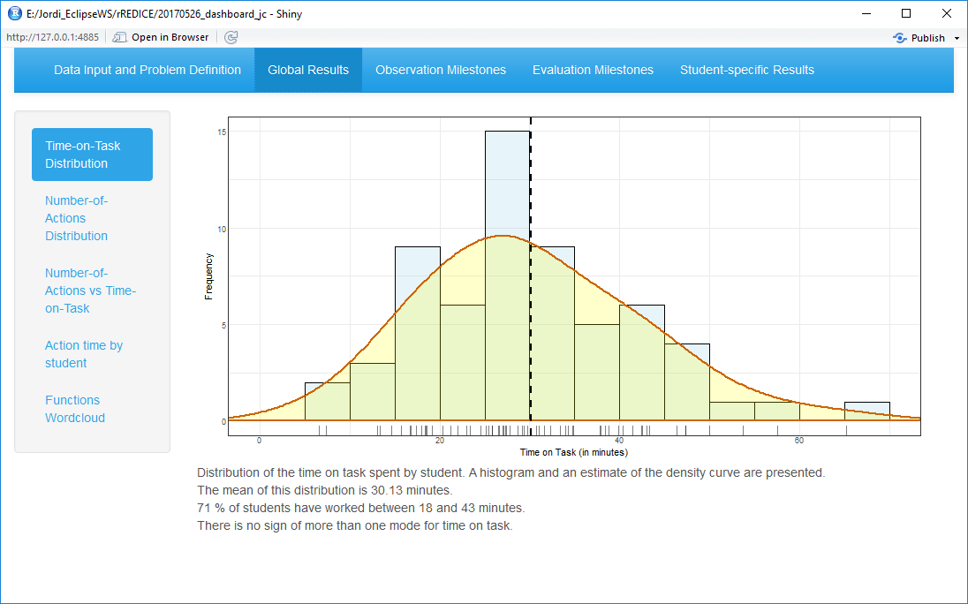
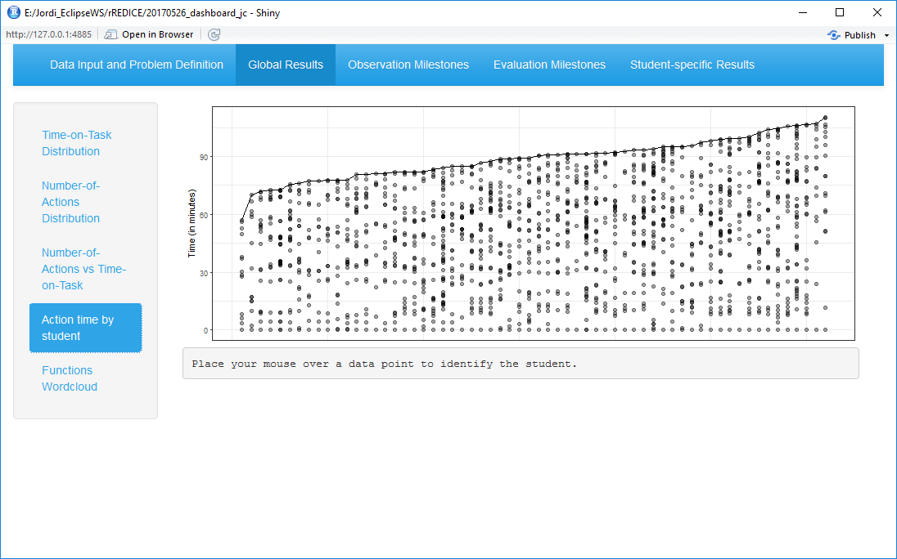
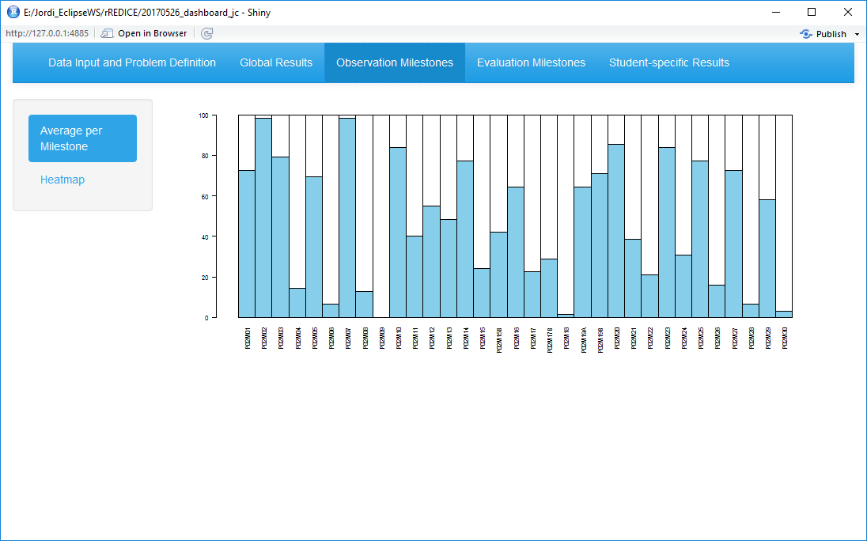
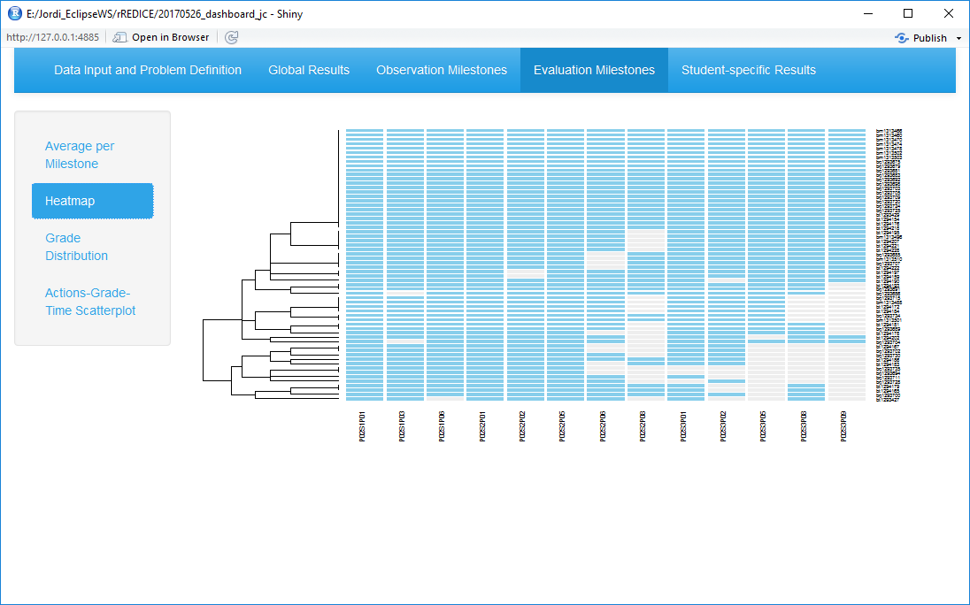
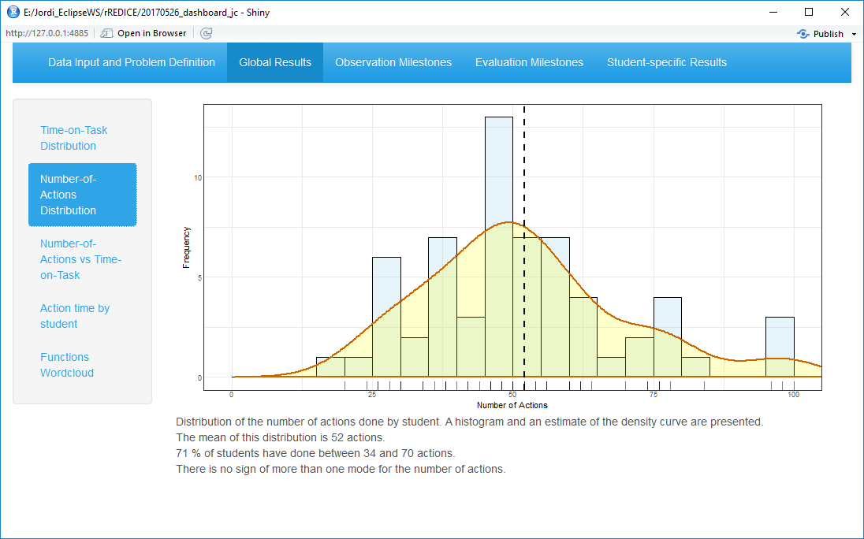
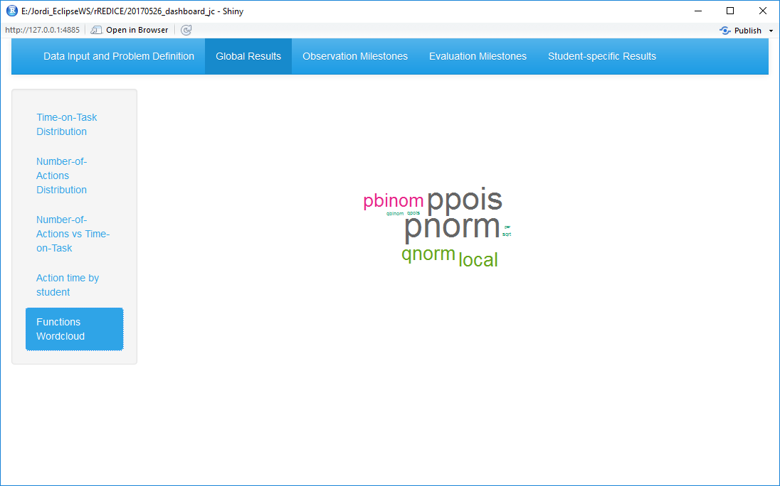
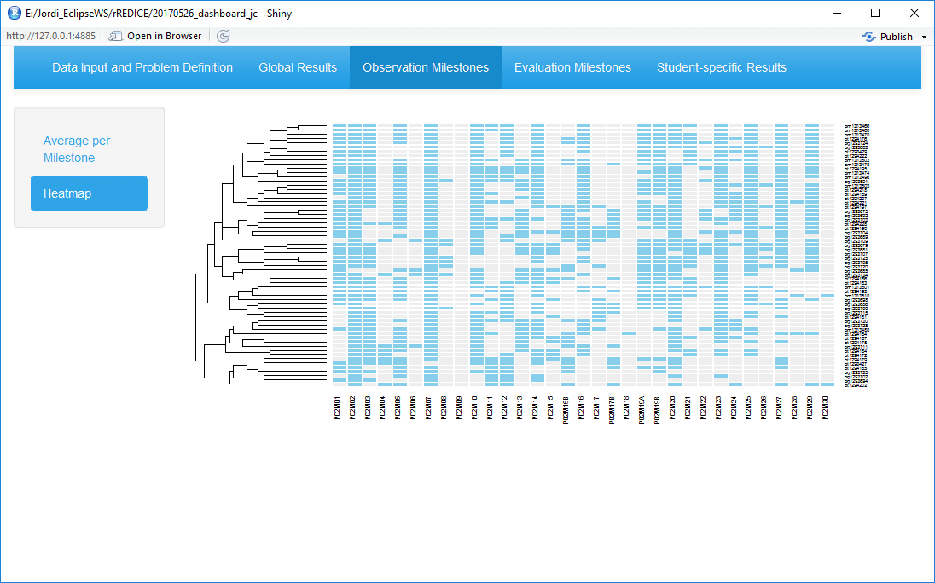
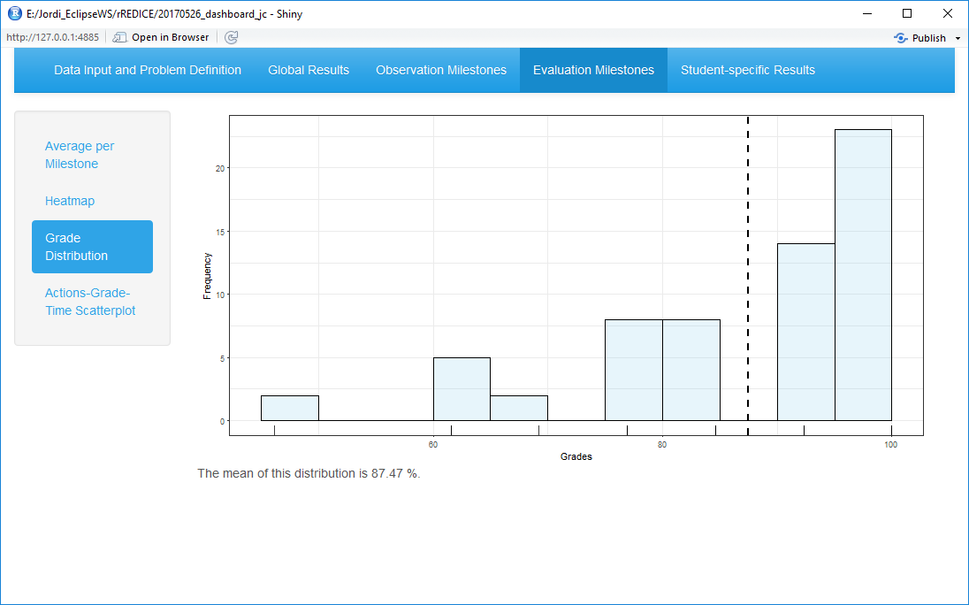
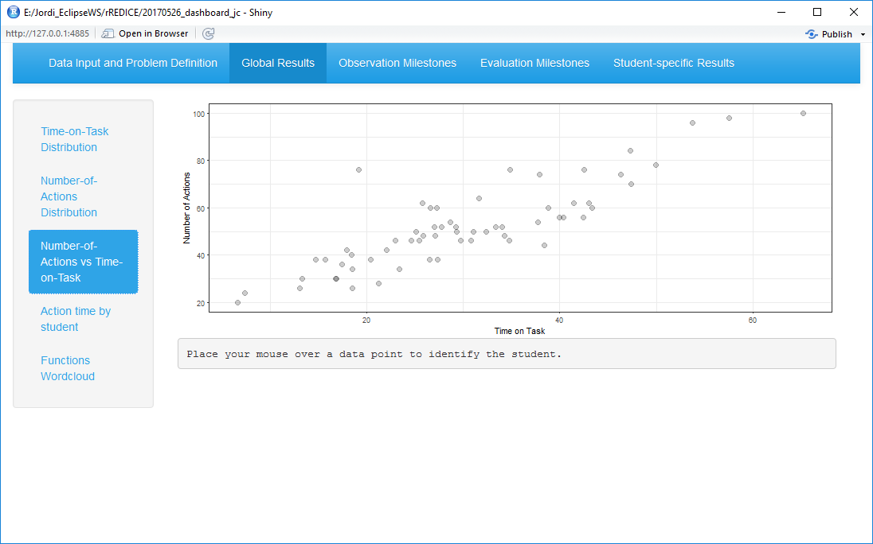
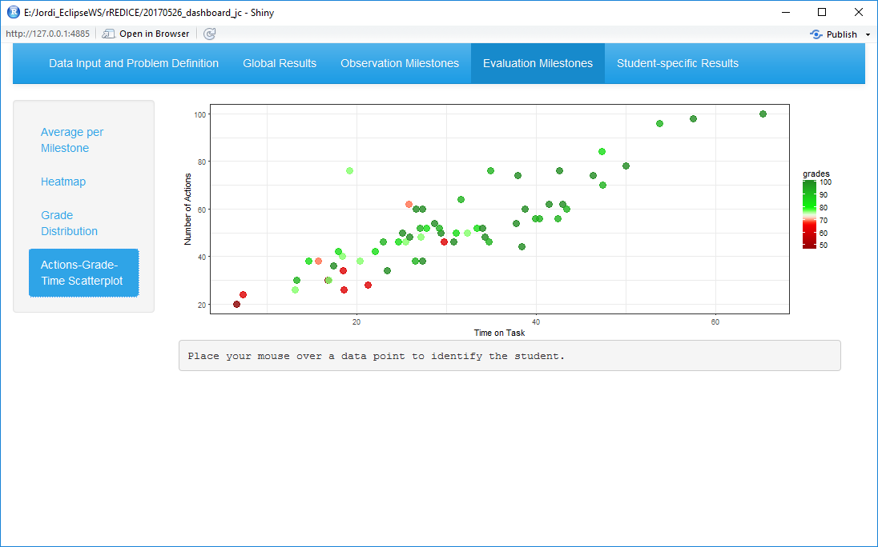
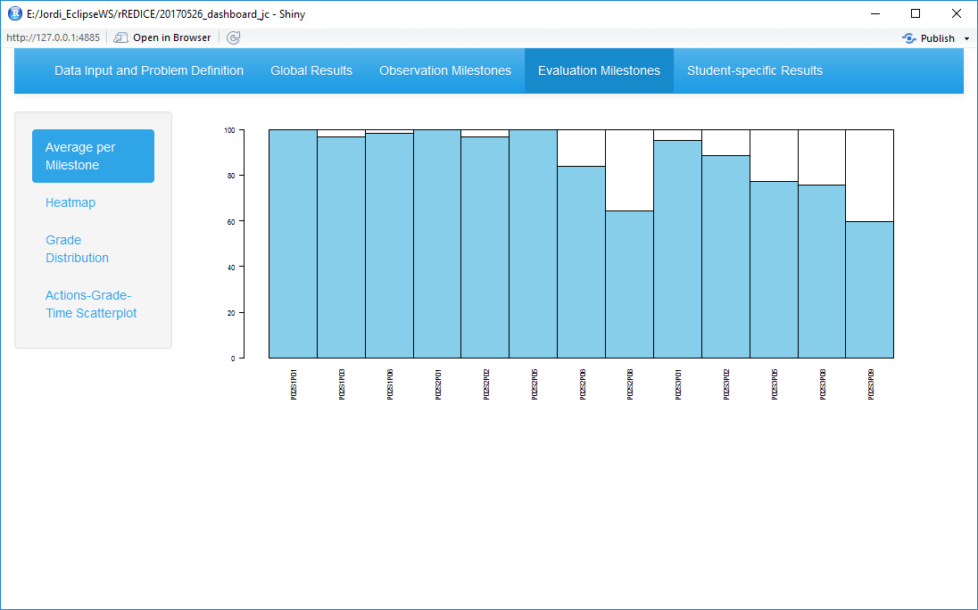
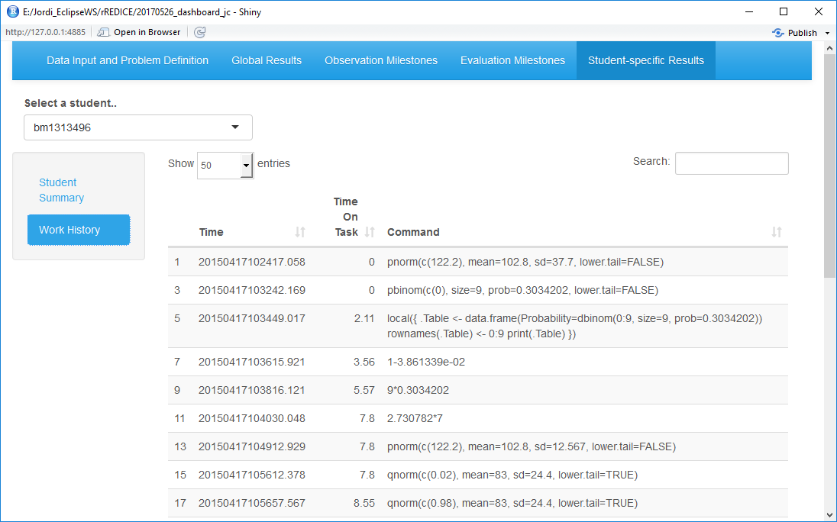
RCmdrTR dashboard
http://asistembe2.iqs.edu/rcmdrtr/

Slide 12
RCmdrTR dashboard

Slide 13
RCmdrTR dashboard

Slide 14
RCmdrTR dashboard

Slide 15
RCmdrTR dashboard

Slide 16
RCmdrTR dashboard

Slide 17
RCmdrTR dashboard

Slide 18
RCmdrTR dashboard

Slide 19
Acknowledgments
Funding agencies
Aristos Campus Mundus 2015
Secretaria d'Universitats i Recerca. Departament d'Economia i Coneixement. Generalitat de Catalunya

Slide 20
Contact info
Dr. Vanessa Serrano
vanessa.serrano@iqs.edu
Dr. Jordi Cuadros
jordi.cuadros@iqs.edu
Dr. Francesc Martori
francesc.martori@iqs.edu

