Slide 1
Overcoming Fears (my own) Teaching Reproducible Research, Big Data and Data Mining
Melinda Higgins, PhD
Associate Research Professor
Emory University, School of Nursing
Office of Nursing Research
[Acknowledgement: Vicki Hertzberg, PhD, Professor]

Slide 2
Outline
Purpose of course
Student makeup (fears 1+)
Prerequisites (fears 2+)
Software (fears 3+)
Reproducible Research Workflow (fears 4+)
Topics Covered (fears 5+)
Student Projects (fears defeated)

Slide 3
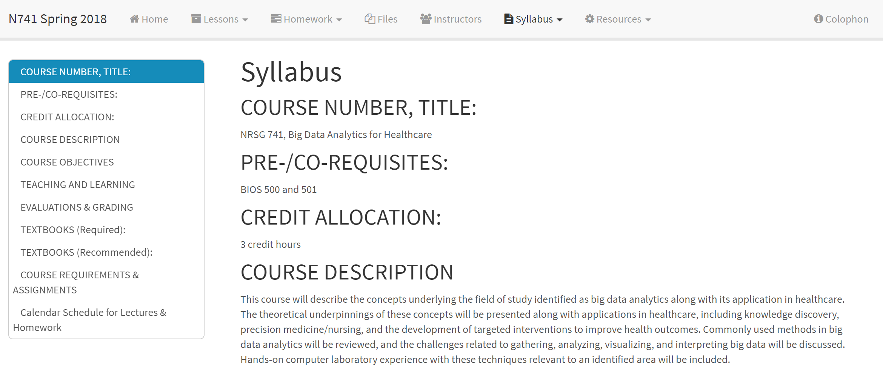
N741 Big Data Analytics for Healthcare
Purpose – Course was created because the School of Nursing recognized the importance of “Big Data” for nursing research and the need for nurse scientists to become conversant in this area.
https://melindahiggins2000.github.io/N741bigdata/syllabus.html

Slide 4
Student Makeup (Master’s and above)
Spring 2017:
  8 PHD Nursing;
  1 PHD Sociology;
  1 PostDoc Nursing
Spring 2018:
  3 MS Public Health (Health Policy)
  1 MS Public Health (Environmental Health)
  4 PHD Nursing
  3 Assistant Professor Nursing (K-grant career training)
Fears:
  Would a mixture of students in different disciplines and at different levels help or hurt?
  Would Nursing students embrace a computer and software intensive course and find it useful?

Slide 5
Prerequisites/Co-requisites
Fear:
  Would students be able to handle more “advanced” data mining with only 1 stats course?
PRE: 1 semester of biostatistics (Fall)
  BIOS 500 – Statistical Methods I – univariate, bivariate stats and tests, correlation, simple linear regression and ANOVA – includes Computer Lab course using SAS to do statistical analysis
CO: 2nd semester of biostatistics (Spring)
  BIOS 501 – Statistical Methods II – continues model building using regression and ANOVA methods, include multivariate linear regression, logistic regression, and survival analysis.

Slide 6
Computer Resources/Requirements
Spring 2017
  Computer Lab was available with R, RStudio, and Git installed
  But most students used their own laptops and installed their own software
Spring 2018
  Computer Lab gone
  Students required to have laptops
  Had to have/Assumed to have admin rights to install and configure software on their own computers (actually an issue for our junior faculty)
Fear:
  Would students be able to install and configure software on their own?
  No safety net Spring 2018

Slide 7
Computer Platforms
May consider RStudio Server or AWS platform solutions in future – pros and cons
Mixture of PCs and Macs
  multiple operating systems
Fears
  Have to be able to support and field questions and problems for multiple operating systems
  I was a PC person and my co-instructor was a MAC person
Advantages
  Gave students perspective of working in teams with multiple people on different operating systems
  And importance of always documenting computer platform and operating system for diagnostic purposes and reproducible research pipelines

Slide 8
Software
Fears:
  Would they be willing to embrace open source
  Would they feel like they are flying blind?
  Would they trust the software?
  Too many new tools all at once?
Open Source
  Intimidating (at first)
  Have to learn/know how to install and configure the software (mostly accept defaults)
R
RStudio – primary IDE
  GUI’s - R Commander (rcmdr) and rattle
GIT

Slide 9
Cloud Resources
Github Account
  Each student created their own public account
Github Education
  Created an organization for the course – each student had a private account within this organization
Datacamp (Spring 2018)
  Student accounts get access for 6 months
  Assigned suggested exercises
Fear:
  Would students be willing to embrace the Github interface and use it?

Slide 10
Reproducible Research Workflow
Fear:
  Would students handle multiple steps and overhead to manage assignments and projects?
Projects
  Keep code, Rmarkdown, data, outputs, etc – all files in 1 place
  Had to learn file management with their computers
Code (R)
  Covered both base R and tidyverse approaches
Text (RMD)
  Simple formatting Rmarkdown
  Add code chunks inside documents
  Keep chunk options simple – ECHO
Version Control GIT + Github
  Primarily GIT through RStudio
  Did demo GIT Bash (stand alone and through RStudio Terminal)

Slide 11
Syllabus Topics
Fear:
  Would students be handle a lot of topics with little depth, would they enjoy this approach?
R/RStudio, GIT/Github
Reproducible Research Workflow and Pipelines
Data Wrangling (1-2 sessions)
Exploratory Data Analysis, Summary Stats, Visualizations
Regular Expressions
Linear and Logistic Regression Models and Prediction
Machine Learning – unsupervised (KNN, PCA, SVM, Cluster Analysis, K-means clustering) and supervised (CART (trees), random forests)
Microbiome Data Processing (dada2 package) (2 sessions)
Networks (igraph)
Amazon Web Services (guest lecture demo)
Web Scraping (guest lecture demo)

Slide 12
Final Projects
FEARS DEFEATED!!
  I was blown away by the level of the projects undertaken
  I was amazed by what they learned on their own initiative
Web Scraping
Text Mining
Linear Regression
Logistic Regression
Supervised data mining (trees, random forests)
Classification Trees and/or Random Forests
Microbiome data processing and visualization
Some only simple t-tests or ANOVA
Tons of data pre-processing and data munging

Slide 13
Actual Quotes From Evaluations
R is tough, but strangely fun!
This course was not typical, as it was more about promoting student knowledge base so we could explore and learn relevant techniques outside of class.
I went from an amorphous understanding of how big data is everywhere to a concrete understanding of how it connects to statistics directly.
I think as much as the project kicked my butt, I feel a bit empowered about seeking out help in R and troubleshooting until it works.

Slide 14
Actual Quotes From Evaluations
I think I will utilize a lot of these skills in analysis of future projects.
All the basic R skills will be used. I will also probably use the microbiome techniques. I also hope to use PCA because I liked the simplicity of it and how it can group like concepts.
It's overwhelming (before and after), but at least I know where to start
Would like more hands-on exercises with using cloud-based computing. It was frustrating to learn workflow in R for analyses with big data, only to have the limitations of local computing resources

