Slide 1
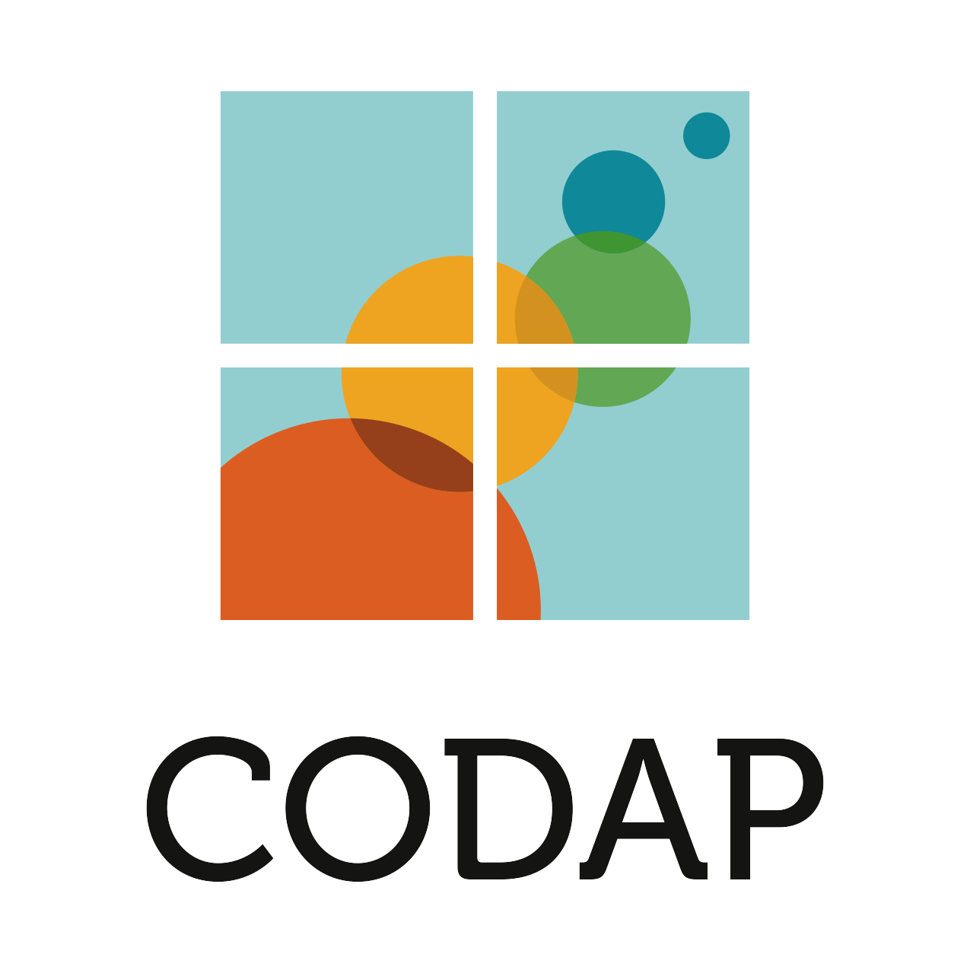
The Common Online Data Analysis Platform
codap.concord.org
Data Immersion
William Finzer, The Concord Consortium
This material is based on work supported by the National Science Foundation under awards numbered IIS-1530578 and DRL-1435470. Any opinions, findings, and conclusions or recommendations expressed in this material are those of the authors and do not necessarily reflect the views of the NSF.

