Slide 1
Welcome to USCOTS 2017!

Slide 2
Special welcome to (please stand)…
First-time attendees
Green sticker on name badge
Pick one up at USCOTS registration booth
Those who have now attended all 7 USCOTS
Or is it USCOTS’s?
Or is it USCOTSes??
Those who have now attended >1 and < 7 USCOTS

Slide 3
Theme: Show Me the DATA!
Helping students understand that data beat anecdotes, data are essential for evidence-based decision-making
Emphasizing data visualization
Embracing ideas of data science
Using data as educators to make informed decisions about effective teaching and learning
Whatever else you’d like the theme to mean ….

Slide 4
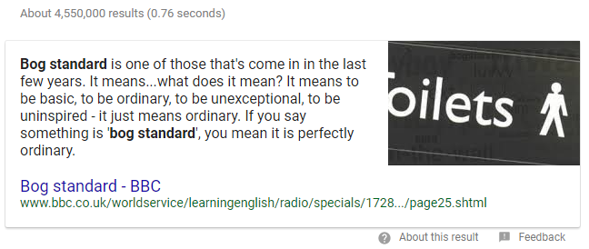
Opening Session
“Oh Say, Can You See?”
Chris Wild, University of Auckland (NZ)
Not a “bog-standard” talk

Slide 5
Opening Session
Show Me The DATA! (Anticipations)
Alison Gibbs, University of Toronto
Dave Hunter, Penn State University
Jessica Utts, University of California – Irvine
Nick Horton, Amherst College
Rebecca Nugent, Carnegie Mellon University
5-minute presentations

Slide 6
Chris Wild

Slide 7
Opening Session
Show Me The DATA! (Anticipations)
Alison Gibbs, University of Toronto
Dave Hunter, Penn State University
Jessica Utts, University of California – Irvine
Nick Horton, Amherst College
Rebecca Nugent, Carnegie Mellon University
5-minute presentations
(Notice use of alphabetical order by first name;
Alison is one of the few people who beat me!
I’m thinking of having my second L removed.)

Slide 8
Five-minute presentations
“I have made this longer than usual because I have not had time to make it shorter.”
Blaise Pascal
“Not that the story need be long, but it will take a long while to make it short.”
Henry David Thoreau
“If I am to speak ten minutes, I need a week for preparation; if fifteen minutes, three days; if half an hour, two days; if an hour, I am ready now.”
Woodrow Wilson

Slide 9
Preview of coming attractions (1)
Four plenary addresses
Fri am: Rob Kass, Carnegie Mellon
Gap Between Statistics Education and Practice
Fri pm: Deb Nolan, UC – Berkeley
Integrating Computational and Statistical Thinking
Sat am: Mine Cetinkaya-Rundel, Duke
Teaching Data Science and Statistical Computation
Sat pm: Jay Lehmann, College of San Mateo
Acceleration and Hope for Non-STEM Students

Slide 10
Preview of coming attractions (2)
Four sets of interactive breakout sessions
Some (ending in B, C, or D*) offered twice
Two sets of Posters and Beyond sessions
Dean’s Hall
Friday am, Saturday am
Birds-of-a-Feather lunch discussions
See online program for topics
Including for first-time attendees
Exhibitor technology demonstrations

Slide 11
Preview of coming attractions (3)
Banquet and awards
Do not miss – in this room tomorrow evening!
A-mu-sing contest winners
Insights from award-winning statistics teachers
Presentation of this year’s Lifetime Achievement Award
No technology glitches this year!
Closing session
Show Me the DATA! (Reflections)
Five 5-minute presentations (different perspectives)
Must be on time: wedding to follow!

Slide 12
Preview of coming attractions (4)
Social media challenge
#USCOTS17
CAUSE Rewards Points!
Free internet throughout conference center: attwifi network
Hallway conversations
Greet first-time attendees
Enjoy!

Slide 13
Preview of coming attractions (5)
Eventually we’ll return home ….
If you want to take the shuttle to SCE airport, you MUST let front desk know in advance
Please let USCOTS registration desk know if:
You can offer a ride to Pittsburgh area or Baltimore area or Harrisburg area on Saturday evening or Sunday morning
You would like to have a ride to the Philadelphia area on Sunday morning

Slide 14
Many thanks (1)
Penn State Department of Statistics
Dennis Pearl, Director of CAUSE
Bob Casey, Kathy Smith, Lorey Burghard
Penn State statistics graduate students

Slide 15
Many thanks (2)
American Statistical Association
JMP Division of SAS Institute (premier sponsor)
Hawkes Learning
John Wiley and Sons
Minitab
Pearson Higher Education
W.H. Freeman

Slide 16
Many thanks (3)
Workshop presenters, participants
Breakout session presenters
Posters & Beyond: Jack Miller, reviewers, presenters, reviewers
Birds-of-a-feather discussion facilitators

Slide 17
Many thanks (4)
ALL of you!!

