Slide 1
Who Is This Guy?
A high school teacher.
(I used to be a math teacher…)
A statistical convert.
(There is no zealot like a convert)
Notes:
It’s my privilege to address such accomplished statisticians and educators.

Slide 2
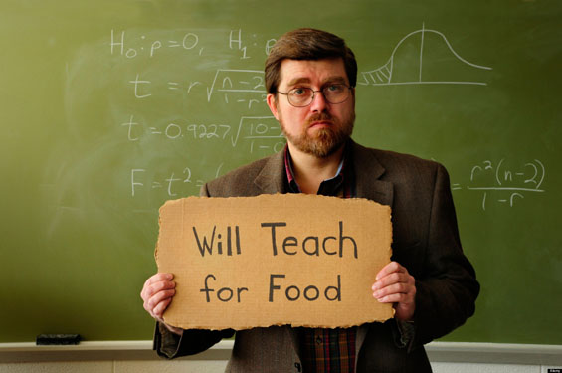
What I Can’t do…
Tell you anything you don’t already know about Statistics.
Give you the perfect
solution to your
teaching problems.
Get you more money.
Notes:
I asked myself what I could contribute that hasn’t already been covered at this conference.
It was easier to think of the things I couldn’t contribute.

Slide 3

What I Can Do…
Remind us that we teach.

Slide 4
Remember
This is not USCOS.
It’s USCOTS.
Notes:
We are at is not USCOS, it’s USCOTS.
We have spent an entire conference showing each other the data, but the important thing is the “T”!

Slide 5

The Game is Simple
“Sometimes I have to
remind myself the
game is simple…”
-Eric Webb
Notes:
Eric Webb: “Sometimes I have to remind myself the game is simple…”
The game is simple – we need to teach our students to think about and reason in the face of variability, uncertainty, and chance.

Slide 6
Remember What We Teach
We teach statistics.
Not mathematics.
Notes:
You might care about the math, but your students don’t!

Slide 7
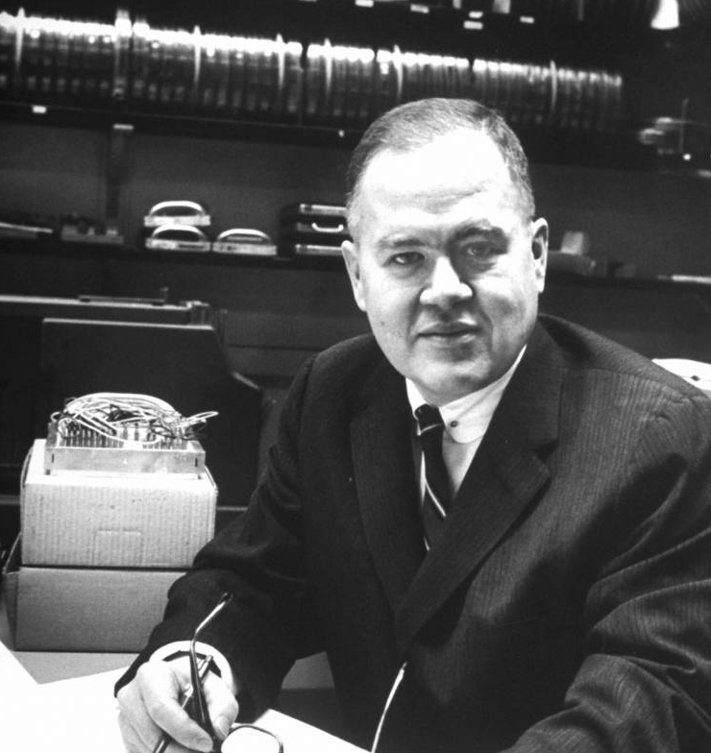
“Statistics is a science in my opinion, and it is no more a branch of mathematics than are physics, chemistry and economics; for if its methods fail the test of experience – not the test of logic –
they are discarded.”
-John Wilder Tukey
Notes:
Teach science. This is WHY we show students the data – because scientists reason about the world around them with data.

Slide 8
Remember What We Teach
We teach curiosity.
Bring the world into the classroom.
Notes:
Engage our students!
Have a sense of wonder about the world around us.
Develop the same in your students.
The world is our laboratory and playground.
But here is our advantage over other disciplines – Statistics is connected to EVERY endeavor!

Slide 9
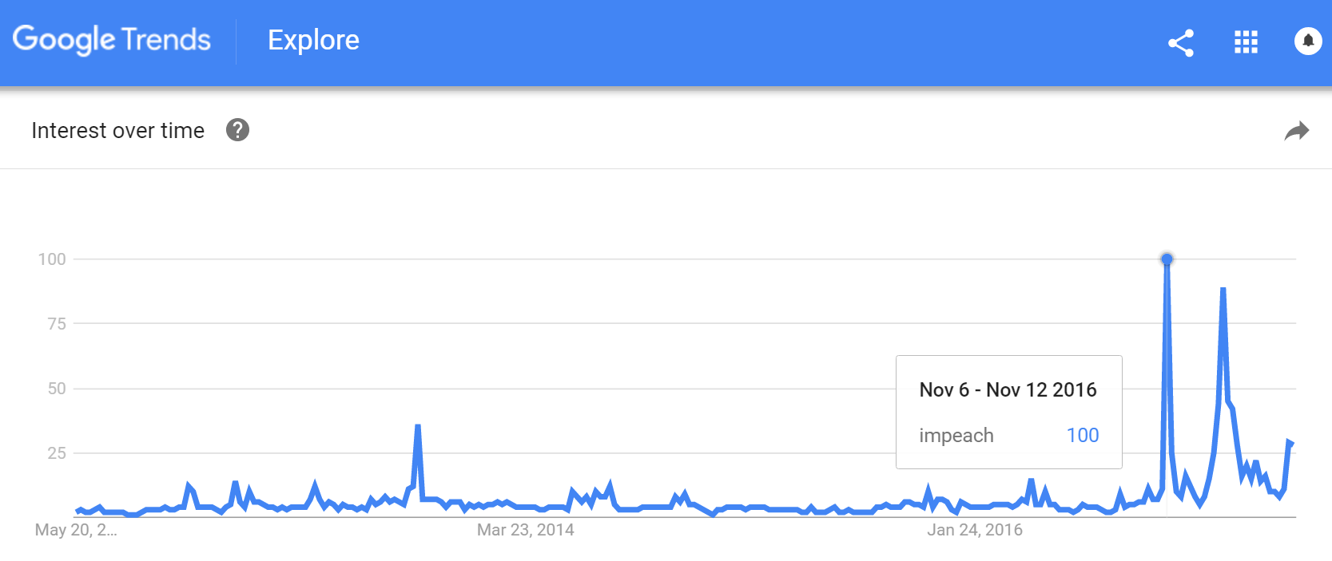
Notes:
Thanks to James Bush for finding this!

Slide 10
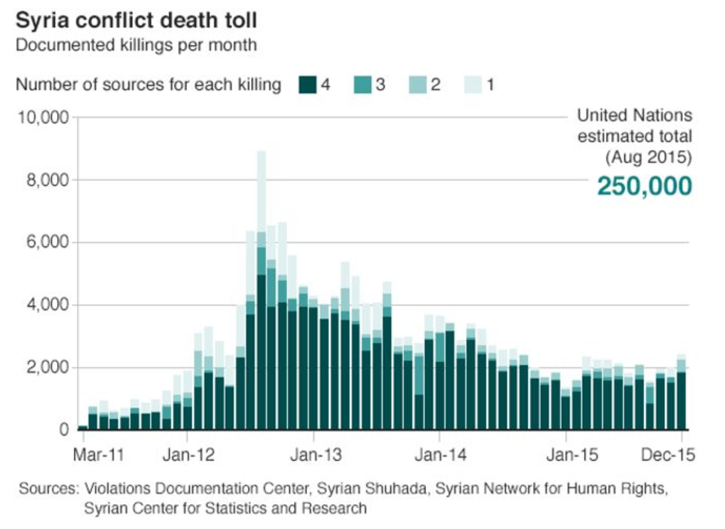

Slide 11
Remember What We Teach
We teach magic.
Revel in it.

Slide 12
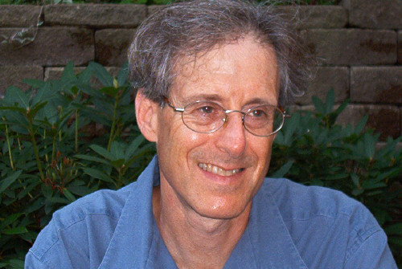
“Revel in the magic of statistical inference.”
-Rob Kass
Notes:
Inference IS magical. Inferring to 300 million from about 1000 is MAGICAL, recent election polls notwithstanding.

Slide 13
Remember What We Teach
We teach students.
Be mindful of them.

Slide 14
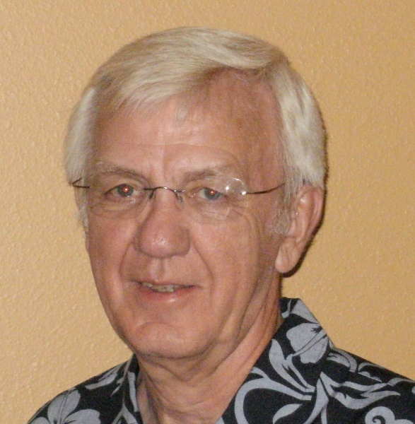
“I was influenced by good teachers who not only loved what they were teaching but also took a personal interest in students above and beyond the call of duty. That’s still a good message for all
of us who teach.”
-Dick Scheaffer
Notes:
Your students can always tell if you are really in their corner or not.

Slide 15
RemembeR
We teach.
What we do matters.

Slide 16
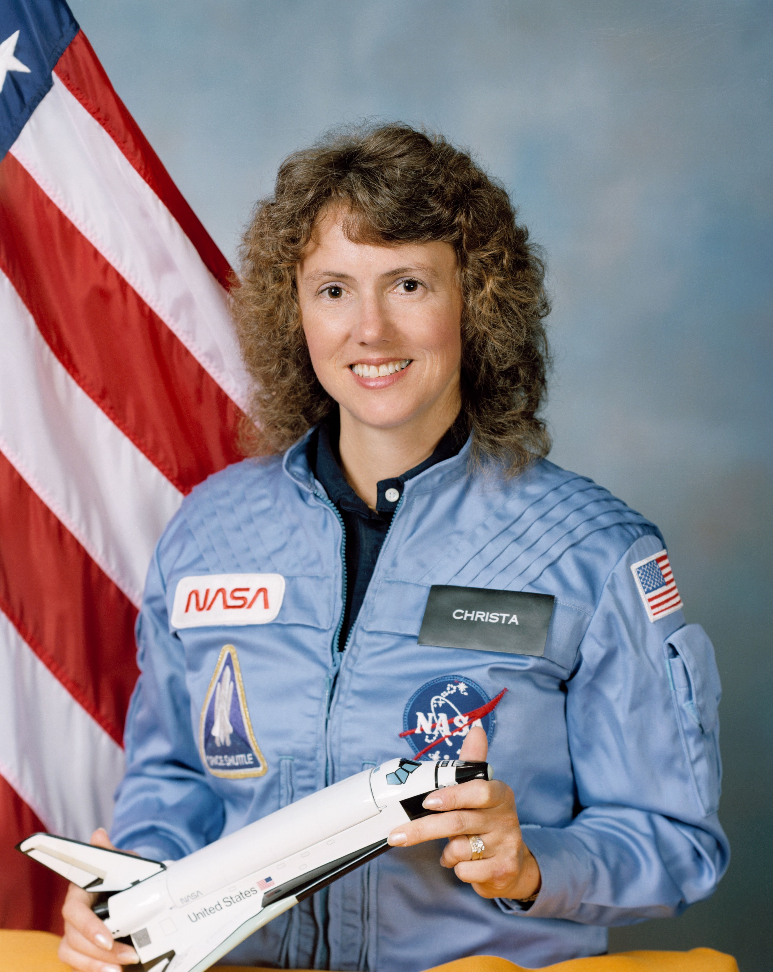
“I touch the future.
I teach.”
-Christa McAuliffe

Slide 17
Our Call to action
Be passionate about teaching.
Learn more about teaching.
Teach better.
Be a teacher. Be an evangelist.
(be like Danny Kaplan)

