Slide 1
Brian Kotz
USCOTS 2017
A Story

Slide 2
Imagine a mathematics department meeting at a two-year college…

Slide 3
Imagine a mathematics department meeting at a two-year college…
High level of care for students, but concern about completion
DFW Rates. Those who fail or withdraw.
“must be taking too many classes"
“must have switched jobs”

Slide 4
Imagine a mathematics department meeting at a two-year college…
High level of care for students, but concern about completion
DFW Rates. Those who fail or withdraw.
“must be taking too many classes"
“must have switched jobs”
“had a big family situation and that was probably it,”
“I think my students don’t go enough to the learning center for help,”
“I think my students go to the learning center too much for help,”

Slide 5
Imagine a mathematics department meeting at a two-year college…
High level of care for students, but concern about completion
DFW Rates. Those who fail or withdraw.
“must be taking too many classes"
“must have switched jobs”
“had a big family situation and that was probably it,”
“I think my students don’t go enough to the learning center for help,”
“I think my students go to the learning center too much for help,”
“Have we ever done a survey and asked students why they withdraw?”

Slide 6
Imagine a mathematics department meeting at a two-year college…
High level of care for students, but concern about completion
DFW Rates. Those who fail or withdraw.
“must be taking too many classes"
“must have switched jobs”
“had a big family situation and that was probably it,”
“I think my students don’t go enough to the learning center for help,”
“I think my students go to the learning center too much for help,”
“Have we ever done a survey and asked students why they withdraw?”
“…and do faculty have access to any tracking or grade data for the students who withdraw and who stay?”

Slide 7
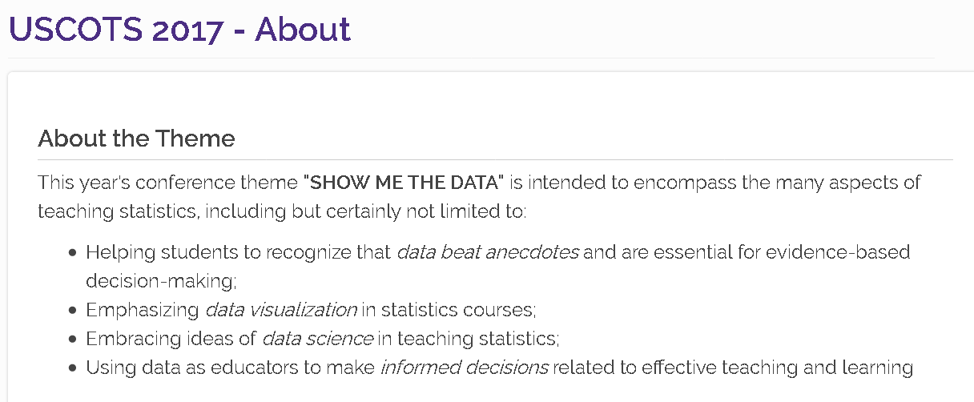

Slide 8
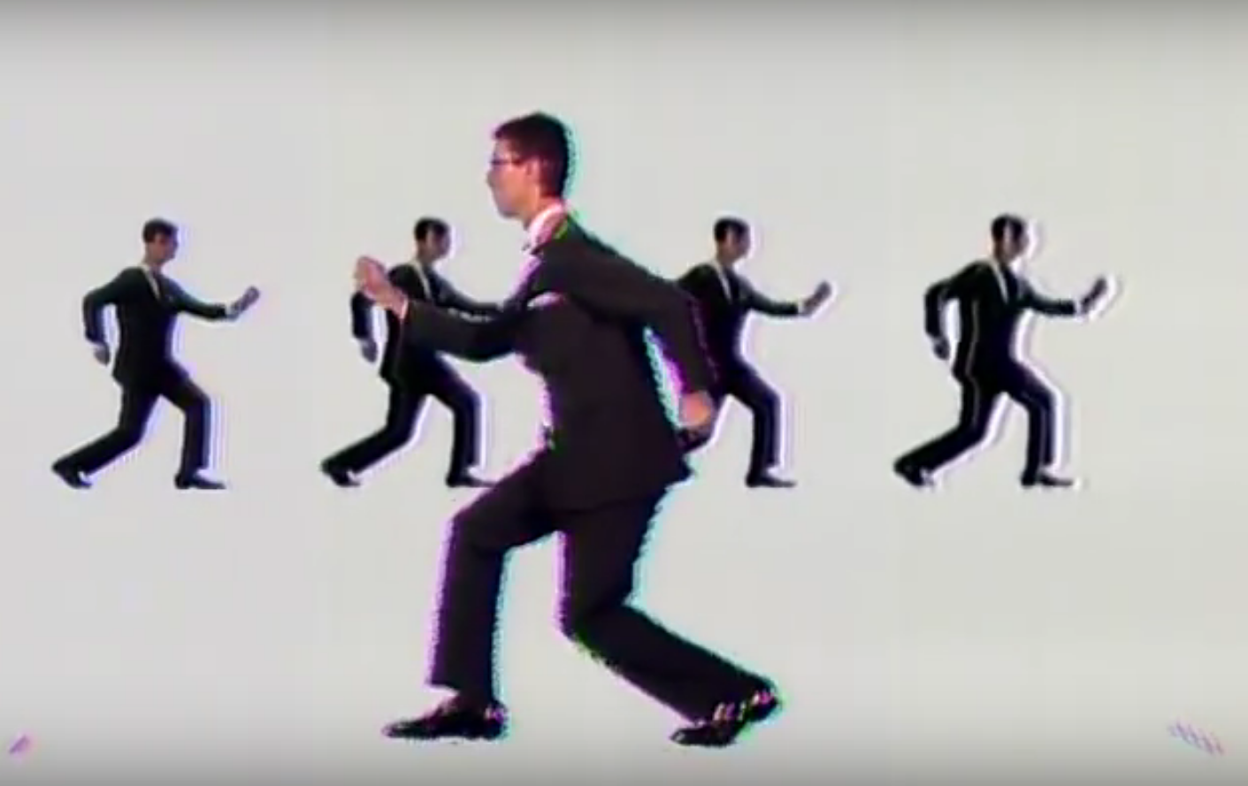
As the project continues….
Talking Heads, Once in a Lifetime, 1980-81

Slide 9
As the project ensues….
How did I get here?
How do I work this?
"My God! What have I done?"
Talking Heads, Once in a Lifetime, 1980-81

Slide 10
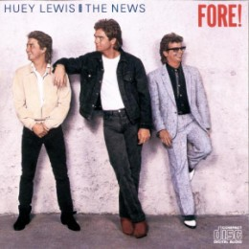
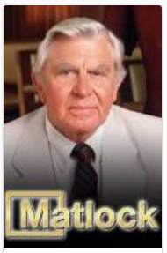
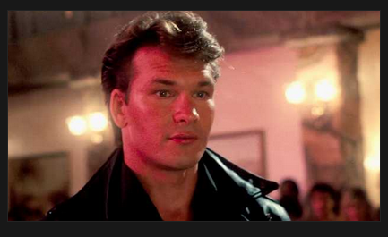
1987…

Slide 11
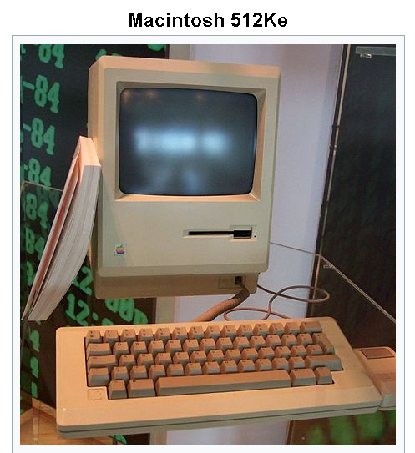

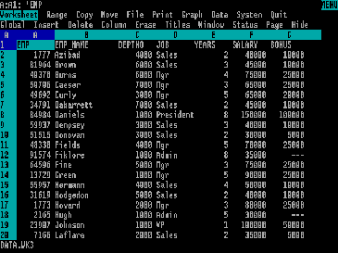

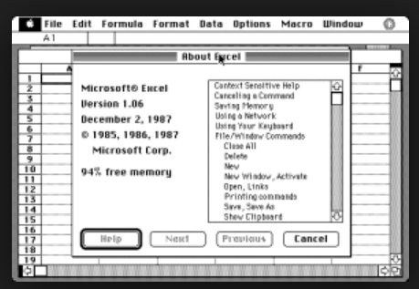
… became an undergraduate statistics major
1987…

Slide 12


Slide 13
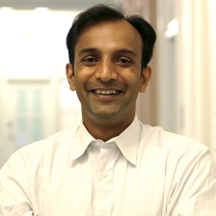
“I'm the U.S. Chief Data Scientist — and I got my start in community college.”

Slide 14

“I'm the U.S. Chief Data Scientist — and I got my start in community college.”
“Will you have data science classes soon?”

Slide 15

His Comfort Zone
Year

Slide 16


His Comfort Zone
This Community!
Year
This Community!

Slide 17

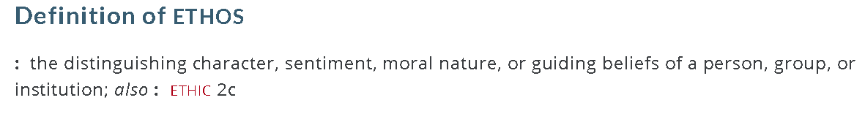
The Ethos of the Community
supported, enthused, enriched, excited, exhausted, proud, recharged, hopeful?

Slide 18
2017…
1987…
Same as it ever was

Slide 19
2017…
1987…
Same as it ever was
Happy to be stuck with you

Slide 20
2017…
1987…
Same as it ever was
Happy to be stuck with you
Nobody puts data in a corner

