Slide 1
Statistical Practices: What do statisticians do?
Layla Guyot & Alex White
Texas State University

Slide 2
Importance of statistics and statisticians
Wide range of applications for statistics (from Actuarial science to Zoology) and the era of Big Data
Employment for statisticians expected to grow by 34% between 2016 and 2026 compared to a 7% growth rate for all occupations:
Statistical Practices: What do statisticians do?
1/20

Slide 3
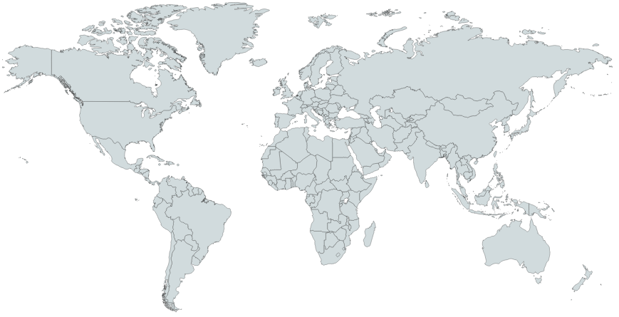
A need for statisticians
Statistical Practices: What do statisticians do?
2/20

Slide 4
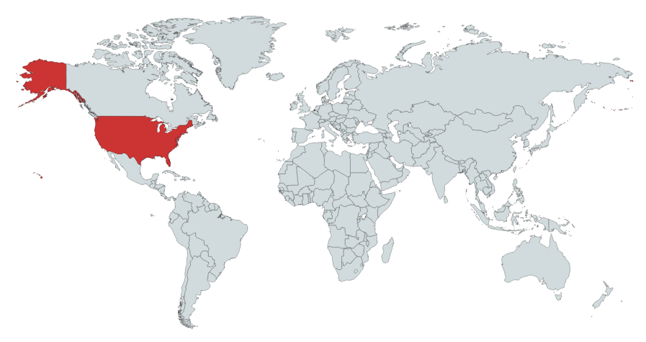
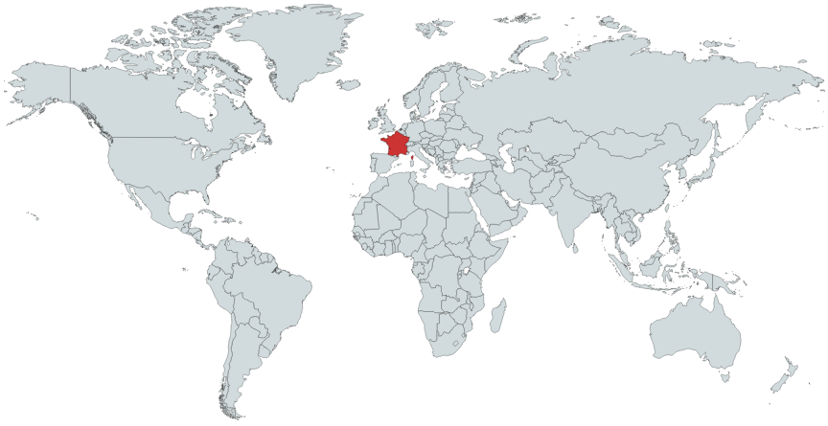
A need for statisticians
“Statisticien, un bac+5 très courtisé”
(Le Parisien Etudiant, 2013)
Statistical Practices: What do statisticians do?
2/20

Slide 5
A need for statisticians
“More Students Earning Statistics Degrees, But Not Enough To Meet Surging Demand for Statisticians”
(American Statistical Association, 2015)
Statistical Practices: What do statisticians do?
2/20

Slide 6
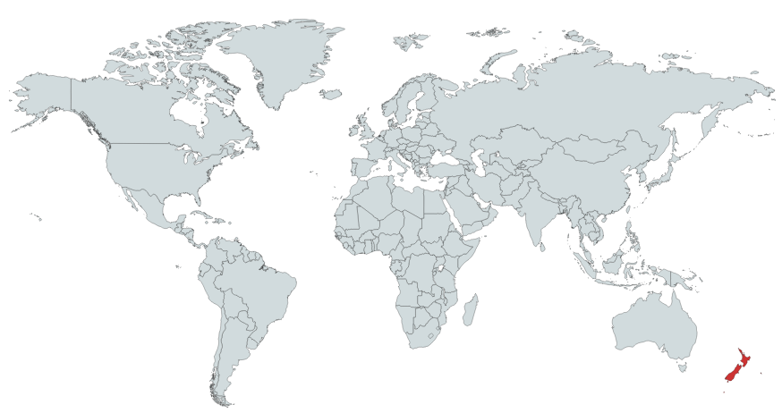
A need for statisticians
“Most employers are looking for experienced statisticians when they are hiring”
(Occupation Outlook, 2018)
Statistical Practices: What do statisticians do?
2/20

Slide 7
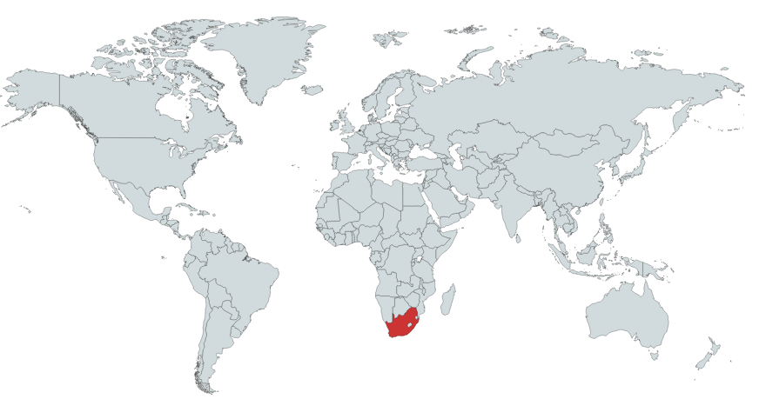
A need for statisticians
“Needed: statisticians – not nerds – with workplace knowledge”
(Mail & Guardian, 2017)
Statistical Practices: What do statisticians do?
2/20

Slide 8
Identifying a challenge
Education
Students focus on statistical theory and concepts
(Kenett & Thyregod, 2006)
Statistical Practices: What do statisticians do?
3/20

Slide 9
Identifying a challenge
Education
Profession
Students focus on statistical theory and concepts
(Kenett & Thyregod, 2006)
Statisticians perform statistics in a specific context
(Pfannkuch & Wild, 2000)
Statistical Practices: What do statisticians do?
3/20

Slide 10
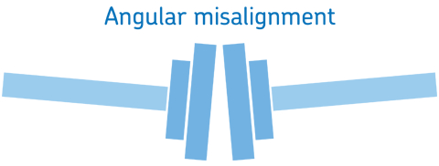
Identifying a challenge
Education
Profession
Students focus on statistical theory and concepts
(Kenett & Thyregod, 2006)
There is a misalignment for statistical practices
(Van der Berg, 2017)
Statisticians perform statistics in a specific context
(Pfannkuch & Wild, 2000)
Statistical Practices: What do statisticians do?
3/20

Slide 11
Identifying a challenge
Van der Berg (2017) surveyed 95 intern statisticians:
71% agreed that they did acquire the appropriate statistical knowledge needed at the workplace
72% indicated that they did not acquire the appropriate statistical skills needed at the workplace
Statistical Practices: What do statisticians do?
4/20

Slide 12
Identifying a challenge
Respondents could list skills required at the workplace and indicate if it was taught or not:
21 out of a total of 28 skills were mentioned as not being taught
Most cited skills were: data collection, questionnaire design, communication, writing skills, and using statistical software.
Statistical Practices: What do statisticians do?
4/20

Slide 13
Identifying a solution
a challenge | There is a misalignment between the practices acquired through education and the practices required for the profession.
Statistical Practices: What do statisticians do?
5/20

Slide 14
Identifying a solution
a challenge | There is a misalignment between the practices acquired through education and the practices required for the profession.
a possible explanation | Statisticians develop practices that grow out of experience during their transition to the profession.
Statistical Practices: What do statisticians do?
5/20

Slide 15
Identifying a solution
a challenge | There is a misalignment between the practices acquired through education and the practices required for the profession.
a possible explanation | Statisticians develop practices that grow out of experience during their transition to the profession.
a possible solution | 1) Identify practices developed by statisticians 2) Investigate how to include these practices in education
Statistical Practices: What do statisticians do?
5/20

Slide 16
Purpose of the study
a challenge | There is a misalignment between the practices acquired through education and the practices required for the profession.
a possible explanation | Statisticians develop practices that grow out of experience during their transition to the profession.
a possible solution | 1) Identify practices developed by statisticians 2) Investigate how to include these practices in education
Statistical Practices: What do statisticians do?
5/20

Slide 17
Identifying statistical practices
from the perspective of mentors at the workplace: Holmes (1997), Ritter, Starbuck, and Hogg (2001), Van der Berg (2017).
from the perspective of statisticians: Van der Berg (2017), Pfannkuch and Wild (2000), Harraway & Barker (2005), Kent et al. (2005), Bakker et al. (2008).
from the perspective of mentors in education: Anderson and Loynes (1987), Cameron (2006).
Statistical Practices: What do statisticians do?
6/20

Slide 18
Identifying statistical practices
Engaging in a task to explore perspectives on the profession of statistician
Meeting statisticians, students and educators of statistics at conferences
Discussing personal experience in an interview
Reflecting on experiences through a survey
Statistical Practices: What do statisticians do?
6/20

Slide 19
Participation to the study
We will now engage in a task that intends to explore your perspective on the profession of statistician.
http://statistician.intelligentedge.com/
Your engagement in the task is part of the workshop session, by answering the questions you are giving permission to use the results for research purposes. You can also complete a survey to share your experience or share your contact information to participate in an interview.
This study has been approved by the Internal Review Board (Approved IRB #6144).
Statistical Practices: What do statisticians do?
7/20

Slide 20
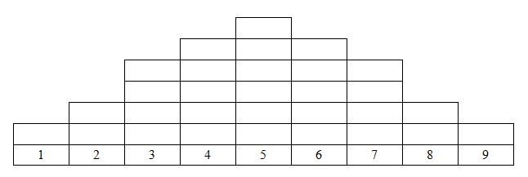
Task http://statistician.intelligentedge.com/
From your perspective, what important practices are statisticians performing at the workplace?
Sort and arrange 24 statistical practices in order of importance, from the least important (1) to the most important (9), into the following shape:
You can add up to 6 practices that were not mentioned in the given list. If you have no practice to add, leave column 5 blank considered neutral.
least important
most important
Statistical Practices: What do statisticians do?
8/20

Slide 21
Discussion
Any practice that was especially challenging to order?
Compare practices on the left and right tails of the distributions with your neighbors.
Comment on the differences/similarities
How do you promote these practices in your courses?
When do statisticians develop these practices?
Compare additional practices with your neighbors.
Have you reported different additional practices?
Why would these practices be different or similar?
Statistical Practices: What do statisticians do?
9/20

Slide 22
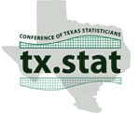
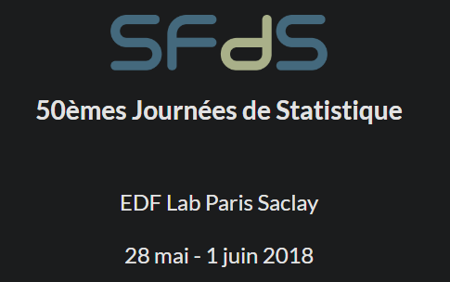
Preliminary results: Participants
 | COTS April 2018 | JDS June 2018 | ICOTS July 2018 | CSP February 2019 | Total
Statistician | 6 | 6 | 1 | 21 | 34
Statistician - Professor | 3 | 2 | 7 | 2 | 14
Professor | 9 | 3 | 0 | 3 | 15
Graduate student | 2 | 7 | 0 | 9 | 18
Undergraduate student | 7 | 0 | 0 | 4 | 11
Total | 27 | 18 | 8 | 39 | 92
+ 5 missing
Statistical Practices: What do statisticians do?
10/20

Slide 23
Preliminary results: Participants
A diversity of degrees (highest degree obtained or currently pursued) in a variety of disciplines:
 | Bachelor | Masters | PhD | Total
Statistics – Data Science – Biostatistics … | 0 | 23 | 21 | 44
Mathematics | 6 | 0 | 5 | 11
Others: Accounting, Engineering, … | 2 | 3 | 5 | 10
Missing description | 6 | 1 | 9 | 16
Total | 14 | 27 | 40 | 81
Statistical Practices: What do statisticians do?
10/20

Slide 24
Preliminary results: Task
- Collected 63 sorting tasks
- Analysis of sorting task (Q-methodology)
using data reduction to identify patterns of thought
applying PCA on tasks (participants are correlated)
identifying 3 groups of participants
identifying 3 perspectives
Statistical Practices: What do statisticians do?
11/20

Slide 25
Task: Categories of practices
Process of data analysis |  |  | Traits
Design | Focus on data | Techniques | Interpersonal skills | Personal skills
- Using knowledge of the context - Translating a real problem into a statistical form - Designing studies - Preparing sampling frames | - Collecting data - Creating / Maintaining databases - Cleaning data - Using statistical software - Producing visual representations - Interpreting data | - Researching appropriate statistical methods - Developing new statistical methods - Applying statistical methods - Using advanced mathematics | - Participating in teams / Collaborating - Communicating in writing - Communicating orally - Consulting with a client - Communicating interpretations of statistics to non-statisticians | - Working independently - Being curious / willing to learn - Being skeptical / critical - Meeting deadlines - Considering ethical issues
Statistical Practices: What do statisticians do?
12/20

Slide 26
Task: Perspective 1
 |  |  |  |  | Meeting deadlines
 |  | Considering ethical issues |  |  | Participating in teams / Collaborating | Being curious / willing to learn
 |  | Working independently | Being skeptical / critical |  | Communicating orally | Communicating in writing
 | Creating / Maintaining databases | Preparing sampling frames | Using knowledge of the context | Designing studies | Using statistical software | Translating a real problem into a statistical form | Consulting with a client
Developing new statistical methods | Using advanced mathematics | Collecting data | Researching appropriate statistical methods | Cleaning data | Producing visual representations | Interpreting data | Applying statistical methods | Communicating interpretations of statistics to non-statisticians
1 | 2 | 3 | 4 | 5 | 6 | 7 | 8 | 9
Statistical Practices: What do statisticians do?
13/20

Slide 27
Task: Perspective 2
 |  |  |  |  | Being skeptical / critical
 |  | Meeting deadlines | Considering ethical issues |  | Participating in teams / Collaborating | Being curious / willing to learn
 |  | Working independently | Communicating in writing |  | Communicating orally | Communicating interpretations of statistics to non-statisticians
 | Preparing sampling frames | Consulting with a client | Cleaning data |  | Producing visual representations | Using statistical software | Researching appropriate statistical methods
Creating / Maintaining databases | Collecting data | Using knowledge of the context | Using advanced mathematics | Designing studies | Developing new statistical methods | Interpreting data | Applying statistical methods | Translating a real problem into a statistical form
1 | 2 | 3 | 4 | 5 | 6 | 7 | 8 | 9
Statistical Practices: What do statisticians do?
13/20

Slide 28
Task: Perspective 3
 |  |  |  |  | Consulting with a client
 |  | Participating in teams / Collaborating |  |  | Designing studies | Translating a real problem into a statistical form
 |  | Working independently | Communicating interpretations of statistics to non-statisticians |  | Preparing sampling frames | Collecting data
 | Considering ethical issues | Communicating orally | Developing new statistical methods | Meeting deadlines | Using knowledge of the context | Producing visual representations | Cleaning data
Being curious / willing to learn | Being skeptical / critical | Communicating in writing | Using advanced mathematics | Researching appropriate statistical methods | Using statistical software | Interpreting data | Applying statistical methods | Creating / Maintaining databases
1 | 2 | 3 | 4 | 5 | 6 | 7 | 8 | 9
Statistical Practices: What do statisticians do?
13/20

Slide 29
Task: Perspectives
 | Perspective 1 |  | Perspective 2 |  | Perspective 3
% explained variance | 20.61 |  | 14.01 |  | 8.64
Number of loading sorts | 24 |  | 20 |  | 7
 | + | - | + | - | + | -
Statistician | 14 |  | 4 | 1 | 1 | 1
Statistician – Professor | 1 |  | 4 |  |  | 2
Professor | 3 |  | 2
Graduate student | 4 |  | 7 |  | 1
Undergraduate student | 2 |  | 2 |  | 2
Statistical Practices: What do statisticians do?
14/20

Slide 30
Task: Adding results from today!
 | Perspective 1 |  | Perspective 2 |  | Perspective 3
 | + | - | + | - | + | -
Preliminary results | 24 | 0 | 19 | 1 | 4 | 3
Session 1 | 9 | 0 | 6 | 0 | 0 | 1
Session 2 | 12 | 0 | 0 | 0 | 0 | 0
Statistical Practices: What do statisticians do?
15/20

Slide 31
Task: Additional Practices
Practices | Occurrences
Training constantly / Learning / Reading | 10
Mentoring / Teaching / Providing feedback | 10
Managing projects / budget / people | 9
Developing computer skills | 3
Communicating with clients / contractors / other departments | 3
Complying with Data Security / Privacy regulations / Ethics | 2
Statistical Practices: What do statisticians do?
16/20

Slide 32
Preliminary results: Survey
- Collected 81 questionnaires
- open-ended questions
- educational background, professional experience, and experience of the transition to the profession
- Analysis of survey
- qualitative analysis
- create categories / themes
Statistical Practices: What do statisticians do?
17/20

Slide 33
Survey: Top 5 practices
Statistical Practices: What do statisticians do?
18/20

Slide 34
Survey: Top 5 practices developed in education
Practices | Occurrences
General statistical methods | 29
Programming | 18
Designing studies | 11
Presentation | 8
Work habits (interpersonal skills) | 7
Statistical Practices: What do statisticians do?
18/20

Slide 35
Survey: Top 5 practices developed for the profession
Practices | Occurrences
General statistical methods | 29
Programming | 18
Designing studies | 11
Presentation | 8
Work habits (interpersonal skills) | 7
Practices | Occurrences
Communication | 19
Specific statistical methods | 17
Programming | 11
Data management | 8
Designing studies | 6
Statistical Practices: What do statisticians do?
18/20

Slide 36
Survey: Top 5 recommendations for education
Practices | Occurrences
Data management / Real data | 12
Projects / Consulting courses | 11
Programming | 10
Use real scenario, case studies, applications | 10
Theory tied to practice | 7
Statistical Practices: What do statisticians do?
18/20

Slide 37
Future Research
Next:
Interviews will be conducted with participants willing to share their experience of the transition to the profession and
how they learned to develop statistical practices at the workplace
or help young statisticians learn to develop these practices.
Statistical Practices: What do statisticians do?
19/20

Slide 38
Wrapping up
Make sure to:
submit the task
start the survey or save the link for later
share your contact for an interview.
The survey, and ultimately the interview, will enable a rich and detailed description of the experiences of statisticians.
Statistical Practices: What do statisticians do?
20/20

Slide 39
References
American Statistical Association. (2015, October 1). More Students Earning Statistics Degrees, But Not Enough To Meet Surging Demand for Statisticians.
Brown, S. R. (1980). Political subjectivity: Applications of Q methodology in political science. New Haven, CT: Yale University Press.
Bureau of Labor Statistics, U.S. Department of Labor (2018). Occupational Outlook Handbook.
Kenett, R., & Thyregod, P. (2006). Aspects of statistical consulting not taught by academia. Statistica Neerlandica, 60(3), 396-411.
Ministry of Business, Innovation and Employment in New Zealand (2017). Occupational Outlook.
Pfannkuch, M., & Wild, C. J. (2000). Statistical thinking and statistical practice: themes gleaned from professional statisticians. Statistical Science, 15(2), 132-152.
Van der Berg, G., H. (2017). A framework to integrate the formal learning with the informal workplace learning of statisticians in a developmental state (Doctoral Dissertation).

Slide 40
Thank you for your participation! Questions? If you are interested in taking part in interviews or spreading the word about this research please contact Layla Guyot at l_g244@txstate.edu http://statistician.intelligentedge.com/

