Slide 1
Randomization Tests - Beyond One/Two Sample Means & Proportions
Patti Frazer Lock, St. Lawrence University
Robin Lock, St. Lawrence University
Kari Lock Morgan, Penn State
USCOTS 2019

Slide 2
Randomization Test
Basic Procedure:
Calculate a test statistic for the original sample.
Simulate a new (randomization) sample under the null hypothesis.
Calculate the test statistic for the new sample.
Repeat 2 & 3 thousands of times to generate a randomization distribution.
Find a p-value as the proportion of simulated samples that give a test statistic as (or more) extreme as the original sample.

Slide 3

Tests in this Breakout
Chi-square goodness-of-fit
Chi-square test for association
ANOVA for means
ANOVA for regression
Cat. vs. Cat.
Cat. vs. Quant.
Quant. vs. Quant.
These all test for a relationship
$$H_{0}: \text{No} \text{relationship}$$
How do we use the data to simulate samples under this null hypothesis?

Slide 4

























No Relationship via Scrambling
$$x_{1}$$
$$y_{1}$$
$$y_{1}$$
$$x_{2}$$
$$y_{2}$$
$$y_{2}$$
$$x_{3}$$
$$y_{3}$$
$$y_{3}$$
$$x_{4}$$
$$y_{4}$$
$$y_{4}$$
$$x_{5}$$
$$y_{5}$$
$$y_{5}$$
$$x_{6}$$
$$y_{6}$$
$$y_{6}$$
$$x_{7}$$
$$y_{7}$$
$$y_{7}$$
$$x_{8}$$
$$y_{8}$$
$$y_{8}$$
$$x_{9}$$
$$y_{9}$$
$$y_{9}$$
Two Quantitative

Slide 5







No Relationship via Scrambling
$$x_{1}$$
$$y_{8}$$
$$y_{1}$$
$$x_{2}$$
$$y_{7}$$
$$y_{2}$$
$$x_{3}$$
$$y_{5}$$
$$y_{3}$$
$$x_{4}$$
$$y_{4}$$
$$y_{4}$$
$$x_{5}$$
$$y_{1}$$
$$y_{5}$$
$$x_{6}$$
$$y_{6}$$
$$y_{6}$$
$$x_{7}$$
$$y_{9}$$
$$y_{7}$$
$$x_{8}$$
$$y_{2}$$
$$y_{8}$$
$$x_{9}$$
$$y_{3}$$
$$y_{9}$$
Two Quantitative

Slide 6

























No Relationship via Scrambling
$$x_{1}$$
$$y_{1}$$
$$A$$
$$y_{1}$$
$$y_{1}$$
$$x_{2}$$
$$y_{2}$$
$$A$$
$$y_{2}$$
$$y_{2}$$
$$x_{3}$$
$$y_{3}$$
$$A$$
$$y_{3}$$
$$y_{3}$$
$$x_{4}$$
$$y_{4}$$
$$B$$
$$y_{4}$$
$$y_{4}$$
$$x_{5}$$
$$y_{5}$$
$$B$$
$$y_{5}$$
$$y_{5}$$
$$x_{6}$$
$$y_{6}$$
$$B$$
$$y_{6}$$
$$y_{6}$$
$$x_{7}$$
$$y_{7}$$
$$C$$
$$y_{7}$$
$$y_{7}$$
$$x_{8}$$
$$y_{8}$$
$$C$$
$$y_{8}$$
$$y_{8}$$
$$x_{9}$$
$$y_{9}$$
$$C$$
$$y_{9}$$
$$y_{9}$$
Two Quantitative
One Categorical
One Quantitative

Slide 7


























No Relationship via Scrambling
$$x_{1}$$
$$y_{8}$$
$$A$$
$$y_{8}$$
$$y_{1}$$
$$x_{2}$$
$$y_{7}$$
$$A$$
$$y_{7}$$
$$y_{2}$$
$$x_{3}$$
$$y_{5}$$
$$A$$
$$y_{5}$$
$$y_{3}$$
$$x_{4}$$
$$y_{4}$$
$$B$$
$$y_{4}$$
$$y_{4}$$
$$x_{5}$$
$$y_{1}$$
$$B$$
$$y_{1}$$
$$y_{5}$$
$$x_{6}$$
$$y_{6}$$
$$B$$
$$y_{6}$$
$$y_{6}$$
$$x_{7}$$
$$y_{9}$$
$$C$$
$$y_{9}$$
$$y_{7}$$
$$x_{8}$$
$$y_{2}$$
$$C$$
$$y_{2}$$
$$y_{8}$$
$$x_{9}$$
$$y_{3}$$
$$C$$
$$y_{3}$$
$$y_{9}$$
Two Quantitative
One Categorical
One Quantitative

Slide 8
















No Relationship via Scrambling
$$x_{1}$$
$$y_{1}$$
$$A$$
$$y_{1}$$
$$A$$
$$yes$$
$$yes$$
$$x_{2}$$
$$y_{2}$$
$$A$$
$$y_{2}$$
$$A$$
$$no$$
$$no$$
$$x_{3}$$
$$y_{3}$$
$$A$$
$$y_{3}$$
$$A$$
$$no$$
$$no$$
$$x_{4}$$
$$y_{4}$$
$$B$$
$$y_{4}$$
$$B$$
$$yes$$
$$yes$$
$$x_{5}$$
$$y_{5}$$
$$B$$
$$y_{5}$$
$$B$$
$$no$$
$$no$$
$$x_{6}$$
$$y_{6}$$
$$B$$
$$y_{6}$$
$$B$$
$$yes$$
$$yes$$
$$x_{7}$$
$$y_{7}$$
$$C$$
$$y_{7}$$
$$C$$
$$yes$$
$$yes$$
$$x_{8}$$
$$y_{8}$$
$$C$$
$$y_{8}$$
$$C$$
$$yes$$
$$yes$$
$$x_{9}$$
$$y_{9}$$
$$C$$
$$y_{9}$$
$$C$$
$$no$$
$$no$$
Two Quantitative
One Categorical
One Quantitative
Two Categorical

Slide 9


























No Relationship via Scrambling
$$x_{1}$$
$$y_{8}$$
$$A$$
$$y_{8}$$
$$A$$
$$yes$$
$$yes$$
$$x_{2}$$
$$y_{7}$$
$$A$$
$$y_{7}$$
$$A$$
$$yes$$
$$no$$
$$x_{3}$$
$$y_{5}$$
$$A$$
$$y_{5}$$
$$A$$
$$no$$
$$no$$
$$x_{4}$$
$$y_{4}$$
$$B$$
$$y_{4}$$
$$B$$
$$yes$$
$$yes$$
$$x_{5}$$
$$y_{1}$$
$$B$$
$$y_{1}$$
$$B$$
$$yes$$
$$no$$
$$x_{6}$$
$$y_{6}$$
$$B$$
$$y_{6}$$
$$B$$
$$yes$$
$$yes$$
$$x_{7}$$
$$y_{9}$$
$$C$$
$$y_{9}$$
$$C$$
$$no$$
$$yes$$
$$x_{8}$$
$$y_{2}$$
$$C$$
$$y_{2}$$
$$C$$
$$no$$
$$yes$$
$$x_{9}$$
$$y_{3}$$
$$C$$
$$y_{3}$$
$$C$$
$$no$$
$$no$$
Two Quantitative
One Categorical
One Quantitative
Two Categorical

Slide 10
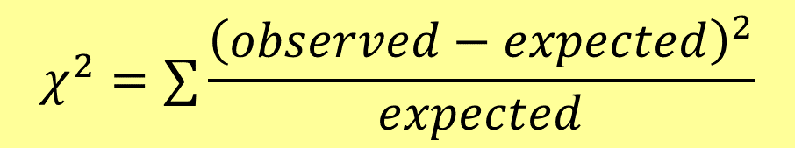
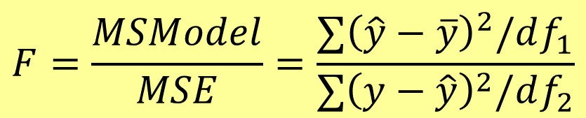
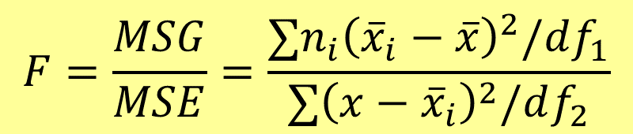
What Statistic?
We can scramble to simulate samples under a null of “no relationship”. What statistic should we compute for each sample?
Chi-square for Association:
$$χ^{2}=∑\frac{{\left(observed−expected\right)}^{2}}{expected}$$
Let technology take care of calculations
ANOVA for Means:
$$F=\frac{MSG}{MSE}=\frac{∑n_{i}{\left({\overline{x}}_{i}−\overline{x}\right)}^{2}/df_{1}}{∑{\left(x−{\overline{x}}_{i}\right)}^{2}/df_{2}}$$
ANOVA for Regression:
$$F=\frac{MSModel}{MSE}=\frac{∑{\left(\hat{y}−\overline{y}\right)}^{2}/df_{1}}{∑{\left(y−\hat{y}\right)}^{2}/df_{2}}$$

Slide 11

Example #1: Which Award?
If you could win an Olympic Gold Medal, Academy Award, or Nobel Prize, which would you choose?
Do think the distributions will differ between male and female students?
 | Olympic | Academy | Nobel
Male | 109 | 11 | 73 | 193
Female | 73 | 20 | 76 | 169
 | 182 | 31 | 149 | n=362
(97.0) | (16.5) | (79.4)
(85.0) | (14.5) | (69.6)
$$χ^{2}=8.24$$
Is that an unusually large value?

Slide 12

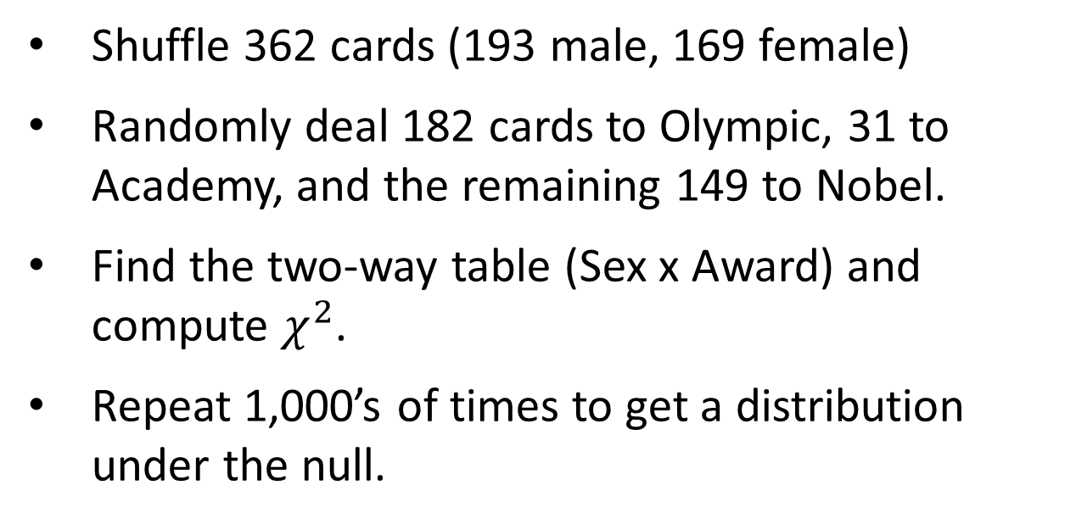
Randomization for Awards
Shuffle 362 cards (193 male, 169 female)
Randomly deal 182 cards to Olympic, 31 to Academy, and the remaining 149 to Nobel.
Find the two-way table (Sex x Award) and compute $χ^{2}$.
Repeat 1,000’s of times to get a distribution under the null.
Time for technology…
http://lock5stat.com/statkey

Slide 13
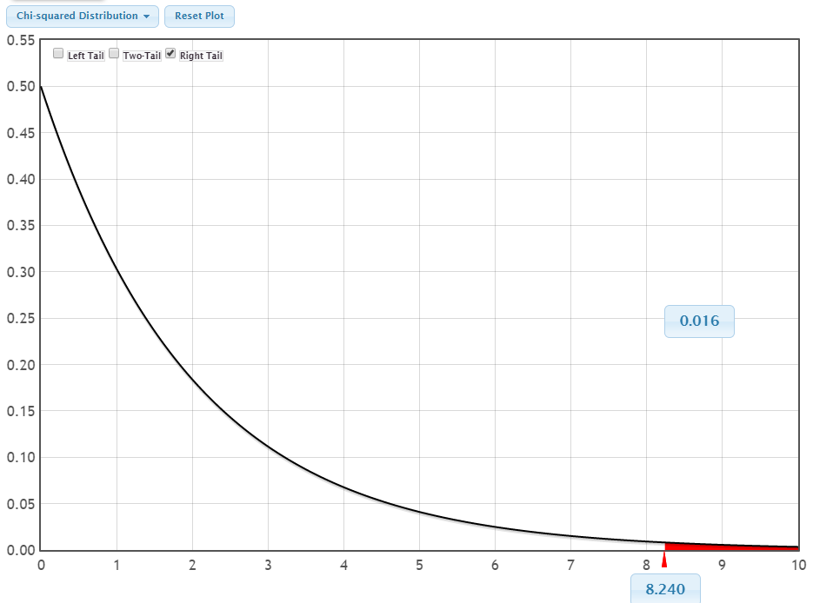
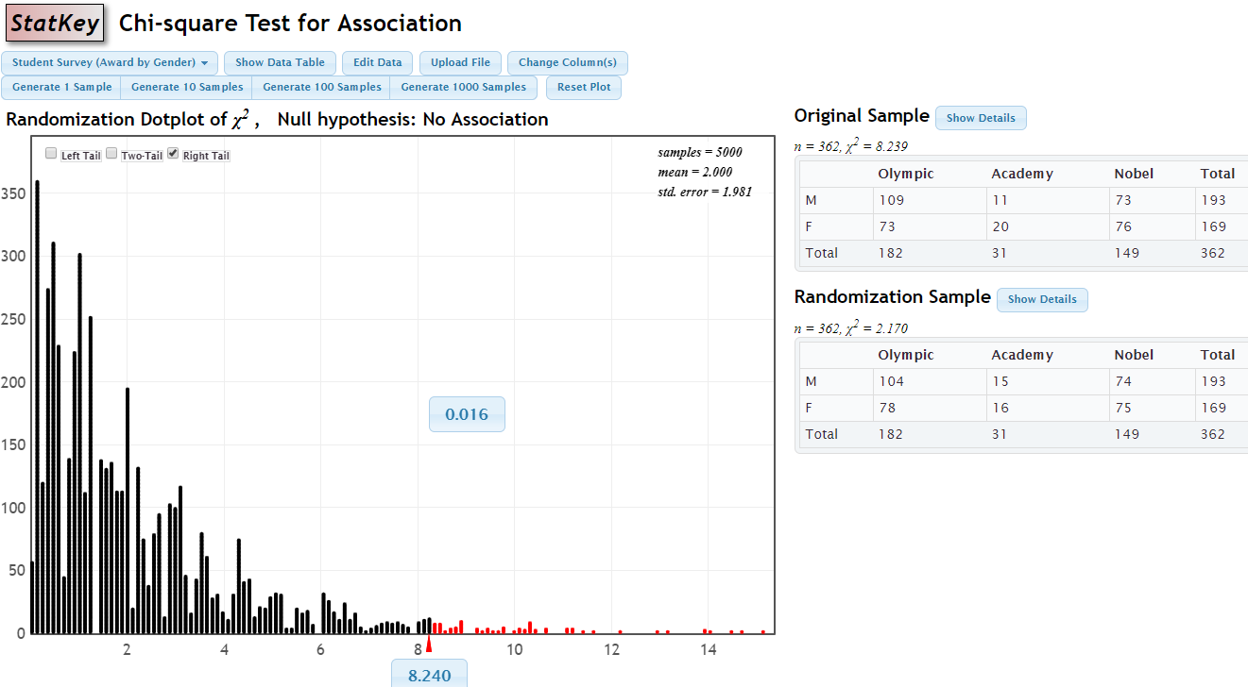

Theoretical $χ_{2 df}^{2}$

Slide 14
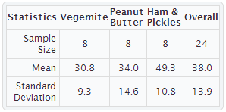
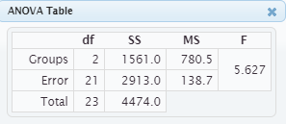
Example #2: Sandwich Ants
Experiment:
Place pieces of sandwich on the ground, count how many ants are attracted. Does it depend on filling?
Favourite Experiments: An Addendum to What is the Use of Experiments Conducted by Statistics Students? Margaret Mackisack
http://www.amstat.org/publications/jse/v2n1/mackisack.supp.html

Slide 15
Randomization for Ants
Write the 24 ant counts on cards.
Shuffle and deal 8 cards to each sandwich type.
Construct the ANOVA table and find the F-statistic.
Repeat 1,000’s of times to get a distribution under the null.

Slide 16
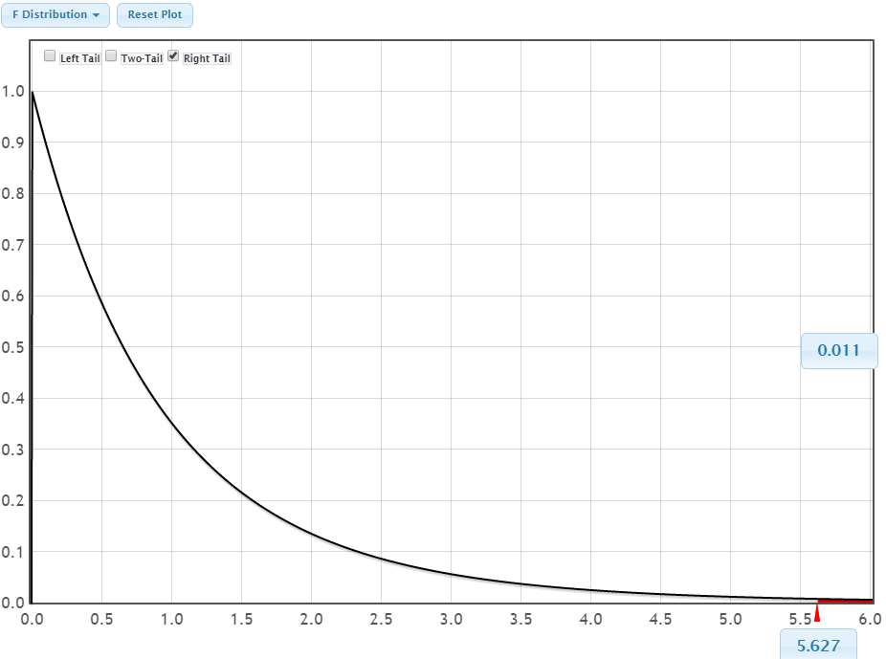
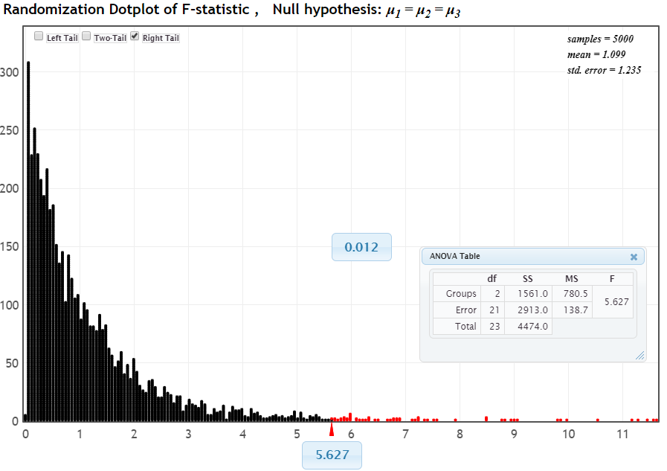

Theoretical $F_{2,21}$

Slide 17
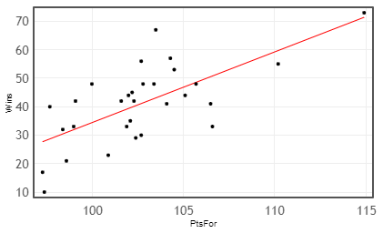
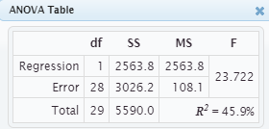

Example #3: Predicting NBA Wins
Predictor: PtsFor (Points scored per game)
$$\hat{Wins}=−213.8+2.48⋅PtsFor$$

Slide 18
Randomization for NBA Wins
Put the 30 win values on cards.
Shuffle and deal the cards to assign a number of Wins randomly to each team.
Compute the F-statistic when predicting Wins by PtsFor based on the scrambled sample.
Repeat 1,000’s of times to get a distribution under the null.

Slide 19
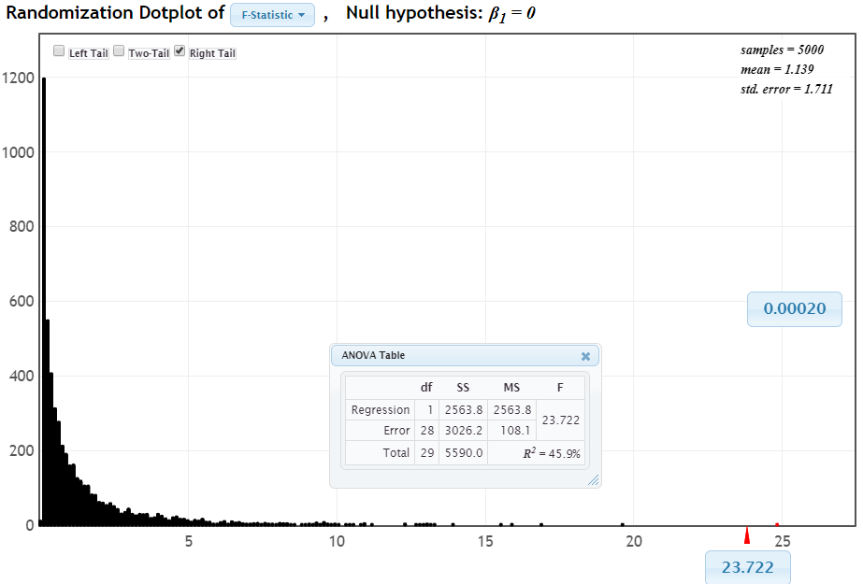
Theoretical $χ_{2 df}^{2}$

Slide 20
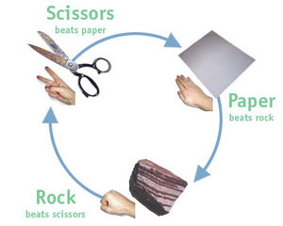
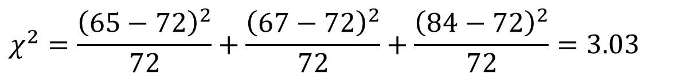
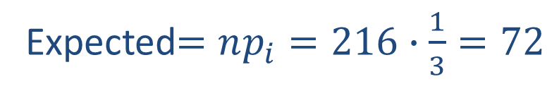
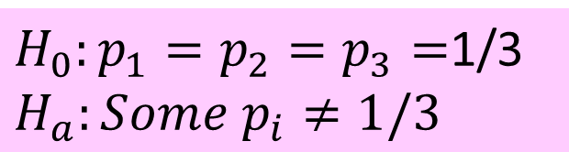
Example #4: Rock, Paper, Scissors
Play best of three games each.
Record counts for all choices.
Rock | Paper | Scissors
(72) | (72) | (72)
65 | 67 | 84
n=216
Let p₁, p₂, p₃ be the respective population proportions
$H_{0}:p_{1}=p_{2}=p_{3}=$1/3
$$H_{a}:Some p_{i}≠1/3$$
Expected$=np_{i}=216∙\frac{1}{3}=72$
$$χ^{2}=\frac{{\left(65−72\right)}^{2}}{72}+\frac{{\left(67−72\right)}^{2}}{72}+\frac{{\left(84−72\right)}^{2}}{72}=3.03$$

Slide 21
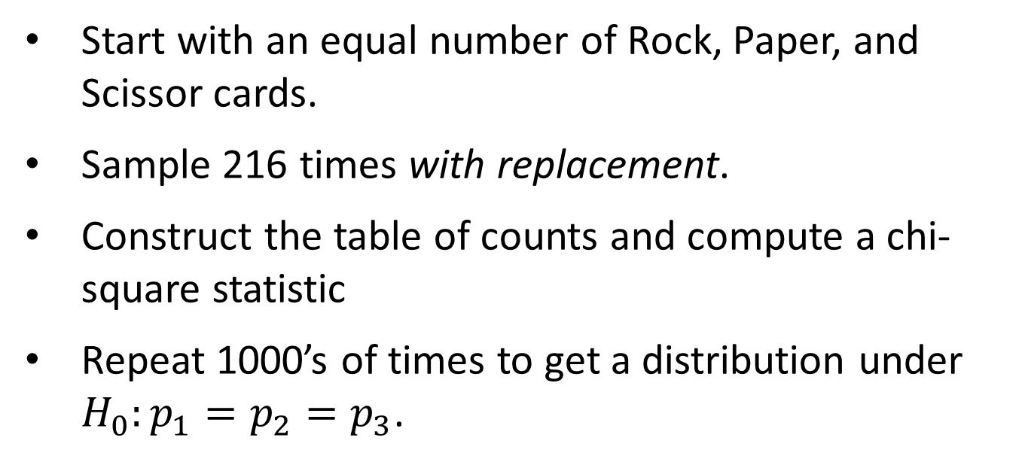
Randomization for RPS
Start with an equal number of Rock, Paper, and Scissor cards.
Sample 216 times with replacement.
Construct the table of counts and compute a chi-square statistic
Repeat 1000’s of times to get a distribution under $H_{0}:p_{1}=p_{2}=p_{3}$.

Slide 22
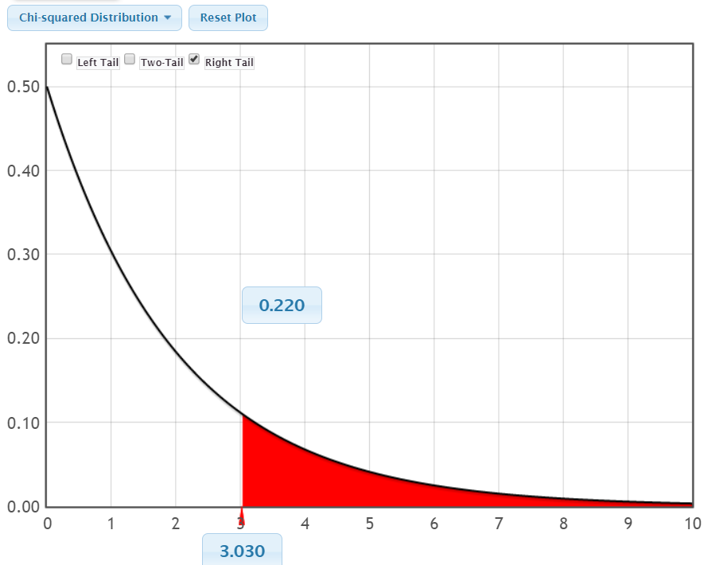
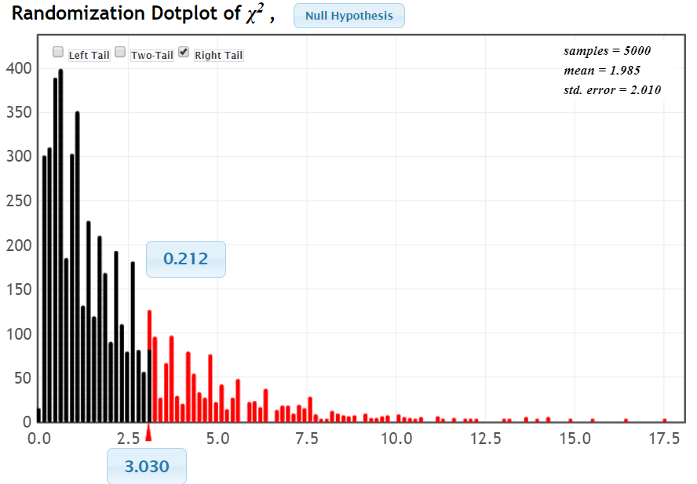
Theoretical $F_{2,21}$

Slide 23
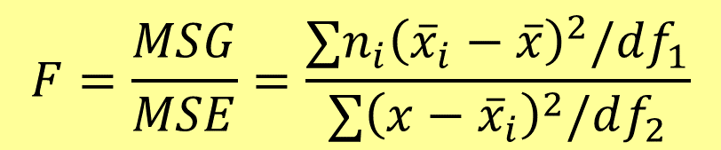

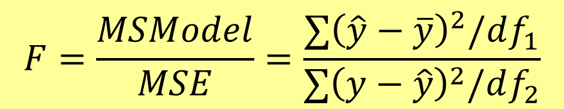
What Statistic?
Chi-square for Association:
$$χ^{2}=∑\frac{{\left(observed−expected\right)}^{2}}{expected}$$
ANOVA for Means:
$$F=\frac{MSG}{MSE}=\frac{∑n_{i}{\left({\overline{x}}_{i}−\overline{x}\right)}^{2}/df_{1}}{∑{\left(x−{\overline{x}}_{i}\right)}^{2}/df_{2}}$$
ANOVA for Regression:
$$F=\frac{MSModel}{MSE}=\frac{∑{\left(\hat{y}−\overline{y}\right)}^{2}/df_{1}}{∑{\left(y−\hat{y}\right)}^{2}/df_{2}}$$
If we were ONLY using randomization, would we still use these?

Slide 24
What Statistic?
But StatKey doesn’t do that statistic...
library(mosaic)
rand_dist=do(5000)*statistic(randomize(data))
SSqs=do(5000)*anova(lm(sample(y)~x,data=db))
library(infer)
rand_dist <- data %>%
specify(y ~ x) %>%
hypothesize(null = "independence") %>%
generate(reps = 10000, type = "permute") %>%
calculate(stat = STATISTIC)

Slide 25
Thank you!
QUESTIONS?
Patti Frazer Lock: plock@stlawu.edu
Robin Lock: rlock@stlawu.edu
Kari Lock Morgan: klm47@psu.edu
Slides posted at www.lock5stat.com

