Slide 1


Welcome to USCOTS 2019!
Opening session will begin at 7:15

Slide 2
Welcome!
Allan Rossman
  USCOTS Program Chair
  Dept of Statistics, Cal Poly – San Luis Obispo
  Always happy to return to Pennsylvania
    Where I lived for the first 39 years of my life
      Until I moved to California 18 years ago
        I guess now you know how old I am
          But the font has gotten mighty small
            Hopefully too small to read

Slide 3
Special welcome to (please stand)…
First-time USCOTS participants
  Sticker on name badge (pick one up at USCOTS registration desk)
  Also see lunch discussion tables for first-timers
Andre Lubecke, Camille Fairbourn, Laura Le, Matt Hayat
  Mentors for first-time USCOTS participants

Slide 4
Special welcome to (please stand)…
Those who have attended all 8 USCOTS

Slide 5
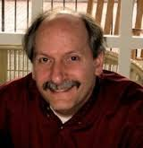
Special welcome to (please stand)…
Dennis Pearl
Director of CAUSE (Consortium for the Advancement of Undergraduate Statistics Education) since its inception

Slide 6
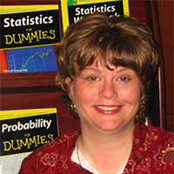
Special welcome to (please stand)…
Deb Rumsey
Program Chair for first 4 USCOTS

Slide 7
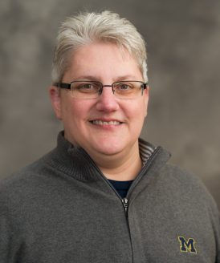
Special welcome to (please stand)…
Jack Miller
Posters and Beyond chair for all 8 USCOTS

Slide 8
Special welcome to (please stand)…
High school teachers
Two-year college teachers
Teachers with “statistics” in dept affiliation
Teachers with “mathematics” in dept affiliation
Teachers with “data science” in dept affiliation
Teachers with none of those words in dept affiliation

Slide 9
Special welcome to (please stand)…
Students
Statistics education researchers
Sponsors/exhibitors
Penn State faculty/staff/students
Penn State alums

Slide 10
Special welcome to (please stand)…

Slide 11
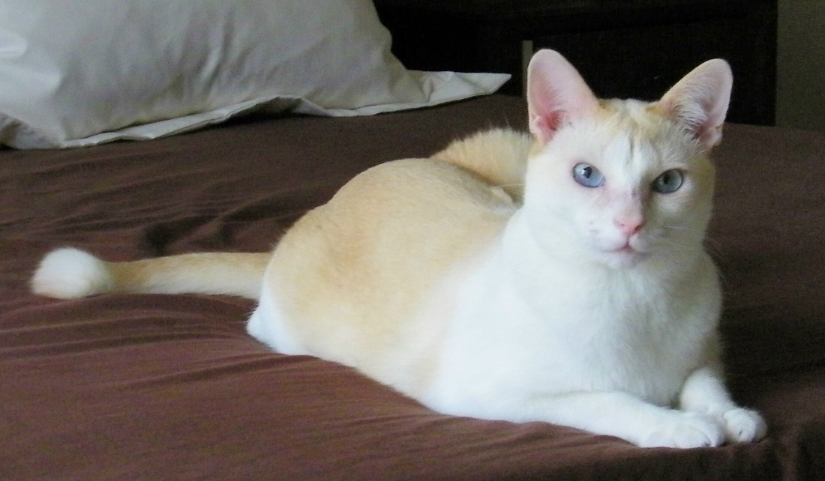
Special welcome to (please stand)…
Anyone who likes cats
Those who think this has dragged on for long enough and want me to move on!

Slide 12
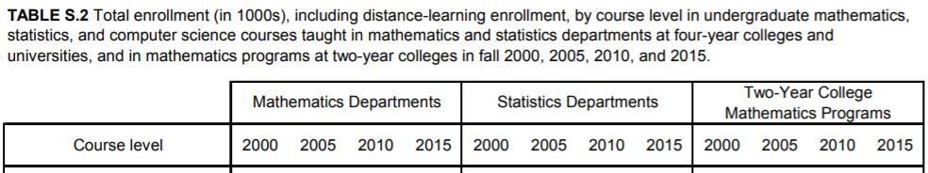
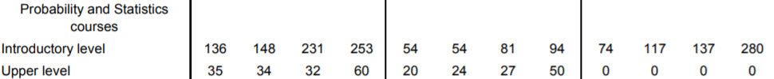
What a great time to teach statistics!
2015 CBMS Survey
Look at this growth (especially at TYCs)!
And > 220K took AP Statistics exam today

Slide 13
Theme: Evaluating Evidence!
Inspired by American Statistical Association
Statement on statistical significance and p-values (March 7, 2016; > 315K views)
Symposium on statistical inference (October 11-13, 2017 in Bethesda)
Special issue of TAS on “Statistical Inference in the 21st Century: A World Beyond p < 0.05” (March 20, 2019; > 83K views)

Slide 14
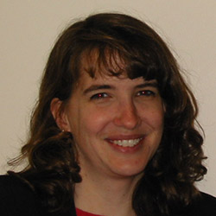
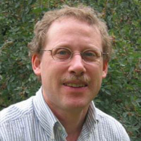
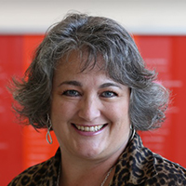
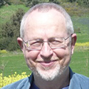
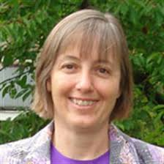
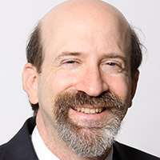
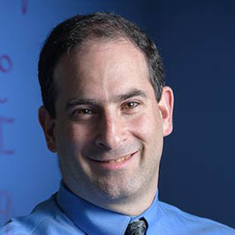
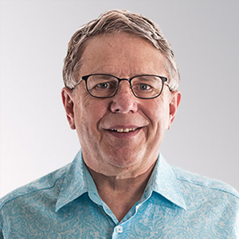
Opening Session
Five-minute talks to anticipate this theme

Slide 15
Opening Session
Beth Chance, Cal Poly – San Luis Obispo
Danny Kaplan – Macalester College
Hollylynne Stohl Lee – North Carolina State Univ
Iddo Gal – University of Haifa
Jessica Utts – University of California – Irvine
Larry Lesser – University of Texas, El Paso
Michael Posner – Villanova University
William Finzer – Concord Consortium

Slide 16
This slide is here to remind Allan not to go past this point until after the five-minute talks are completed

Slide 17
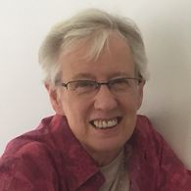
Special welcome to (please stand)…
Jane Watson
Univ of Tasmania
Practice of statistics at school: what does evaluating evidence look like in the classroom?
Friday, 8:20am

Slide 18
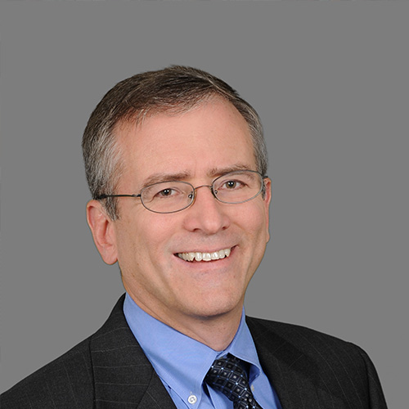
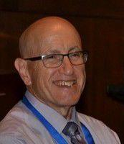
Special welcome to (please stand)…
Allen Schirm, Ron Wasserstein
Mathematica Policy Research (retired), American Statistical Association
Moving to a world beyond p < 0.05
Friday, 1:45pm

Slide 19
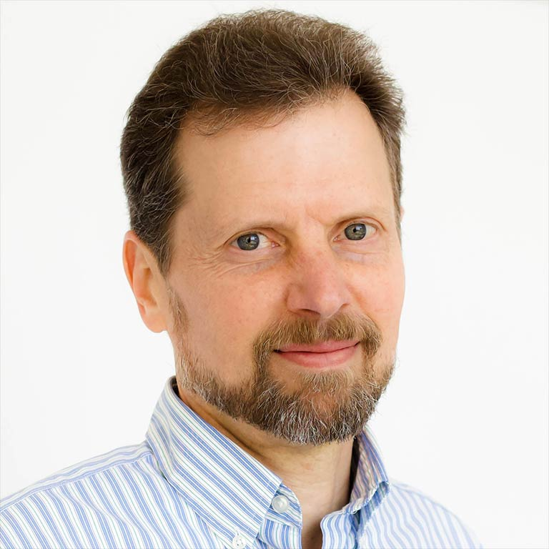
Special welcome to (please stand)…
John Kruschke
Indiana University, Dept of Psychological and Brain Sciences
Teaching Bayesian and frequentist methods side-by-side
Saturday, 8:20am

Slide 20
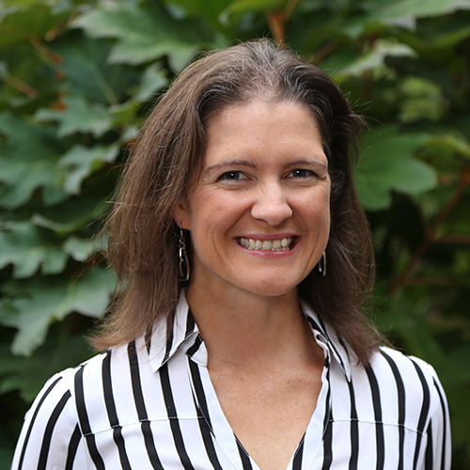
Special welcome to (please stand)…
Kari Lock Morgan
Penn State Univ
Teaching introductory students how to evaluate evidence
Saturday, 1:45pm

Slide 21
What else to expect (1)
Breakout sessions
  Four sets, with 8 options per set, some repeated
Posters & beyond sessions
  Two sets, not repeated
Birds-of-a-feather lunch discussions
  Look for signs on tables
Exhibitor technology demonstrations
Closing session
  Five-minute reflections

Slide 22
What else to expect (2)
Banquet and awards
  Rob Gould, Citizen Statisticians: Then and Now
  A–μ–sing contest winners
  Presentation of Lifetime Achievement Award(s)
  Friday, 6:30pm in this room
Hallway/break/meal conversations about teaching statistics
  Breakfasts downstairs
  Lunches in this room

Slide 23

What else to expect (3)
15-minute performance at end of this session
One-hour workshop to follow closing session on Saturday, 5:15pm

Slide 24
Other stuff I want to say but don’t know what title to put on the slide
Refer to the online program for abstracts:
www.causeweb.org/cause/uscots/uscots19/program
Free wifi in conference center: attwifi
Airport shuttle: arrange in advance (hotel front desk)

Slide 25
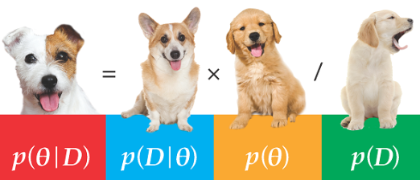
Other stuff I want to say but don’t know what title to put on the slide
Dog lovers are welcome too!

Slide 26
Many thanks (1)
Penn State Department of Statistics
Dennis Pearl, Director of CAUSE
Bob Carey, Kathy Smith, Lorey Burghard, Tom Varughese
Review committee members for breakout, P&B sessions

Slide 27

Many thanks (2)

Slide 28
Many thanks (3)
ALL of you!!

