Slide 1

2013 USCOTS
Writing More Effective
NSF Proposals
Lee Zia
Division Undergraduate Education
National Science Foundation
May 19, 2013

Slide 2
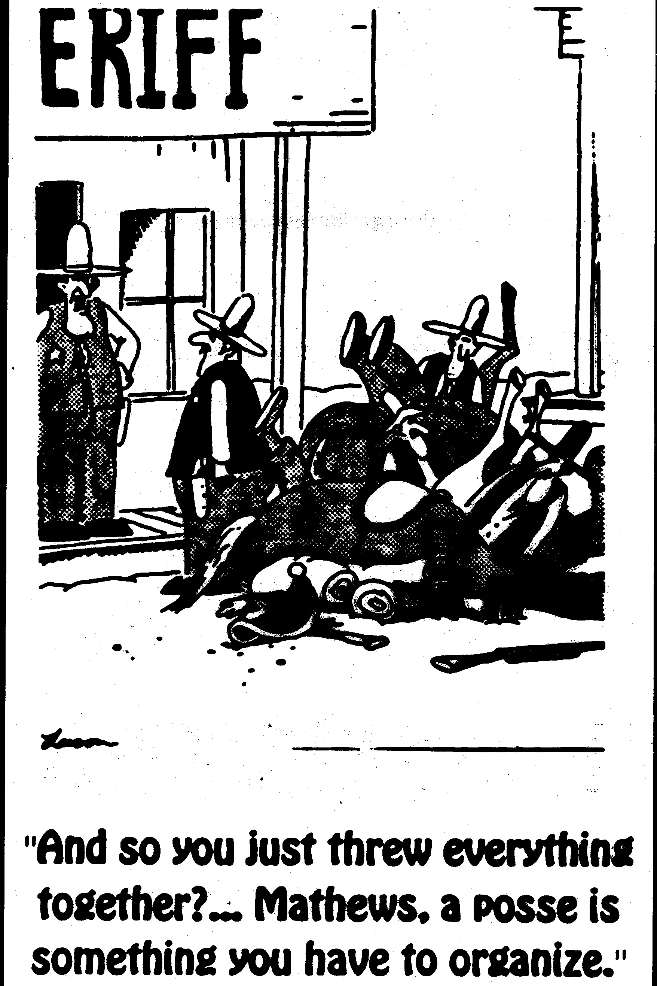

Slide 3
Outline
General advice
NSF context and criteria
Mock Panel Review
Helpful Hints/Fatal Flaws
Conclusion

Slide 4
Great Idea to Great Proposal
Addresses a recognized problem, need or opportunity: innovative within its context
Proposed “intervention” has the potential for important and widespread impacts
Problem, need or opportunity and possible solutions are well researched and referenced
Clearly articulated goals and objectives
Proposal answers: Who, What, Where, When, Why, and How?

Slide 5
Basic Proposal Parts
(but be sure to read the solicitation!)
Project Summary (Intellectual Merit and Broader Impacts)
Project Description
  Goals and outcomes
  Background and rationale
  Implementation and management plan
  Qualifications of personnel, availability of resources
  Evaluation Plan
  Dissemination Plan
References, Biosketches of the PI team, other information
Budget and Budget Justification
Current and Pending Support

Slide 6
Proposal review criteria and review process
Two criteria for peer review
Intellectual Merit (IM)
Broader Impacts (BI)

Slide 7
NEW! Merit Review Criteria
Guiding Principles
All NSF projects should be of the highest quality and have the potential to advance, if not transform, the frontiers of knowledge.
NSF projects, in the aggregate, should contribute more broadly to achieving societal goals.
Meaningful assessment and evaluation of NSF funded projects should be based on appropriate metrics, keeping in mind the likely correlation between the effect of broader impacts and the resources provided to implement projects.

Slide 8
(NEW!) Merit Review Criteria
Intellectual Merit: The intellectual Merit criterion encompasses the potential to advance knowledge; and
Broader Impacts: The Broader Impacts criterion encompasses the potential to benefit society and contribute to the achievement of specific, desired societal outcomes.

Slide 9
NEW! Merit Review Elements
The following elements should be considered in the review for both criteria:
What is the potential for the proposed activity to:
  advance knowledge and understanding within its own field or across different fields (Intellectual Merit); and
  benefit society or advance desired societal outcomes (Broader Impacts)?
To what extent do the proposed activities suggest and explore creative, original, or potentially transformative concepts?
Is the plan for carrying out the proposed activities well-reasoned, well-organized, and based on a sound rationale? Does the plan incorporate a mechanism to assess success?
How well qualified is the individual, team, or institution to conduct the proposed activities?
Are there adequate resources available to the PI (either at the home institution or through collaborations) to carry out the proposed activities?

Slide 10
Intellectual Merit
Addresses a major challenge
Improved student learning
Informed by other projects
Effective evaluation and dissemination
Led by capable faculty and others
Adequate facilities and resources
Institutional and departmental commitment

Slide 11
Quality of the Ideas
Is a major problem being addressed?
Is the “intervention” innovative, realistic, well-developed, worthwhile?
Are plans to assess the progress and results appropriate and adequate?

Slide 12
Capability of People and Institution(s)
Does the PI team have the right expertise and experience?
Is the team aware of current research practices or pedagogical issues?
Are there adequate facilities and resources?
Is the institution and department committed?

Slide 13
Broader Impacts
Integrated into the institution’s academic programs
Contributes to knowledge base and useful to other institutions
Widely used products which can be disseminated through commercial and other channels
Improved content and pedagogy for faculty
Increased participation by women, underrepresented minorities, and persons with disabilities
Ensures high quality STEM education for people pursuing careers in STEM fields or as teachers or technicians

Slide 14
Utility and Relevance
Does the project take into account audience background, preparation, and experiences?
Is the project integrated into an academic program?
Are the “products” to be created transportable? Will project results be adequately disseminated?

Slide 15
Impact on National
Infrastructure
Is there potential for impact on a broad national audience?
Are there good dissemination plans?
Does it meet any special national needs (e.g., faculty/teacher preparation, multidisciplinary or interdisciplinary approaches, increase in participation of underrepresented groups, etc.)?

Slide 16
NSF Proposal Review and Decision Process
Mail
Reviews
Award
(Via DGA)
Investigator/
Institution
FastLane:
Central
Processing
Program
Manager
Division
Director
Declination
Withdrawal
Panel
Review
Inap-
propriate

Slide 17
Practical Aspects of the
Review Process
Reviewers read, review, and rate 10-12 proposals before the review panel
Reviewers have a finite time during the panel for the discussion of your proposal
Reviewers bring a mix of reviewing experience to the panel
Reviewers represent a diverse set of institution types

Slide 18
Mock Panel Review
san060417
25565

Slide 19
References, CVs, etc.
Use appropriate citations to the literature
Include a CV for all senior personnel and your evaluator – highlight why appropriate for project
Include letters of commitment from administrators, evaluator, consultants, faculty at test sites, etc.
  Get specific commitments, not just generic good will and approval of the project
NOTE: Reviewers are not required to read supplementary documents
  Don’t use to extend page limit
  But if you can draw the reviewer in…

Slide 20
Budget
Realistic and carefully tied to the project description
Follows program guidelines
  Grant Proposal Guide
  Program solicitation
Complete and unambiguous
Don’t inflate: budget should reflect cost of completing the project as described in the work plan

Slide 21
What do YOU think?
Write down three strengths commonly cited by reviewers.
Share with a neighbor or two.

Slide 22
Most Common Strengths Cited by Reviewers
Work these into your
proposal, but only if
meaningful

Slide 23
What do YOU think?
Write down three weaknesses commonly cited by reviewers.
Share with a neighbor or two.

Slide 24
Most Common Weaknesses Cited by Reviewers
Too many proposals lose
funding because of inadequate evaluation and dissemination plans.
Don’t let your
proposal be one of them!

Slide 25
Compliance Check
To be compliant all DUE proposals must have the following:
Intellectual Merit and Broader Impact must be inputted separately in the project summary
The project description cannot be more than 15 pages
Proposals that include support for a postdoctoral researcher must include a mentoring plan
Correct font size
  Arial, Courier New, or Palatino Linotype at a font size of 10 points or larger
  Times New Roman at a font size of 11 points or larger
  Computer Modern family of fonts at a font size of 11 points or larger

Slide 26
Helpful Hints/
Fatal Flaws

Slide 27
Bye for Now. Hope to Hear From You Soon. NSF needs all of you. You may need NSF!!

Slide 28
Questions? Contact Us!
Ron Buckmire, rbuckmir@nsf.gov
Mike Jacobson, mjacobso@nsf.gov
Lee Zia, lzia@nsf.gov
Phone: 703-292-8670

