Slide 1
Making a Big Change: Teaching Math → Teaching Statistics
Daren Starnes
Mathematics Department Chair
The Lawrenceville School

Slide 2
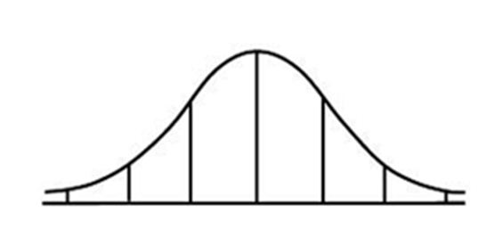
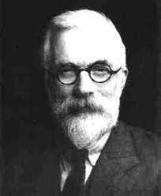
How do you change
Math Teachers
Into
Statistics Teachers
$$−3σ$$
$$−2σ$$
$$−1σ$$
$$0$$
$$1σ$$
$$2σ$$
$$3σ$$
MATH
STATISTICS

Slide 3
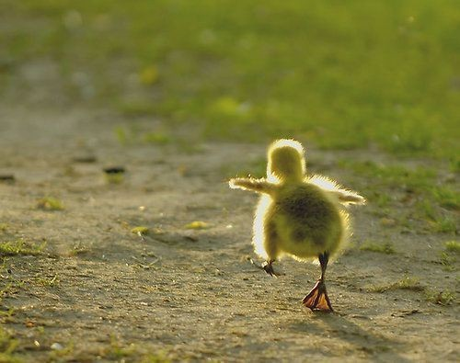
The journey begins with...
Repeat Algebra 1?
AP Statistics

Slide 4
What math teachers like
Computation
For the data set {1, 3, 4, 4, 4, 5, 7, 8, 9}
$\overline{x}=\frac{\sum{x_{i}}}{n}= \frac{1+3+4+4+4+5+7+8+9}{9}=\frac{45}{9}=5$
${s_{x}}^{2}=\frac{1}{n−1}\sum{{\left(x_{i}−\overline{x}\right)}^{2}}$
$=\frac{1}{9−1}\left(16+4+1+1+1+0+4+9+16\right)$
$=\frac{52}{8}=6.5$
$$∴s_{x}=\sqrt{6.5}≈2.55$$

Slide 5
What statistics teachers like
Real data
A group of elementary school children was asked how many pets they have. Here are their responses, arranged from lowest to highest:
1 3 4 4 4 5 7 8 9
How many pets does the typical student in this class have? Justify your answer.

Slide 6
What math teachers like
Derivations/proofs
$${s_{x}}^{2}=\frac{1}{n−1}\sum{{\left(x_{i}−\overline{x}\right)}^{2}}= \frac{1}{n−1}\sum{\left({x_{i}}_{}^{2}−2x_{i}\overline{x}+{\overline{x}}^{2}\right)}$$
$$=\frac{1}{n−1}\left(\sum{\left({x_{i}}^{2}\right)}−\sum{2x_{i}\overline{x}}\text{ +} \sum{{\overline{x}}^{2}}\right)$$
$$=\frac{1}{n−1}\left(\sum{\left({x_{i}}^{2}\right)}−2\overline{x}\sum{x_{i}}\text{ +} n{\overline{x}}^{2}\right)$$
$$=\frac{1}{n−1}\left(\sum{\left({x_{i}}^{2}\right)}−2\overline{x}\left(n\overline{x}\right)\text{ +} n{\overline{x}}^{2}\right)$$

Slide 7
What statistics teachers like
Concepts
Mean = balance point of distribution
Standard deviation = typical distance from mean
Value | 1 | 3 | 4 | 4 | 4 | 5 | 7 | 8 | 9
Deviation | -4 | -2 | -1 | -1 | -1 | 0 | 2 | 3 | 4
Squared deviation | 16 | 4 | 1 | 1 | 1 | 0 | 4 | 9 | 16

Slide 8
What math teachers don’t like
Too many words

Slide 9
What statistics teachers like
The importance of data production
Sampling versus experimentation
Methods
Principles
Possible sources of bias
Scope of inference: random sampling vs. random assignment

Slide 10
What math teachers like
Classical counting and probability
There are 15 male and 10 female pilots in a lottery. If 8 pilots are chosen at random for a captain’s position, find the probability that 5 or more females are selected.
$$P\left(X≥5\right)=\frac{\left(\begin{matrix}15 \\ 3\end{matrix}\right)\left(\begin{matrix}10 \\ 5\end{matrix}\right)}{\left(\begin{matrix}25 \\ 8\end{matrix}\right)}+\frac{\left(\begin{matrix}15 \\ 2\end{matrix}\right)\left(\begin{matrix}10 \\ 6\end{matrix}\right)}{\left(\begin{matrix}25 \\ 8\end{matrix}\right)}+\frac{\left(\begin{matrix}15 \\ 1\end{matrix}\right)\left(\begin{matrix}10 \\ 7\end{matrix}\right)}{\left(\begin{matrix}25 \\ 8\end{matrix}\right)}+\frac{\left(\begin{matrix}15 \\ 0\end{matrix}\right)\left(\begin{matrix}10 \\ 8\end{matrix}\right)}{\left(\begin{matrix}25 \\ 8\end{matrix}\right)}$$

Slide 11
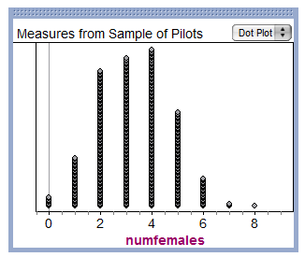
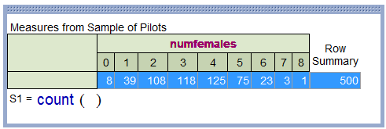
What statistics teachers like
Using simulations to estimate probabilities

Slide 12
Finding common ground?
Suppose that one percent of the women in a certain region have breast cancer.
• For women who have breast cancer, the probability of a positive mammogram is 0.90.
• For women who don’t have breast cancer, the probability of a positive mammogram is 0.09.

Slide 13
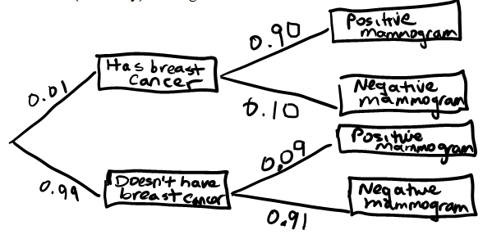
P(breast cancer given test +)
$P\left(C | +\right)=\frac{P(C∩+)}{P(+)}$
$$=\frac{P(C)∙P(+|C)}{P\left(C\right)∙P\left(+ | C\right)+P(C^{′})∙P(+|C^{′})}$$
$=\frac{(0.01)(0.90)}{\left(0.01\right)\left(0.90\right)+(0.99)(0.09)}=\frac{0.009}{0.0981}=0.092$

Slide 14
P(breast cancer given test +)
Think of 1,000 women who participate in screening. We expect that 1000(.01) = 10 have breast cancer. Of these, 10(0.90) = 9 will test positive. Of the 990 who do not have cancer, about 990(0.09) = 89 will test positive.
 | Have cancer?
Test result | Yes | No | Total
Positive
Negative
Total |  |  | 1000
9/98 = 0.092
9
89
98
10
990

Slide 15
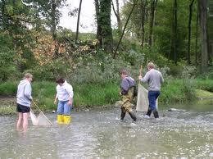
What did it for me?
APES/Stats
Field study work in forests and streams
Playing the role of data consultant

Slide 16
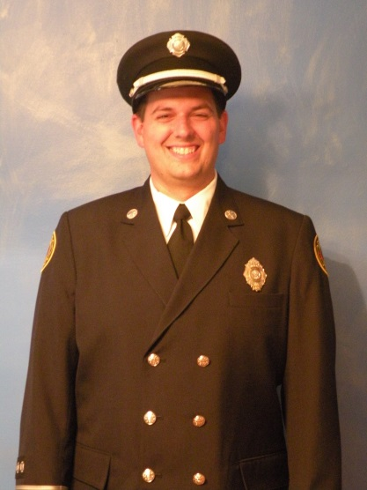
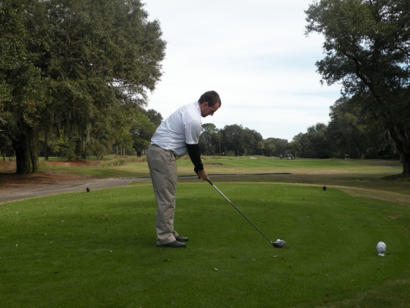
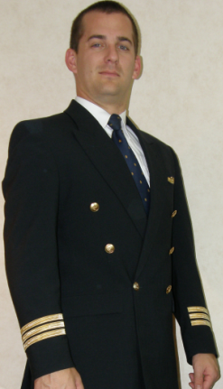
The data are trying to tell us a story…
Son #1: The firefighter
Call response times
Son #2: The athletic trainer
Flexibility in knees after exercise
Son #3: The pilot
Hiring discrimination?

Slide 17
What makes teaching statistics so difficult for math teachers?
Lack of content knowledge
Haven’t studied some topics recently/at all
Don’t know underlying theory
Aren’t familiar with statistical vocabulary
Emphasis on interpretation, not computation
How to assess student understanding

Slide 18
Will Common Core Help?
Substantial statistics content added in Grades 7-12 standards
Rich assessment tasks being developed
Will curriculum materials be sufficient?
What about teacher training?

Slide 19
Helping math teachers make the change
Don’t suffocate them with study design!
Stress the statistical problem solving process
Ask questions
Collect data
Analyze data
Interpret results
Provide resources and support for teachers who want to learn more about statistics

Slide 20
How do you change
Math Teachers
Into
Statistics Teachers
$$−3σ$$
$$−2σ$$
$$−1σ$$
$$0$$
$$1σ$$
$$2σ$$
$$3σ$$
MATH
STATISTICS
The data are trying to tell us a story

