Slide 1
Preparing Future Faculty to Teach and
Assess Today and Tomorrow’s Students

Slide 2
The Challenge…..

Slide 3
How students get information
WIKIPEDIA
The Free Encylopedia
Notes:
Way in which students get information has changed dramatically….World Book Encylopedia or Encylopedia Britannica known as ”Book to Ask Questions of” ….now…World Wide Web…“Ask Jeeves”

Slide 4
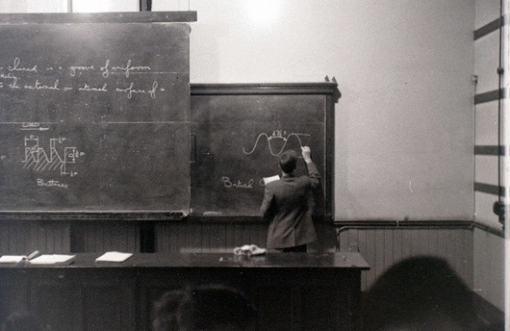
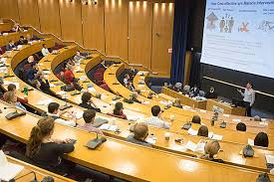
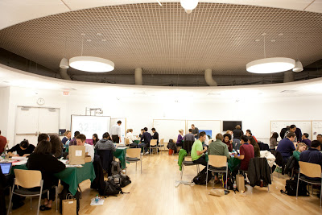
The Changing Classroom
Notes:
Classroom and our teaching has changed….Blackboard only, students taking note; Powerpoint presentation with students taking notes; Powerpoint presentation available online—follow on the lap top—why come to class?; The Flipped Classroom

Slide 5
Teaching the Student of Today
What do we want them to learn?
How do we achieve this?
How do we know?

Slide 6
ARE MY STUDENTS ACTUALLY LEARNING?
May 6, 2013
What Do I Want My Students to Learn?
What’s the Evidence that My Teaching is Effective?
What Can We Learn from Student Evaluations?
How Can We Evaluate 40,000⁺ Students?
How Can I Know that my Teaching Has Lasting Impacts?
Funded By Council of Graduate Schools Sloan Foundation Grant

Slide 7
Goal of the Retreat
To learn about assessment and evaluation
tools and methods being used across the
university and to share best practices
To begin to identify areas of training in
assessment and evaluation for current
and future faculty
To foster collaborations between schools,
departments and individuals

Slide 8
What Do I Want My Students to Learn?
Skills
Encouraging the Gifted vs Advancing Everyone
Breaking It Down to Build the Rubric (and to Improve Individually)
Tracking Progress—Pre and Post
Fact-Based Knowledge
Value—Is It Important?
Measuring Effectively (Cold Call? Exam? I-movie Projects?)
Student Ownership of Learning (e.g., for Flipped Classroom)
Notes:
Teaching Skills---sometimes easy to fall into promoting those that already have strong skills vs bringing up those that don’t
to teach a skill need to understand the different parts and create a rubric that assesses each---important helping students improve in specific areas
importance of looking at whether they have improved by pre-course and post-course assessment
Fact-Based Knowledge: What’s the value if you can look it up on the internet vs If you don’t have foundation how do you build on this
How do you effectively measure this---classroom cold call vs traditional exam vs other methods(Viktoriia’s video example comes to mind but is discussed in the next slide)
For the flipped classroom, much of this will be on the student---how do you encourage student ownership of their learning/ instill this culture

Slide 9
What’s the Evidence that My
Teaching is Effective?
Identifying Ways to Look at Long Term Impact
Following Cohorts
Subsequent Choice of Course/Major
Introducing New Types of Assessment
Video and I-movie
Making Traditional Types of Assessment
More Effective
Test for Misconceptions as well as the Correct Answer
Notes:
End of class eval vs following students long term---following the class subsequently---courses they choose to take, what do they say about the course a year later, what is their majori
New types of Assessment—Viktoriia’s video model---challenges—what are the rubrics? Following the students in the long run to see if it is a more effective assessment
Making the traditional type of assessment more effective---multiple choice test—teaching the misconception as well as the correct answer—value of students understanding their own misconception to help them learn-
importance of testing for “dispelling of the misconception” on the exam---if they don’t choose the misconception better assessment of if your teaching has been effective

Slide 10
What Can We Learn from Student Evaluations?
Using Them Effectively and Appropriately
Students Communicating to Faculty?
Students Communicating to Future Students?
Do Students Know How It is Used?
Changing the Q-guide
Paper vs Electronic—Gains and Losses
Alternatives—Qualitative Evaluations and Focus Groups
Improving Response Rates
Incentives (e.g., See Grades Earlier)
When They Fill it Out (Return to In Class?)
Notes:
Change in purpose of Q-guide---from student feedback to faculty to students letting other students know whether or not to take a course
Change from paper to electronic has made it easier from a “collection” side but fewer students take it, amt of time spent dramatically decreased; quality of comments decreased
Need to find ways to improve response rate for this to be useful---provide incentives; return to the “fill it out in class” model

Slide 11
How Can We Evaluate 40,000⁺ Students?
Certificate Student vs Transient Learner
Maximizing Student Engagement
Avoiding Replication of Physical Classroom
Different Learning Modalities to Fit the Student
Notes:
Wide range of student goals—want to serve different groups;
Forums to promote discussion; peer instruction
MOOC can’t be replication of traditional classroom; can MOOC help improve the classroom
MOOC opens possibility of teaching to many types of learners—how do you help student understand how they learn best?

Slide 12
How Can I Know that My Teaching
Has Lasting Impacts?
Need Learning Goals That Are Measurable Later
Need Control Groups
Study Not Only Intended Effects But Overall Effects

Slide 13
Something we all can do, and with minimal cost:
Engage alumni, who are eager to tell us what did work and what did not

