Slide 1
The Reality of Online Teaching
Making Changes to Do It Well and Still Have a Life
Michelle Everson, University of Minnesota
Camille Fairbourn, Utah State University
Ellen Gundlach, Purdue University
Additional information about this break-out session found at:
bit.ly/10BXM7F

Slide 2
The 24-Hour Professor
The Chronicle of Higher Education
Jeffrey Young
http://chronicle.com/article/The-24-Hour-Professor/25750

Slide 3
The 24-Hour Professor
"I have been online every day of the semester," says Mr. Grenci, though he says he tries to limit the amount of time he spends on the course on weekends.

Slide 4
The 24-Hour Professor
"Saturdays I just check in once, sort of like a doctor, to make sure none of my patients are ill. Otherwise my wife would kill me."

Slide 5
The 24-Hour Professor
He says the institution considered a 24-hour reply requirement, but it decided that such a promise would cut into professors' personal lives unnecessarily.
"We thought weekends they (faculty) should have some free time.”

Slide 6
The 24-Hour Professor
"If we're not careful, we're going to have faculty so overwhelmed with answering individual e-mail questions that they don't have time to teach, research, and deal with the larger concerns of the course," he says.

Slide 7
The 24-Hour Professor
"E-mails are like Hitchcock's birds. They pursue you relentlessly, hover in flocks, and leave you running for cover.“
--Elizabeth Phillips

Slide 8
The 24-Hour Professor
“We've had a millennium to figure out how to control workload in a classroom. We're in a phase right now with the development of online learning where we're trying to figure out what the rules should be.”
--Gary E. Miller, associate vice president of distance education at Penn State and executive director of its World Campus.

Slide 9
The 24-Hour Professor
"The general feeling is that it takes longer when you're teaching online. I typically say 25 percent more time.”
—Ms. Schweizer of Marquette
"People are confusing frequency with amount. People think that online teaching is more work, but it's just more often.”
—Mr. DiBiase

Slide 10
When was this written?

Slide 11
When was this written?
2002
http://chronicle.com/article/The-24-Hour-Professor/25750

Slide 12
Break-out the Break-out

Slide 13
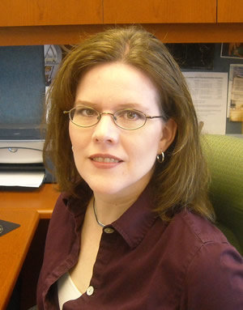
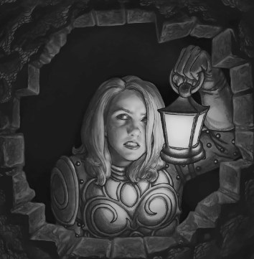
Camille Fairbourn
Utah State University
Regional Campuses and Distance Education
camille.fairbourn@usu.edu
www.math.usu.edu/cfairbourn
Can talk forever about…

Slide 14
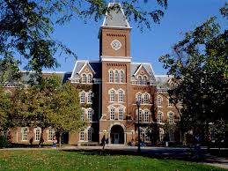
Expectations for an online instructor/online class
Institutional Expectations
Student Expectations
Self Expectations

Slide 15
Institutional Expectations
Office hours
According to USU Policy 403.3.1 regarding Standards of Conduct: Responsibilities to Students, (4) Faculty members with teaching responsibilities maintain regular office hours for consultation with students, or they otherwise assure accessibility to students.
Response times for student emails
Other academic responsibilities

Slide 16
Student Expectations
Organization
Clear expectations
Clear instructions
Frequent, visible, stable due dates
Interaction with the professor
Prompt replies to emails
Visible presence in discussion boards
Online office hours

Slide 17
Self Expectations
Setting boundaries that work for you

Slide 18
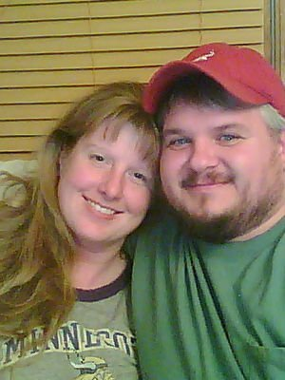
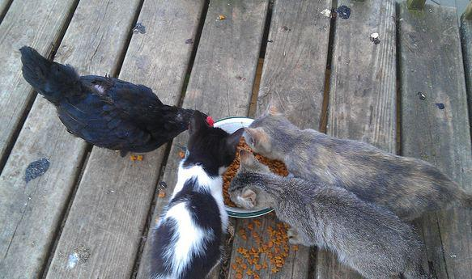
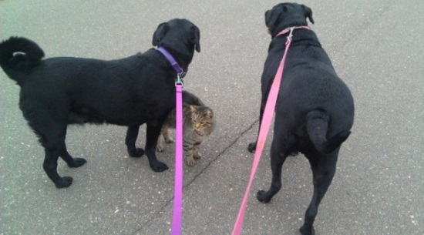
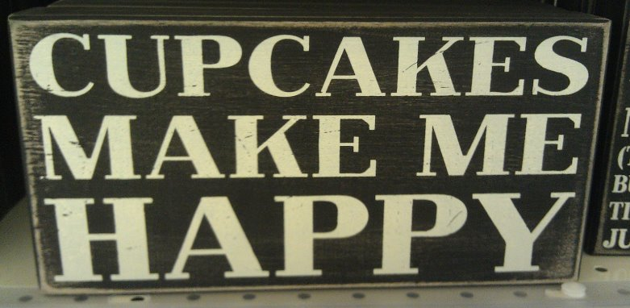
Michelle Everson
Senior Lecturer, Department of Educational Psychology, University of Minnesota (gaddy001@umn.edu)
10 years of online course development and teaching experience
Lover of coffee, cupcakes, cats, dogs, my husband Chad, and bike riding

Slide 19
Does this sound familiar?

Slide 20
How can we hold students accountable?
“In the face-to-face environment, we can clearly see our learners, hear their voices, and touch concrete objects within the walls of the classroom. Because of this closeness, we are able to use our senses to have eye contact, hear voice nuance, read body language, move around the room, and pick up objects to demonstrate course concepts.

Slide 21
How can we hold students accountable?
“Conversely, the online environment is elusive. We are unable to see or hear our learners, unless we incorporate specific technologies. We have to think carefully about how we can relate to the learners, create a sense of closeness, and explicitly describe our actions." Conceicao, S., & Lehman, R. (2011)

Slide 22
What do we expect of our students?
We expect students to:
Read
Prepare and be prepared
Be alert
Ask questions
Work collaboratively in certain circumstances and independently in others

Slide 23
What do we expect of our students?
Are students doing these things? If not, WHY?
Are students in online courses better or worse when it comes to doing these things than students in a “traditional” courses? WHY?

Slide 24
Can we better motivate students to follow directions?
Are students today only motivated by extrinsic factors (e.g., points on assignments, extra credit)?
In Tools for Teaching (Gross, 2009), it is recommended that instructors motivate their students by giving “frequent, early, positive feedback that supports students' beliefs that they can do well” (p. 278)
Will this work in an online course if students are not paying attention to the feedback you are trying to give?

Slide 25
Do we need to think more like students?
“I wish that more teachers could see students and student culture from ‘the other side’…Teachers would come to know that when a student openly snoozes in class, or invents a story about why the paper hasn’t been written on time, or wants an override into a course because of its time slot, this is the small stuff, the workings of a culture. As hard as it may be to realize sometimes, it is really not personal.” Nathan, R. (2005)

Slide 26
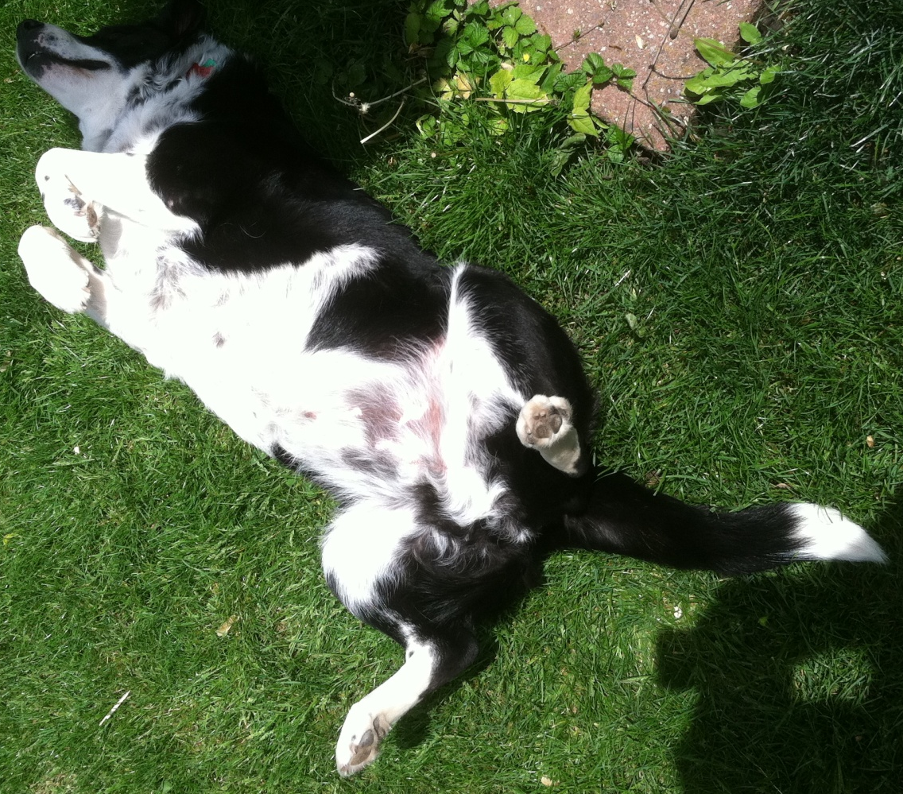
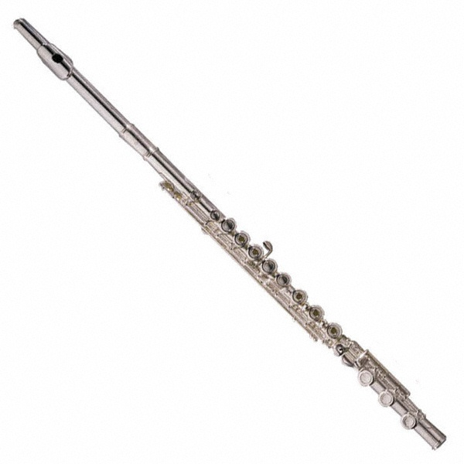
Ellen Gundlach
Purdue University, gundlach@purdue.edu
Online, traditional large-lecture, hybrid classes.
Lover of roller derby, hiking with my dog, good books, making music with friends, and supplying large quantities of food to teenage boys.

Slide 27
Do online students cheat more than traditional students?
“There is little research to support claims that online students cheat significantly more than face to face students. What the research does show is that there is a perception that the opportunity to cheat as an online student is greater than for their on-campus counterparts. The distance learning community is aware of this perception and, as a result is adopting best practices for online teaching to enhance academic integrity.”
http://sloanconsortium.org/node/160521

Slide 28
Cheating in the Digital Age
Do Students Cheat More in Online Courses?
George Watson and James Sotille, Online Journal of Distance Learning Administration, Volume XIII, Number I, Spring 2010. http://www.westga.edu/~distance/ojdla/spring131/watson131.html

Slide 29
Cheating in the Digital Age
Survey Question | More likely live | More likely online | Neither | Don’t Know
Do you feel you are more likely to cheat in a live or an online class? | 10.2% | 42.2% | 38.9% | 8.7%
Do you feel your classmates are more likely to cheat in a live or online class? | 11.5% | 61.0% | 8.9% | 18.6%
George Watson and James Sotille, Online Journal of Distance Learning Administration, Volume XIII, Number I, Spring 2010. http://www.westga.edu/~distance/ojdla/spring131/watson131.html

Slide 30
Best practices for preventing academic misconduct in online courses
Use of multiple assessment techniques in place of high stakes exams.
Greater reliance on written assignments and threaded discussions.
Use of test banks, randomization, and timed test delivery.
Use login/password to get access to course materials.
Make assignments difficult enough that only somebody who has done the previous work in your class can do them.
Ask mastery questions instead or memorization questions.
Provide practice exam questions and solutions.
Raising awareness among students about what constitutes appropriate and inappropriate behavior in an online course.
http://sloanconsortium.org/node/160521
http://www.ion.uillinois.edu/resources/tutorials/assessment/cheating.asp

Slide 31
Higher Education Opportunity Act (HEOA, 2008)
602.17 Application of standards in reaching an accreditation decision.
(1) Requires institutions to verify the identity of a student who participates in class or coursework by using, at the option of the institution, methods such as --
(i) A secure login and pass code;
(ii) proctored examinations; and
(iii) New or other technologies and practices that are effective in verifying student identification;
http://www.ed.gov/policy/highered/leg/hea08/index.html

Slide 32
Why do we need grades?
http://www.slate.com/articles/double_x/doublex/2013/05/the_case_against_grades_they_lower_self_esteem_discourage_creativity_and.html

Slide 33
George Cobb: Against Fairness
First, abandon fairness.
Try to assess a student’s work in the context of that individual’s own background, interests, goals, and learning styles.
Second, embrace grade inflation.
Emphasize effort and accomplishments.
If good assessment leads to better learning, students deserve higher grades.
Low grades are often mainly a symptom of the shortcomings of our system.
Third, surprise Roger.
Make it safe to screw up.
Emphasize things done well and things that a student can fix, and provide the opportunity for revision. Value authenticity over sincerity.

Slide 34
But what if you’re not George Cobb?
http://www.rossmanchance.com/artist/proceedings/cobb.pdf (After-dinner talk from ARTIST Roundtable Conference on Assessment, 2004).
Also: Joan Garfield, Andrew Zieffler, Daniel Kaplan, George W. Cobb, Beth L. Chance and John P. Holcomb (2011): Rethinking Assessment of Student Learning in Statistics Courses, The American Statistician, 65:1, 1-10.

Slide 35
Why do they cheat?
“If you don’t give a $h*t about the class but are required to take it and the info they are making you learn you know you won’t ever use again.”
“If it’s online. Online courses suck.”
“When the info on the test/paper/HW is totally irrelevant!”
“My Freshman Year: What a Professor Learned by Becoming a Student”
by Rebekah Nathan, Penguin Books, 2005 (p. 126)

Slide 36
Why do they cheat?
“When it’s a liberal studies class that has no relevance to your major.”
“If you studied but the test doesn’t test what the instructor promised. As long as you learned the info, what’s wrong with it?”
“When it pertains to absences. I cheat on absent slips. We pay to come to college—they shouldn’t make us sign in for any class!”
“My Freshman Year: What a Professor Learned by Becoming a Student”
by Rebekah Nathan, Penguin Books, 2005 (p. 126)

Slide 37
Why do they cheat?
“What it feels like to be bad at math”
Muddled half-comprehension.
Fear of asking questions.
Shyness about getting the teacher’s help.
Badgering a friend instead.
Copying homework.
Excuses; blaming others.
Procrastination.
Anxiety about public failure.
Terror of the teacher’s judgment.
Feeling incurably stupid.
Not wanting to admit any of it.
http://mathwithbaddrawings.com/2013/04/25/were-all-bad-at-math-1-i-feel-stupid-too/

Slide 38
Ellen’s discussion on academic honesty
Can't we just trust students to be honest?
Do we even need grades?
What is your definition of cheating?
How important is protecting academic integrity?
How important is promoting collaboration between students?
How do you decide which activities they can/can’t do with help?
How do we change our courses so that we spend more time being teachers and less time being “gatekeepers”?
Transfer credit acceptance?
Are there differences between your answers for online and traditional courses?

Slide 39
Discussion topics
Work/life balance: What are the challenges specific to online/distance teaching and how can instructors draw boundaries to protect their non-work life from the intrusion of 24/7 student demands?
Student preparation and ability to follow instructions: What portion of the responsibility to prepare students for class and have them follow instructions lies with instructors and what portion lies with individual students?
Cheating vs. collaborating: Do we care? How can we spend more time teaching and less time as “gatekeepers”?

Slide 40
References
“The 24-Hour Professor” by Jeffrey Young The Chronicle of Higher Education
http://chronicle.com/article/The-24-Hour-Professor/25750
Angry wife photo from
http://eirian-stock.deviantart.com/
Conceicao, S., & Lehman, R. (2011). Managing online instructor workload: Strategies for finding balance and success. San Francisco, CA: Jossey-Bass.
Nathan, R. (2005). My freshman year: What a professor learned by becoming a student. Ithaca, NY: Cornell University Press.
http://sloanconsortium.org/node/160521
Statistics Instructors in Cyberspace http://bit.ly/10BXM7F

