Slide 1

Cultivating Learning & Harvesting Insight:
Designing Human-Centered Assessments for Agricultural Statistics
Samantha Robinson, PhD
University of Arkansas
Notes:
Arkansas ranks first among rice-producing states, accounting for more than 40 percent of U.S. rice production - primarily long and medium grain varieties

Slide 2



Who am I?
Samantha Robinson
sewrob@uark.edu
Associate Professor
Director of the Center for Statistical Research and Consulting
Former Director of Data Science Initiatives
Former Vice Chair of Mathematical Sciences
Statistical Consultant
Chair of ASA JEDI ☺

Slide 3

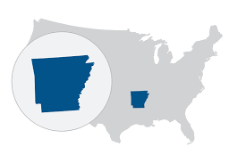

Where am I?
University of Arkansas
  Fayetteville, Arkansas, USA
  Land-grant University
  Flagship Institution of the UA System
  R1 Institution
  SEC School
  🏈 🏈 🏈
Department of Mathematical Sciences
Center for Agricultural Data Analytics
Notes:
Southeastern Conference ≠ Securities and Exchange Commission

Slide 4

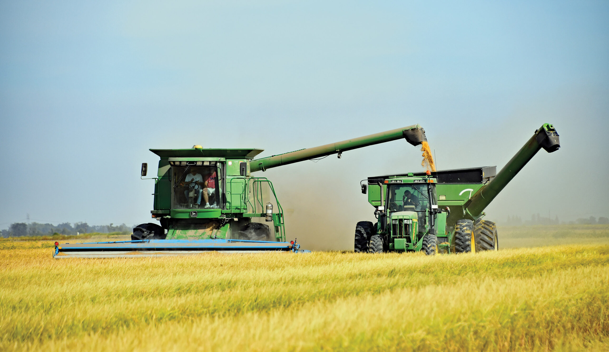
Making the Classroom Connection
Cultivating
To nurture and develop something through careful effort, patience, and attention
Planting seeds of curiosity
Nurturing with care
Protecting from threat
Harvesting
The process of gathering mature, valuable materials at the end of their growing cycle
Reaping understanding
Gathering diverse yields
Sowing for future seasons
Notes:
Great teaching is agriculture: you cultivate conditions for growth, then harvest the insight that emerges.

Slide 5

Motivation & Overall Idea

Slide 6
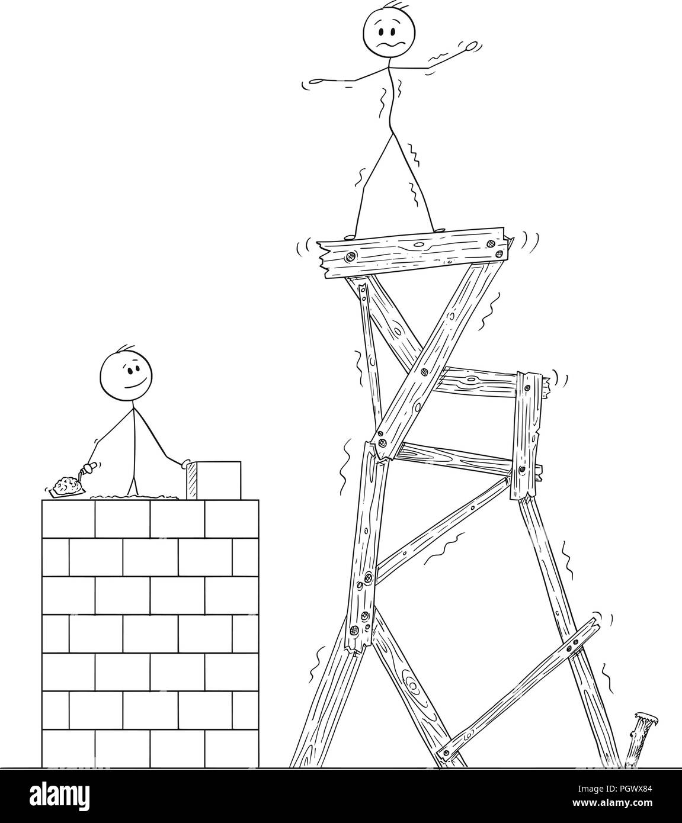


Background: The Illusion of Competence
True Scenario
A student submits a flawless-looking statistical analysis.
The Core Question: Does AI-assisted performance actually mean students learned?

Slide 7
Background: A Whirlwind Timeline
2022
ChatGPT launches - 1M users within 5 days; 100M users in 2 months
2023
GPT-4, Claude 2, Gemini arrive; multimodal AI goes mainstream
2024
AI agents, coding copilots, and reasoning models emerge
2025
AI deeply embedded in research workflows and classrooms
2026
Near-expert performance on many disciplinary benchmarks
Notes:
The timeline is almost unbelievable. In the span of a bachelor's degree, the entire AI landscape has transformed multiple times.
IBM: “Multimodal AI refers to machine learning models capable of processing and integrating information from multiple modalities or types of data”

Slide 8
Background: The Acceleration Problem
Policies become outdated before they take effect
Assessment designs have a shorter shelf life
Faculty development can't keep pace
Students often outpace instructors' tool literacy
We are not adapting to a technology - we are adapting to a rate of change

Slide 9
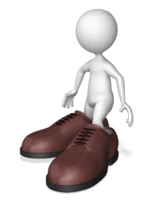
Put Yourself in Their Shoes
The Course - Principles of Experimentation
  Graduate-Level
  A “First” Statistics Course
  The Prerequisite Course for All Others
  Introduction to applied statistical methods, basic experimental design, and the use of statistical software (R/RStudio)
  Approximately 25-35 Students

Slide 10
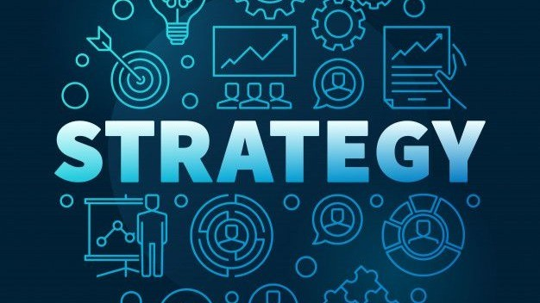
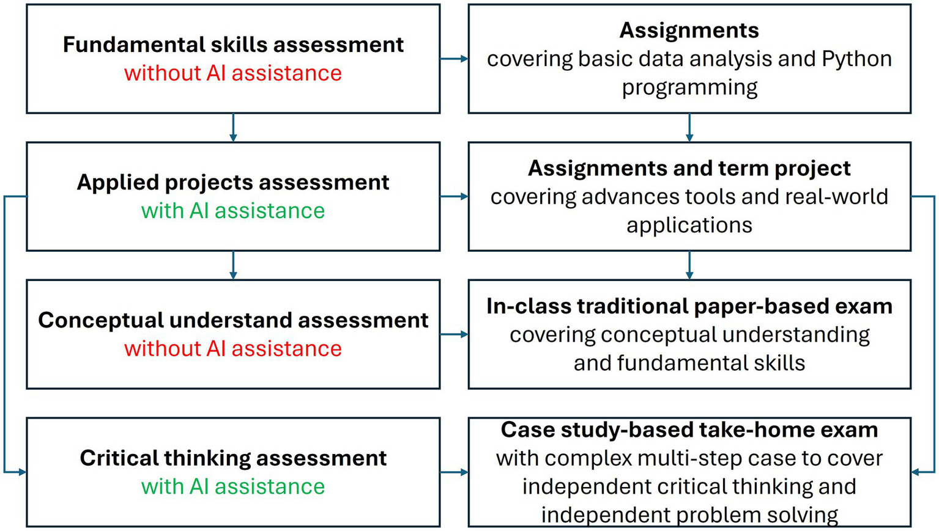
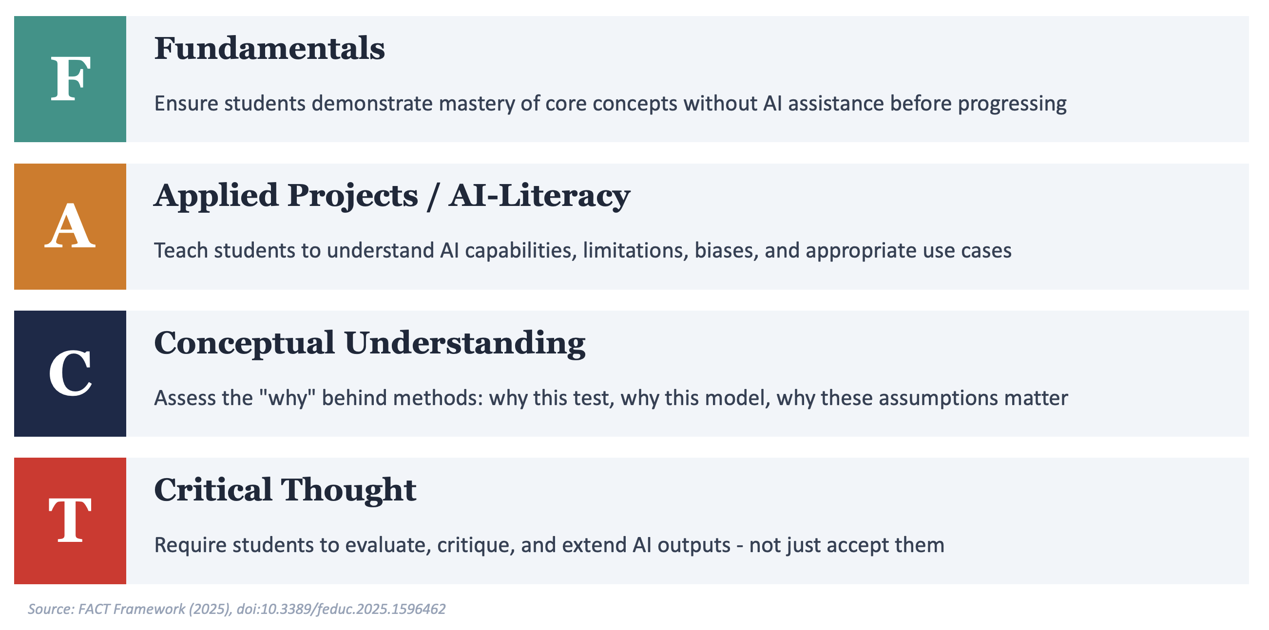
Strategies for Educators
Redesign Assessments
Focus on interpretation and judgment, not execution. Ask more "why” questions.

Slide 11
My Approach:
A Progressive Framework for AI Integration
Foundations First
No AI until core concepts are solid
Guided Integration
AI used with explicit guardrails: instructor-designed prompts, required reflection, comparison of AI output(s)
Critical Collaboration
Teach students to treat AI as a peer i.e., questioning, verifying, and extending its outputs
The emphasis should be on evaluation and judgment (not reliance)
Notes:
progressive - foundations first, then guided use, then critical collaboration

Slide 12



My Approach:
Human-Centered Assessments
Personal Data Collection
Critical & Domain-Specific Thinking
Students collect their own data from agricultural settings, making each project unique and non-replicable by AI.
Assessments require reasoning rooted in students' individual research interests and agricultural expertise.
Communication Across Settings
Career Readiness Integration
Peer-to-peer discussion and varied presentation formats where personal insight is essential.
Via the UA Career Everywhere Catalyst Program, assessments build skills AI cannot replicate.

Slide 13

My Approach:
Assessment Designs
Closed-Book, In-Class Exam
Tests foundational knowledge retention without external aids
Applied, In-Class Exam
Tests application and critical thinking under pressure with GenAI available
Oral, In-Person Exam
Examines depth of understanding and assesses communication of statistical concepts
Scientific Abstract (Using Student’s Own Data)
Requires personal context and domain insight
Poster and Presentation (Using Student’s Own Data)
Requires analysis and communication of both statistical and domain knowledge

Slide 14

Results
Unique projects spanning several application areas
Conference poster presentations
Manuscript submissions
Graduate Microcertificates in Statistics and Analytics (STAN)
Membership on multiple graduate committees
College-level colleague appreciation
Notes:
Hatchery science, technology adoption, heat stress, food safety, greenhouse gases, edamame breeding, etc.

Slide 15

Results
Student Perspective
88.5% Positive Sentiment
Course Scores of 4.90-5.00
Instructor Score of 5.00
“The dynamic nature of the assignments really enrich the class content and student understanding.”
“This class has had a positive impact on how I think about the scientific method, experimental design, and hypothesis generation.”
“The professor really takes care to make sure students understand the material being presented to them and assess students in various ways that highlight individual strengths - something not many professors are willing to do.”
“Dr. Robinson is … extremely effective helping the students with research questions related to students projects.”
“I learned a lot with her class, not only because of the way she teaches, but also because of the different forms of evaluation and assignments that she requires. ”
Notes:
Sell the benefits!!!

Slide 16

Well… almost…

Slide 17

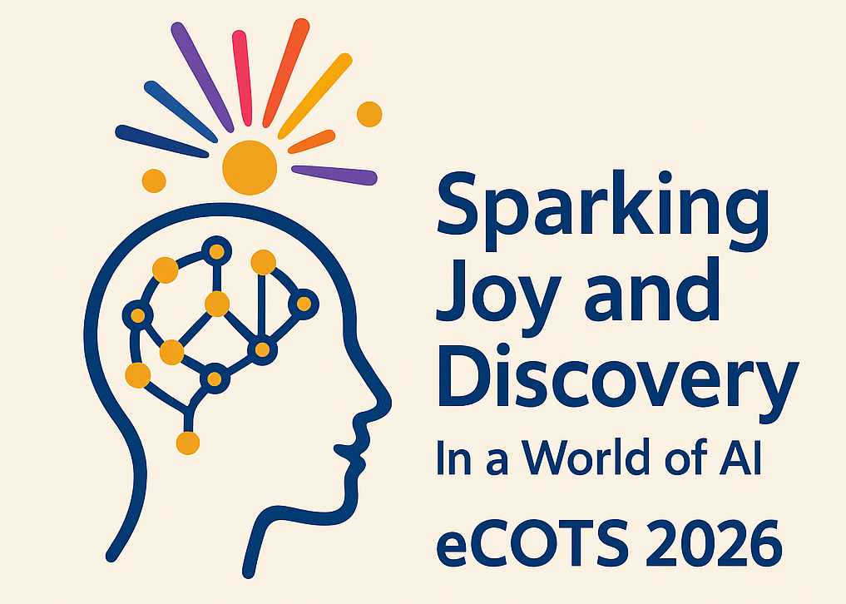
Suggestions
Consider Logistics
  BUT
Keep Innovating! Collaborating! Sparking Joy and Discovery!
Notes:
Design assessments that prioritize the human context
Personal data collection makes each project unique
Integrate career readiness for skills students value
Adaptable framework for any applied statistics course

Slide 18

Questions? (sewrob@uark.edu)

