Slide 1
Fostering Growth Mindset and Statistical Reasoning in a Flipped Biostatistics Course
Kylie Van Dyke
Abraham Ayebo, PhD
University of Minnesota Rochester
Friday, 24th of June, 2026 Electronic Conference on Teaching Statistics

Slide 2

What is a Growth Mindset?
Fixed Mindset
Growth Mindset
Success is about succeeding
Qualities are predetermined or assigned
Prioritize perfection
Mistakes mean failure
Success is about learning
Qualities are cultivated through efforts and experience
Prioritize development
Mistakes provide opportunities to learn
  The course aims to foster a growth mindset in our students when learning statistical concepts and the basics of coding.

Slide 3
Course Description
University of Minnesota Rochester
  Small University with about 900-1000 students
  All enrolled students are either in the Bachelor of Science in Health Sciences or Bachelor of Science in Health Professions program
  All courses employ a flipped learning environment
STAT 2161: Biostatistics
  Statistical Topics
    Descriptive Statistics, Probability, Bayesian Statistics, Confidence Intervals, Hypothesis Testing, Regression, Parametric Tests, and Non-parametric tests
  Software: R Studio
  Course Evaluations [2025]
    Homework
    Class participation
    2 major Coding Projects
    Final Project

Slide 4
Course Goals and Feedback
Students will gain the ability to:
  1. Interpretate Statistical Summaries and Figures
  2. Apply skills in Statistics to real world problems
  3. Apply coding skills with raw data
Disparity between course goals and student perceived outcomes
Skill Gained | Fall 2024
Coding skills in R | 100% (6)
Statistical Knowledge | 100% (6)
Application of Statistical Knowledge | 83% (5)
Ability to apply Coding/Statistical skills with Raw Data | 67% (4)
Interpretate Statical Summaries | 67% (4)
Interpretate Statical Graphs | 67% (4)
I did not gain any skills of note in this course | 0% (0)
Students did not have enough opportunities to work with real world data or time to engage with statistical summaries/graphs

Slide 5
Adjustments to 2025 Course Aimed to Support Student Learning
Exit tickets
  Participation points
  Location for students to: rate speed of lecture, rate understanding of lecture, and ask questions or clarifications regarding lecture
Check Homework Quizzes
  Students can check if their Homework answers are correct prior to submission
Late Day policy
  Students can turn certain assignments in a number of days late (max 3) using “Late Days” as a currency
  Each student has 14-16 Late Days to use for the entire semester
Work-With the Data (WWtD) ← Aimed to address working with real world data
  A new coding focused project
Final Project ← Aimed to address engaging with and interpreting statistical results
  Adjusted to provide more time to engage with the project

Slide 6
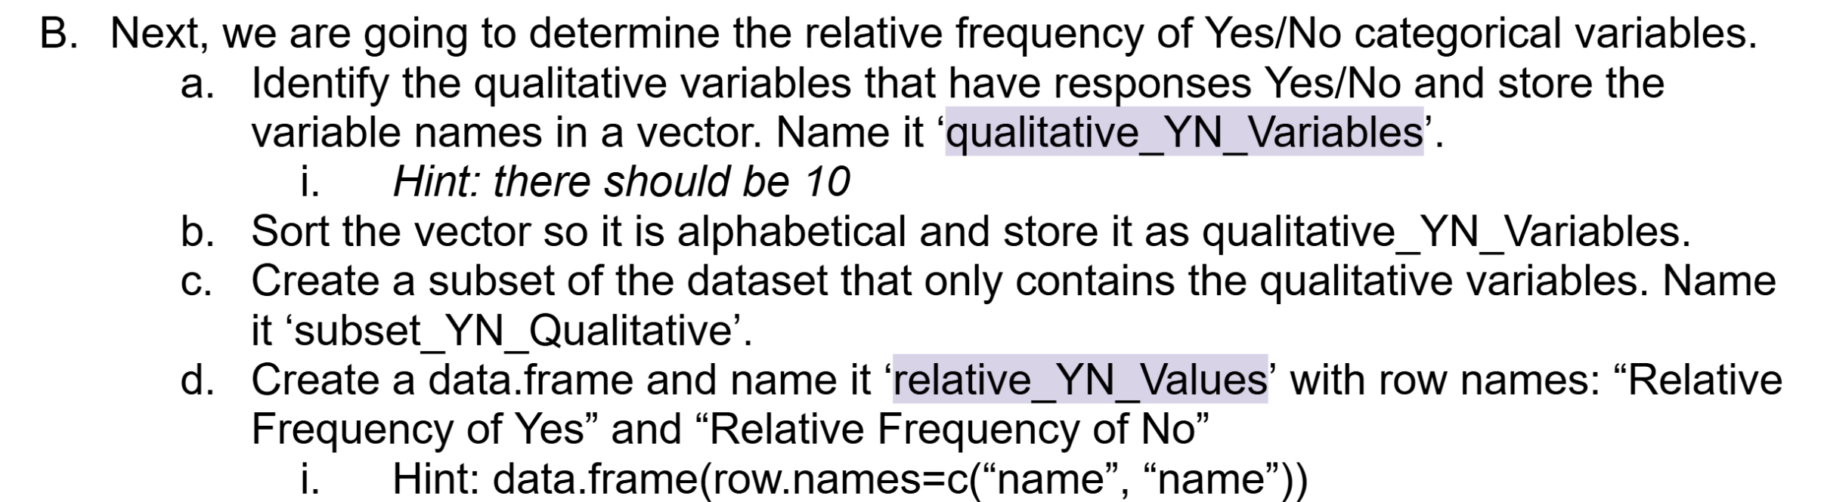
WWtD Assignments
Students provided detailed instructions for each WWtD
  For WWtD1 a skeleton script was also provided
WWtD 1: Demographic Analysis of Epidemiological Data
Grading Rubric
Due: Week 7, Points: 30
Goals for the Project
  Practice loading, visualizing, and analyzing data in R
  Using For Loops
  Learn About Statistical analysis in the epidemiological field
Excerpt from WWtD1, Part B
Sometimes at the start or end of class time is dedicated to going over trickier segments
Additional Office Hours around this specific assingment
Each WWtD has 2 points of extra credit involving advanced testing methods
  WWtD1: linear and multilinear regression
  WWtD2: Principal Component Analysis
WWtD Grade Averages
  WWtD1: 94% (28.20/30)
  WWtD2: 91% (27.59/30)
WWtD 2: Analysis of RNA Expression Data & Mice Survival
Grading Rubric
Due: Week 15, Points: 30
Goals for the Project
  Learn about RNA expression analysis
  Cleaning and Visualizing real world data
  Analyzing real world data

Slide 7
Adjustments to The Final Project
Part I: Abstract Reading
Completion
Due: 3rd Week of Semester, Points: 5
Annotate 2 Article Abstracts (A & B)
Reading Research “Through a Statistical Lens.”
  Each student is assigned 2 journal articles (#A & #B) recently published from the New England Journal of Medicine
  Over the course of the semester the students will breakdown their articles, recognizing statistical concepts and then present their results at the end of the semester
    Specifically Utilizing the Four-Step framework (State-Plan-Do-Conclude) that is utilized in class and in homework assignments
2024 Final Project
  Structured to take place between Weeks 10-15
  Little time for instructor feedback
  Less time for student engagement with individual articles
2025 Final Project Adjustments
  More Scaffolding
    Allows for more opportunities of feedback
    Ensures students can spend an adequate amount of time with each article
    Encourages learning over assessment
  Previous examples provided
Instructor Feedback
Part II: 4 Step Method
Completion
Due: 8th Week of Semester, Points: 5
Create 4 Step Method for 2 Articles (A & B)
Instructor Feedback
Part III: Presentation
1) Written Report
Due: 14th Week of Semester, Points: 15
Synthesize statistical concepts from Article A
2) Oral Presentation
Due: 14th Week of Semester, Points: 35
Present statistical concepts from Article B
Grading Rubric
Part IV: Reflections (5)
Completion
Due: End of Semester, Points: 2 each
1 Self Reflection, 4 Peer Reflections, 250 words

Slide 8
Course Outcomes
Skill Gained | Fall 2024 | Fall 2025
Coding skills in R | 100% (6) | 91% (10)
Statistical Knowledge | 100% (6) | 82% (9)
Application of Statistical Knowledge | 83% (5) | 82% (9)
Ability to apply Coding/Statistical skills with Raw Data | 67% (4) | 91% (10)
Interpretate Statical Summaries | 67% (4) | 82% (9)
Interpretate Statical Graphs | 67% (4) | 82% (9)
I did not gain any skills of note in this course | 0% (0) | 0% (0)
With new course adjustments we saw an increase in the applicable student perceived outcomes in these skill areas
An increase in confidence in using the Four Step Framework reflected in
Student Feedback

Slide 9
Student Feedback
“I completely loved the way the final project was split into smaller parts. This allowed me to be ready and not become overwhelmed by doing it all within the same week. Doing the abstract first somehow made me aware of the type of articles that I would be working on and doing the 4 steps method first before the presentation was perfect because we were able to get feedback and improve based on those comments for the final presentation.” [2024, Feedback Quiz]
“Overall, I had a great experience working with this final project. I loved getting to read full, professionally published papers about active application of biological data in statistics! In comparison to the beginning of the semester reading through the abstracts, I understood a lot more of the language the authors used when reading it back at the end of the semester. I felt confident and prepared to be able to present on the information in the article; I especially felt confident on being able to separate the information into the 4 step process and communicate it effectively. We had a lot of clear instructions and guidelines for the presentation and paper, so the only part I felt like I needed clarification on was the presenting of the information itself (especially clearing up the different endpoints the study was looking at). When actually presenting the information, I felt very confident in being able to explain and back up my answers.” [2025, Self Reflection]
“When it came to engaging with the scholarly work, I spent most of my time looking for mentions of terminology or tests we learned in class such as cox-proportional hazards or Kaplan-Meier survival curves. Despite the stress I felt it was a lot of fun being able to apply what we learned in class to the analysis of a research paper. It was exciting to read a line from the paper and understand from a statistics perspective what they were looking at, how they were looking at it, and understanding the reasoning behind the choice of statistical tests they used. Being able to look deeper using statistics beyond reading the conclusion helped me gain more insight into the article beyond the summary the researchers presented.” [2025, Self Reflection]

Slide 10
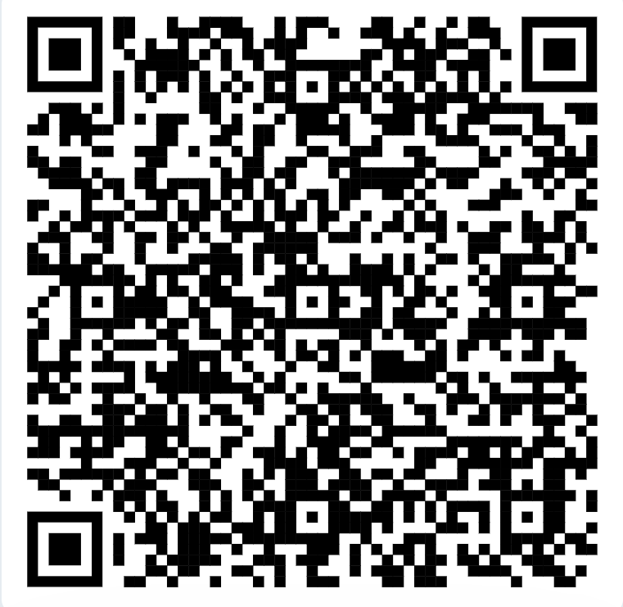
Lessons Learned
Students showed the greatest gains in the exact areas targeted by the redesign.
Authentic projects helped students connect statistical concepts to real-world applications.
Scaffolding and feedback encouraged persistence and confidence.
Growth mindset can be cultivated through intentional course design.
Implications for Statistics Educators
Use authentic datasets.
Scaffold major projects.
Build opportunities for revision.
Provide regular formative feedback.
Emphasize learning over perfection.
Examples of Student Work

Slide 11
References and Citations
Ayebo, A., & Dingel, M. (under review). Through a statistical lens: Undergraduate reflections on engaging with scholarly research in an introductory statistics course.
Dweck, C. S. (2006). Mindset: The new psychology of success. Random House.
Garfield, J., & Ben-Zvi, D. (2008). Developing students’ statistical reasoning. Springer.
Wild, C., & Pfannkuch, M. (1999). Statistical thinking in empirical enquiry. International Statistical Review, 67(3), 223–265.
Thank you for your time, any questions?

