Slide 1



BASE-AI-SPARK
Baseline Statistical Educational Model with AI support to Spark Discovery
Ariadni Papana
June 16, 2026

Slide 2
Introduction
Motivation
Background
  Building on BASE-on-AI (USCOTS 2025)
  Bloom’s Taxonomy: reflection
BASE-AI-SPARK Framework
  AIS, AIL, AID
AID activity
Evidence of Effectiveness
  Data, findings
Key Takeaways

Slide 3
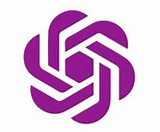

Motivation
Modernize Instruction
Embrace new technology and prepare students for rapidly evolving workforce
AI meaningful activities
AI for responsible and transparent use
BASE-AI-SPARK
Leverage AI to support learning, bridge disciplines and help students appreciate statistics through AI-supported meaningful and engaging experiences.
Conceptual Learning
Deepen understanding of statistical concepts
Through AI designed activities
Enhance Learning
Increase engagement and effectiveness through personalized experiences
Spark Curiosity
Foster curiosity and discovery with guided explorations and real world connections
Bridge statistics & disciplines
Connect statistical methods to students’ diverse academic interests and real-world context
Reflect
Promote reflection so students appreciate role of statistics in problem solving, decision making and create impact across disciplines and beyond
Appreciate statistics
Help students recognize value, relevance and impact of statistics

Slide 4

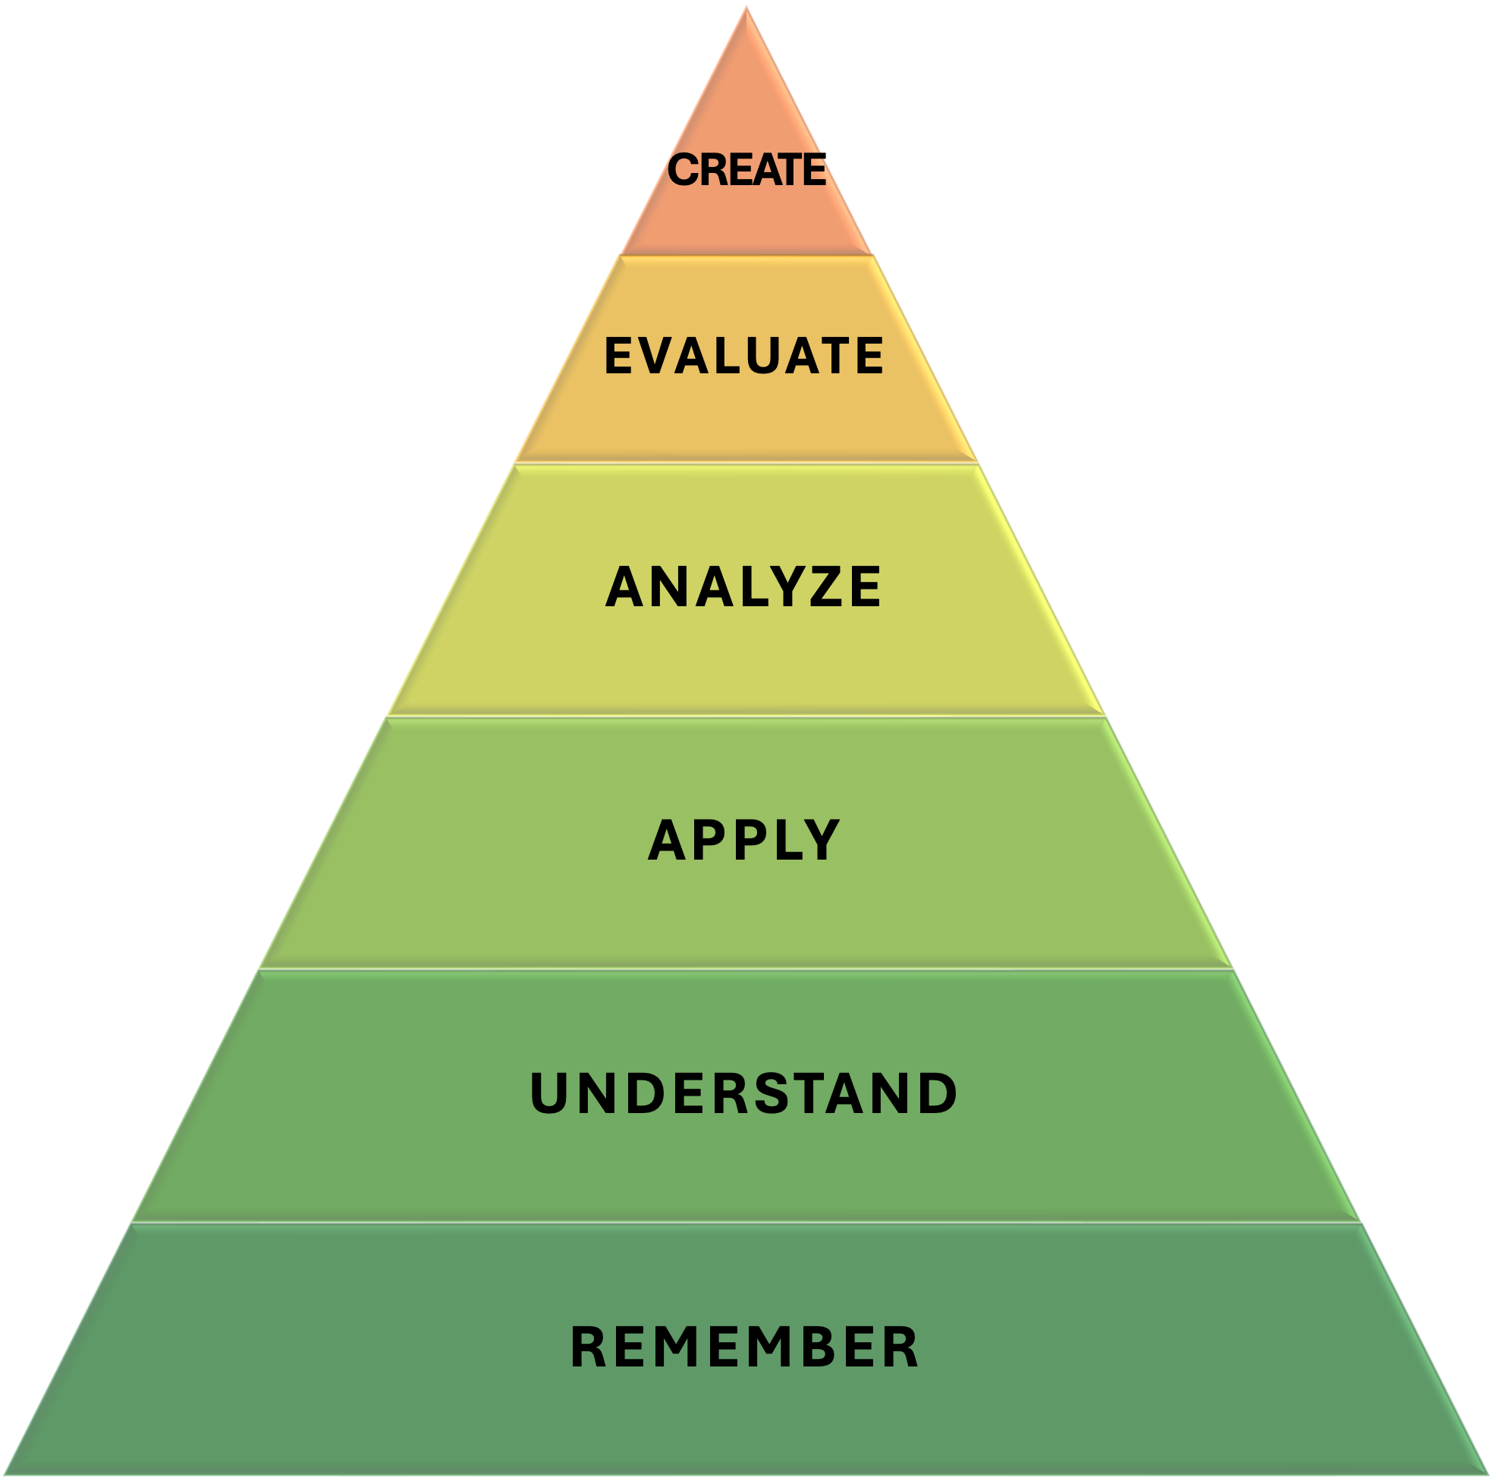
Bloom’s Taxonomy & Reflection
BASE-AI-SPARK
REFLECTION
AI LABS
AI Discovery
2024
AI-Syllabus

Slide 5
BASE-AI-SPARK framework
1
2
3
AI SYLLABUS STATEMENT
Clear AI policy & expectations for responsible integration.
AI LABS
Traditional data analysis problems enhanced with AI-guided problems
Conceptual understanding
Flexible prompt-engineering
15% cap on points
Team-work recommended
AI DISCOVERY
Guided exploration of statistical inference using AI-prompting and student disciplinary interest.
Opportunity to explore
Statistics connections with disciplines
Awareness of role of statistics
Understand the value of statistics and promote interest in statistics
Link statistics to students’ personal interests and real-world meaning.
Engaging experience
  Individual work
teamwork

Slide 6

AIS: AI policy
AI Tools (ChatGPT, Microsoft Copilot, Claude etc.)
Students are permitted to use AI-based tools under specific conditions. For guidance see CSU's AI Tools page.
Permitted Use
AI tools may be used as study support (brainstorming, generating ideas, refining drafts).
All final submissions must be your own work.
Clearly document any use of AI tools (tool name + contribution).
Accuracy & Integrity
AI can be biased, inaccurate, or incomplete.
You are responsible for verifying accuracy.
Misuse or failure to cite properly = academic misconduct.
Citation Example: “Generated with the assistance of ChatGPT, OpenAI.”
Privacy Do not share sensitive or personal data with AI tools.
Ask the instructor for clarification before using AI tools in coursework.
Notes:
The syllabus AI statement establishes expectations for responsible AI use and communication in the course.
These can be customized according to your institutions' guidelines.

Slide 7

AI LABS
AIL
teamwork
      Go to ChatGPT, enter prompt.
      Prompt design: template provided by instructor or student
Discuss
TYPE 1
Student
Engineered-prompt
TYPE 2
Instructor
Engineered-prompt
Notes:
AI-modified labs serve as the primary learning space for developing statistical and technical skills, enriched with AI activities that support conceptual understanding. AI LABS are described in more detail in Base-on-AI model.

Slide 8

AID: AI Discoveries
Major: Health Sciences
Minor: Biology
Career interest: doctor
Course Buddy: BIO xxx
(Introductory Microbiology)
Topic: Plant growth
SI: one-way ANOVA
ChatGPT activity
Academic Focus
Major & Minor
Career of interest
Course Buddy
Syllabus
Student’s Choice
Course Buddy Key Topic
Statistical Inference
Student or Instructor choice
AI-guided prompting
Reflection
Learn
CREATE
EVALUATE
REMEMBER
APPLY
ANALYZE
UNDERSTAND
CREATE
EVALUATE
REMEMBER
APPLY
ANALYZE
UNDERSTAND
CREATE
EVALUATE
REMEMBER
APPLY
ANALYZE
UNDERSTAND

Slide 9
AID
Course Buddy
Gather syllabi from courses in students’ discipline or ask student to select course
Biology
Topic
Identify key topic from course buddy. This is setting the context of the problem
Plant growth
Statistical Method
Select inferential method learned.
One-way ANOVA
Linking with AI
Use AI to connect topic & statistical method. Prompt design: template provided by instructor or student.
ChatGPT
AI PROMPT
Step 1
Complete Prompt
Step 2
Copy to ChatGPT
Step 3
Record & review
I am a student majoring in [your major]. In my [course name] course we are studying [topic]. Suppose researchers want to investigate whether [claim, comparison, or relationship]. I am learning [selected statistical method] in statistics.
How can this method help analyze the problem? Explain in simple terms and describe what data would be needed and why statistics is useful for addressing this research questions?
Why is statistics useful to you? Did the AI explanation make sense?
What did you learn from this activity? Was this helpful? Why or why not?
Step 4
Reflect

Slide 10
AID prompt: marketing
I am a student majoring in marketing. In my business course, we are studying consumer behavior and advertising. Suppose a company wants to investigate whether increased advertising spending leads to higher sales.
I am learning simple linear regression.
How can this method help answer this research question? Explain in simple terms and describe what data would be needed and why statistics is useful for addressing this research questions?
company wants to investigate whether increased advertising spending leads to higher sales
marketing
simple linear regression
consumer behavior and advertising
business
course

Slide 11
AID prompt example: nursing
I am a student majoring in nursing. In my anatomy course, we are studying the cardiovascular system and blood pressure. Suppose researchers want to investigate whether students who exercise regularly have lower blood pressure than those who do not. I am learning regression analysis.
How can this method help answer this research question? Explain in simple terms and describe what data would be needed and why statistics is useful for addressing this research questions?

Slide 12
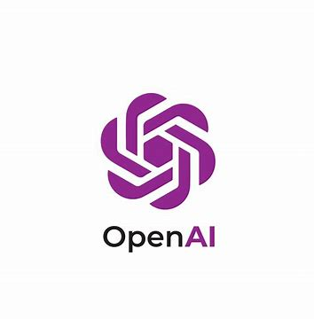
ChatGPT response for nursing discovery
Regression analysis is a statistical method that helps researchers examine the relationship between variables. In this study, regression can be used to determine whether students who exercise regularly tend to have lower blood pressure than students who do not exercise regularly.
To conduct this analysis, researchers would need data from a sample of students. For each student, they would collect:
Blood pressure (the outcome or response variable)
Exercise information (the explanatory variable), such as
    Whether the student exercises regularly (yes/no), or
    Number of days per week they exercise, or
    Hours of exercise per week
Researchers may also collect additional information such as age, weight, gender, diet, or stress level because these factors can also affect blood pressure.
Regression analysis helps by estimating how blood pressure changes as exercise habits change. For example, if the analysis shows a negative relationship between exercise and blood pressure, it would suggest that students who exercise more tend to have lower blood pressure. The regression model can also estimate the size of this relationship, such as how much blood pressure decreases on average with additional exercise.
Student | Hours of Exercise per Week | Systolic Blood Pressure (mmHg)
1 | 0 | 130
2 | 2 | 125
3 | 5 | 118
4 | 7 | 112

Slide 13
ChatGPT response for nursing discovery (cnt’d)
Statistics is useful because it allows researchers to move beyond individual observations and determine whether a pattern exists in the larger population. It helps summarize data, measure the strength of relationships, and assess whether the observed differences are likely due to exercise rather than random chance. This provides evidence that can support health recommendations and guide future research. In simple terms, regression analysis helps answer the question:
"Do students who exercise more tend to have lower blood pressure, and if so, by how much?”
FOLLOW UP Questions
Is this statistical method is appropriate and why?
What are the advantages of using this statistics for understanding [topic]?
Are there any major limitations? Is there an alternative statistical method I should use?
Is this used in today’s research or practice?

Slide 14
What did we learn?
Usefulness
Why is statistics useful to you?
Did the AI explanation make sense?
Evidence based practice
  Better decisions than guessing
  Identify significant changes
  Interpret findings
  Connection to discipline
  Made sense…
  Helpful…
Reflection
What did you learn from this activity? Was this helpful? Why or why not?

Slide 15
Classroom & Findings
Target Audience
  Introductory statistics students at research institutions, four- year colleges, community colleges, and AP courses.
  Class size: small to medium (up to 35 students).
  Graduate stats classes with diverse populations
  Online, hybrid & in-person
Evidence of efficacy
Preliminary classroom observations from online undergraduate statistics applied course from students in health sciences, biology, data science, sociology, psychology, environmental science and communications.
All student data and work anonymized; no identifying information retained; IRB to be collected
AID assigned at the end of semester
AID can be redesigned to be used throughout the semester
Reflections collected (Spring 2026)
IRB in progress

Slide 16

Key Takeaways
Statistics Toolbox with AI
Statistics approachable and fun
Hands-on activity
Bridge statistics discipline to many
AI pedagogy
Support metacognition, reflection and higher order thinking.
Personalized activity
Curiosity-driven exploration to boost connection to statistical concepts.
Reflection
Awareness of role of statistics in sciences and beyond
AI should not replace statistical learning but it can help students discover why statistics matters.

Slide 17
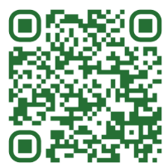
Thank you!
SCAN ME
SUBMIT IDEAS & CONNECT

