Slide 1
Engaging Students with Bingo to Assess Statistical Fluency
Dr. Laura Taylor
Prof. Larry Cantwell
Dr. Keta Henderson

Slide 2
Introduction to Bingo Assessment
We used a Bingo game to assess student learning
After learning about one-sample (means and proportions), paired-sample, and two-independent samples tests
  Students worked in teams to create Bingo cards about hypothesis testing
  Students completed a survey after the activity
Study was conducted under Elon IRB approval (#25-3342)
Goal: To assess student learning about hypothesis testing in a non-graded team-based game.

Slide 3
Introduction to Bingo Assessment
Before we begin, we invite you to pause the video and make a 3x3 ECOTS Bingo card with words and terms you expect to hear us say in our presentation about a Bingo assessment.
E | CO | TS
statistics | fun | p-value
Free space | eCOTS | CAUSE
June | Bingo | summer

Slide 4
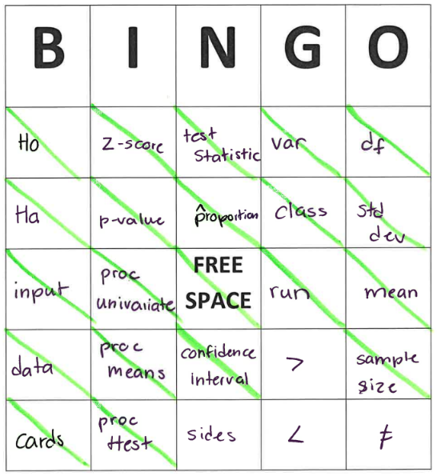
Student Bingo Card
Many of the words were related to the most recent hypothesis test learned (z-score, proportion)
Included key hypothesis testing terms (H₀, H_{a}, test statistic, p-value)
Included key SAS terms (cards, sides, run)

Slide 5
Survey
After the activity, students completed a survey about:
The words, terms, symbols, and phrases that they wish they had included (and why)
To rate their engagement in the lesson with the Bingo cards
To respond to one reflection question:
  What surprised them while filling out card?
  What are any new connections while filling out card?
  What was learned about hypothesis testing?
  What was liked most or least about the Bingo activity?

Slide 6
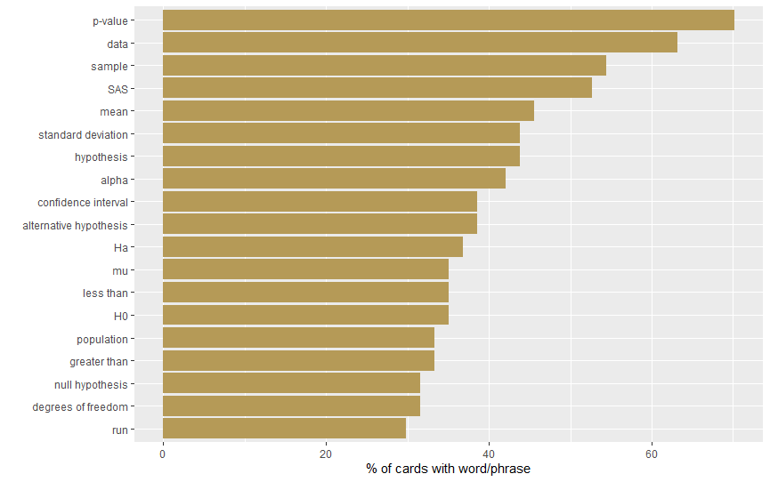
Common Words

Slide 7
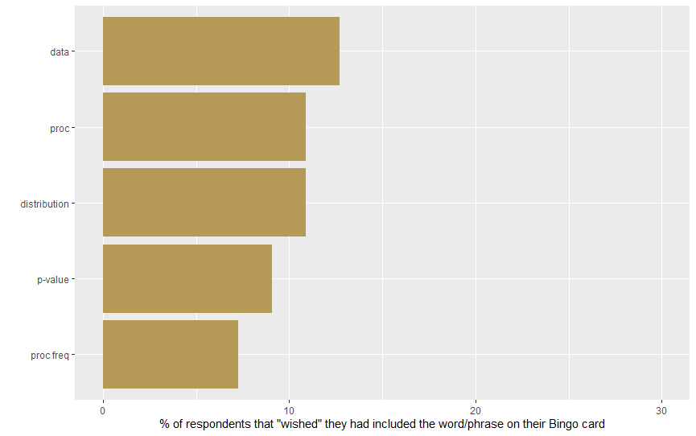
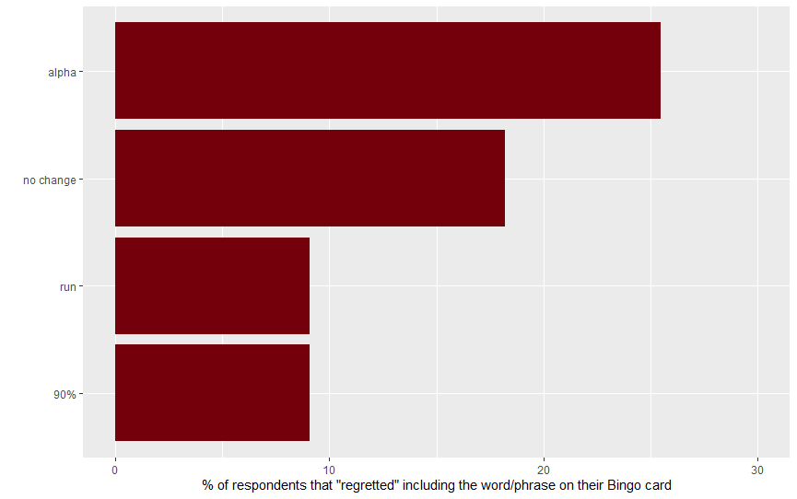
Bingo Card "Wishes" and "Regrets"

Slide 8
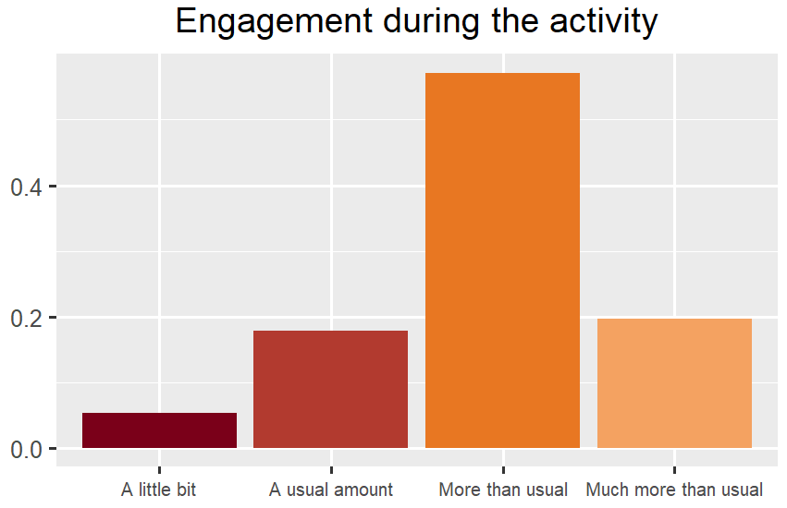
Increased Engagement and Attention
It gave me a motive to listen for specific wording
I was more enthusiastic than usual
I liked how focused it made me
I was more engaged in class, making sure that I heard everything
I was more engaged and aware of what Larry was saying
Students repeatedly mention being more engaged, less likely to zone out, and more aware of the lecture content.

Slide 9
Increased Vocabulary Reinforcement and Active Listening
Made me think about what vocab words I know
I was listening more actively to listen for the words in the BINGO
It was easier to actively listen the whole class when I was trying to hear certain words.
Helped me understand a few new concepts
This reflects cognitive reinforcement of lecture content.

Slide 10
Increased Collaboration and Social Interaction
I got to do it with my friends
Loved the participation of the whole class
I liked how we got to collaborate to make them
The group activity and learning at my table
Some students valued the group/table aspect and peer interaction.

Slide 11
Awareness of Prior Knowledge, Vocabulary Gaps, and Perceptions of Content Frequency
I know more words than I thought
I don't know as many words as I thought
I was surprised about the amount of vocabulary used in statistics everyday
I already know more about the topics than I realized
Students became more aware of what they knew or did not know about statistical terminology.

Slide 12
Connecting Prior Knowledge to New Knowledge
I thought about how some hypothesis testing use the same terms of course, but I had not thought about it. Many of the terms are connected A lot of the notes overlap with each other I realized how our old words connected to the new lesson we were learning. New connections I made was different variety of phrases being used such as the word confidence I was able to track key words that I found common over previous lessons!
Students recognized strong connections between concepts and vocabulary across lessons.

Slide 13
Incentives (Candy / Rewards) and Fun, Enjoyment (Game Mechanics)
Felt like a fun addition
It was engaging and made class a bit more fun than usual
I enjoyed the excitement it brought to the classroom
It was a fun thing that made class more engaging
I liked the reward system
Extrinsic motivation, especially candy- was explicitly mentioned as a driver of engagement.
Students also responded to the structure of bingo itself as motivating
Few students reported concern that the activity could distract from deeper understanding or be difficult to follow- suggesting a tension between engagement and content processing.

Slide 14
Instructor Reflections
Bingo was a perfect mid-semester morale boost, generated fun group discussions, and motivated students to look back at prior content!
Consider increasing the initial Bingo requirement, or offering "consolation" prizes for additional Bingos.
Be specific about what to include, and how to mark off the card:
  Are symbols just stand-ins for the words, or can you include both? What verbal statements should cause a symbol to be marked?
  Only include statistical language? What if a word is used during the lesson but in a more casual context (e.g., "alternative")?

Slide 15
Contact Information
Did you get Bingo?
Larry Cantwell (lcantwell2@elon.edu)
Keta Henderson (ahenderson13@elon.edu)
Laura Taylor (ltaylor18@elon.edu)

