Slide 1

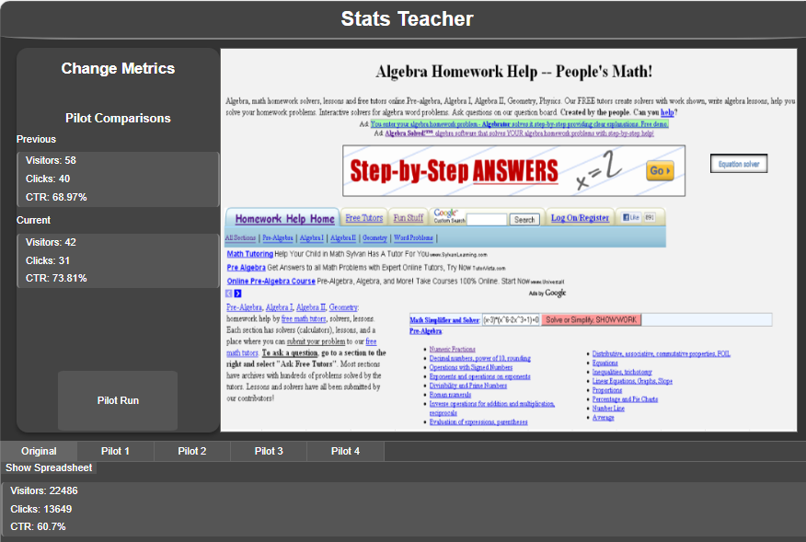


Teaching Statistical Inference Through a Computer Game with an AI Mediator
eCOTS 2026
The idea for the game was inspired by the website Algebra.com, developed in 2000. In the pre-AI era, it generated significant profits through ads linked to clickable content. In this game, you can reposition the Equation Solver button and pilot it for a day. Then, using methods of inferential statistics, you analyze the results from several trial locations and publish the website to see whether your chosen location was effective.
https://stats-teacher.org/
?
?
Andrei Perkhounkov, mathematics professor

Slide 2

In paper-and-pencil format, some of the following ideas could be used in class:
• Label your pilot locations on the image below.
• For each location, report the sample size (n) and the sample click-through rate.
• Use significance tests or confidence intervals to compare each pilot location to the original design.
• To compare any two piloted options, use two-sample significance tests or confidence intervals.
After the pilot is published:
o Determine whether there was an improvement.
o If the new location did not meet your expectations, identify which type of error was committed.
o Consider whether the effect size is practically significant.

