Slide 1

Exploring Students’ Perceptions of Generative AI Use in Mathematical Statistics
Miguel Rodriguez Mejia, Maria Cruciani, and Jennifer L. Green
Michigan State University

Slide 2

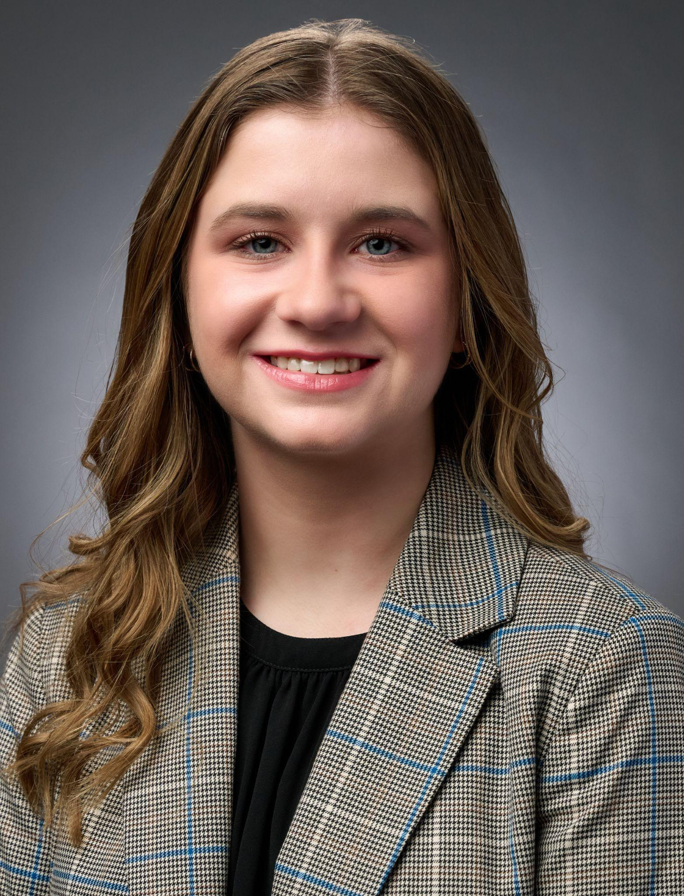

Miguel R Mejia
Maria Cruciani
Jennifer L. Green
PhD Student
rodr1190@msu.edu
PhD Student
cruciani@msu.edu
Associate Professor
jg@msu.edu
Program in Mathematics Education (PriME)
Department of Statistics and Probability

Slide 3

Motivation
Generative AI (GenAI) offers both opportunities and risks in statistics education. But what can this look like in a senior-level mathematical statistics course and what are the students’ perspectives about using GenAI within this context?

Slide 4
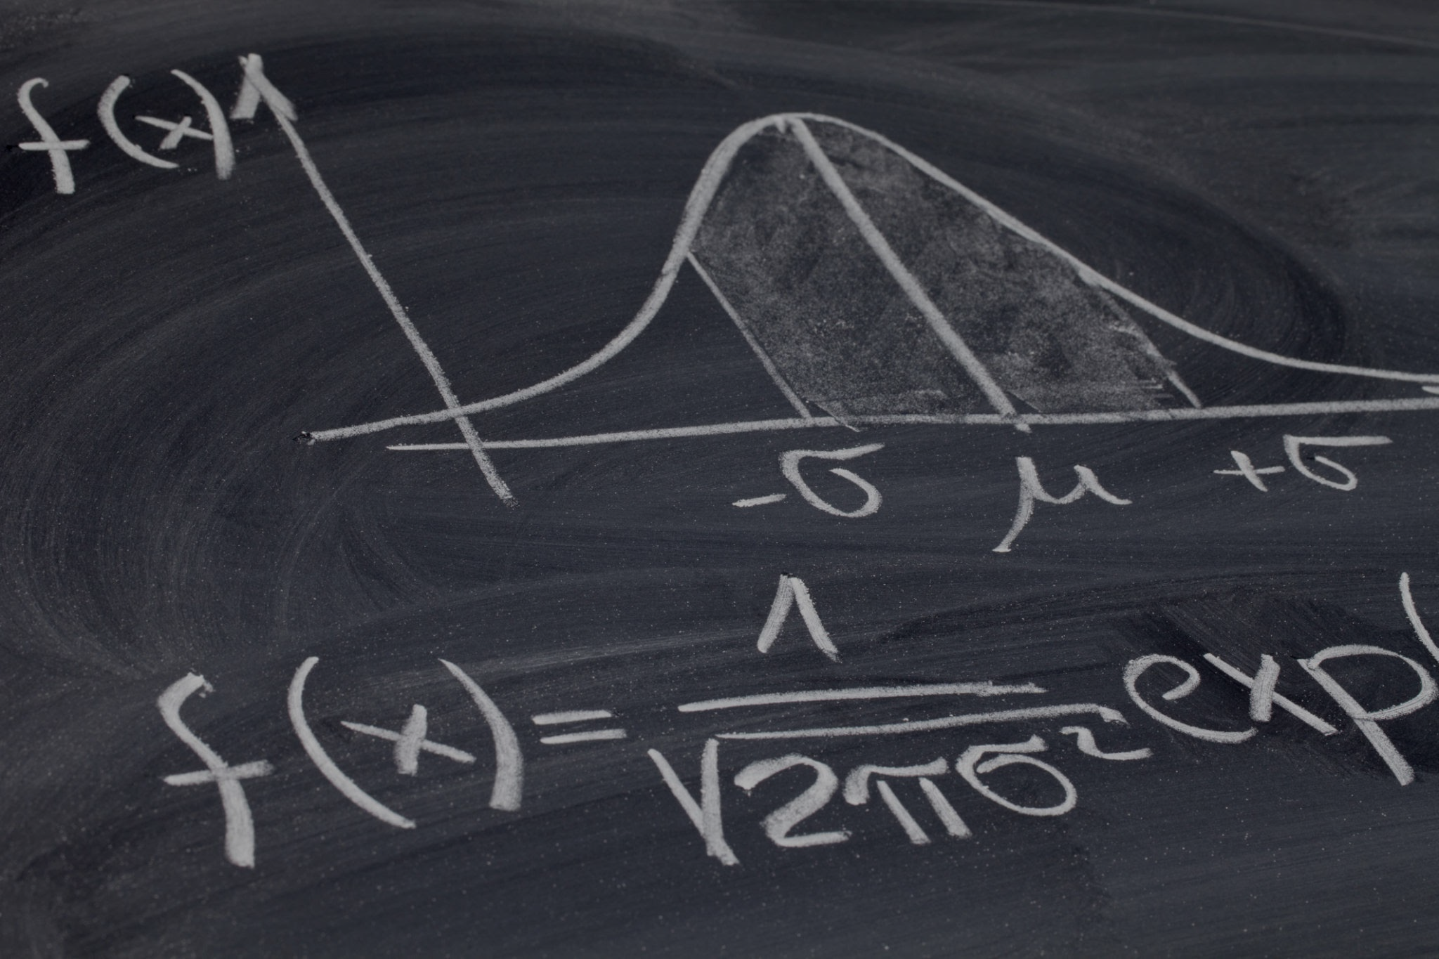
Context
Course and Setting:
Undergraduate mathematical statistics course
Focused on statistical inference theory (sampling distributions, estimation, hypothesis testing)
30–40 upper-level undergraduates per section (statistics, data science, mathematics, and related majors)
GenAI Integration:
Students expected to cite all instances of GenAI use
Course included GenAI discussions, activities, and reflection questions throughout the semester

Slide 5

GenAI Activities
Question of the Day
Sampling Distributions
Group Project
Use moment generating functions to prove the following:
Review the prompt I used within ChatGPT and the result it gave me: https://chatgpt.com/share/67ac39dbeb24-8000-83d9-9ee3a8b57886
Craft a homework problem and its solutions addressing a sampling distribution studied in class.
Explore GenAI:
Compare group’s solutions with those provided by the GenAI tool
Summarize GenAI-informed revisions
Reflect on experience

Slide 6
Methodology
Research Question | How do undergraduate students in a mathematical statistics course perceive the affordances and limitations of GenAI when reflecting on and comparing AI-generated outputs with their own understanding and work?
Participants & Data Sources | Undergraduate students in Mathematical Statistics: Responses from the “Question of the Day” (30 students) Reflections from the group project (7 groups; 24 students total) Follow-up interviews (2 students)
Data Analysis | Thematic analysis through individual and collective coding strategies

Slide 7
Affordances
Brainstorming / Guidance for Solving Problems
Verifying Answers and Procedures
Creating and Explaining R Code
“I think ChatGPT is useful to give us a place to start if we are unsure.”
“I think it is appropriate to use in any context if you are checking answers”
“often strong ability for ChatGPT to perform computational tasks”
Clarifying / Explaining Statistical Concepts
Generating Fast Answers
“I would think it[’]s appropriate to ask ChatGPT for the general from [sic] of the MGF of a normal random variable”
“if, for whatever reason, you just need quick solutions to a problem without much explanation, this is another potentially good use for AI.”

Slide 8
Limitations
Lack of Mathematical Detail and Explanation
Inaccuracies
Omission of Steps and Jumps in Solutions
“it tends to...not show full proofs to each solution. Sometimes it will generalize the steps in words, rather than showing all of the appropriate math.”
“The expectation we produced was 2λ whereas the output of ChatGPT only produced lambda”
“ChatGPT has the process right mostly but skips steps enough to where it is difficult to follow unless you have the final answer in front of you.”
Requires Prior Knowledge
R Coding Barriers
“Proceed with caution and try to have a prior understanding so that you can properly evaluate chat’s answer.”
“ChatGPT took several more lines by storing each parameter as a variable before using them in the replicate function.”

Slide 9
Insights from Interviews: Sophia
Awareness and Curiosity About Algorithms -> Skepticism
“I'm interested in the mathematics of the behind the scenes, but I don't want to get lied to, well, I mean, lied to is ascribing morality where I don't necessarily think it exists, but I don't want to experience a mathematical hallucination.”

Slide 10
Insights from Interviews: Lydia
Role of Peer/Group Interactions
“[I]n the first group, I definitely felt like I was using it [GenAI] more, just because the other group mates were also using it more….It's not something that I use very often… [so] seeing how they used it was… interesting because they were using it for like homeworks and stuff where they'd just be like, okay, this is what they say. And then I was definitely like…let's double check this real quick first though…”
“[I]n the second group, I wasn't using it near as much, because we were collaborating and using it as like, okay, we'll get some code from this, but it wasn't like, okay, let's pull our entire answer right from there.”

Slide 11


Implications for Practice
Come brainstorm with us!
Students’ GenAI use ranged across a spectrum (from quick answer retrieval to collaborative thinking through problems), with many students noting caution and agentic desires
How can we continue supporting students across their statistical education in shifting toward using GenAI as a thought partner to deepen statistical understanding—and maintain their agency?

Slide 12


Thank you!
Please join us at our zoom session on Monday, June 15th 3:30-4:15 pm ET.
Miguel R Mejia: rodr1190@msu.edu
Maria Cruciani: cruciani@msu.edu
Jennifer Green: jg@msu.edu

